Slide 1

Lightweight CI Test Framework
Automated API smoke testing with Karate
Purple = Karate Teal = HTTP call Amber = your service
Demo for Management
Notes:
One-line frame: Unit tests prove the code is correct; Karate proves the deployment is correct. This deck covers what it is, what it can and can't do, how it compares, who benefits, what it costs, and the production-safety story.

Slide 2




The gap today
Our unit tests prove the code compiles. Nothing today automatically proves the deployed service is healthy.
Regressions caught late
No post-deploy gate
Restricted CI runners
Found in manual QA days later, or in production — not minutes after the change.
After we deploy to QA/UAT, nothing automatically checks the environment is actually working.
Our build agents can't start Docker, Testcontainers, or embedded Kafka — so container-based tests can't run there.
Notes:
Frame the problem before the tool. These three gaps are why we need a post-deploy smoke layer that doesn't depend on Docker.

Slide 3

The idea in one line
JUnit protects the build.
Karate protects the release.
Build stage
Release stage
JUnit + Mockito + MockMvc
Karate smoke tests
Runs inside the JVM. No Docker. Catches broken logic before anything ships.
Runs against the deployed service over real HTTP. Catches config, network and environment failures unit tests can't.
Notes:
This is the sentence to repeat. Two layers, two jobs. Neither replaces the other.

Slide 4

How it fits the pipeline
1
Build
2
Deploy
3
Smoke
4
Prod gate
mvn test -Pcomponent
deploy to QA / SIT / UAT
mvn verify -Psmoke
mvn verify -Pprod-smoke
JUnit, Mockito, MockMvc.
No Docker, no broker.
Service goes live in the
target environment.
Karate hits the running
service over real HTTP.
Read-only health checks
only. Zero data written.
Same Maven, same GoCD pipeline, same EKS network — no new tooling and nothing leaves our network.
Notes:
Smoke tests belong AFTER deployment, not in the build. That split is deliberate and is what makes them work on restricted runners.

Slide 5

What a test actually looks like
Scenario: Service is healthy
Given url baseUrl + '/actuator/health'
When method get
Then status 200
And match response contains { service: '#string' }
No imports, no class, no annotations — this is the entire test.
Given / When / Then maps directly to HTTP: set up, call, assert.
A QA engineer or business analyst can read it without knowing Java.
'#string' is a fuzzy match — checks the field exists and is a string.
Notes:
Show this early in the live demo. The 'zero Java' point is what makes QA co-ownership possible.

Slide 6

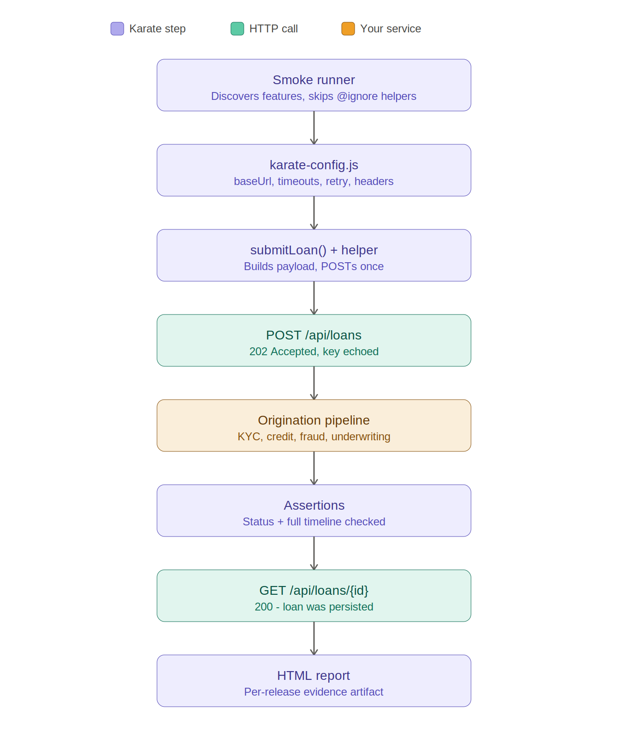
End-to-end loan approval flow
The test behaves like a real customer:
Submits a loan
POST /api/loans returns 202 Accepted and echoes the idempotency key.
Waits for the decision
The service runs the full pipeline — KYC, credit, fraud, underwriting, offer.
Checks it did the right thing
'contains only' proves all 8 regulated stages ran — none skipped, none added.
Looks it up again
A separate GET confirms the loan was persisted — read-after-write consistency.
Notes:
This is the showcase scenario. The 'contains only' timeline assertion is the strongest audit point for a bank — it proves mandatory checks weren't bypassed.

Slide 7




How to answer 'can it do X?' — three tiers
Native core
Java interop
Enterprise add-ons
Free (MIT)
Free (you write it)
Paid (Karate Labs)
REST, SOAP/XML, GraphQL, assertions, data-driven, retry, reporting, mock server, performance.
Call any Java library from a feature file — Kafka, JDBC, gRPC stubs, cloud SDKs.
Native keywords for async Kafka / gRPC / WebSocket; AI, SSO, RBAC, audit platform.
No Java needed.
How we tested Kafka.
We don't use these.
Notes:
This framing makes you sound like you own the tool. Native/interop/paid — almost every 'can it do X' falls into one of these three.

Slide 8

What Karate can do — native, free
HTTP & protocols
Smart assertions
REST/JSON, SOAP/XML, GraphQL, multipart upload, text & binary.
Strict vs partial match, fuzzy types (#string, #regex), JsonPath, XPath.
Data-driven
Reuse & async
Scenario Outline + Examples table — add a row, not a method.
callable feature files, callSingle, retry-until polling for async APIs.
Reporting
Mock & performance
Built-in HTML report: every request/response, timing, colour diff.
Built-in HTTP mock server; reuse the same tests as Gatling load tests.
Notes:
These are all free, no Java. Lead with reporting and data-driven for a management audience.

Slide 9

What Karate can't do — honest limits
No native free messaging keyword
Not a JVM mocking tool
Kafka / JMS need Java interop (free, what we did) or a paid add-on.
Can't mock Java objects like Mockito — that's the component-test layer.
Manages no infrastructure
No consumer-driven contracts
Won't start Docker, Testcontainers or a broker — you bring those.
Not Pact-style; it's example/assertion-based, not contract-broker-based.
Not a heavy UI / visual tool
Not a security scanner / APM
Selenium / Playwright are stronger for complex browser & pixel testing.
No SAST/DAST; response-time is a coarse gate, not deep tracing.
Notes:
Naming the limits builds credibility. None of these are surprises and most are 'different layer', not 'gap'.

Slide 10
Karate vs the alternatives
Capability | Karate | RestAssured | Postman | Cucumber
Who can write tests | Dev + QA | Java devs only | QA, manually | Dev (glue code)
Lives in Git with code | Yes | Yes | No — cloud | Yes
Runs in CI (mvn verify) | Yes | Yes | Separate (Newman) | Yes
Retry / poll for async | Built-in | Add Awaitility | No | Manual
Data-driven | Examples table | In code | Limited | Examples + glue
Reporting | Built-in HTML | Add plugin | Extra tooling | Add plugin
Glue / boilerplate | None | Base classes | — | Step definitions
Not best-at-everything — best fit for a post-deploy API layer that Dev and QA co-own.
Notes:
Don't oversell. Position Karate as best-fit for this layer and these constraints, not best at all things.

Slide 11

It complements, not replaces
Two frameworks, two layers — both already built.
Component tests
Build-time. Validates logic against the code. No HTTP.
JUnit + Mockito + MockMvc
Lightweight smoke (this)
Post-deploy. Validates the deployed API contract & health.
Karate, no Docker
Full event framework
Heavy integration: real Kafka, DLT routing, third-party stubs.
Karate + Testcontainers + WireMock
This deck is about the middle layer. We own all three — that's the full testing pyramid.
Notes:
Pre-empt the 'this doesn't test real Kafka' objection: we have a separate full framework for that. This makes you look like you understand the pyramid.

Slide 12

Who benefits
Developers
QA / Testers
One framework, not five bolted together. Tests live in Git, reviewed in PRs.
Write & own tests in plain English — no Java for the common cases.
Management
Architecture
A post-deploy gate we don't have today. Zero licence cost. Same pipeline.
Fits restricted CI; clean two-layer split; respects our constraints.
Ops / SRE
Audit / Risk
Read-only health & SLA gate in the pipeline — deploy confidence, no data risk.
Per-release HTML evidence; read-only in prod; nothing leaves our network.
Notes:
Calibrate the QA point live: simple tests yes; data-driven/JS still needs a developer to seed. 'QA owns and extends, Dev seeds.' Don't imply we cut developer involvement.

Slide 13

Licensing & cost
Core framework
Java interop
Enterprise add-ons
MIT — free
Free
Paid
Everything this framework uses: HTTP, assertions, reporting, mock server, CI/CD execution.
Our own Kafka helpers using the standard Apache Kafka client. We wrote it; nothing to licence.
Native Kafka / gRPC / WebSocket keywords + AI/SSO/RBAC platform. We use none of these.
What we need to pay: nothing.
Notes:
The licence is about WHICH code talks to Kafka, not where our infra runs. Our own helper is free; the paid add-on only buys a ready-made keyword we don't need.

Slide 14

Production safety — defense in depth
Karate only calls the URL you give it. Five layers keep it read-only in production.
1
2
3
4
5
Separate folders
Tags
Hard-wired runner
Config guard
Server-side reject
Write tests and prod-safe tests live in different folders.
@prod-safe vs @write — the pipeline filters on them.
The prod runner only reads the prod-smoke folder — it can't reach write tests.
karate-config.js flags the prod environment and tightens timeouts.
The service refuses automation headers — the one hard control.
In QA/SIT Karate validates the full contract including writes. In production it is strictly read-only — proving the deploy is healthy without touching business data.
Notes:
For a bank this slide is what gets it approved. Be honest: layers 1-4 are conventions; layer 5 (server rejecting automation headers) is the only hard control — recommend implementing it.

Slide 15
Return on investment
2–3 days
3–5 min
2–3
₹0
manual regression per release
the same checks in CI
releases to break even
licence cost
Framed as replacing manual regression time — not adding new work. Every regression caught automatically is an incident avoided.
Notes:
Numbers management remembers. The break-even point is the key business line.

Slide 16

Questions to expect
Q
Can it test our Kafka events?
Yes — via Java interop, which we built in the full framework. No native free keyword; the add-on is paid and we don't need it.
Q
Is there a licence cost?
No. Core is MIT, free for CI/CD. We use nothing that's paid.
Q
What stops it writing to prod?
Five layers, ending in the service rejecting automation headers — the one hard control.
Q
Can QA really write these without Java?
Simple tests yes. Data-driven needs a developer to seed. QA owns and extends; Dev seeds.
Q
What if the vendor disappears?
MIT open source, backed by Karate Labs (used by 76 of the Fortune 500). Commercial support exists if we ever want it.
Notes:
Rehearse these five. The Kafka, licence and prod-safety answers are the ones most likely to come up in a bank.

Slide 17

Recommendation
Adopt Karate as the post-deploy API smoke layer in the GoCD pipeline.
Start with health, auth and read-only checks against QA — zero risk, immediate value.
Add the server-side automation-header guard before any production use.
Grow coverage per the Definition of Done: one smoke test per new endpoint.
Notes:
Close with a concrete, low-risk ask: read-only checks against QA first. Easy yes.

