Slide 1

SESHADRI RAO GUDLAVALLERU ENGINEERING COLLEGE (An Autonomous Institute with Permanent Affiliation to JNTUK)
Department of Electronics and Communication Engineering
A SUPERVISED INTRUSION DETECTION SYSTEM FOR SMART HOME IOT DEVICES
Batch number :B2
Under Guidance of
Dr.Ch.Balaswamy M.Tech ,PhD
Presented By:
K. DEVI DILEEP KUMAR-(23485A0412)
K. HEMA VARSHA-(22481A04A8)
K. PARDHU SREE-(22481A04A5)
L. RAJESH-(22481A04C8)

Slide 2
Contents:
Objectives
Abstract
Introduction
Block Diagram
Implementation Diagram/flow of project
Hardware and software Tools
Implementation
Result
References

Slide 3
Objectives:
To design an IoT-enabled security system using the ESP32 for real-time monitoring.
To implement a dual-layered protection system covering both Intrusion Detection and
Fire/Smoke Safety.
To provide instant remote notifications via the Blynk IoT platform and visual verification
using an integrated Camera Module.

Slide 4
Abstract :
This project presents an advanced IoT-based Smart Home Security and Fire Safety System. By integrating an ESP32 with the Blynk platform, it replaces traditional GSM alerts with faster Wi-Fi-based notifications. The system uses dual ultrasonic sensors for intrusion detection and an MQ-series sensor for fire safety. Upon any trigger, a local alarm (Buzzer/LED) activates, and a camera module captures the intruder's image for the owner's verification, providing a comprehensive and economical residential security solution.

Slide 5
Introduction :
Need for Security: Rising theft and fire hazards necessitate automated, 24/7 home monitoring.
The Shift to IoT: Moving from local alarms to cloud-based systems for global accessibility.
System Overview: A multi-sensor approach (Ultrasonic + Smoke) managed by a powerful ESP32 microcontroller.
Visual Verification: Unlike basic alarms, this system provides photographic evidence of the breach.

Slide 6
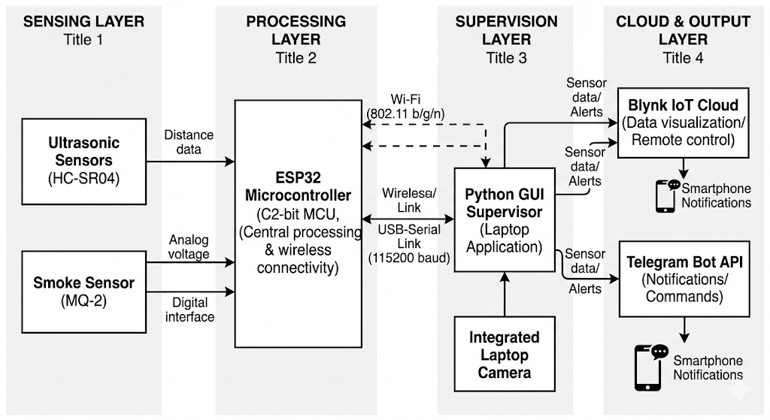
Block Diagram :

Slide 7
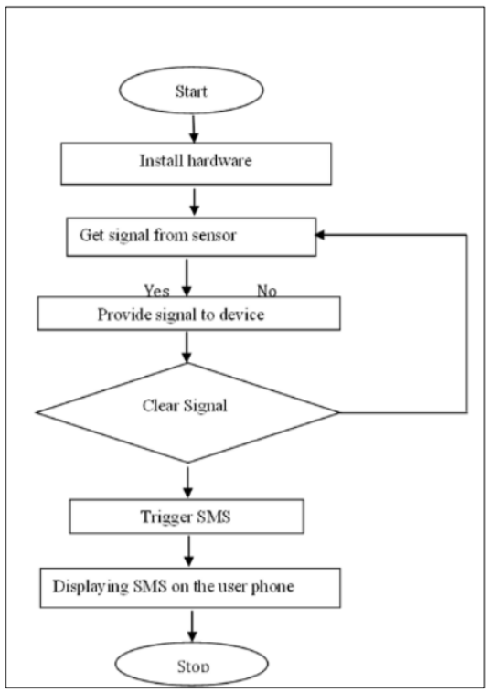
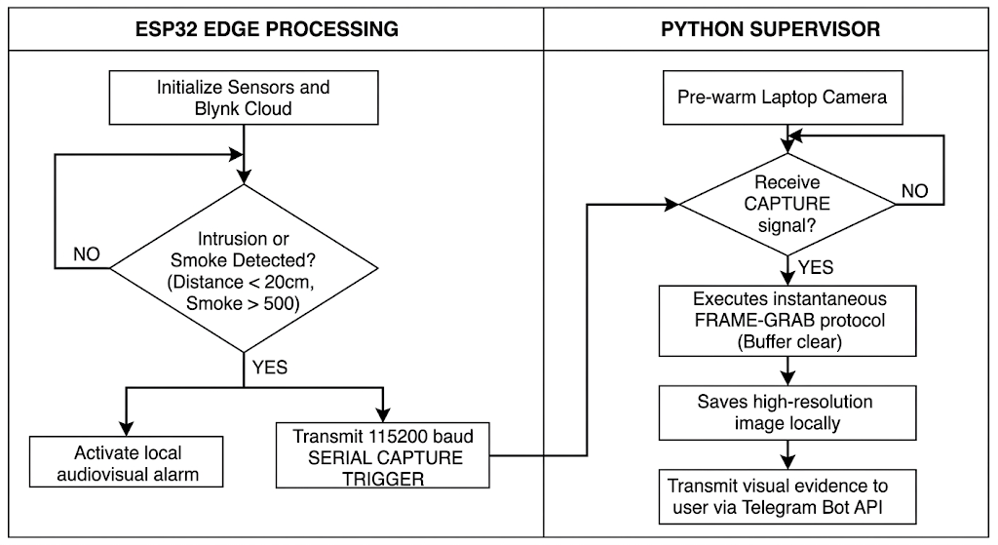
Flow of Project:

Slide 8
Hardware Tools :
Esp 32 Board
Ultrasonic Sensor (HC-SR04)
MQ-2 Smoke/Gas Sensor
Camera Module (Integrated Laptop Camera)
Jumper wires
Breadboard
Buzzer & LED
USB cable

Slide 9
Software Tools :
Arduino IDE
Blynk IoT Cloud & Mobile App
Python IDLE

Slide 10
Implementation:
Hardware Setup
ESP32 Board: The Wi-Fi-enabled central controller that processes sensor data and communicates with the Blynk cloud.
Ultrasonic Sensors: Two sensors placed at entry points to detect movement and measure intruder distance.
MQ-2 Smoke Sensor: A gas sensor used to detect smoke or fire hazards and trigger safety protocols.
Buzzer & LED: Local hardware indicators that provide immediate sound and light alerts during a breach.
Camera Module: The integrated laptop camera used to capture and store visual evidence of the intrusion.
Breadboard & Jumper Wires: The physical platform and connectors used to interface all sensors with the ESP32.

Slide 11
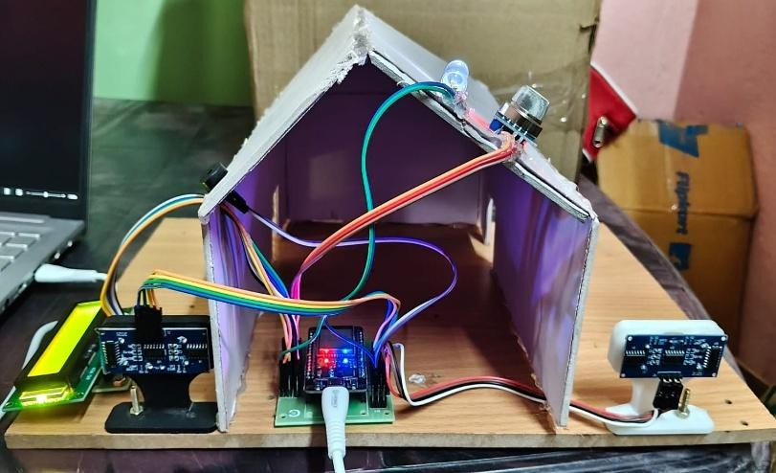
Result:
Fig: Hardware Setup

Slide 12
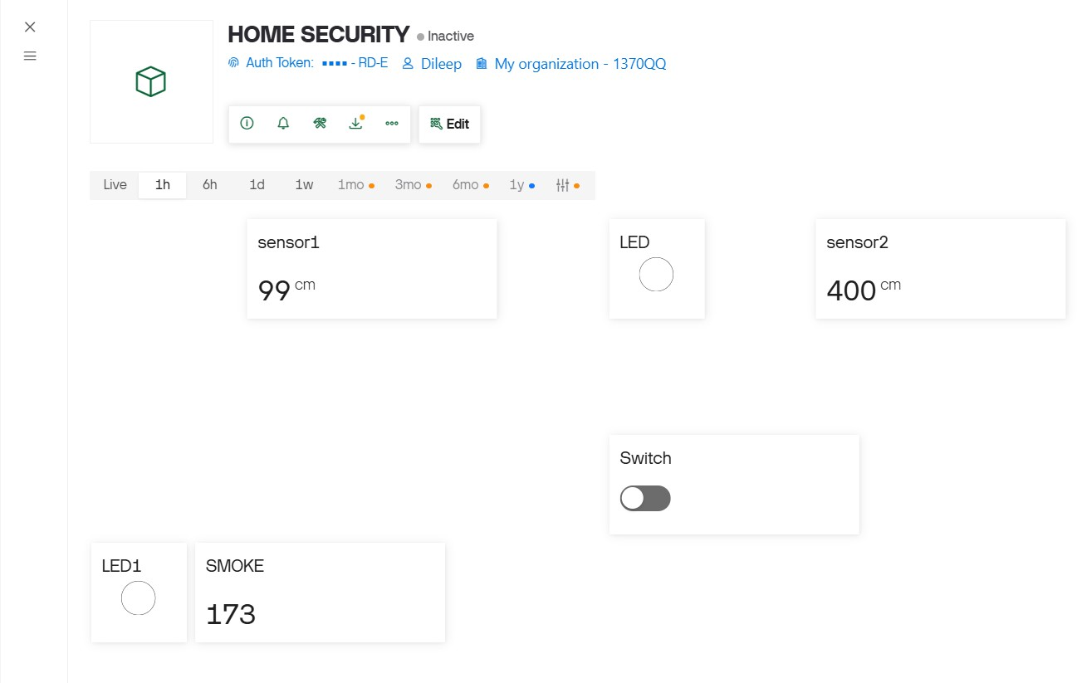
Fig: Web Dashboard

Slide 13
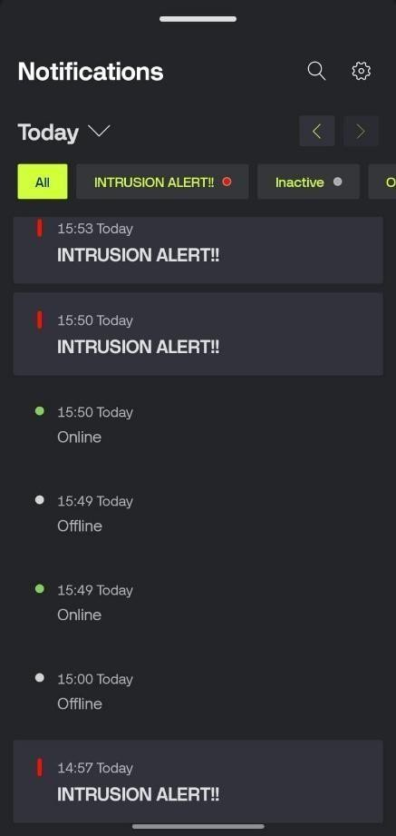
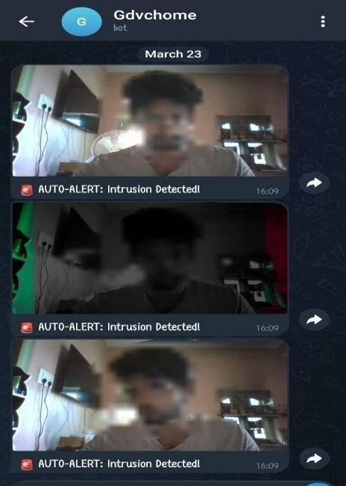
Fig: Blynk Notifications
Fig: Telegram Notifications

Slide 14
References:
Alsakran, F., Bendiab, G., Shiaeles, S., Kolokotronis, N. (2020). Intrusion Detection Systems for Smart Home IoT Devices: Experimental Comparison Study, International Symposium on Security in Computing and communication, 1208: 87–98.
ANDREWS, A. (2022). How To Protect Your Tangible Assets, available at https://www.fresconews.com/protecttangible-assets/, accessed on 23rd September, 2023.
Doukas, C. (2012). Building Internet of Things with the Arduino, CreateSpace Independent Publishing Platform United State, available at https://dl.acm.org/doi/10.5555/2500975, accessed on 22nd September, 2023.
Carnes, B. (2021). Arduino course for beginners, available at https://www.freecodecamp.org/news/create-yourown-electronics-with-arduino-full-course/, accessed on 23rd September, 2023.

Slide 15
THANK YOU

