Slide 1

CVR COLLEGE OF ENGINEERING
Department of CSE B.Tech CSE II Year II Semester
Real Time/Field Based Research Project Review-1, Feb. 2025
Student 1 : M.DILEEP KRISHNA-23B81A0576
Student 2 : B.NIHAN REDDY-23B81A0589
Student 3 : B.PRAJEETH REDDY-23B81A0592

Slide 2
“TasteTrove” Web Based Application for Finding Everyday Meals and Nutrition
M.DILEEP KRISHNA-23B81A0576
B.NIHAN REDDY-23B81A0589
B.PRAJEETH REDDY-23B81A0576

Slide 3
Introduction
Promotes Healthy Cooking: This helps the user find healthy, delicious recipes to make informed choices about meals.
User Friendly Interface: Easy design to look for recipes and track nutritional
contents.
Diverse Recipes: Offers options for various dietary needs like vegan, gluten- free, and high-protein.
Convenient & Educational: Ease of use with nutritional education for healthier cooking.
Global Reach: Encourages home cooking worldwide, balancing flavor with nutrition

Slide 4
Literature Review or Related works
S No | TITLE OF PROJECT | DISADVANTAGES | ADVANTAGES
1. | CookBook | Paid subscription | User friendly interface
2. | MealBoard | Complex interface
3. | Tandoor | Requires self-hosting | Unique and various dishes .
4. | BigOven | Lot of ads,some features unlock at pro | Creats user community
5. | ChefTap | Occasional syncing issues | Sync over multiple devices.
Simplifies meal planning, grocery shopping.

Slide 5
Proposed Method and Modules
Guest User: Can browse, search, filter, and view recipes but has limited functionality
Key Features :Browse, search, and filter recipes.View recipe details, ingredients, steps,
and nutrition.
Registered User: Login for personalized features.
.Registered User: Has full access, including login and use of an interactive timer.
Full access to all features, including interactive timer during cooking.

Slide 6
Functional & Non-functional Requirements
Functional • Non-functinoal
1.Login System for registered users.
2.Recipe Browsing and Searching with filters (veg/non-veg)
3.Recipe Details page for ingredients, steps, and nutrition.
4.Interactive Timer for registered users.
Mobile Responsiveness for cross-device usage.
1.Performance: Handle multiple users simultaneously.
2.Security: Secure data and user authentication
.
3.Scalability: Easy to expand as needed.
4.Usability: Simple and intuitive UI.

Slide 7
Hardware & Software Requirements
Hardware • Software
Operating system : Windows 7 Ultimate and above.
Coding Language : JavaScript.
Front-End: HTML , CSS.
Software: Visual Studio Code
Processor – Dual-core processor,1GHz and above.
Battery – 1200mAh and above.
RAM – 512 MB and above.
Memory – 2 GB and above.
.

Slide 8
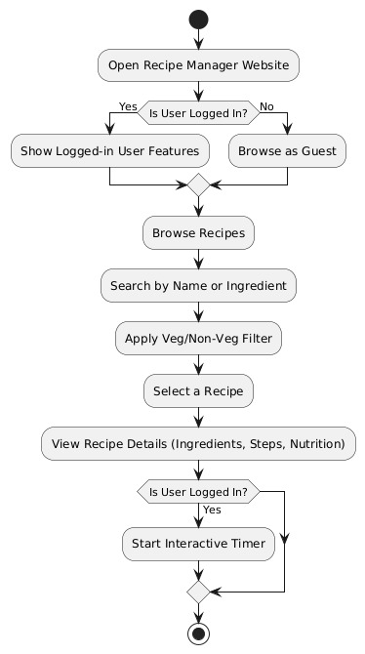
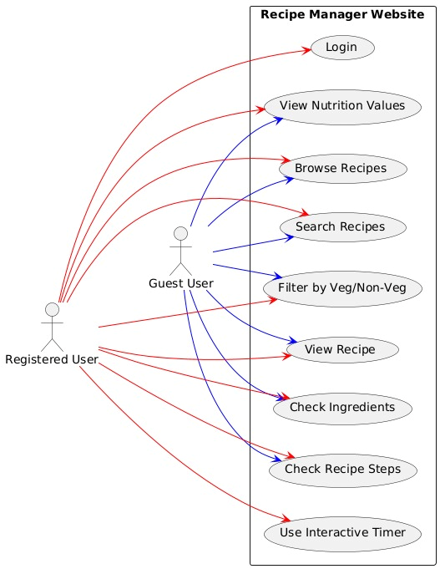
Architecture diagram

Slide 9
References
Website :
(2006, January 22). Indian Recipes | Vismai Food. https://vismaifood.com

Slide 10
Thank you

