Slide 1

REAL TIME DETECTION FOR ENHANCED VITAMIN DEFICIENCY DIAGNOSIS BATCH - 17
Department: Computer Science and Engineering (AIML)
Under the esteemed guidance of
Dr . K . Narasimha Raju
Associate Professor
Department of CSE GVPCE(A)
Submitted by
Name: Nittala Lalitha Roll no: (21131A4227)
Name: Irri Dileep Kumar Roll no: (21131A4255)
Name: Tarun Yegireddi Roll no: (21131A4243)
Name: Udai Aksheeth Palla Roll no: (21131A4244)

Slide 2
Table of contents
Abstract
Existing Systems (Literature Survey)
Drawbacks of Existing Systems
Proposed System
System Architecture and Flow
Core Algorithms
Hardware and Software Requirements
Current Status of the Project
References

Slide 3
abstract
Vitamin deficiency creates significant health risks worldwide. Early detection is crucial to prevent irreversible damage. There is a critical need for accessible, cost-effective methods for diagnosing vitamin deficiencies. Modern technologies, particularly image processing and artificial intelligence, offer promising avenues for vitamin deficiency detection. Deep learning models can analyze images, but existing works suffer from providing real-time analysis and easy access solutions. In this project, hybrid deep learning model-based application to address the issue of vitamin Deficiency

Slide 4
LITERATURE SURVEY
Title Name | Author | Publisher & Year | Methodology | Dataset | Result
[1] Vitamin D Deficiency Detection: A Novel Ensemble Approach with Interpretability Insights | Md.Fahim Ul Islam, Mehedi Hasan, Md.Tahmid Rahman, Amitabha Chakrabarty | IEEE & 2024 | This study introduces an automated system using advanced neural networks (MobileNet, CNN, NasNet-mobile) to detect vitamin deficiencies from images of eyes, lips, tongue, and nails. | collected dataset has the approval of the Institute Ethical Committee of Bharathidasan Govt. College for Women in Puducherry, India, used 3044 college students aged 18-21 years as primary data | Decision Tree achieved Accuracy – 92.6% Precision – 0.92 Recall – 0.83
[2] Diagnosis of Vitamin Deficiency in Human Beings using DNN Algorithm | Elavarasi K, Shanmugapriya K | IEEE & 2023 | This paper develops an RCNN-based system to diagnose vitamin deficiencies using skin microscopy images, leveraging Blur Trace techniques and median filtering for feature extraction and preprocessing | PH2 database is a commonly used benchmark for skin lesion classification, it may not reflect the diversity of lesions seen in real-world scenarios. For example, the database only includes 200 images | Accuracy – 98% Sensitivity – 97%
4

Slide 5
LITERATURE SURVEY
Title Name | Author | Publisher & Year | Methodology | Dataset | Result
[3 ] Explainable Machine Learning for Vitamin A Deficiency Classification in School children | Jayroop Ramesh, Donthi Sankalpa, Amar Khamis, Assim Sagahyroon, Fadi Aloul | IEEE & 2022 | This paper uses machine learning for classifying Vitamin A deficiency in school children using sparse ocular health data, bypassing the need for blood tests using Support Vector Classifier (SVC) | This data was collected from the town of Maradi in Niger, Africa from school children aged 6-15, studying in grades 1 to 9 during government mandated annual eye checkups. Initially there are 125 variables, across 86,216 records. | SVC achieved Accuracy - 75.7% F-1 score - 0.407
[4] Vitamin Deficiency detection using neural networks | T.Krishna Chaithanya, Jiniya Gupta, M.S.Roobini | IEEE & 2020 | This study introduces an automated system using advanced neural networks (MobileNet, CNN, NasNet-mobile) to detect vitamin deficiencies from images of eyes, lips, tongue, and nails. | The dataset encompasses a diverse set of 2,000 images designated for training and 400 images earmarked for testing purposes. These images span a wide spectrum of visual characteristics, encompassing distinctive features such as bluish nails, eyes affected by glaucoma, and intricate depictions of the lip and tongue | Training Accuracy CNN – 90% Training Accuracy MobileNet – 92%
5

Slide 6
Proposed system
We have collected the real time images from the hospital from the patients of nails, eyes, tongue, teeth which can provide real time analysis.
Our system includes various modules which relies on the concept of ensemble methods (Max Voting) , EfficientNet, InceptionResNet, which are highly efficient including MobileNet, ResNet, InceptionV3 which gives best performance in ensemble methods.
We provide the cure for the diseases predicted and precautions to be taken which gives the best user performance
The entire workflow is done through the Web Application and Mobile App for the best user Experience

Slide 7
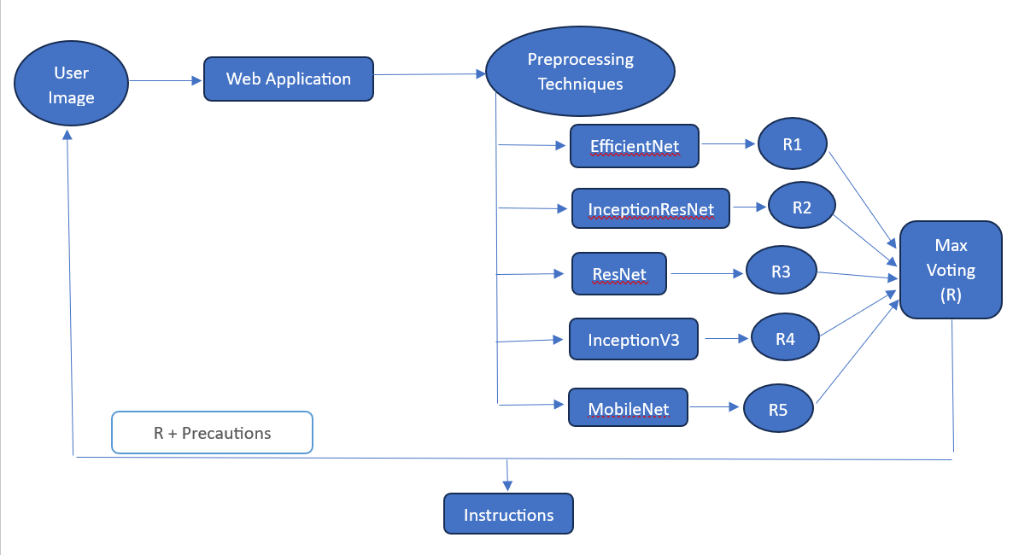
System architecture

Slide 8
Core algorithm
This project leverages an ensemble of advanced neural network models, including EfficientNet, InceptionResNet, MobileNet, ResNet, and InceptionV3, combined with max voting to detect and classify vitamin deficiencies from medical images. By integrating the strengths of these models, the system ensures high accuracy, robustness, and efficiency, offering a non-invasive, accessible, and reliable diagnostic tool for addressing global nutritional health challenges.
EfficientNet: A CNN model optimized for high accuracy and efficiency by uniformly scaling depth, width, and resolution.
InceptionResNet: Combines the strengths of Inception modules and residual connections for robust feature extraction and efficient learning.
MobileNet: A lightweight CNN architecture designed for mobile and embedded vision applications with high efficiency.
ResNet: A deep learning model with residual connections, solving the vanishing gradient problem and enabling training of very deep networks.
InceptionV3: An advanced version of the Inception architecture optimized for accuracy with fewer parameters through factorized convolutions and dimensionality reduction.

Slide 9
Hardware and software requirements
Hardware Components:
T4 GPU for training
Software Components:
Python, OpenCV, PyTorch, React, Kotlin, FastAPI

Slide 10
current Status of the project
We have Completed collecting the real time Data from the patients in the directly which includes the images of the Nails, Tongue, Teeth, Eyes
We further need to proceed with the App Design , Web Application Design and training of the Model using the ensemble methods

Slide 11
References
[1] Md.Fahim Ul Islam, Mehedi Hasan, Md.Tahmid Rahman, Amitabha Chakrabarty."Vitamin D Deficiency Detection: A Novel Ensemble Approach with Interpretability Insights".In:2024 6th International Conference on Electrical Engineering and Information & Communication Technology (ICEEICT),2024.DOI: 10.1109/ICEEICT62016.2024.10534371.
[2] Elavarasi K, Shanmugapriya K."Diagnosis of Vitamin Deficiency in Human Beings using DNN Algorithm".In:2023 Second International Conference on Electronics and Renewable Systems (ICEARS),2023.DOI: 10.1109/ICEARS56392.2023.10085334
[3] Jayroop Ramesh, Donthi Sankalpa, Amar Khamis, Assim Sagahyroon, Fadi Aloul."Explainable Machine Learning for Vitamin A Deficiency Classification in Schoolchildren".In:2022 IEEE-EMBS International Conference on Biomedical and Health Informatics (BHI),2022.DOI: 10.1109/BHI56158.2022.9926924.
[4] T. Krishna Chaithanya, Jiniya Gupta, M.S. Roobini."Vitamin Deficiency Detection Using Neural Networks".In:2024 International Conference on Wireless Communications Signal Processing and Networking (WiSPNET), 2024.DOI: 10.1109/WiSPNET61464.2024.10533044.

