Slide 1
HEART DISEASE DATASET ANALYSIS
VYTLA SAI KALYAN

Slide 2
DATASET DISCRIPTION
This dataset contains 76 attributes ( 76 rows) and 14 Fields (columns).
Database used is a Cleveland database.
The 'Target' field refer to predicted values of heart disease or not. If the value is 1 it is positive or if it is 0 then it is negative.

Slide 3
DATASET CONTENTS
AGE – in years.
SEX – 0 or 1 ( 0 = female , 1 = male )
Cp - chest pain type
Trestbps – blood pressure ( in mm hg )
Chol - serum cholestoral in mg/dl
Fbs - (fasting blood sugar > 120 mg/dl) (0=false, 1=true)

Slide 4
DATASET CONTENTS
Restecg - resting electrocardiographic
thalach - maximum heart rate
exang - exercise induced angina (1 = yes; 0 = no)
oldpeak - ST depression induced by exercise relative to rest
slope - the slope of the peak exercise ST segment
ca - number of major vessels colored by flourosopy
thal - 3 = normal; 6 = fixed defect; 7 = reversable defect
target - have disease or not (1=yes, 0=no)

Slide 5
TECHNIQUES USED
Logistic Regression
Logistic regression is one of the statistical method for analyzing a dataset in
which there are one or more independent variables that determine an outcome.
K- nearest neighbor
KNN is a non-parametric method which uses feature similarity which means that new
point is assigned to a value based on how close it resembles the points in the dataset.
Decision Tree
Decision Tree is a tree structure where each internal node represent attributes, branch
represent a decision rule and each leaf node represent the outcome.

Slide 6
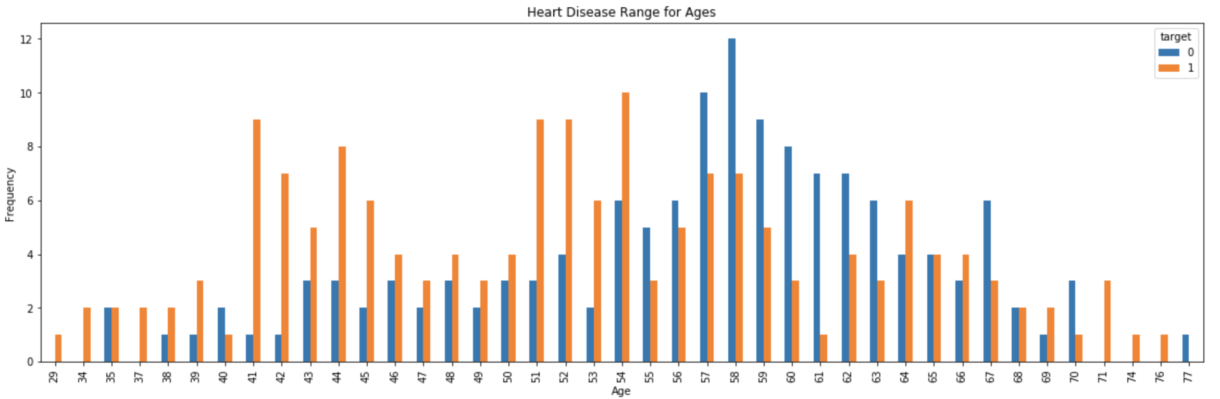
Sample Analysis
From the analysis, we can say that age with 58 has less number of heart diseases and age with 54 has more number of heart diseases

Slide 7
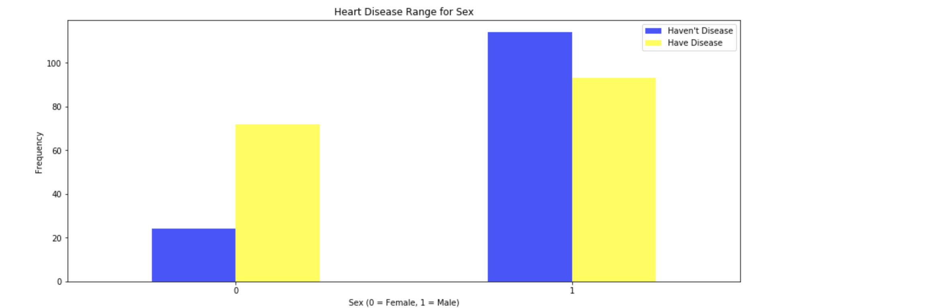
Sample Analysis
Here we can say that male patients are recorded with less number of heart disease problem than the female patients.

Slide 8
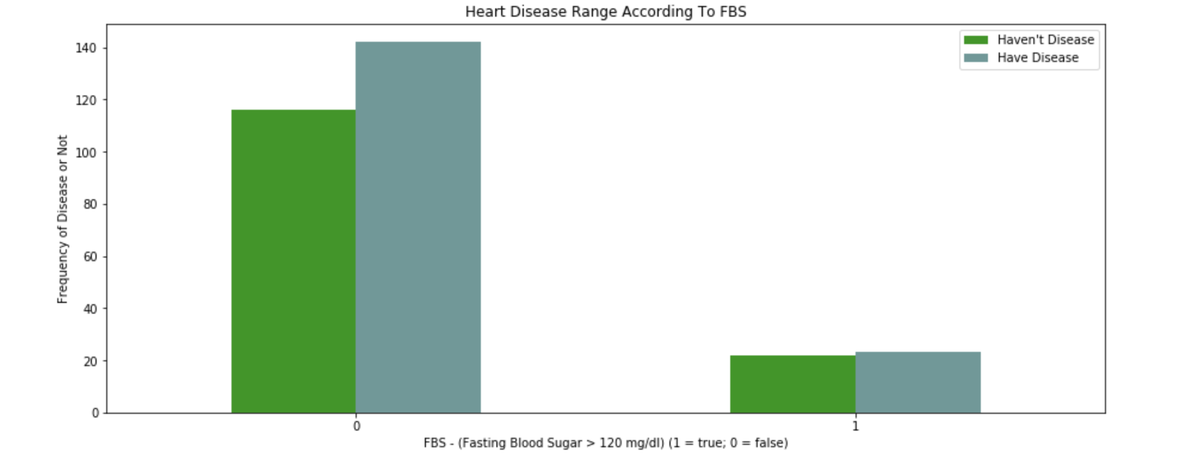
Sample Analysis
Now, we can say that patients who don't have FBS more than 120 will have a greater ratio than others.

Slide 9
summary
Finally from the dataset, KNN has got more accuracy that remaining.
Logistic Regression - 85.25%
KNN - 90.16%
Decision Tree - 73.77%

Slide 10
THANK YOU

