Slide 1
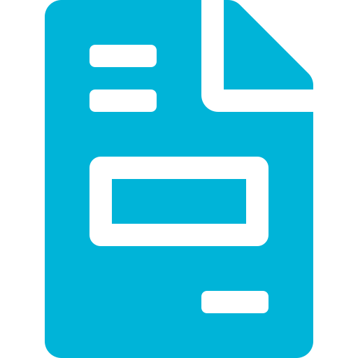
IDP-Invoice
Intelligent Document Processing for Invoices
Automate. Validate. Deliver.

Slide 2


Introduction
What is IDP-Invoice?
The Challenge
Businesses receive hundreds of invoices daily. Manual entry is slow, costly, and prone to human errors — leading to payment delays, incorrect records, and compliance risks.
IDP-Invoice stands for Intelligent Document Processing — Invoice. It is a fully automated system designed to replace the slow, error-prone process of manually handling invoices in a business.
Who is it for?
Finance & accounts payable teams
Enterprises handling large invoice volumes
Businesses seeking audit-ready records
Organizations replacing manual data entry
The Solution
Automatically reads invoice images & PDFs
Rates quality, deblurs poor-quality scans
Extracts & organizes data via OCR + AI
Validates totals & flags anomalies instantly
Stores clean data & delivers on demand

Slide 3



Application Overview
IDP-Invoice is an end-to-end Intelligent Document Processing system that automates invoice ingestion, extraction, validation, and delivery.
What It Is
What It Does
What You Get
An AI-powered invoice processing pipeline
Supports image & PDF invoice formats
Combines OCR, AI models & validation logic
Built for high-volume business environments
Reads & extracts invoice data automatically
Scores file quality & pre-processes if needed
Validates totals and checks for invoice numbers
Flags anomalies for human or error review
Structured, validated invoice data in database
100% accuracy with automated cross-checks
95% reduction in manual effort
On-demand delivery of processed records

Slide 4
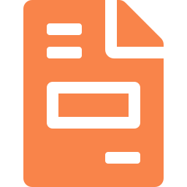


Why IDP-Invoice?
Volume Overload
Time & Effort
Accuracy at Risk
Large volumes of invoices ranging from hundreds to thousands each day make manual processing impractical for modern businesses to keep up with.
Manually entering and storing invoice data is slow, tedious, and consumes significant employee hours that could be better spent.
Human data entry introduces errors. Our IDP-Invoice system delivers higher accuracy, processing hundreds of files within minutes.
✦ IDP-Invoice processes hundreds of invoices in minutes with superior accuracy and zero fatigue.

Slide 5





IDP-Invoice: How It Works
1
2
3
4
5
6
Upload
▶
▶
▶
▶
▶
Quality
Check
Pre-
process
OCR
Organize
& Store
API-Sync
Invoice
Image / PDF/Excel/Text
Score out
of 10
Enhancement if
score < 7
Extract
contents
Model
structures data
Data sent
to down stream systems
Quality Branching Logic
Score ≥ 7 → File skips pre-processing and goes directly to OCR extraction.
Score < 7 → Deblurring & image enhancement applied first, then OCR. File is flagged for HITL review.
Pre-processed files are always routed to Human-In-The-Loop (HITL) review regardless of other checks.

Slide 6



Validation & Flagging System
✔ Clean Invoice
✗ Error Flag
⚑ HITL Flag
Invoice number found
System-calculated total = OCR-extracted total
Image did NOT require pre-processing
Stored directly to database
Data synced with downstream system either on request or on scheduled basis
Capability to interact using chatbot
No invoice number detected in the file
File is immediately flagged as ERROR
Routed for manual inspection
Not stored until validated by operator
Prevents corrupt records in database
Calculated total ≠ OCR-extracted total
OR file went through pre-processing
Human-In-The-Loop review triggered
Expert corrects / confirms extracted data
Approved data then stored & data synced with down stream systems

Slide 7





Key Benefits
100x
Faster Processing
Hundreds of invoices processed in minutes.
95%
Efficiency
100%
Significantly reduces manual workload through intelligent automation.
Accuracy
Automated validation ensures error-free storage.
IDP-Invoice
HITL
API
Key Benefits
Human Oversight
Easy Data Delivery
Smart flagging routes only uncertain files to review.
Processed data delivered on demand.

Slide 8
IDP-Invoice
Smart Invoice Processing, Every Time.
Upload any invoice image or PDF
Auto quality check → pre-process if needed
OCR extracts → model organizes → stored in database
Intelligent flagging: Error & HITL for review
On-demand delivery of processed data
Transforming Manual Invoice Workflows into Intelligent Automation

