Slide 1
RAILWAY RESERVATION MANAGEMENT SYSTEM
Database Management Systems
Department of Computer Science and Engineering
Aditya University, Surampalem
Team Members:
J. DILEEP KUMAR (25B11CS342)
AKSHAY PUTTA (25B11CS022)
SAMPATHI HEMANTH 25B11CS844)
SASANK AKULA (25B11CS027)

Slide 2

Problem Statement
Railway reservation involves managing different types of related data.
Passenger, train, station, reservation, ticket, and payment information are interconnected.
Managing these related records requires proper organization and relationships between the data.
A structured database is needed to store and connect this information efficiently.
Without a proper database structure, retrieving and maintaining related records can become complex
RAILWAY MANAGEMENT RESERVATION SYSTEM | DBMS CORNERSTONE PROJECT
2

Slide 3
Objectives of the Project
Develop a centralized railway reservation database.
Manage passenger records, including multiple contact numbers.
Maintain train and station information.
Store reservation details: journey, class, fare, seat and coach.
Link ticket (PNR) and payment records to each reservation.
Reduce duplicate data and update anomalies; maintain referential integrity.

Slide 4
Existing vs Proposed System
Existing System | Proposed System
Manual or semi-manual records | Centralized relational database
Multiple disconnected spreadsheets | Related tables with PK, FK and constraints
Duplicate passenger and reservation records | Duplicates prevented by keys and UNIQUE rules
Hard to check seat availability | Available seats derived through a view
Slow searches, error-prone entry | Fast SQL-based search and reporting

Slide 5
Functional Requirements
Module | Requirement
Passenger Management | Add, update, search, display passengers, with multiple phone numbers
Train Management | Train identity, name, type and seat capacity
Station Management | Station name, city, state; stations served by each train
Reservation Management | Book seats; maintain journey, class, fare, seat, coach
Ticket Management | Generate and store PNR and booking date
Payment Management | Store amount, date and mode for each reservation
Search and Reporting | Retrieve information using SQL queries

Slide 6
Non-Functional & System Requirements
Performance – efficient results for normal reservation workloads.
Integrity – no invalid references or duplicate keys.
Security – controlled database privileges.
Usability, Reliability (consistent transactions), Scalability.

Slide 7
End Users of the System
User | Role in the System
Passenger | Provides personal details, books a seat, pays the fare and receives a ticket (PNR)
Reservation Staff | Adds and updates passenger records, processes reservations, generates tickets and records payments
Database Administrator | Creates and maintains tables and constraints, controls user privileges, takes backups

Slide 8
Relationships
Relationship | Meaning
Passenger → Reservation | One passenger can make multiple reservations
Train → Reservation | One train can have multiple reservations
Reservation → Ticket | A reservation includes a ticket
Reservation → Payment | A reservation generates a payment record
Train ↔ Station | A train serves many stations and a station is served by many trains; implemented through the Train_Station table

Slide 9
Keys and Constraints
Type | Applied To
Primary Key | Passenger_ID, Train_ID, Station_Name, Reservation_ID, Ticket_ID, Payment_ID; composite keys in Passenger_Phone and Train_Station
Foreign Key | Reservation → Passenger, Train; Ticket, Payment → Reservation; Passenger_Phone, Train_Station links
NOT NULL | Names, date of birth, journey date, source, destination, PNR
UNIQUE | PNR_ID; one ticket and one payment per reservation
CHECK | Gender (M, F); Total_Seats > 0; Class; Fare > 0; Amount > 0; Payment_Mode
DEFAULT | Booked_Seats = 0

Slide 10
Database Schema
Relation | Attributes
PASSENGER | Passenger_ID (PK), First_Name, Last_Name, Gender, Date_of_Birth
PASSENGER_PHONE | Passenger_ID (PK, FK), Phone_No (PK)
TRAIN | Train_ID (PK), Train_Name, Train_Type, Total_Seats, Booked_Seats
STATION | Station_Name (PK), State, City
TRAIN_STATION | Train_ID (PK, FK), Station_Name (PK, FK)
RESERVATION | Reservation_ID (PK), Passenger_ID (FK), Train_ID (FK), Journey_Date, Source, Destination, Class, Fare, Seat_Number, Coach_No
TICKET | Ticket_ID (PK), PNR_ID, Booking_Date, Reservation_ID (FK)
PAYMENT | Payment_ID (PK), Amount, Payment_Date, Payment_Mode, Reservation_ID (FK)

Slide 11
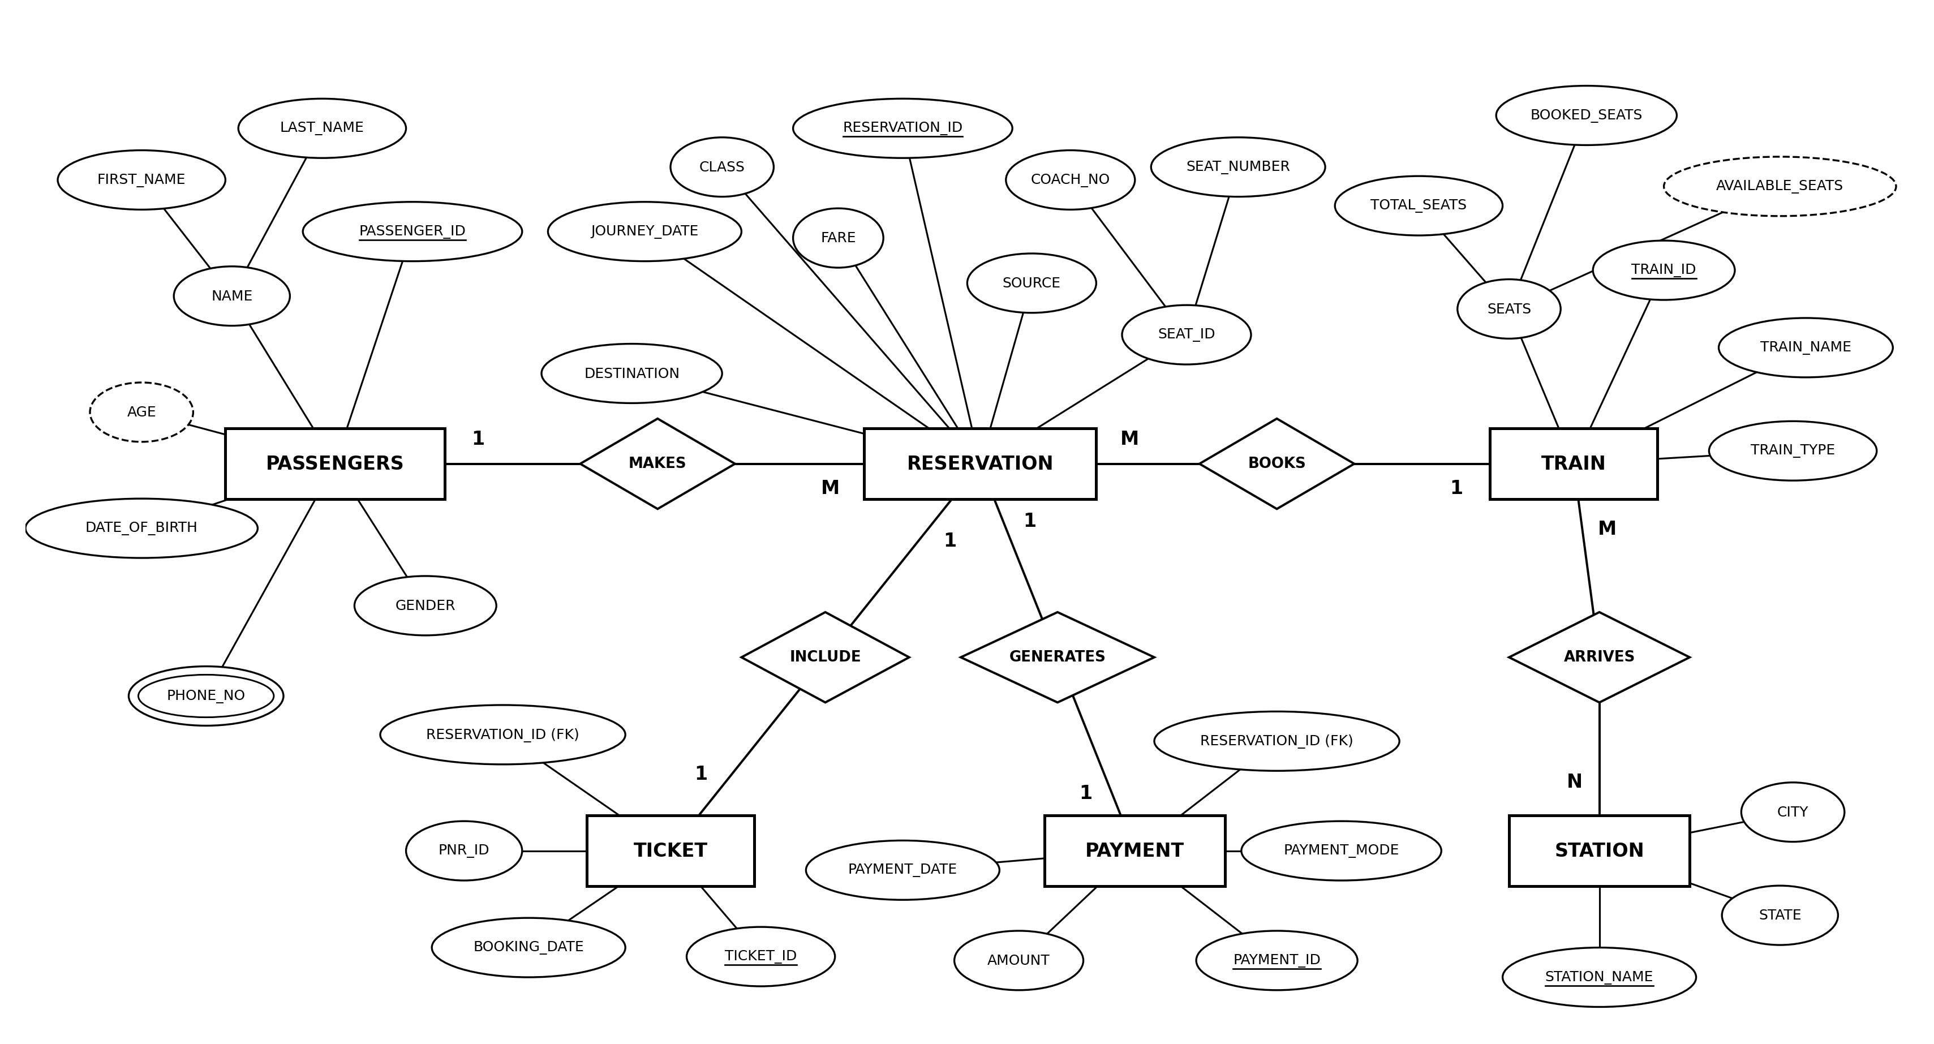
ER Diagram

Slide 12
Cardinality
Relationship | Cardinality | Explanation
Passenger – Passenger_Phone | 1 : M | One passenger can have many phone numbers
Passenger – Reservation | 1 : M | One passenger can make many reservations
Train – Reservation | 1 : M | One train can have many reservations
Reservation – Ticket | 1 : 1 | Each reservation has exactly one ticket (UNIQUE)
Reservation – Payment | 1 : 1 | Each reservation has exactly one payment (UNIQUE)
Train – Station | M : N | Resolved by Train_Station: Train 1:M Train_Station and Station 1:M Train_Station

Slide 13
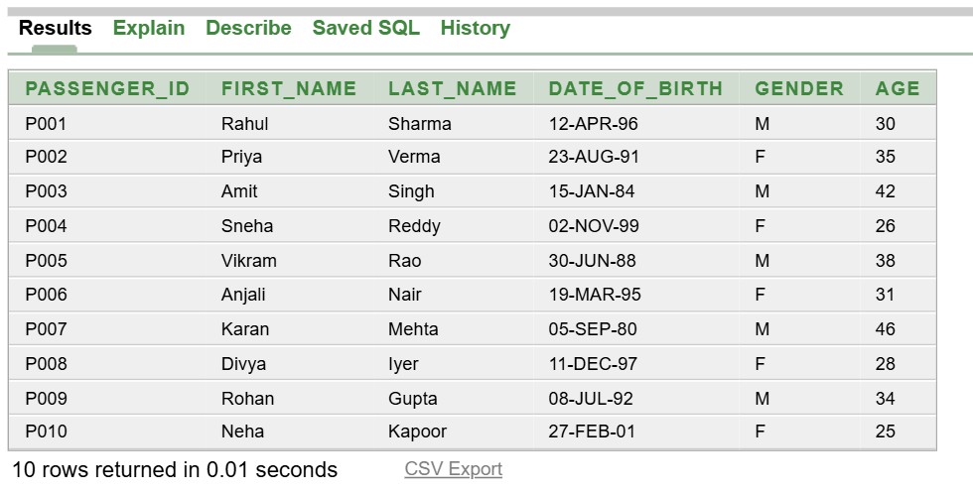
Table Design 1: Passenger
Table creation query
Output: SELECT * FROM Passenger;
CREATE TABLE Passenger (
Passenger_ID VARCHAR2(10) PRIMARY KEY,
First_Name VARCHAR2(30) NOT NULL,
Last_Name VARCHAR2(30) NOT NULL,
Gender CHAR(1),
Date_of_Birth DATE NOT NULL,
CONSTRAINT chk_gender
CHECK (Gender IN ('M','F'))
);
CREATE OR REPLACE VIEW v_passenger_age AS
SELECT Passenger_ID, First_Name,
Last_Name, Date_of_Birth,gender,
FLOOR(MONTHS_BETWEEN(SYSDATE,
Date_of_Birth)/12) AS Age
FROM Passenger;

Slide 14
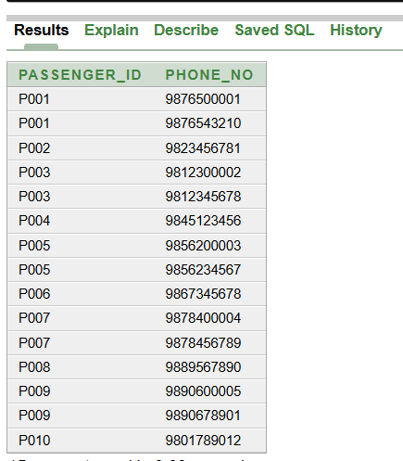
Table Design 2: Passenger_Phone
Table creation query
Output: SELECT * FROM Passenger_Phone;
CREATE TABLE Passenger_Phone (
Passenger_ID VARCHAR2(10),
Phone_No VARCHAR2(15),
CONSTRAINT pk_phones
PRIMARY KEY (Passenger_ID, Phone_No),
CONSTRAINT fk_phones
FOREIGN KEY (Passenger_ID)
REFERENCES Passenger(Passenger_ID)
);

Slide 15
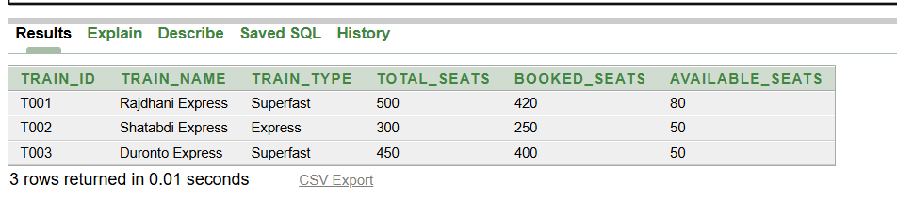
Table Design 3: Train
Table creation query
Output: SELECT * FROM Train;
CREATE TABLE Train (
Train_ID VARCHAR2(10) PRIMARY KEY,
Train_Name VARCHAR2(50) NOT NULL,
Train_Type VARCHAR2(20),
Total_Seats NUMBER,
Booked_Seats NUMBER DEFAULT 0,
CONSTRAINT chk_total_seats
CHECK (Total_Seats > 0),
CONSTRAINT chk_booked_seats
CHECK (Booked_Seats >= 0 AND
Booked_Seats <= Total_Seats)
);
CREATE OR REPLACE VIEW v_train_seats AS
SELECT Train_ID, Train_Name, Train_Type,
Total_Seats, Booked_Seats,
(Total_Seats - Booked_Seats)
AS Available_Seats
FROM Train;

Slide 16
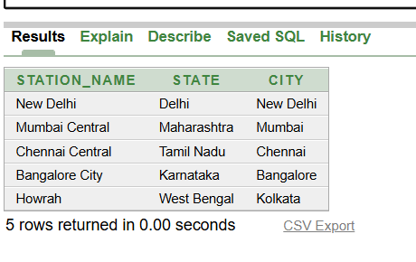
Table Design 4: Station
Table creation query
Output: SELECT * FROM Station;
CREATE TABLE Station (
Station_Name VARCHAR2(50) PRIMARY KEY,
State VARCHAR2(50) NOT NULL,
City VARCHAR2(50) NOT NULL
);

Slide 17
Table Design 5: Train_Station
Table creation query
Output: SELECT * FROM Train_Station;
CREATE TABLE Train_Station (
Train_ID VARCHAR2(10),
Station_Name VARCHAR2(50),
CONSTRAINT pk_train_station
PRIMARY KEY (Train_ID, Station_Name),
CONSTRAINT fk_ts_train
FOREIGN KEY (Train_ID)
REFERENCES Train(Train_ID),
CONSTRAINT fk_ts_station
FOREIGN KEY (Station_Name)
REFERENCES Station(Station_Name)
);
Train_ID | Station_Name
T001 | New Delhi
T001 | Mumbai Central
T002 | Chennai Central
T002 | Bangalore City
T003 | Howrah
T003 | New Delhi

Slide 18
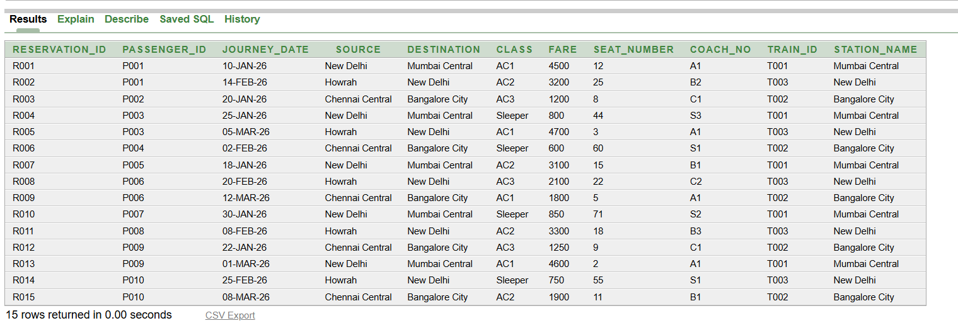
Table Design 6: Reservation
Table creation query
Output: SELECT * FROM Reservation;
CREATE TABLE Reservation (
Reservation_ID VARCHAR2(10) PRIMARY KEY,
Passenger_ID VARCHAR2(10) NOT NULL,
Train_ID VARCHAR2(10) NOT NULL,
Journey_Date DATE NOT NULL,
Source VARCHAR2(50) NOT NULL,
Destination VARCHAR2(50) NOT NULL,
Class VARCHAR2(20),
Fare NUMBER(10,2),
Seat_Number VARCHAR2(10),
Coach_No VARCHAR2(10),
CONSTRAINT chk_class CHECK
(Class IN ('AC1','AC2','AC3','Sleeper')),
CONSTRAINT chk_fare CHECK (Fare > 0),
CONSTRAINT fk_res_passenger
FOREIGN KEY (Passenger_ID)
REFERENCES Passenger(Passenger_ID),
CONSTRAINT fk_res_train
FOREIGN KEY (Train_ID)
REFERENCES Train(Train_ID)
);

Slide 19
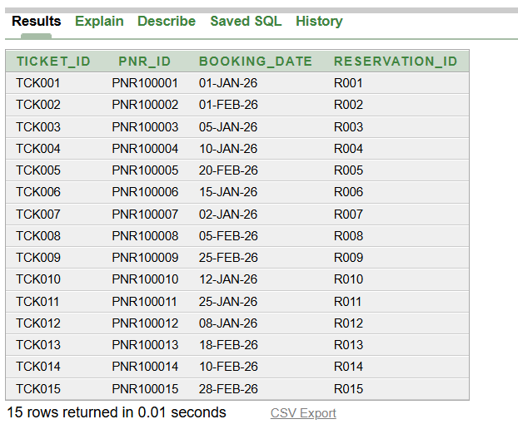
Table Design 7: Ticket
Table creation query
Output: SELECT * FROM Ticket;
CREATE TABLE Ticket (
Ticket_ID VARCHAR2(10) PRIMARY KEY,
PNR_ID VARCHAR2(20) NOT NULL UNIQUE,
Booking_Date DATE,
Reservation_ID VARCHAR2(10) NOT NULL UNIQUE,
CONSTRAINT fk_ticket_res FOREIGN KEY (Reservation_ID)
REFERENCES Reservation(Reservation_ID)
);

Slide 20
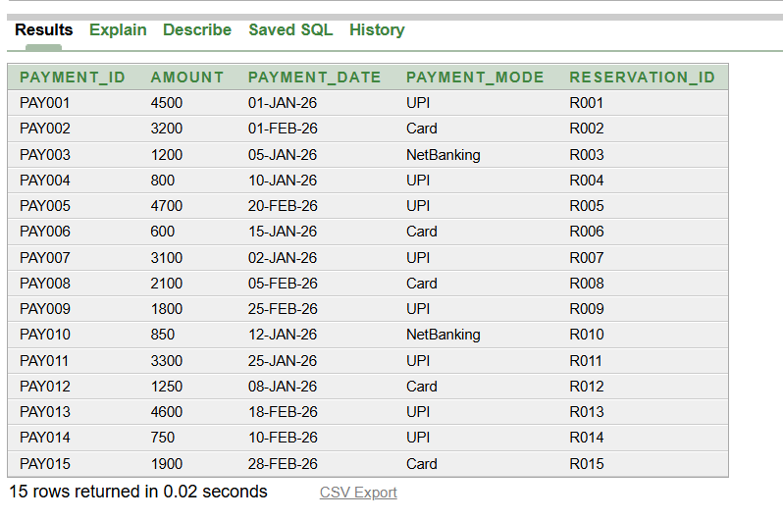
Table Design 8: Payment
Table creation query
Output: SELECT * FROM Payment;
CREATE TABLE Payment (
Payment_ID VARCHAR2(10) PRIMARY KEY,
Amount NUMBER(10,2),
Payment_Date DATE,
Payment_Mode VARCHAR2(20),
Reservation_ID VARCHAR2(10)
NOT NULL UNIQUE,
CONSTRAINT chk_amount
CHECK (Amount > 0),
CONSTRAINT chk_pay_mode CHECK
(Payment_Mode IN ('UPI','Card',
'NetBanking')),
CONSTRAINT fk_payment_res
FOREIGN KEY (Reservation_ID)
REFERENCES Reservation(Reservation_ID)
);

Slide 21
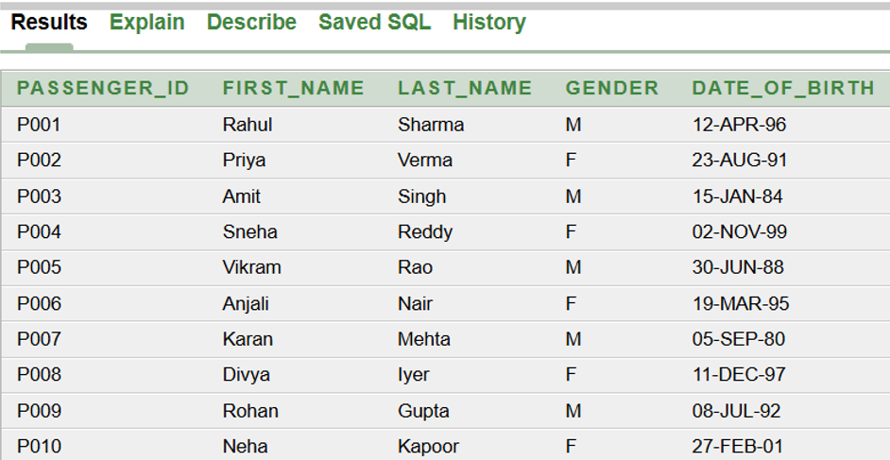
Query 1
Query 1: Display all passengers
SELECT * FROM passengers_3nf;

Slide 22
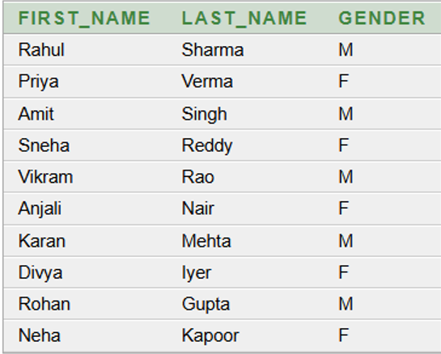
Query 2
Query 2: Passenger names and gender
SELECT first_name, last_name, gender
FROM passengers_3nf;

Slide 23
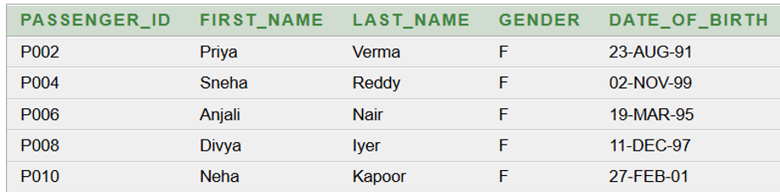
Query 3
Query 3: Display female passengers
SELECT * FROM passengers_3nf
WHERE gender = 'F';

Slide 24
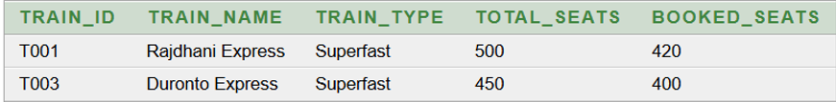
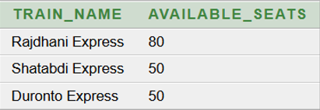
Queries 4 & 5
Query 4: Trains with over 400 seats
SELECT * FROM trains_3nf
WHERE total_seats > 400;
Query 5: Available seats per train
SELECT train_name,
(total_seats - booked_seats)
AS available_seats
FROM trains_3nf;

Slide 25


Queries 6 & 7
Query 6: Average fare of reservations
SELECT AVG(fare) AS average_fare
FROM reservations_3nf;
Query 7: Total amount collected
SELECT SUM(amount)
AS total_amount_collected
FROM payments_3nf;

Slide 26
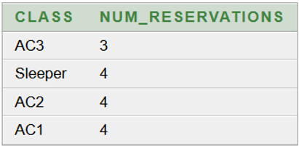
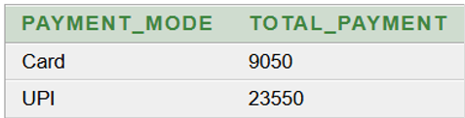
Queries 8 & 9
Query 8: Reservations per class
SELECT class,
COUNT(*) AS num_reservations
FROM reservations_3nf
GROUP BY class;
Query 9: Payment modes above 3000
SELECT payment_mode,
SUM(amount) AS total_payment
FROM payments_3nf
GROUP BY payment_mode
HAVING SUM(amount) > 3000;

Slide 27
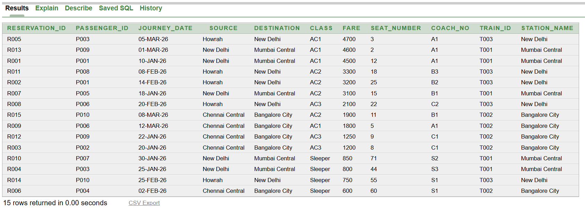
Query 10
Query 10: Reservations sorted by fare (highest first)
SELECT * FROM reservations_3nf
ORDER BY fare DESC;

Slide 28
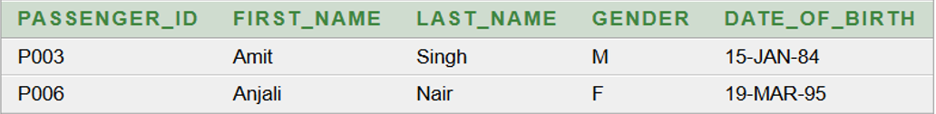

Queries 11 & 12
Query 11: First name starts with A
SELECT * FROM passengers_3nf
WHERE first_name LIKE 'A%';
Query 12: Highest fare
SELECT MAX(fare) AS highest_fare
FROM reservations_3nf;

Slide 29

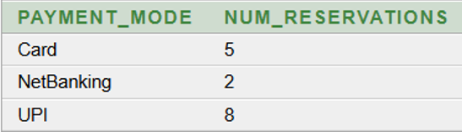
Queries 13 & 14
Query 13: Total number of passengers
SELECT COUNT(*) AS total_passengers
FROM passengers_3nf;
Query 14: Payments per payment mode
SELECT payment_mode,
COUNT(*) AS num_reservations
FROM payments_3nf
GROUP BY payment_mode;

Slide 30
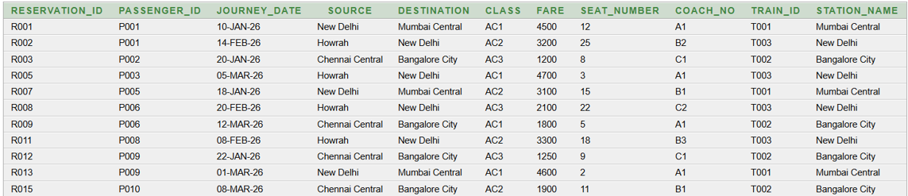
Query 15
Query 15: Reservations with fare above 1000
SELECT * FROM reservations_3nf
WHERE fare > 1000;

Slide 31
Normalization – From UNF to 3NF
Railway Reservation Management System | DBMS Project
Normalization organizes a table to remove redundancy and anomalies.
We normalize the railway reservation data step by step: UNF → 1NF → 2NF → 3NF.
Each normal form fixes one specific kind of problem.
UNF
1NF
2NF
3NF
➜
➜
➜
Cells hold many values
Every cell is atomic
Full dependency on key
Only the key decides
Notes:
Introduce the topic: we normalize the railway reservation data step by step from UNF to 3NF.
తెలుగు: రైల్వే రిజర్వేషన్ డేటాను UNF నుండి 3NF వరకు దశలవారీగా normalize చేస్తాము.

Slide 32
What is Normalization?
Organizing a table to remove redundancy and anomalies
1
UNF
2
1NF
3
2NF
4
3NF
Cells hold many values
Every cell is atomic
Full dependency on key
Only the key decides
Fixes: Multivalued PHONE_NO
Fixes: Partial dependency
Fixes: Transitive dependency
Fixes: Clean design
Why normalize?
Without it, we face insertion, deletion and update anomalies, and the same data is stored again and again. Each form removes one kind of problem.
Notes:
Normalization removes redundancy and anomalies. Each normal form fixes one specific problem.
తెలుగు: Normalization వల్ల redundancy మరియు anomalies తగ్గుతాయి. ప్రతి normal form ఒక సమస్యను తొలగిస్తుంది.

Slide 33
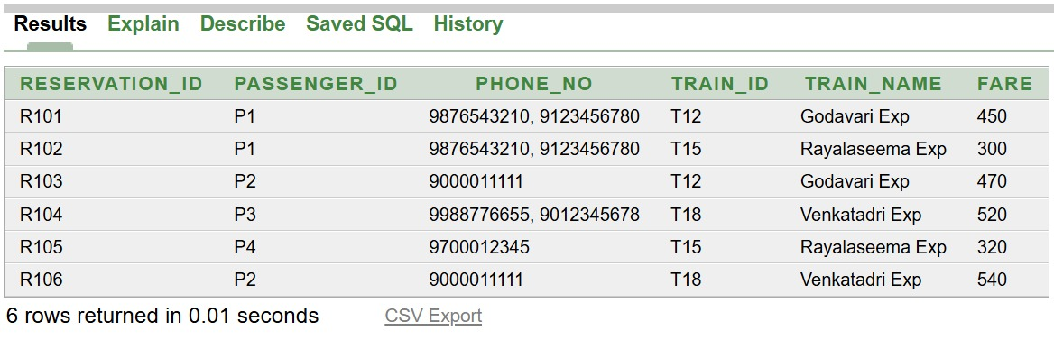
1. Unnormalized Form (UNF)
Table: railway_unf (6 rows)
Problem
PHONE_NO has two values in one cell (R101, R102, R104). A cell must hold one value.
Anomalies
Insert: new train needs a reservation.
Delete: removing R105 loses P4's phone.
Search: needs LIKE '%...%'.
Notes:
PHONE_NO is multivalued, so the table is UNF. FDs: RESERVATION_ID -> PASSENGER_ID, TRAIN_ID, FARE; TRAIN_ID -> TRAIN_NAME; PASSENGER_ID ->> PHONE_NO.
తెలుగు: ఒక cell లో రెండు phone numbers ఉన్నాయి, కాబట్టి ఇది UNF.

Slide 34
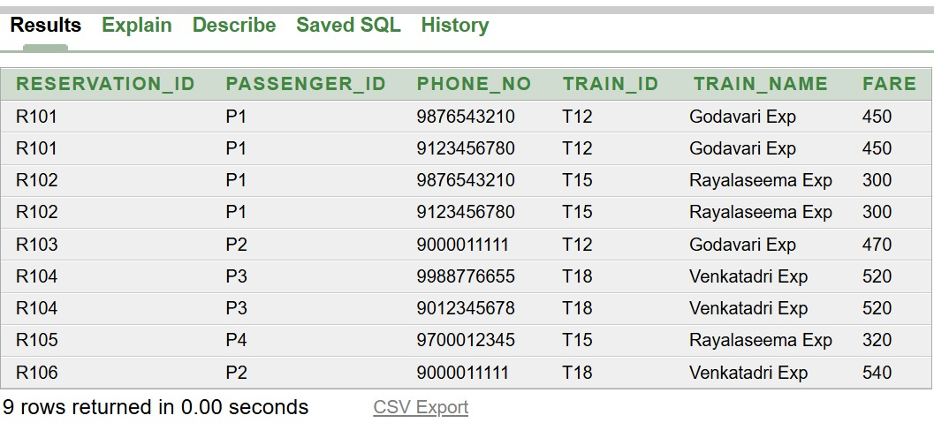
2. First Normal Form (1NF)
Table: railway_1nf (6 rows became 9) | Key: (RESERVATION_ID, PHONE_NO)
Fix applied
One phone number per row. Every cell is now atomic.
Remaining problem
Partial dependency: train and fare details depend only on RESERVATION_ID. They repeat in every phone row.
Notes:
Split multivalued PHONE_NO into separate rows. New problem: partial dependency, because non-key attributes depend only on part of the key.
తెలుగు: ప్రతి row లో ఒకే phone number. ఇప్పుడు partial dependency సమస్య ఉంది.

Slide 35
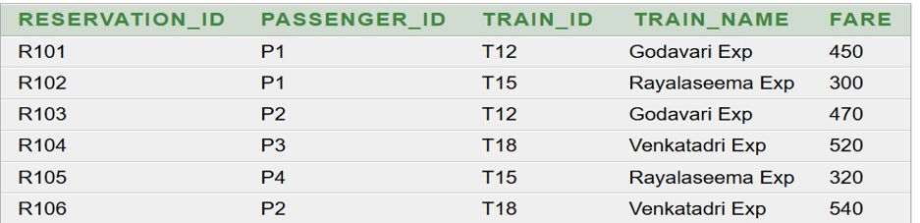
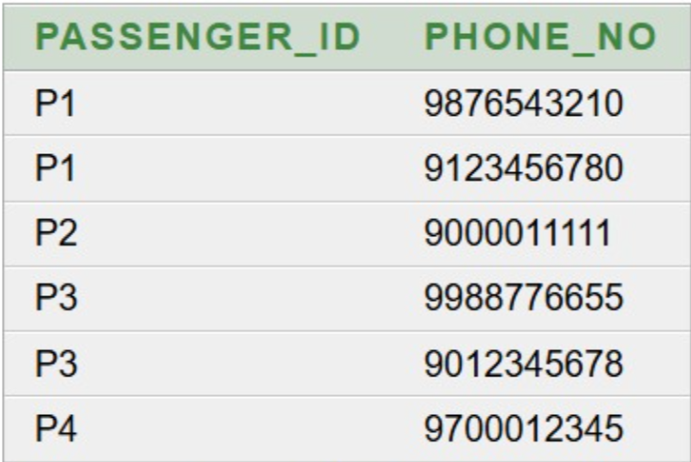
3. Second Normal Form (2NF)
Partial dependency removed by splitting into two tables
railway_2nf_reservation (Key: RESERVATION_ID)
railway_2nf_phone (Key: both columns)
Fix applied
Reservation details and phone numbers are in separate tables. Each non-key column depends on the whole key.
Remaining problem
Transitive dependency: RESERVATION_ID → TRAIN_ID → TRAIN_NAME. The train name still repeats.
Notes:
Partial dependencies removed. New problem: transitive dependency via TRAIN_ID.
తెలుగు: Partial dependency తొలగించాము. ఇప్పుడు transitive dependency మిగిలింది.

Slide 36
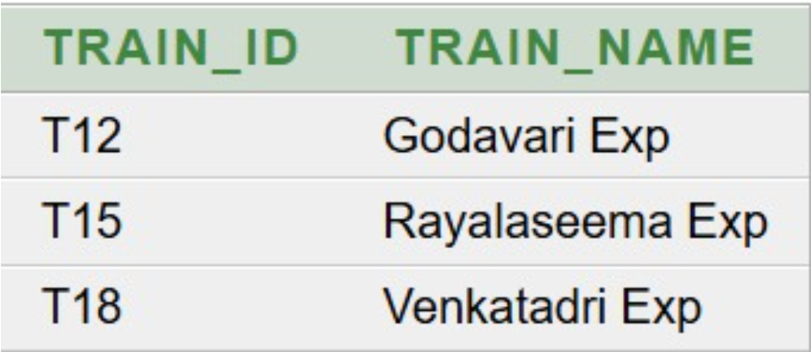
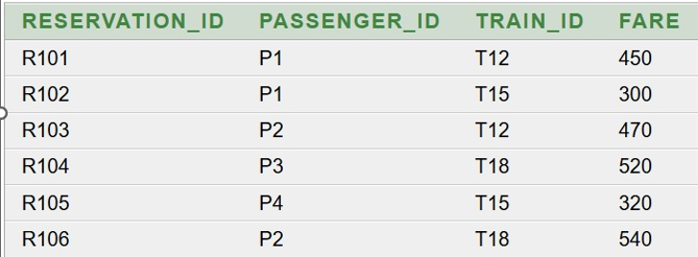
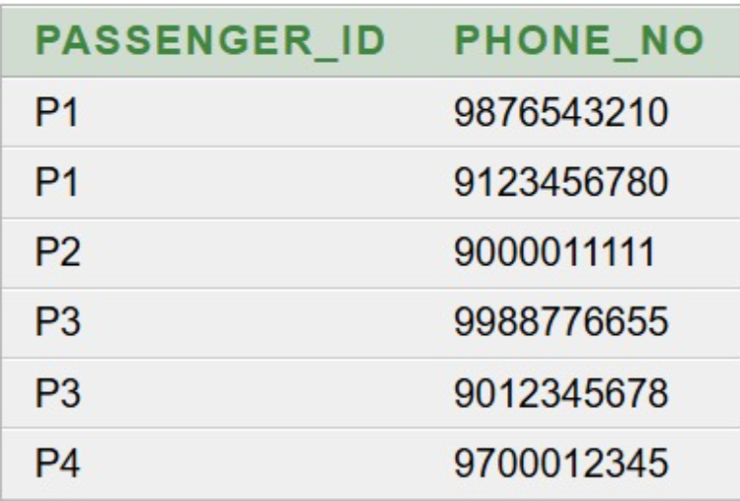
4. Third Normal Form (3NF)
Transitive dependency removed: three tables
TRAIN
RESERVATION (TRAIN_ID is a foreign key)
PASSENGER_PHONE
Insert
Add a train without a reservation
Delete
Deleting a booking keeps train and phone data
Update
Change a train name in one row
Redundancy
Each name and phone stored once
Notes:
TRAIN_NAME moved to its own TRAIN table. All anomalies are removed, and joining the tables gives back the original 9-row data (lossless join).
తెలుగు: TRAIN_NAME ను వేరే టేబుల్ లోకి మార్చాము. అన్ని anomalies తొలగిపోయాయి.

Slide 37
Summary
Step | Problem removed | How
1 UNF to 1NF | Multivalued PHONE_NO | One phone per row
2 1NF to 2NF | Partial dependency | Separate reservation and phone tables
3 2NF to 3NF | Transitive dependency | Separate TRAIN table
Result: consistent data, minimum redundancy, and no data lost.
Notes:
Recap the three steps and the final result.
తెలుగు: మూడు దశల సారాంశం: multivalued, partial, transitive dependencies తొలగించాము.

Slide 38
Conclusion
A structured relational database for passengers, phones, trains, stations, reservations, tickets and payments.
Normalized up to 3NF to reduce redundancy and anomalies.
Derived views compute passenger age and available seats.
SQL queries support common reservation reports.

Slide 39
Future Enhancements
Cancellation, refund, RAC and wait-list management.
Real-time seat availability and automatic seat allocation.
Online payment gateway and SMS/email notifications.
Role-based access, audit logging and stronger security.
Web and mobile application interfaces.

Slide 40
Thank You

