Slide 1
Machine Learning for Glaucoma Detection Using Fundus Images
Implementation of a Convolutional Neural Network (CNN)
Dileep 023-21-0057
Dileep 023-21-0059
Preety 023-21-0062

Slide 2
Introduction
• Glaucoma as a leading cause of blindness
• Importance of fundus imaging for eye health
• Objective: Develop a machine learning model to detect glaucoma

Slide 3
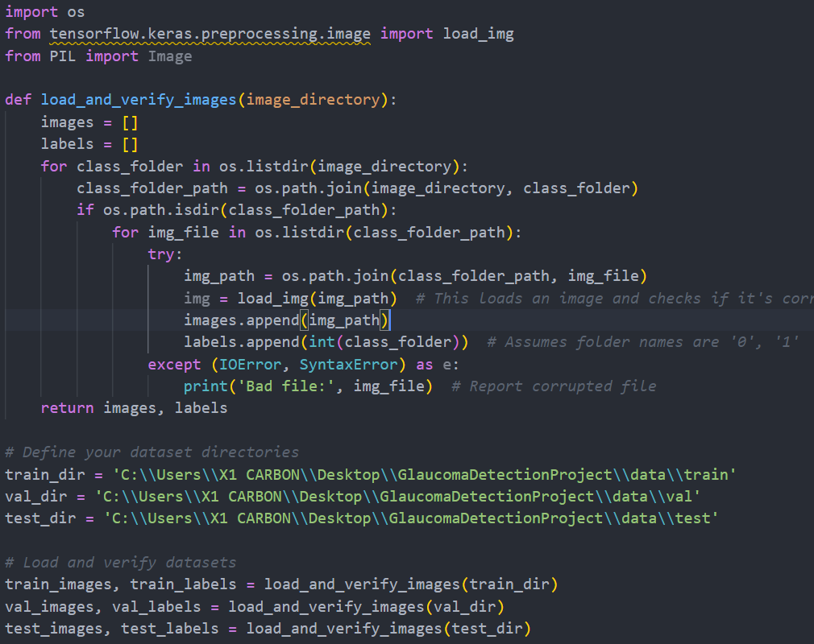
Data preparation

Slide 4
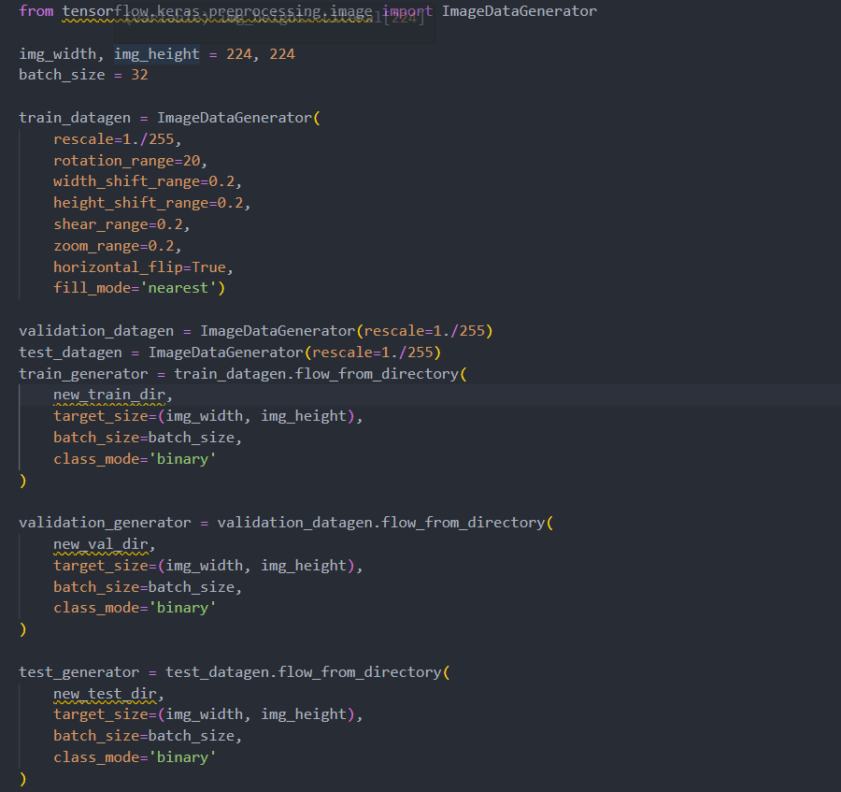
Preprocessing

Slide 5
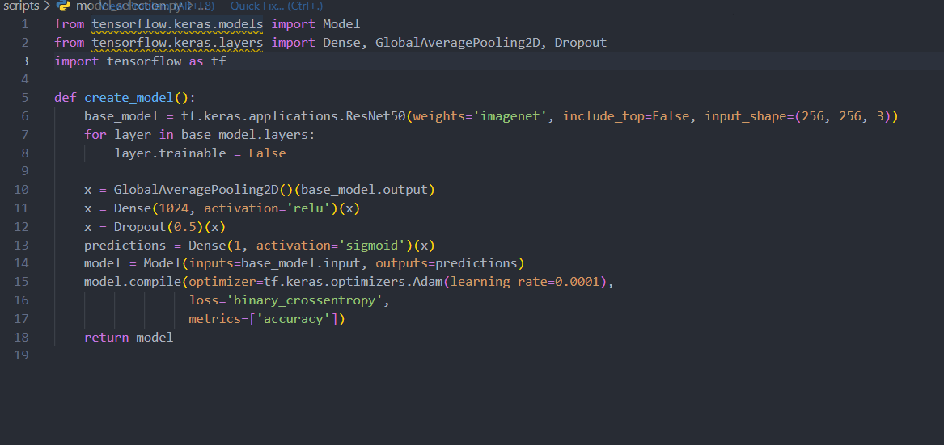
Model Selection

Slide 6
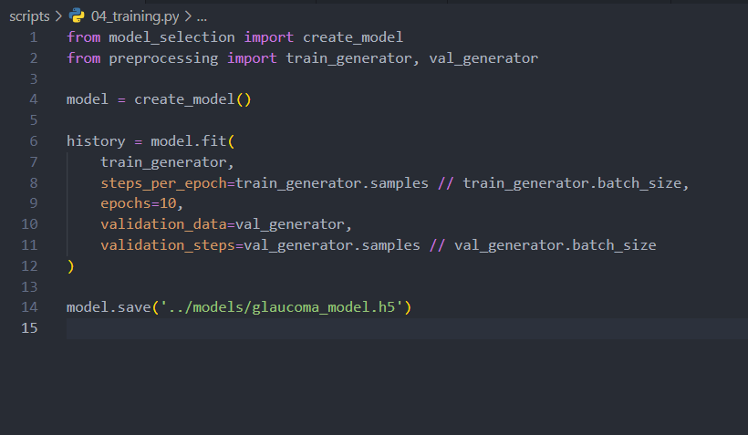
Training the Model

Slide 7
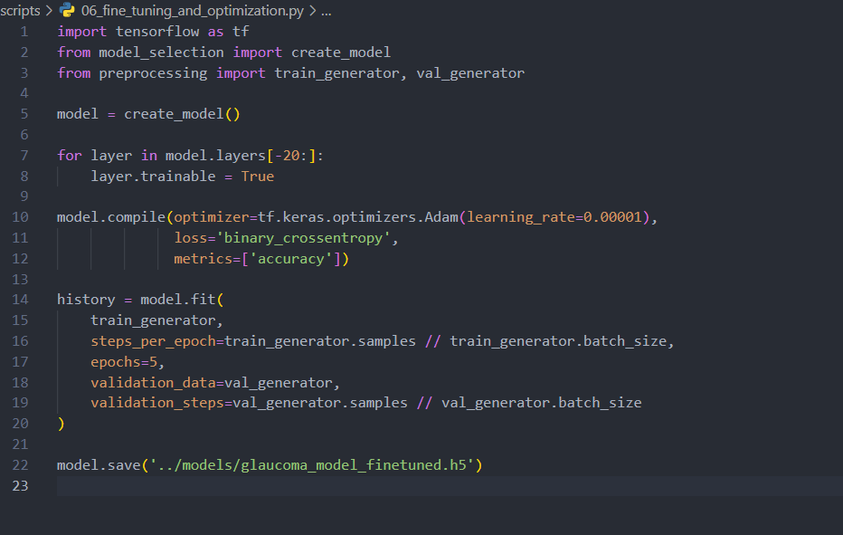
Fine-tunning

Slide 8
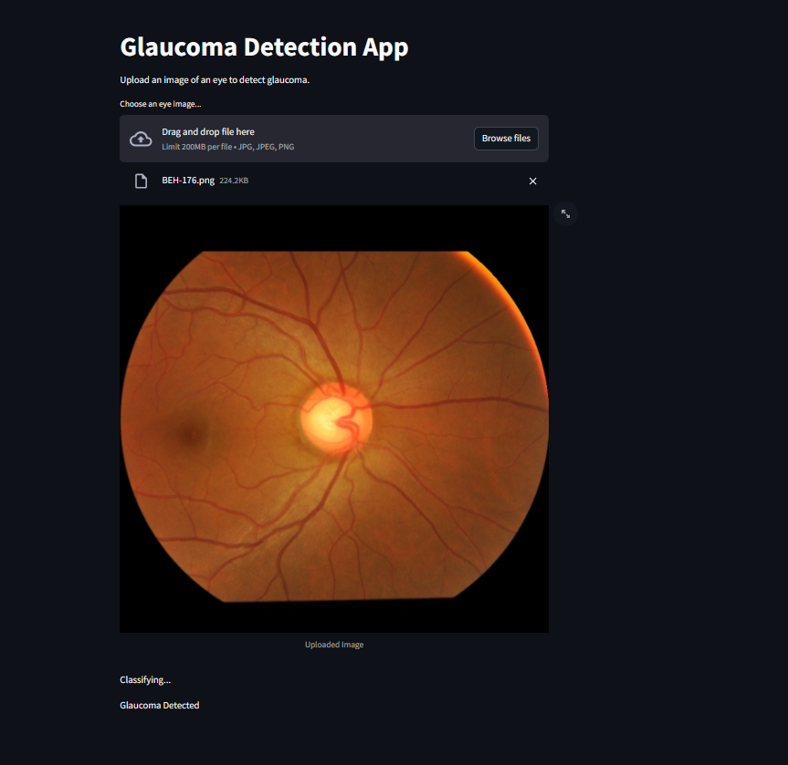
Conclusion

