Slide 1
Data Mining Assignment 2
Submitted By:
Dileshwori Joshi (28385)

Slide 2
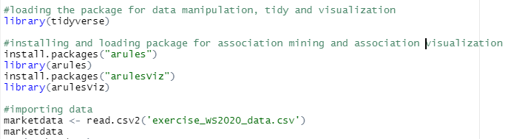
Importing the file
Fig 1: code snippet for installing packages and loading the file
Firstly, all the environment variables are removed from the environment.
All the required packages and libraries are installed and loaded which consists of tidyverse, arules and arulesviz.
tidyverse package is used here for data manipulation, and tidying.
arules and arulesviz package are used for association mining and visualizing association respectively.
Then the csv file is loaded, checked and analyzed.

Slide 3
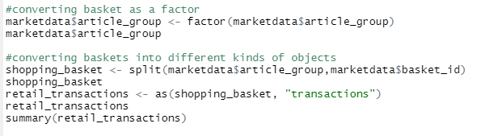
Data Conversion
Fig 2: Code snippet for conversion of the data into transaction type
The basket data is converted as factor to input as parameters to the split function.
After the split is done, the data frame is converted to transactions to ease the association rule mining.

Slide 4
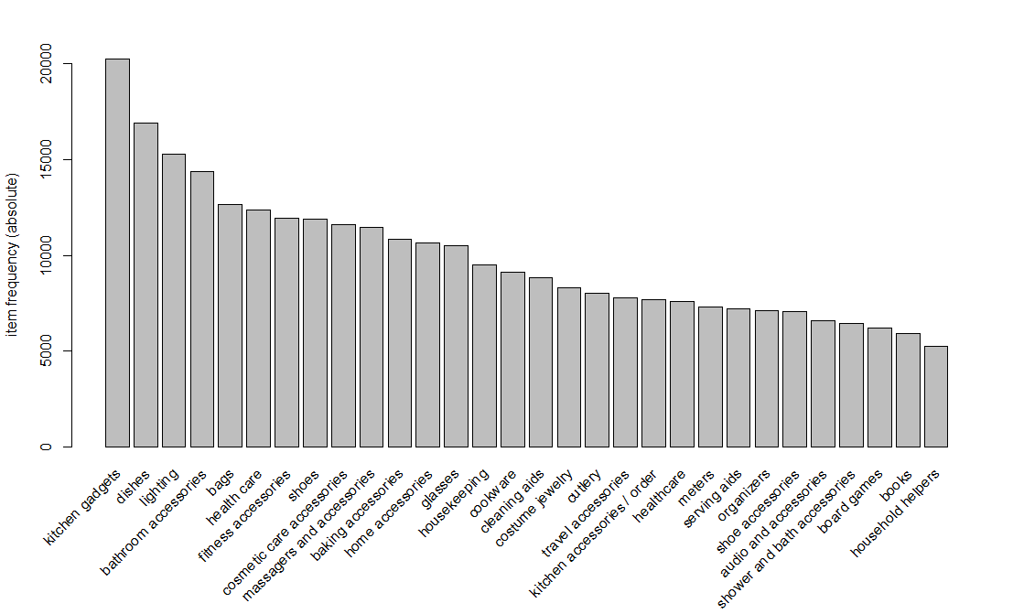
Data Visualization
Fig 3: Data visualization for top 30 frequently bought items
The absolute item frequency of the top 30 items in the transactions is shown in the figure at the right.
The kitchen gadgets and dishes are highest bought item and household helpers is 30th frequently bought item.
So, to increasing the sales of cutlery items, retailer can put it near kitchen gadgets.
The summary(retail_transactions) function gave the top five items as Kitchen gadgets, dishes, lighting, bathroom accessories and bags with the frequencies 20250, 16898, 15312, 14375, and 12680 respectively.

Slide 5
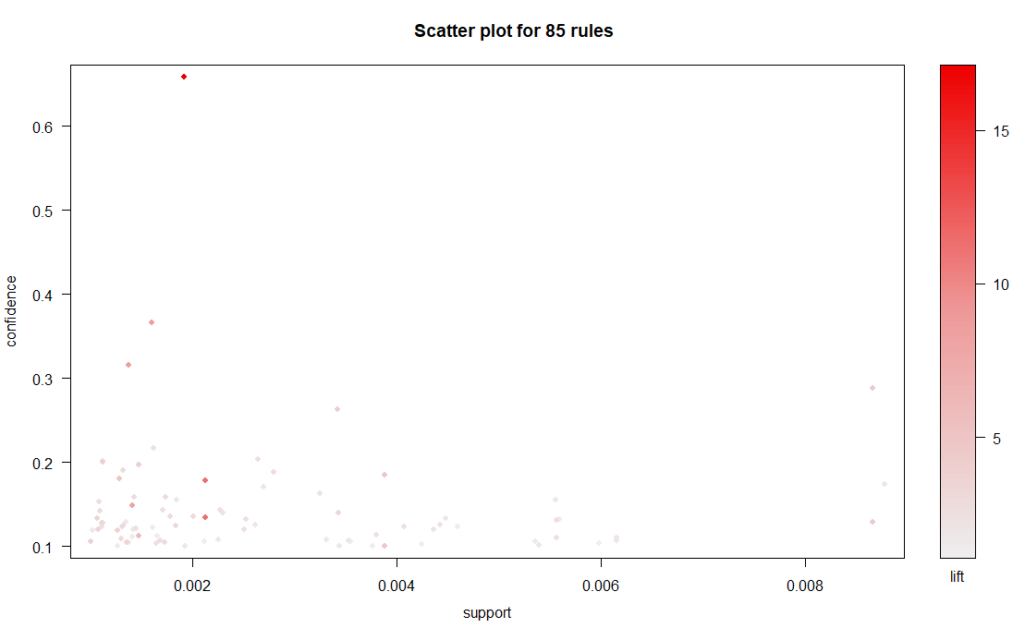
Association Rule visualization - I
Fig 4: Visualization of association rules with threshold support=0.001 and confidence=0.1
The scatter plot illustrates the 85 rules produced by apriori algorithm at support=0.001 and confidence=0.1
The darker the color of the circle, higher the value of the lift.
According to fig 4, the higher the correlation between the itemset (lift value), lower is the support.

Slide 6
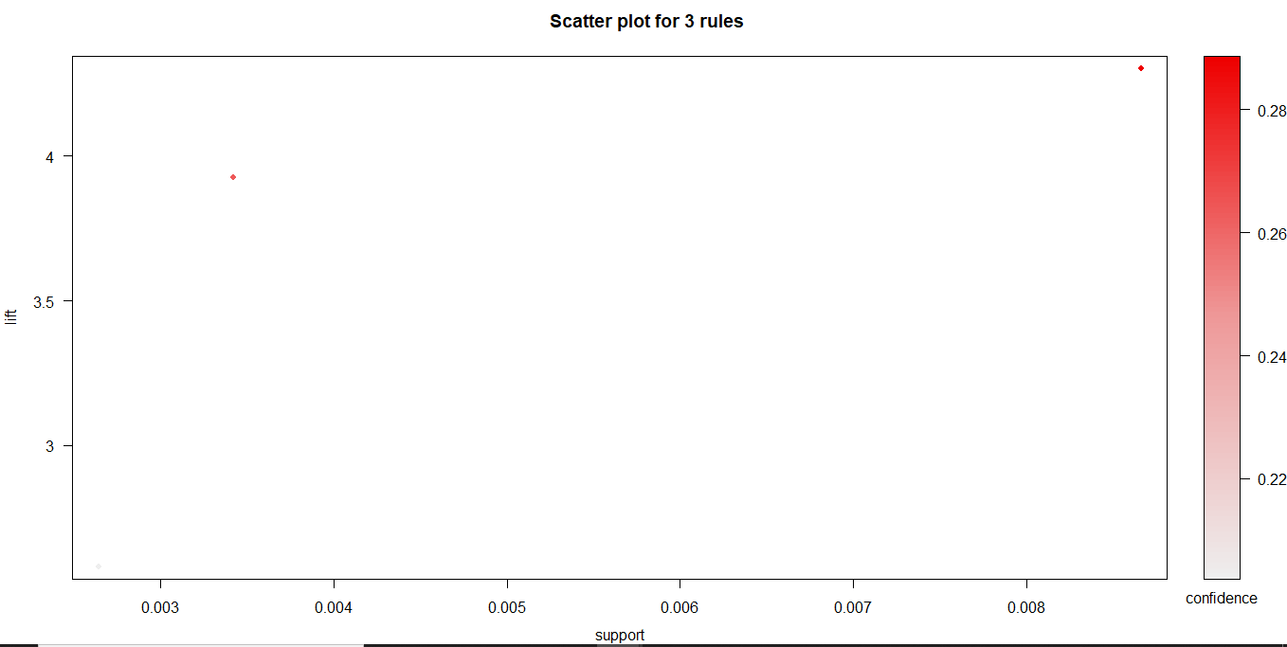
Association Rule Visualization - II
Fig 4: Visualization of association rules with threshold support=0.002 and confidence=0.2
The scatter plot illustrates the 3 rules produced by apriori algorithm at support=0.002 and confidence=0.2.
It shows only 3 rules at the minimum threshold support of 0.002 and min. threshold confidence of 0.2.
There is only one rule with high lift according to the fig 4.

Slide 7
Thank You

