Slide 1
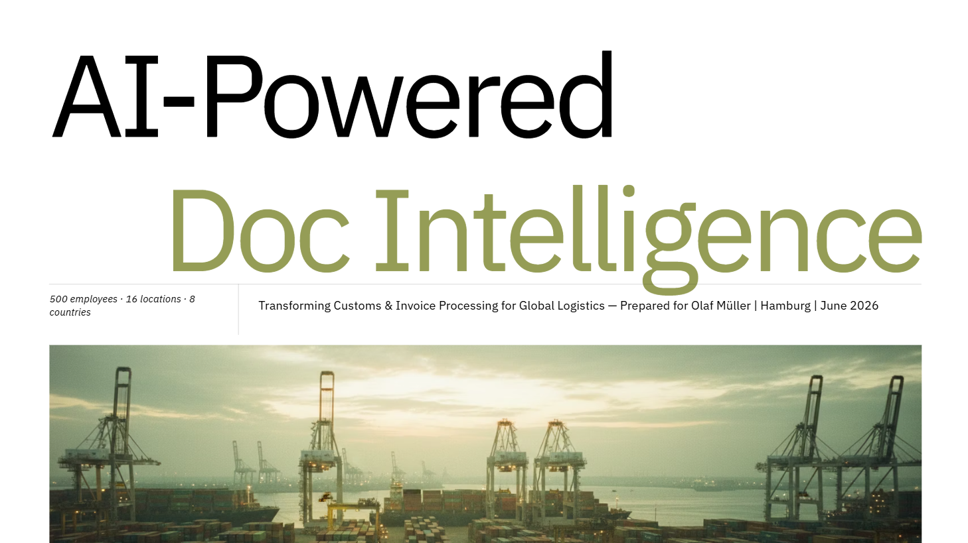

Slide 2
Everything shown so far has nothing to do with AI
=>
This is the current operational reality.
Now let me show you what changes.

Slide 3
How It Works
AI · Rules · Human
The Four-Stage AI Pipeline
01
02
03
04
AI
AI
Rules + AI
Human
Ingest &
Classify
Extract
Fields
Validate &
Score
Human
Sign-off
Monitors email, FTP, API & manual uploads. Classifies each document — invoice, B/L, declaration, packing list — before any extraction begins.
OCR converts scans to text. NLP extracts structured field values across all document types in EN, DE, FR and corridor languages.
Every field gets a confidence score: Green (auto-approved) · Orange (review flagged) · Red (manual entry). Cross-validation checks values, weights, HS codes and document completeness.
Licensed declarant reviews all Orange & Red fields with AI suggestion alongside source document. Legal submission under EU Union Customs Code. Corrections feed back to retrain the model.
CNN / Vision Transformer
OCR + NLP models
Traffic-light routing
EU UCC compliant

Slide 4
Timeline
16–18 months to full deployment · 40% conservative adjustment applied to all benchmarks
1 Discovery
2 Data Prep
3 PoC
4 Pilot
5 Rollout
6 Monitor
Wks 1–4
Wks 5–8
Wks 9–18
Wks 19–34
Mo 8–16
Mo 4+
Stakeholder interviews, doc audit, vendor shortlist, go/no-go
Document samples, GDPR/POPIA review, TMS field mapping, DPA signed
Model build, extraction test, validation incl. degraded docs & multi-regime
Germany–South Africa live corridor, parallel run, go-live Wk 23
Canada/USA → France → African corridors. 3–4 wks per corridor
Monthly KPIs, quarterly accuracy audits, Opportunity 2 readiness Mth 12
Key milestones
Go/no-go
DPA signed
PoC sign-off
Pilot go-live
First ROI data
Full network
Wk 4
Wk 8
Wk 18
Wk 23
Wk 28
Mo 16

Slide 5
Estimated Costs
Year 1 total · 30% contingency included · actual costs confirmed in Phase 1 vendor assessment
Cost Component
Low
High
Conservative
Platform / SaaS licence (annual)
€18,000
€60,000
€95k – €115k
Direct API, single vendor SaaS
Implementation & integration
€15,000
€45,000
Internal staff time
€38,200
€68,200
Base Case
€145k – €175k
Training & change management
€3,000
€8,000
Medium integration, full legal review
Legal / DPA review
€2,000
€6,000
High Complexity
Contingency (30%)
€22,000
€57,000
€195k – €240k
Total Year 1
€95,200
€239,200
Custom TMS build, scanning infra
Ongoing Year 2+
€20k – €65k / year
Platform licence + maintenance only

Slide 6
