Slide 1
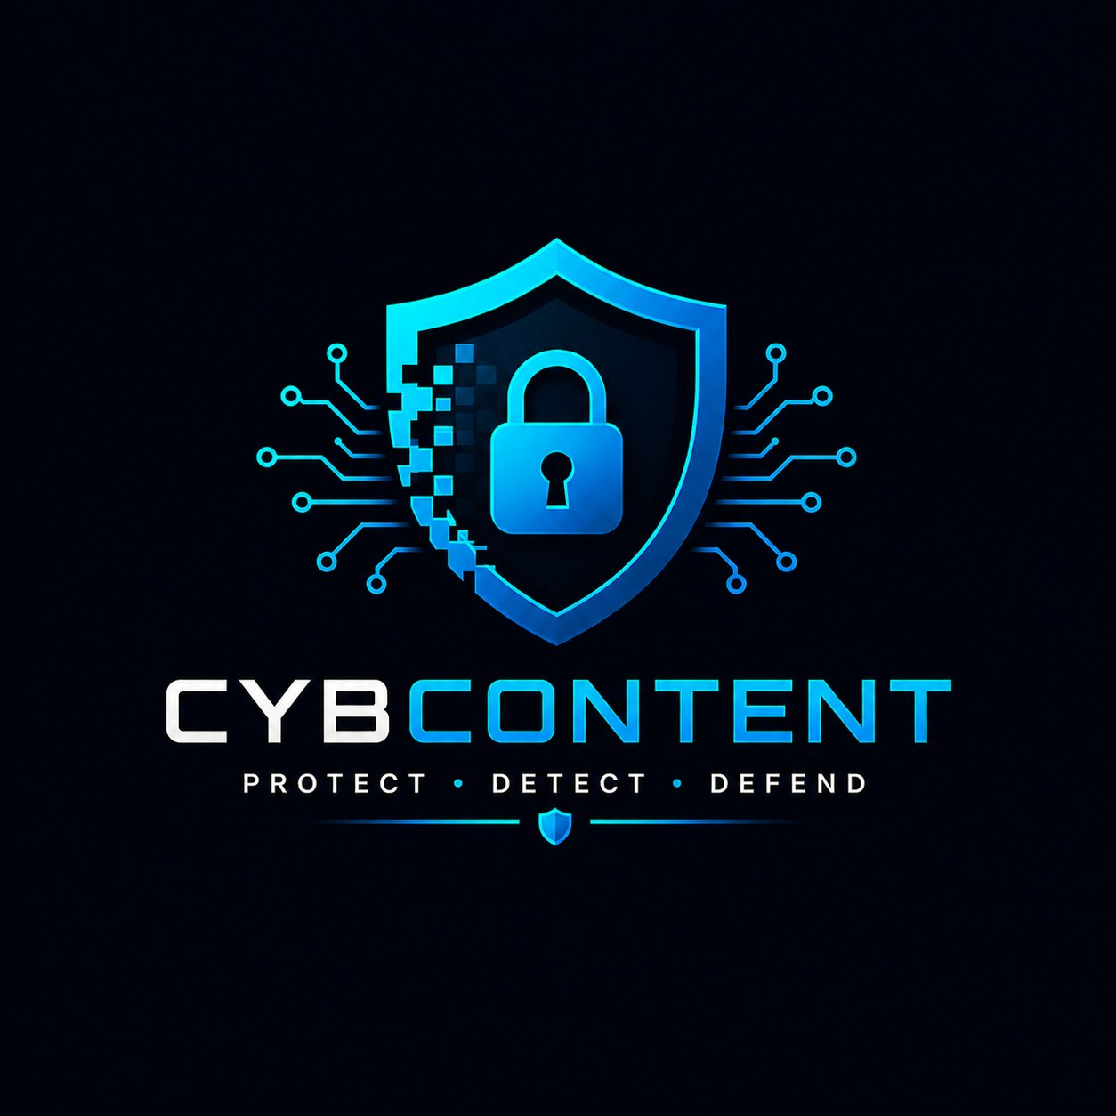

AI Content Creator
for Cyber Security
Brand-aligned, non-generic content
powered by a two-tier knowledge base
PROTECT · DETECT · DEFEND
Client:
CybContent | 2026

Slide 2
01 WHO WE ARE
Meet CybContent
A cybersecurity content agency that produces
brand-aligned, distinctly non-generic content
for security companies.
Dilia
Ankita
Oli
Madhuri
Co-Founder
Co-Founder
Co-Founder
Co-Founder
Our Client
IronVeil Security — a cybersecurity company specializing in EDR, ITDR, and MDR for mid-market companies.
CybContent | Confidential

Slide 3
02 KNOWLEDGE BASE ARCHITECTURE
Two-Tier Knowledge System
PRIMARY KB
SECONDARY KB
brand_guidelines.md — voice ,tone and banned phrases
product_specs.md — differentiators and positioning
past_content/performance_data.md — historical
content analytics
market_trends.md — threat landscape & budget
competitor_analysis.md — positioning and content gaps
↔
grounded
context
CybContent | Confidential

Slide 4
03 PIPELINE DEMONSTRATION
Five-Stage Content Pipeline
1
Analyze trends & competitors → 5 ranked content opportunities
Full-context generation via selected template + human review
Refine on feedback; surfaces brand-guideline conflicts
2
3
4
5
Document
Monitor
Brief
Publish
Iterate
Ingest & index all KB .md files by type, category & keyword
Generate structured brief: title, angle, key points, CTA
$ python src/main.py run --topic "Alert fatigue is a leadership failure" --template blog_post_ciso
CybContent | Confidential

Slide 5
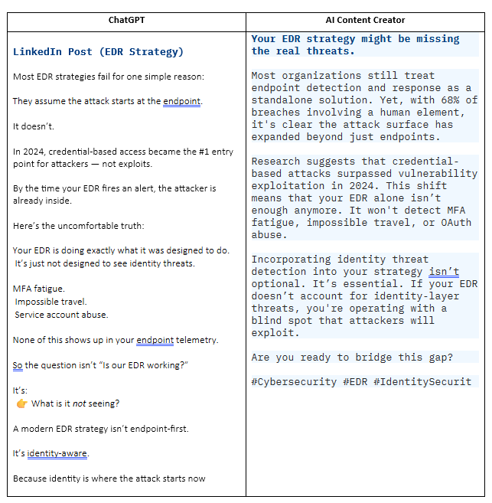
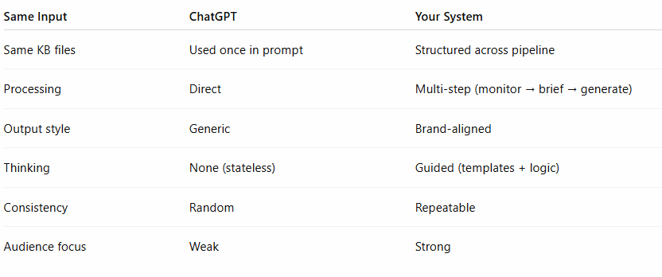
04 UNIQUENESS DEMONSTRATION
Why we are Unique
Side-by-side diff available at: diff.pdf (shared in Slack)
CybContent | Confidential

Slide 6
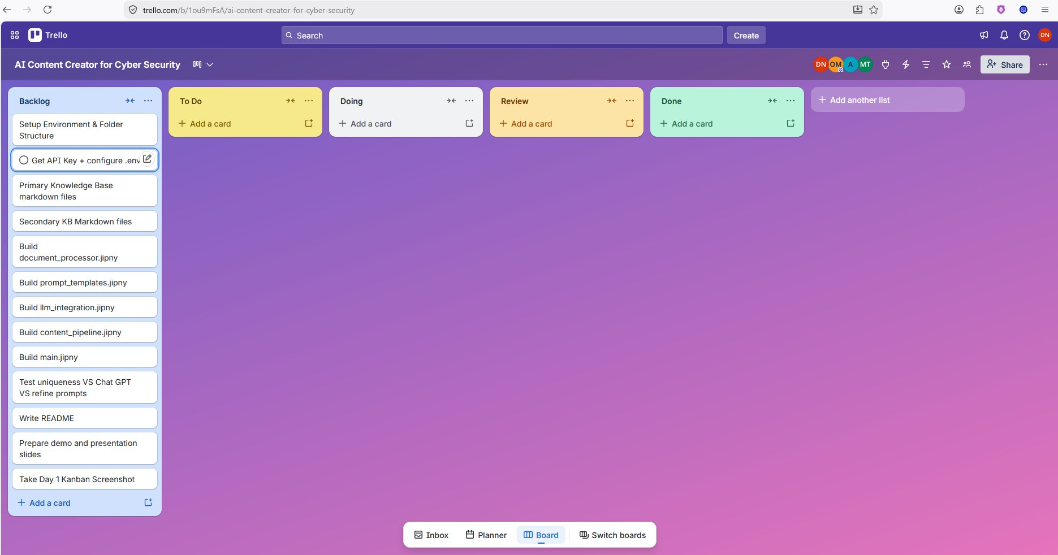
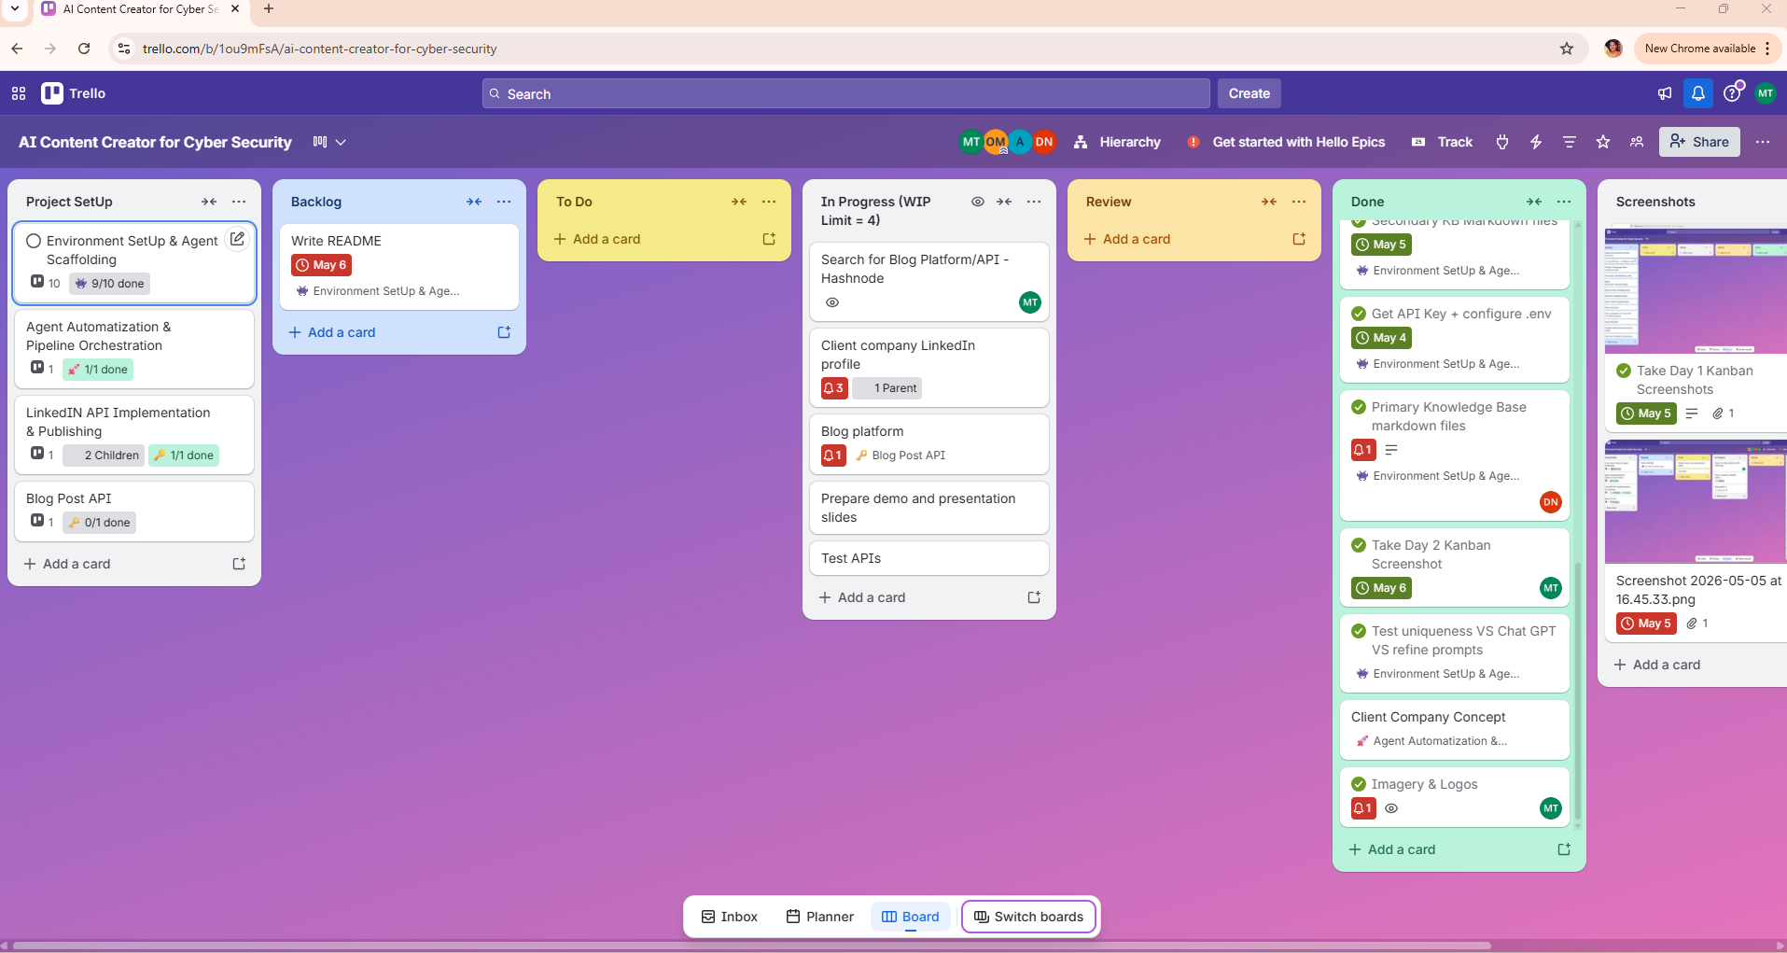
05 KANBAN BOARD
Workflow Evolution: Day 1 → Day 2
END OF DAY 1 — Backlog Only
END OF DAY 2 — Flow Established
Key shift: from a flat backlog to hierarchical epics with WIP tracking, Definition of Done, and multi-column flow.
CybContent | Confidential

Slide 7
06 TECHNICAL IMPLEMENTATION
Stack & Prompt Engineering
🐍
🤖
🎨
📚
Python
OpenAI GPT-4o
Gradio UI
Markdown KB
Pipeline orchestration
CLI via main.py
LLM backbone
Retry + token tracking
app.py web interface
Human review step
Auto-discovered docs
Section-level retrieval
Anti-Homogenization Strategies
→ Hard-coded anti-patterns:
→ KB grounding:
NEVER: "In today's landscape", "robust", "cutting-edge", "leverage"
Every generation injects both KB layers for forced specificity
→ Audience-Specific Structure:
→ Human-in-the-loop:
CISO vs SOC Analyst templates enforce different structures & references
Pipeline stops for review; iterate template surfaces brand conflicts
CybContent | Confidential

Slide 8
07 CHALLENGES & LEARNINGS
Technical Challenges & How We Solved Them
01
Generic AI output tone
→ Hard-coded forbidden phrase lists in system prompts + KB grounding force specificity at every generation call
02
Prompt Context Overflow
→ Two-tier KB with targeted retrieval — only inject relevant sections, not entire documents, to stay within token limits
03
Brand Voice Consistency
→ Audience-specific templates (CISO vs SOC Analyst) with structural constraints; one analogy rule, one counterintuitive point rule
04
Human Review Integration
→ Pipeline pauses after Stage 4; feedback fed into dedicated iterate_and_refine template that flags brand conflicts explicitly
05
Measuring Uniqueness
→ Side-by-side diff against raw ChatGPT output; internal scoring rubric for brand alignment, specificity, and competitive angle
CybContent | Confidential

Slide 9
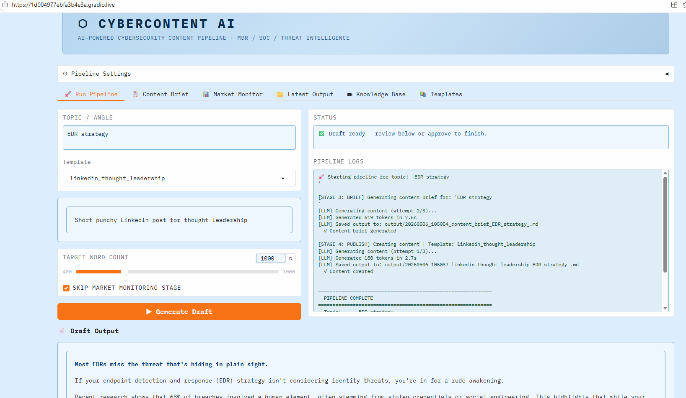
08 Demo UI
A Live Content Pipeline -> from KB to Published
KB are loaded
Maret Scrapping
Pick oEnter a pic
Select an Audience
Select Pubshing Platform
CybContent | Confidential

Slide 10
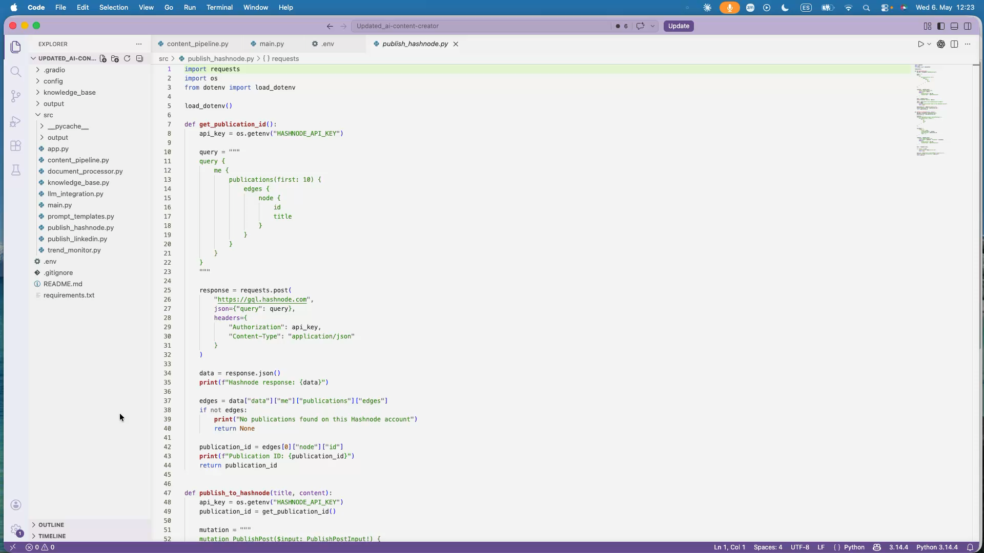
09 API INTEGRATIONS
Publishing an audience-tailored article in Hashnote
CybContent | Confidential

Slide 11
Questions?
We're ready to demo the pipeline live.
Cyber Content Team
Dilia · Ankita · Oli · Madhuri
Client:
PROTECT · DETECT · DEFEND

