Slide 1



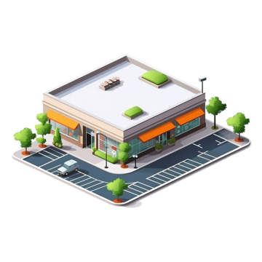










Retail Store
Hourly batch run schedule
Business User
JSON Flattening
Micro Batch 128 MB/ 60 sec
Event Trigger
Curated Layer
Archive Data
Stage Layer
RAW Layer
Archive Layer

