Slide 1
ODYSSEY – The Data Explorer
ODYSSEY – THE DATA EXPLORER
AI/BI Agent
WIPRO DATABRICKS HACKATHON 2026
TEAM: DOUBLE IMPACT
THEME: AI/BI Agent
TEAM MEMBERS: Kondala Sravani, Dilip A

Slide 2
ODYSSEY – The Data Explorer
PROBLEM STATEMENT
To build a "Talk to your Data" application using the AI/BI Genie and Databricks Dashboards.
This agent should allow business users to ask ad-hoc, natural language questions about key performance indicators (KPIs) and receive dynamic, context-aware insights, moving beyond static reports.
OBJECTIVES
To enable users to ask natural language questions and convert them into SQL queries on Delta tables.
To enable users, interact with dashboards using chat commands
To generate narrative summaries of KPIs
To generate predictive responses Predictive/what-if analysis
To Implement validation while answering BI queries, LLM enforcing governance

Slide 3
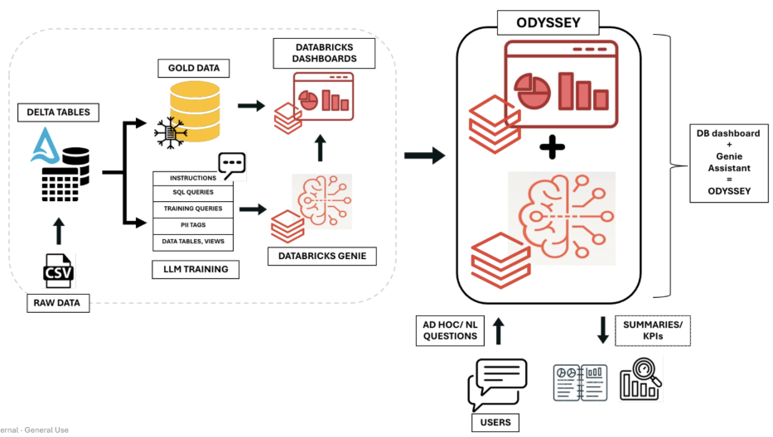
ODYSSEY – The Data Explorer
PROPOSED SOLUTION - ODYSSEY

Slide 4
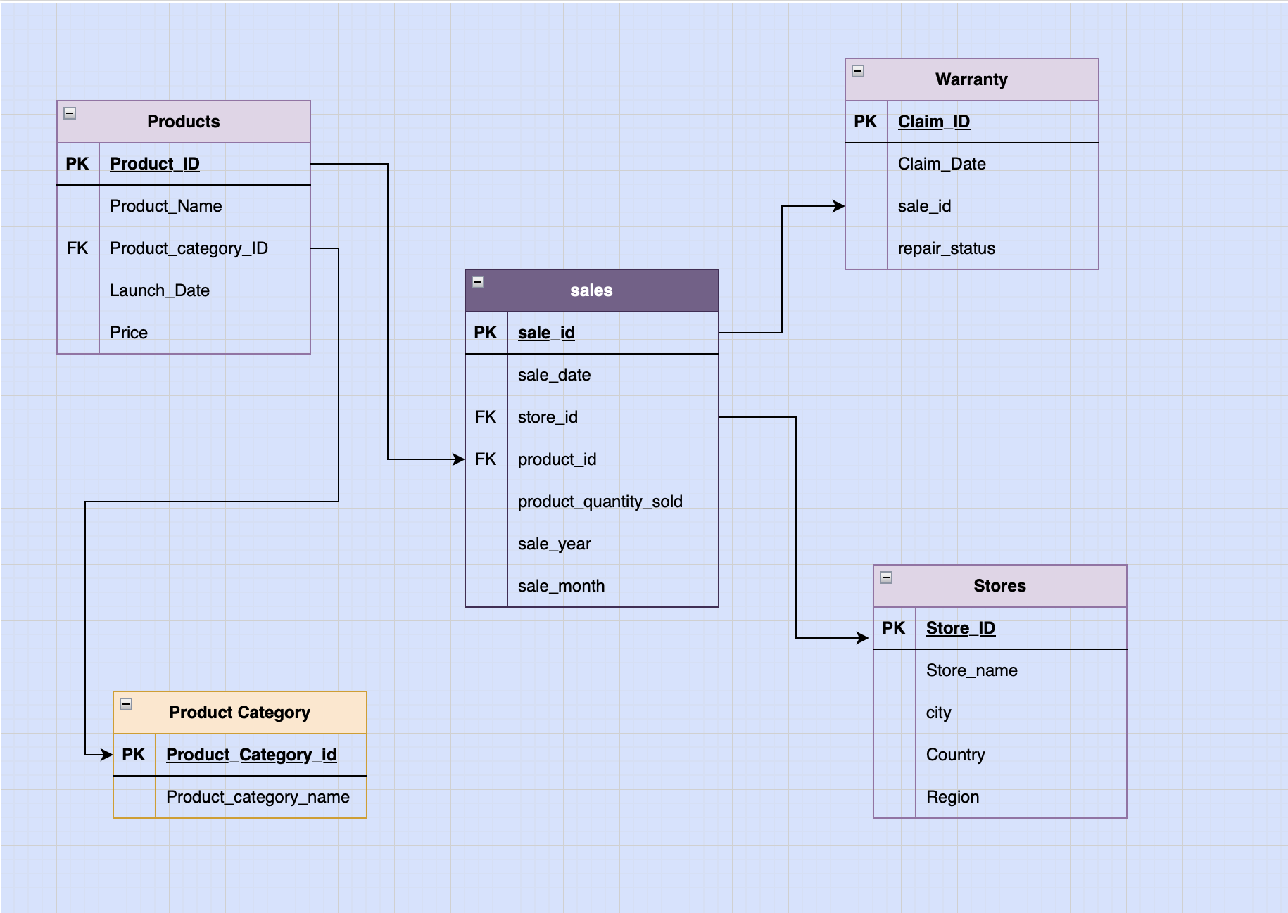
ODYSSEY – The Data Explorer
TECH STACK & IMPLEMENTATION
Data Type: Apple Retail and sales data – 1M+ Rows
Data Modelling: Snowflake Schema
Tools, Languages, Framework: Databricks Genie, Databricks Dashboards, Delta Table, SQL, Unity Catalog, Perplexity, Draw.io

Slide 5
ODYSSEY – The Data Explorer
KEY FEATURES & DEMO
ODYSSEY is an interactive Dashboard which allows the user to know Executive Summary as well as In detail performances. Additionally, an agent to interact with dashboards using chat commands
ODYSSEY is an AI/BI agent which users to ask natural language questions and convert them into SQL queries on Delta tables.
ODYSSSEY generates narrative summaries, KPIs and in detail performance metrics using the Data provided in real time.
ODYSSEY ensures validation while answering BI queries and uses LLM intelligence in enforcing governance. As a result of which the PII data secured and not compromised.
ODYSSEY generates Predictive/what-if analysis responses learning the curves in data and provides real time responses.

Slide 6
ODYSSEY – The Data Explorer
IMPACT
Boosts Decision Making Speed – Users get insights faster using natural language.
Data Security – PII Data protection while analysis.
Drives Business values – Predictive and What if analysis for forecast outcomes.
Improves accessiblity – Non Tech users can get insights with knowing SQL
Scales easily – Handles 1M+ rows with near real time responses.
Increases Productivity – Less Time spent on querying manually
FUTURE SCOPE
Feedback Loop – We can improve the AI agent accuracy with user feedback
Data Sources - Many other Data Sources can be added (CRM, Sales, customer feedback)

