Slide 1
PROJECT CHATBOT
PRESENTED BY
DILIP CHALAMALASETTY
UNDER THE GUIDANCE OF RAHUL VANPULLY (ASSOCIATE PROCESS MANAGER AT eClerx)

Slide 2
TECHNOLOGIES USED
WEB TECHNOLOGIES
MACHINE LEARNING TECHNOLOGIES
NO SQL DATABASES

Slide 3
WORK DONE BY USING WEB TECHNOLOGIES
WE USED ANGULAR TO CREATE THE WEB INTERFACE SO THAT THE USER CAN COMMUNICATE WITH THE BOT
WE USED NODEJS TO FACILITATE THE RUN TIME ENVIRONMENT FOR OUR PROJECT.
WE USED KOA AS AN SERVER WHICH DEALS WITH THE DATABASES AND COMMUNICATE WITH ALL THE RUNNING SERVERS.

Slide 4
WORK DONE BY USING MACHINE LEARNING TECHNOLOGIES
SPACY
IT IS USED FOR PREPROCESSING OF TEXT.
IT IS NLP PACKAGE
RASA
IT IS USED FOR INTENT CLASSIFICATION, ENTITY EXTRACTION, AND FINDS THE REQUIRED ACTION NEED TO BE TAKEN.
IT IS NLU PACKAGE (NATURAL LANGUAGE UNDERSTANDING)
SPACY HAVE DIFFERENT SIZE INBUILD MODELS WHICH ARE MOSTLY PREFERRED BASE ON OUR NEED.

Slide 5
USE OF NO SQL DATABASES
ELASTIC SEARCH
WHICH IS USED TO GIVE SUGGESTIONS BASED UPON THE USER INPUT IN THE TEST BOX.
NODEJS SERVER WILL TRIGGER THE ELASTICSEARCH DATABASE SERVER EVERY 2 SECONDS WHEN THE USER IS TYPING.
MONGODB
WHICH IS USED TO STORE THE DATA OF THE USRS AND CHATLOGS

Slide 6
NUMBER OF SERVERS RUNNING FOR THIS PROJECT
ANGULAR SERVER
NODEJS FOR ADMIN PAGE
ELASTICSEARCH SERVER
MONGODB SERVER
RASA SERVER
RASA CUSTOM ACTION SERVER

Slide 7
WORKING OF PROJECT
1.Initially the user interface is kept live by running the angular server.
2.User will interact with the chatbot by entering the message into the textbox.
3.While user entering the message the node server running behind will trigger the elastic search to get the suggestions for the user same as google show suggestions while you are searching for something.
4.After entering message it will be handled by the rasa server which is also running behind the scenes to find the intent , extract entities and find the custom action that need to be performed.

Slide 8
WORKING OF PROJECT
5. The replay is given but by custom action and the chatlogs will be stored in the mongodb.
6. The admin node server is used to handle the api request of login, register and the chatlogs api.
7. The spacy is used in the pipeline of rasa model which is used for text preprocessing .

Slide 9
WORK DONE BY ME
RASA (NATURAL LANGUAGE UNDERSTANDING)
WRITTEN THE CODE FOR CUSTOM ACTION EG:EXTRACTING USER DATA BY UNDERSTANDING THE MESSAGES OF THE USER
WRITTEN THE COMPONENT WHICH IDENTIFIES THE SENTEMENT OF USER INPUTTED MESSAGE.
WRITTEN THE CODE TO TRAIN THE RASA MODEL DIRECTLY EXTRACTING DATA FROM THE DATABASE AND SEND THAT DATA TO THE REST API THEN THAT REST API WILL HANDLE THAT DATA TO TRAIN THE MODEL.
WRITTEN THE CONTENT OF THE STORIES.MD FILE WHICH IS THE CORE PART FOR THE TRAINING.

Slide 10
WORK DONE BY ME
ELASTIC SEARCH QUERIES
WRITTEN THE QUERIES FOR FETCHIG THE SUGGESTING DEPENDING UPON THE USER INPUT.
WRITTEN THE QUERIES FOR ALL THE CRUD OPERATIONS.
NODEJS
MADE THREE REGISTER,CRUD API USING NODEJS ,EXPRESS AND MONGOOSE
TESTED THIS API BY USING POSTMAN SOFTWARE TOOL FOR CHECKING THE API.

Slide 11
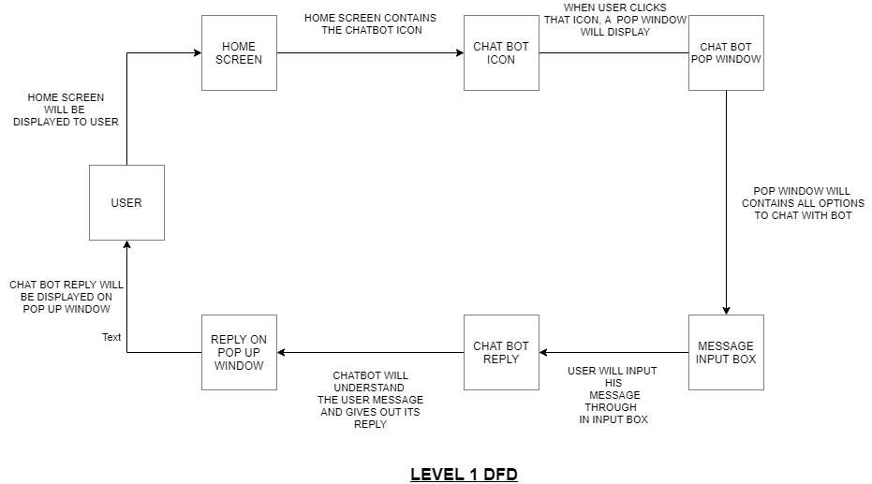

Slide 12
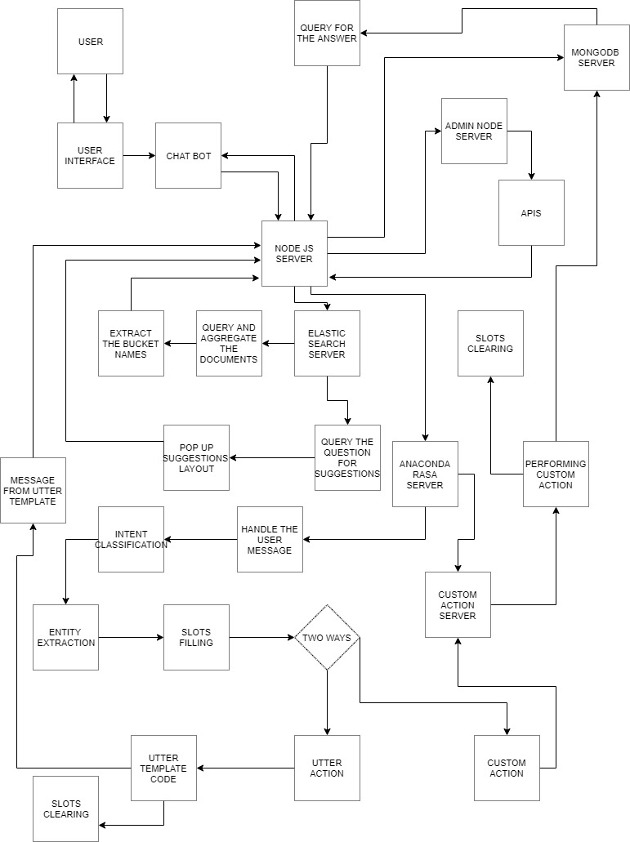
LEVEL 2 DFD OF OUR PROJECT

Slide 13


THANK YOU FOR LPU , FOR BRINGING COMPANIES VERY EARLY AND PROVIDING US THE CHANCE TO DO LIVE PROJECTS BEFORE COMPLETION OF OUR GRADUATION.

