Slide 1
SURVEY ON IPL
GROUP 14
Team Members
DILIP KUMAR REDDY (ES20BTECH11020)
BANU BHARADWAJ (ES20BTECH11021)
CH VAMSI (ES20BTECH11011)
T VARUN REDDY (ES20BTECH11028)
B DEVAKI (ES20BTECH11008)
G SAI SRAVYA (ES20BTECH11013)
R PRASHANTH (CS19BTECH11042)
G SREE TANAY (ES20BTECH11014)

Slide 2
Survey Method
The data required for the project was collected by conducting a survey.
Data collection was done by rolling out a Google form by mail to the IITH community.
We received a total of 272 responses.
Except for gender, age, and program, no other personal information was recorded from the participants.
The questionnaire had 3 questions for the demographic characteristic of the participants and the rest 13 aimed to understand their favorites such as team, player, batsman, etc. and their opinions on the greatest players of the league and betting.

Slide 3
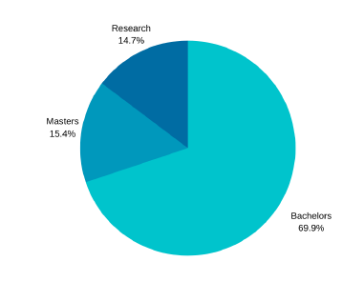
Visualizing the Data
Out of the 272 responses received, 226 (83%) were from males and the remaining 46 responses (17%) were from females.
Out of the 272 responses received, 190 (69.9%) were from bachelors, 42 (15.4%) responses were from masters, and the remaining 40 (14.7%) responses were from research.

Slide 4
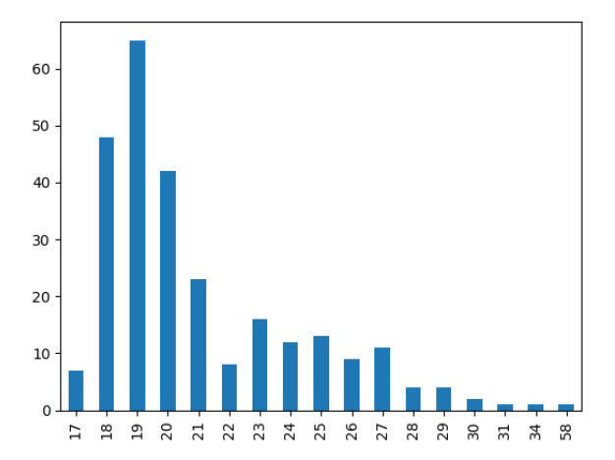
Age vs No. of participants is distributed as shown in the bar graph below. Most responses are from the age group of 18-20 which includes 156 (57.4%) responses among the total.
Below are the statistics for the number of matches watched in a week by the participants:
Mean: 4.95
Standard deviation: 2.83
1st Quartile: 3.00
Median: 4.00
3rd Quartile: 7.00

Slide 5
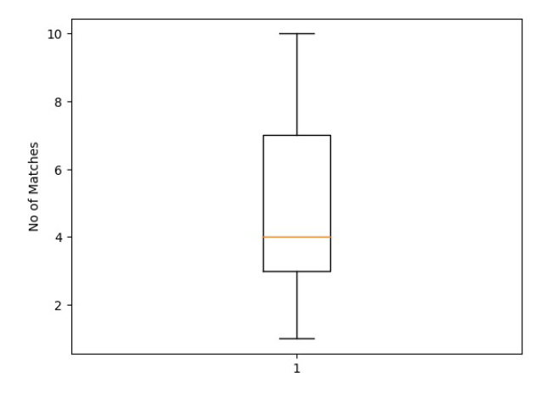
Below is the box plot for this data:

Slide 6
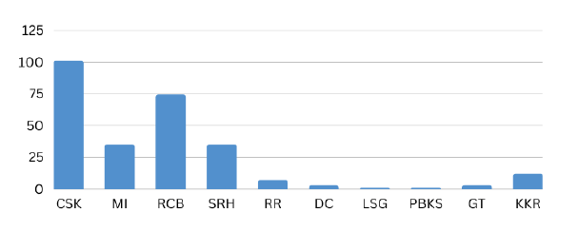
101 (37.1%) of participants chose CSK as their favorite IPL team with RCB being the second highest chosen team with 74 (27.2%) responses.
LSG and PBKS are the least favorite teams with just one favourable response each among 272 responses.
Below is the bar corresponding bar graph:

Slide 7
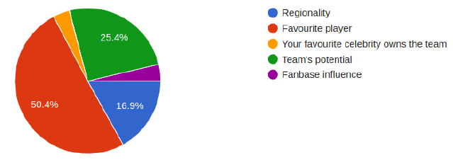
Out of the 272 responses received, 137 (50.4%) participants liked their favorite team because of their favorite player.
Fan base influence and celebrity influence come out to be the least possible reasons for liking their favorite team with just 10 (3.7%) responses each.
Below is the pie chart representing the reason for liking their favorite teams:

Slide 8
Below are the statistics on the opinions of participants on the greatest 5 players of the league:
For greatest captain, there are 201 (73.9%) responses favoring MS Dhoni and the second highest being just 30 (11%) responses for Rohit Sharma. The difference between the first two is 171 which clearly explains that the sample is biased towards just one player.
For greatest batsman, there are 92 (33.8%) responses favoring Virat Kohli and the second highest being 69 (25.4%) responses for AB De Villiers. The difference between the first two is 23.
For greatest bowler, there are 52 (19.1%) responses favoring Malinga and the second highest being 50 (18.4%) responses for Bumrah. The difference between the first two is just 2 which indicates that responses are more evenly distributed than the above two cases. Similar results can be obtained in the case of the greatest fielder and greatest all-rounder.

Slide 9

Analysing the Data
We analyze the percentage of fans for each team in IITH using the confidence interval.
Let’s take the case of CSK. Out of 272 responses, 101 responses are favorable for CSK, therefore the sample proportion for CSK is:
We use this sample proportion to estimate, with 95% confidence, the proportion p of IITH students with CSK as their favorite team.

Slide 10
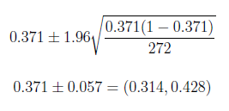
For α = 0.05, Zα/2 = 1.96. Therefore, the confidence interval of p is:
Thus, we can be 95% confident that between 31.4% to 42.8% of IITH students are fans of CSK. This interval can be calculated for other teams as well.
Note: For teams DC, LSG, GT, and PBKS, we cannot calculate confidence intervals for proportions since n*p < 5 for these teams.

Slide 11

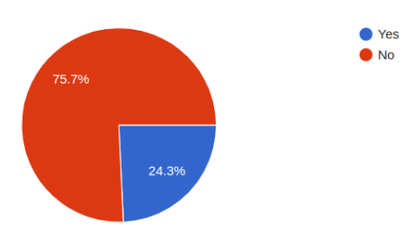
Now, we analyze the proportion of IITH students involved in IPL betting using confidence interval.
Out of 272 responses, 66 participants are involved in betting. Therefore, the sample proportion is:

Slide 12
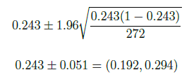
We use this sample proportion to estimate, with 95% confidence, the proportion p of IITH students involved in betting.
For α = 0.05, Zα/2 = 1.96. Therefore, the confidence interval of p is:
Thus, we can be 95% confident that between 19.2% to 29.4% of IITH students are involved in IPL betting.

Slide 13

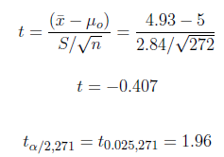
Hypothesis Testing 1
Now, we have a hypothesis that the average number of matches watched by IITH students per week is 5. Now, we want to test this hypothesis. Let μo be the average number of matches watched by IITH students per week.
We know ¯x = 4.95, S = 2.83 and n = 272. Taking α = 0.05 and μo = 5, the test statistic is given by:
Since t < tα/2,271 and t > -tα/2,271, we failed to reject null hypothesis H0.
Thus, we cannot conclude the alternate hypothesis H1. So, we cannot say that the average number of matches watched by IITH students per week is 5.

Slide 14



Hypothesis Testing 2
Now, we have a hypothesis that the average number of matches watched by IITH students per week is greater for the age group below 20 when compared with the age group above 20. Now, we want to test this hypothesis. Let μbelow20 be the average number of matches watched by IITH students per week in the below 20 age group and μabove20 be the other.
We know ¯xabove20 = 4.54, Sabove20 = 2.85, n1 = 108,¯xbelow20 = 5.19, Sbelow20 = 2.80, n2 = 164.
Since, 1/2 ≤ Sabove20/Sbelow20 , σabove20 ≃ σbelow20. So, the common standard deviation can be calculated as:

Slide 15
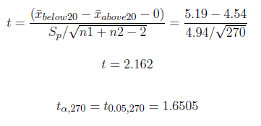
Taking α = 0.05, the test statistic is given by:
Since t > tα,270, we reject the null hypothesis H0.
Thus, we can conclude the alternate hypothesis H1. So, we can conclude that the average number of matches watched by below 20 years of IITH students per week is greater than that of those above 20 years students.

Slide 16



Hypothesis Testing 3
Here, we have a hypothesis that the average number of matches watched per week is more for Bachelors than Masters and Research students in IITH. Let us test this hypothesis: Let μbachelors be the average number of matches watched by the Bachelors in a week and let μpg be the average number of matches watched by Masters and Research students in a week.
We see that, from the sample, ¯xbachelors = 5.217, Sbachelors = 2.806, n1 = 190, ¯xpg = 4.329, Spg = 2.789 and n2 = 82.
Here also, we can say that variances are similar. Since, 1/2 ≤ Spg/Sbachelors, σbachelors ≃ σpg. So, the common standard deviation can be calculated as:

Slide 17
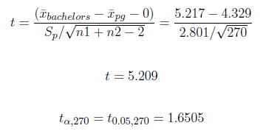
Taking α = 0.05, the test statistic is given by:
Since t > tα,270, we reject the null hypothesis H0.
Thus, we can conclude that the average number of matches watched by Bachelors in a week is greater than the average number of matches watched by Masters and Research students in a week in IITH.

Slide 18



Hypothesis Testing 4
Now, we have a hypothesis that the average number of matches watched by male in a week is greater than the number of matches watched by female in a week in IITH.
Let μmale be the average number of matches watched by the male students in a week and let μfemale be the average number of matches watched by female students in a week.
We see that, from the sample, ¯xmale = 5.133, Smale = 2.825, n1 = 225, ¯xfemale = 4.043, Sfemale = 2.675 and n2 = 47.
Here also, we can say that variances are similar. Since, 1/2 ≤ Sfemale/Smale, σmale ≃ σfemale. So, the common standard deviation can be calculated as:

Slide 19
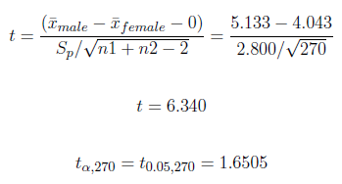
Taking α = 0.05, the test statistic is given by:
Since t > tα,270, we reject the null hypothesis H0.
Thus, we can conclude that the average number of matches watched by male students in a week is greater than the average number of matches watched by female students in a week in IITH.

Slide 20
THANK YOU

