Slide 1

Customer segmentation
1
By: -Dilip Kumar

Slide 2
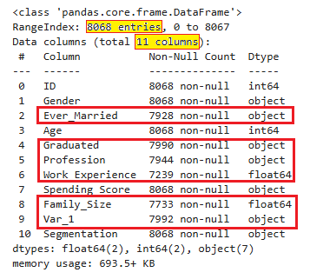
Customer segmentation
2
Sanity Check & Data Cleaning
Total No. Of Rows : 8068
Total No. Of Columns : 11
Missing Values Found in: 6 columns
No. Of Numeric Type columns: 4
No. Of Object Type columns: 7
No Duplicate Records Found

Slide 3
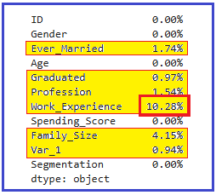
Customer segmentation
3
Missing Imputation
6 Features as Missing Values
Ever_Married (Object Type)
Graduated (Object Type)
Profession (Object Type)
Wrok_Experience (Fload64 Type)
Family_Size (Fload64 Type)
Var-1 (Object Type)
How handled missing imputation?
For Numeric: Replaced with Mean after doing outlier treatment
For Object Type: Ever_Married Graduated replaced with Replace Using a Probabilistic Approach
because both has either Yes No as values hence can be replaced with probabilistic approach.
For Object Type: Ever_Married Graduated replaced with Replace Using a Probabilistic Approach
because both has either Yes No as values hence can be replaced with probabilistic approach.

Slide 4
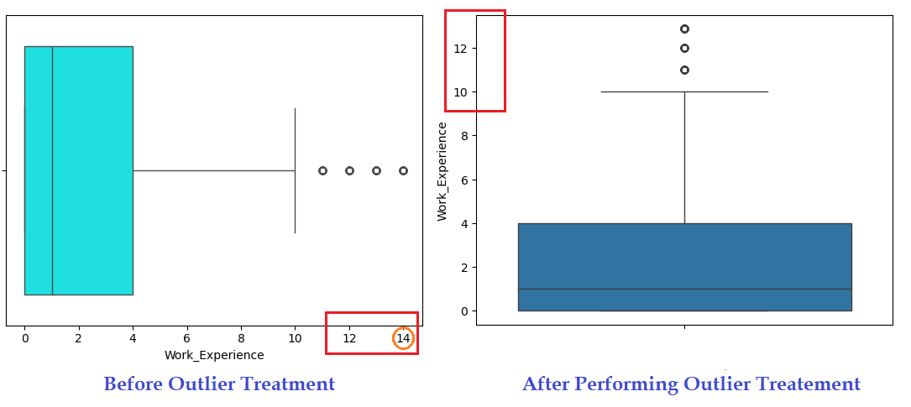
Customer segmentation – Missing Imputation
4
How handled missing imputation?
For Numeric: Replaced with Mean after doing outlier treatment

Slide 5
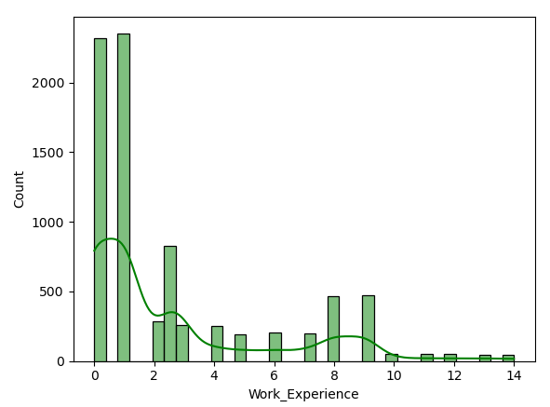
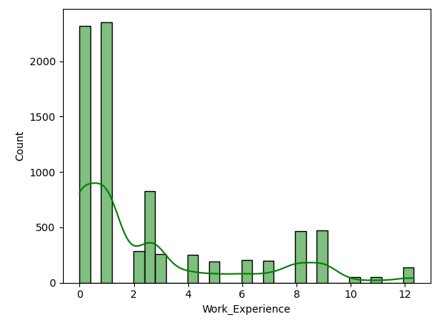
Customer segmentation
5
Verifying the distribution after treating outlier: Right skewers has been normalized from 14 to 12

Slide 6
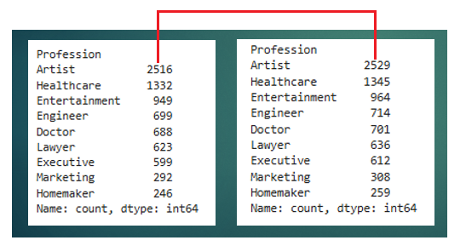
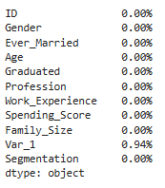
Customer segmentation – Missing Imputation
6
How handled missing imputation?
For Object Type: Ever_Married, Var_1 & Graduated replaced with
Replace Using a Probabilistic Approach because both has either Yes or No
hence can be replaced with probabilistic approach (max occurrence)
For Object Type: Profession missing value imputation by distributing them equally among the categories.
All Missing Values Treated

Slide 7
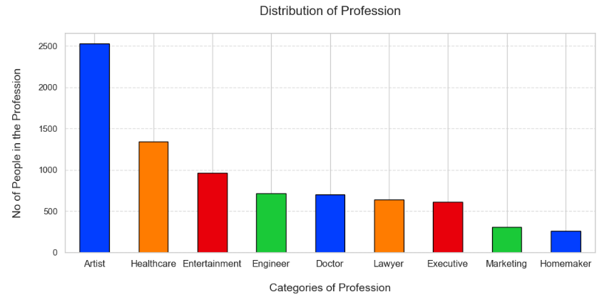
Customer segmentation
7
Distribution of Profession:
Observation:
Top most customers are an artist.
Second Segment of Customers are Engineer, Doctor, Lawyer and Executive.
Third Segment of Customers are from Healthcare and Entertainment
Last Segment of Customers are from Marketing and Homemaker

Slide 8
Customer segmentation
8
Performed One Hot Encoding using getDummies()
Gender
Profession
Spending_Score

Slide 9
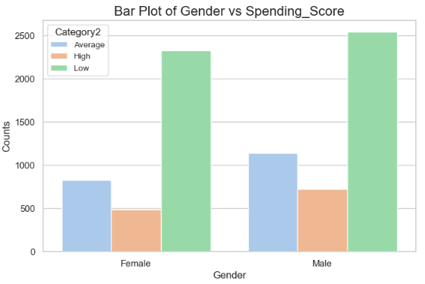
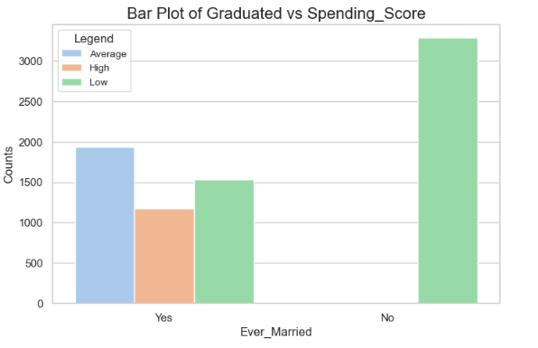
Customer segmentation
9
Male Vs Female Spending Score
Ever Married Vs Spending Score
Observation: Male expends more in compare of females.
Observation: Married people has more spending then
unmarried.

Slide 10
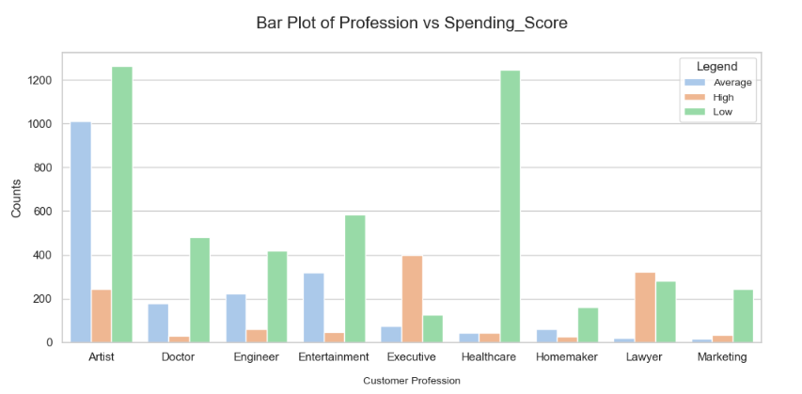
Customer segmentation
10
Profession Vs Spending Score

Slide 11
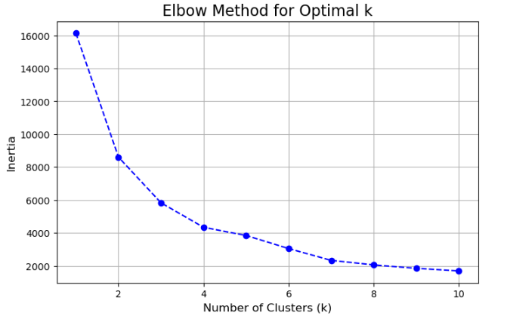
Customer segmentation
11
Optimal K value should be 3 or 4

Slide 12
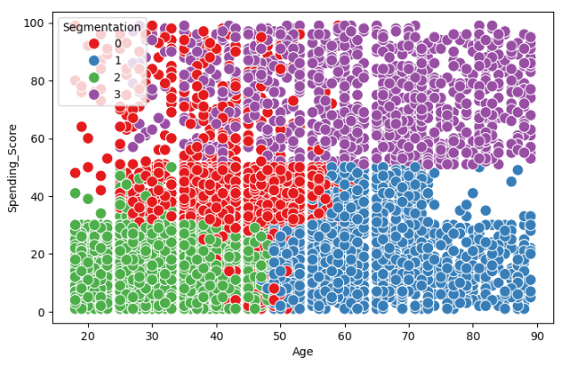
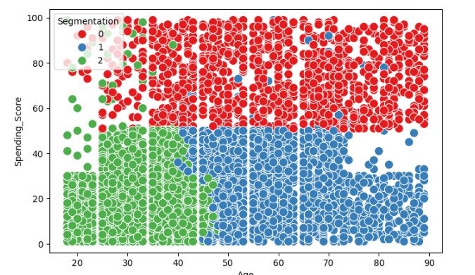
Customer segmentation
12
Segmented with K value as 4
Segmented with K value as 3
Plot with K value as 3 looks perfect hence can be use.

Slide 13
Thank You
13

