Slide 2
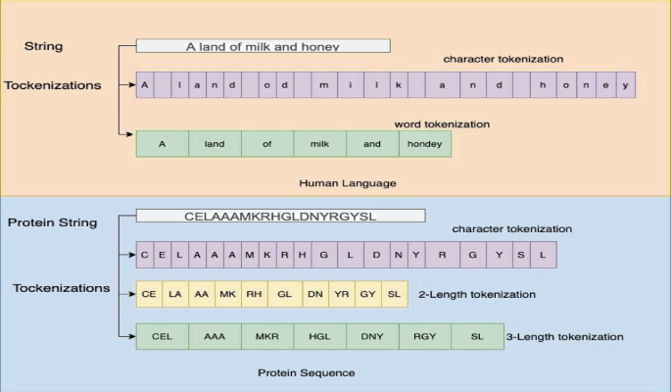

Slide 3
Input encoding
One-Hot Encoding:
With one-hot encoding, we might start with a larger number of filters to capture various patterns from the basic amino acid identities. But this is just a way to identify amino acids and no biologically significant data can be encoded this way.
Physicochemical Property Vectors:
If we use property vectors, the kernels can be designed to capture patterns based on the numerical values of these properties, for instance, a kernel might learn to detect a sequence of hydrophobic amino acids.

Slide 4
Applications of CNN on Protein Sequences
Motif Discovery:
CNNs can learn motifs from sequences and be used in tasks like transcription factor binding site prediction.
Protein Function Prediction:
CNNs can be trained to predict protein functions based on their sequences.
Protein-Protein Interaction Prediction:
CNNs can be used to model protein interactions by analyzing sequence embeddings.
Protein Homology Detection:
CNNs can be used to identify proteins with similar sequences and potentially similar functions.

Slide 5
Complexity
To accurately predict a protein property (e.g., solubility, binding affinity), you might prioritize a larger number of kernels to capture more complex, and potentially more abstract, features. You may not need to explicitly interpret every feature that is being extracted.
To explicitly discover new sequence motifs related to a biological function, you might focus on techniques like kernel transformation to translate kernels into interpretable representations like position weight matrices (PWMs).
Therefore, instead we will focus on some tasks where you can achieve good results while maintaining a less complex CNN.

Slide 6
Simplicity
Protein Secondary Structure Prediction
Task: Secondary structure is primarily determined by local interactions between nearby amino acids, making CNNs with their ability to capture local patterns. Predict the local structural elements of a protein (alpha-helices, beta-sheets, coils) based on its amino acid sequence.
Protein Feature Prediction
Task: Certain protein features are often linked to specific sequence motifs or physicochemical characteristics that a relatively shallow CNN can learn to identify. Predict specific features or properties like post-translational modification (PTM) sites (Eg., phosphorylation or glycosylation) or predict membrane-attachment sites based on hydrophobic patches.
Protein Stability Prediction Upon Point Mutation
Task: The impact of a single mutation is often localized, and a CNN can learn to recognize the local structural and chemical context around the mutation site to predict its effect on stability. Predict the change in stability of a protein when a single amino acid is mutated.
Protein Remote Homology Detection
Task: While sequence similarity is low, remote homologs often share subtle patterns or conserved motifs that CNNs can learn to detect. Identifying proteins with similar 3D structures or functions even when their sequences are very divergent (low sequence similarity).
Notes:
1. Protein secondary structure prediction
Task: Predicting the local structural elements of a protein (alpha-helices, beta-sheets, coils) based on its amino acid sequence.
Why simpler CNNs work: Secondary structure is primarily determined by local interactions between nearby amino acids, making CNNs with their ability to capture local patterns well-suited.
Achieving simplicity:
Fewer layers: A CNN with just a couple of convolutional layers can achieve decent accuracy.
Smaller kernel sizes: Focusing on smaller kernels (e.g., 3x3) to capture motifs of 3 amino acids or local physicochemical patterns can be sufficient.
Simpler pooling: Use max-pooling or average pooling layers with small window sizes to retain crucial information while reducing dimensions.
Combine with shallow classifiers: Features extracted by the CNN can be fed to a simpler classifier like a Support Vector Machine (SVM) or a Random Forest.
Example: Predicting 3-state secondary structure with a 2-layer CNN, max-pooling, ReLU activations, and a softmax classifier can achieve good performance, especially when complemented by a simpler classifier for a combined model.
2. Protein remote homology detection
Task: Identifying proteins with similar 3D structures or functions even when their sequences are very divergent (low sequence similarity).
Why simpler CNNs work: While sequence similarity is low, remote homologs often share subtle patterns or conserved motifs that CNNs can learn to detect.
Achieving simplicity:
Focus on capturing short and long-range interactions using dilated CNNs or by combining CNN with other models like GRU.
Utilizing a smaller number of convolutional layers to keep the model's complexity in check.
Example: ConvRes, a CNN based model combining Inception and Resnet blocks, has been shown to achieve comparable precision to more complex methods like ProDec-BLSTM while significantly reducing training time.
3. Protein feature prediction (specific, less complex features)
Task: Predicting specific features or properties that are known to be determined by local sequence patterns.
Examples: Predicting post-translational modification (PTM) sites (like phosphorylation or glycosylation) or predicting membrane-attachment sites based on hydrophobic patches.
Why simpler CNNs work: These features are often linked to specific sequence motifs or physicochemical characteristics that a relatively shallow CNN can learn to identify.
Achieving simplicity:
Employing filters specifically designed to recognize particular motifs or patterns related to the target feature.
Using physicochemical property vectors as input, along with simple CNN layers, to train a classifier to predict the desired feature.
4. Protein stability prediction upon point mutation
Task: Predicting the change in stability of a protein when a single amino acid is mutated.
Why simpler CNNs work: The impact of a single mutation is often localized, and a CNN can learn to recognize the local structural and chemical context around the mutation site to predict its effect on stability.
Achieving simplicity:
Employing simpler CNN models alongside techniques like persistent homology to extract topological features, improving performance without excessive complexity.

Slide 7
Kernels/Filters = Feature Extractions
Protein Secondary Structure Prediction
Task: Secondary structure is primarily determined by local interactions between nearby amino acids, making CNNs with their ability to capture local patterns. Predict the local structural elements of a protein (alpha-helices, beta-sheets, coils) based on its amino acid sequence.
What Kernels Should Extract:
Local Sequence Motifs: Kernels should learn to detect short, recurring patterns of 3-7 amino acids (depending on the kernel size) that are characteristic of Alpha-helices, beta-sheets, or coils.
Physicochemical Patterns: Given input encodings that include properties like hydrophobicity, charge, and side-chain bulkiness, kernels should extract combinations of these properties.
Evolutionary Conservation: If PSSM profiles are used as input, kernels would extract patterns reflecting the degree of conservation at different positions, which is often crucial for secondary structure elements.
For example:
Alpha-helix detection: A kernel might learn to identify sequences with a periodic pattern of hydrophobic residues every ~3.6 residues, as is typical of alpha-helices.
Beta-sheet detection: A kernel might become sensitive to alternating patterns of polar and nonpolar residues, characteristic of \(\beta \)-strands, especially when beta-sheets form a more rigid structure.
Coil detection: Other kernels might learn to identify less structured, more flexible regions with a different distribution of amino acid types.

Slide 8
Lets now build a 1D protein sequence CNN:
Phase 1:
Lets build a modern, interactive protein embedding and motif visualization platform suitable for computational biology and bioinformatics research. Later in the next phases, we implement CNN.
The following is a product requirements document specific for Phase 1 Implementation:
Purpose:
To develop a software tool that allows users to input a protein sequence, apply advanced embeddings to convert it into a numerical matrix, and visualize both the embedded sequence and motif activations from a convolutional neural network (CNN). The tool should offer flexible embedding choices, interactive visualizations, and be suitable for research and educational use.
Functional Requirements
Input & Preprocessing: Input accepts FASTA format (1D protein sequence)
Embedding: Converts each amino acid into a vector using the selected embedding (ProtBert)
Kernel (Motif Extraction Filter): Configurable kernel (filter) sizes (e.g., 3, 5, 7),
Visualization
Embedding Visualization:
Motif Activation Visualization:
User Interface
Non-functional Requirements
Performance: Real-time embedding and visualization (<5sec for reasonably sized sequences).
Extensibility: Modular codebase, easy to integrate new embeddings or neural architectures.
Accessibility: Cross-platform, compatible with major browsers.
Documentation: Clear tutorial and in-app explanations for each step and visualization.

Slide 9
4. Technical Stack Recommendations
Backend: Python (PyTorch or TensorFlow for ML, bio_embeddings for pretrained models).
Frontend: React.js or Streamlit for interactive visualization; Plotly or seaborn/matplotlib for heatmaps and projections.
Visualization Libraries: Plotly, D3.js, or seaborn (for advanced plotting).
Deployment: Docker for easy reproducibility, pip or conda environment setup.
5. Examples of User Flow
User selects “ProtBert” embedding and CNN kernel sizes 3, 5, 7.
Tool embeds the sequence, runs the CNN, and renders:
The embedding matrix (as a color-coded map).
Heatmap showing locations of strong motif activations.
Option to download embedding or features.
User pastes a protein sequence or uploads a FASTA file.
6. Acceptance Criteria
Tool accepts standard protein sequences and correctly embeds them using selected methods.
CNN motifs can be visualized and interpreted for the input sequence.
Output visualizations are interactive, clear, and exportable.
All processing and visualization steps come with descriptive guides and easily navigable UI.
7. Optional Features
Compare motif activations across different CNN kernels or models.
Visualize multiple protein sequences side-by-side.
API access for automated or programmatic embedding and visualization.

Slide 10
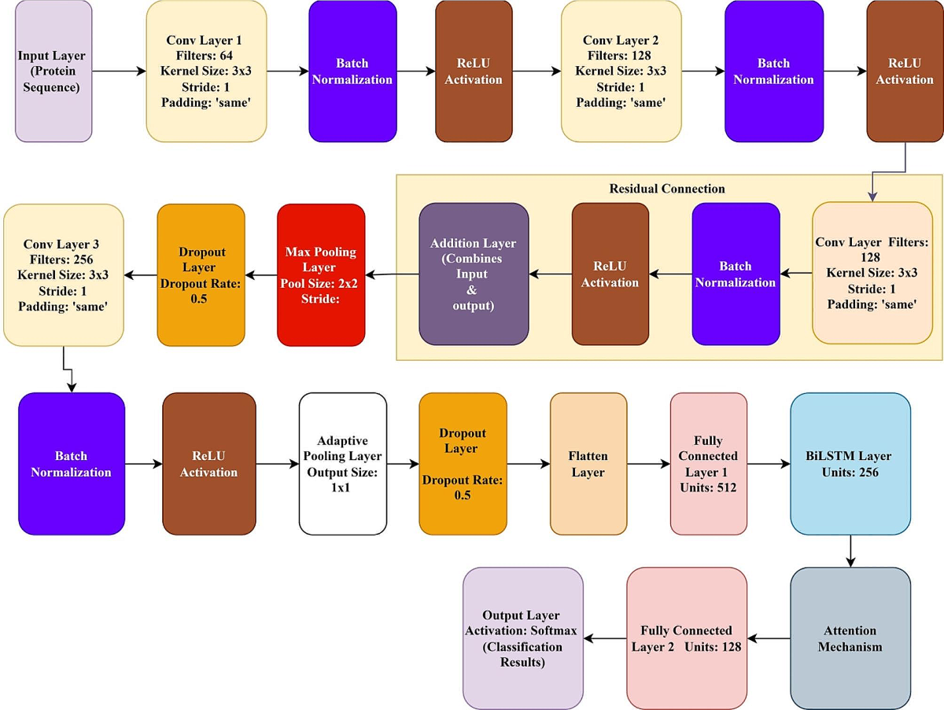

Slide 11
5. Key Concepts:
Motifs:
Recurring sequence patterns that often have specific biological functions.
One-hot encoding:
A common way to represent amino acids as vectors, where each position corresponds to an amino acid and is set to 1 if the amino acid is present at that position and 0 otherwise.
PSSM:
Position-Specific Scoring Matrix, a matrix that represents the likelihood of each amino acid occurring at each position in a sequence.
Convolutional Layers:
Layers in a CNN that apply kernels to extract features from the input data.
Pooling Layers:
Layers that reduce the spatial dimensions of the convolved output, typically using max or average pooling.

