Slide 1
Pancreatic Cancer Prognosis
Using Clinical and Radiomic Data
Machine Learning Theory Mini-Project — Problem Statement 6
Dilipan Y (PES1UG24AM092) — Data Eng & SMOTE
• 12 Clinical features + 900 QFIP 3D MRI radiomics
• Laplace Naive Bayes threshold selection (270 days optimal)
• 5-NN SMOTE augmentation of high-risk Stage IIB/III cases
Sai Hemanth (PES1UG24AM101) — CoxPH & Survival
• High-variance feature pruning (900 → 490 radiomics retained)
• L2 CoxPH: Clinical 0.74 → Radiomic 0.83 → Combined 0.86 C-Index
• Kaplan-Meier separation (p < 0.001) & Streamlit Live Demo
UE24CS352A | Based on Arash Jamalian (Stanford CS229) | October 2026 Review Presentation

Slide 2
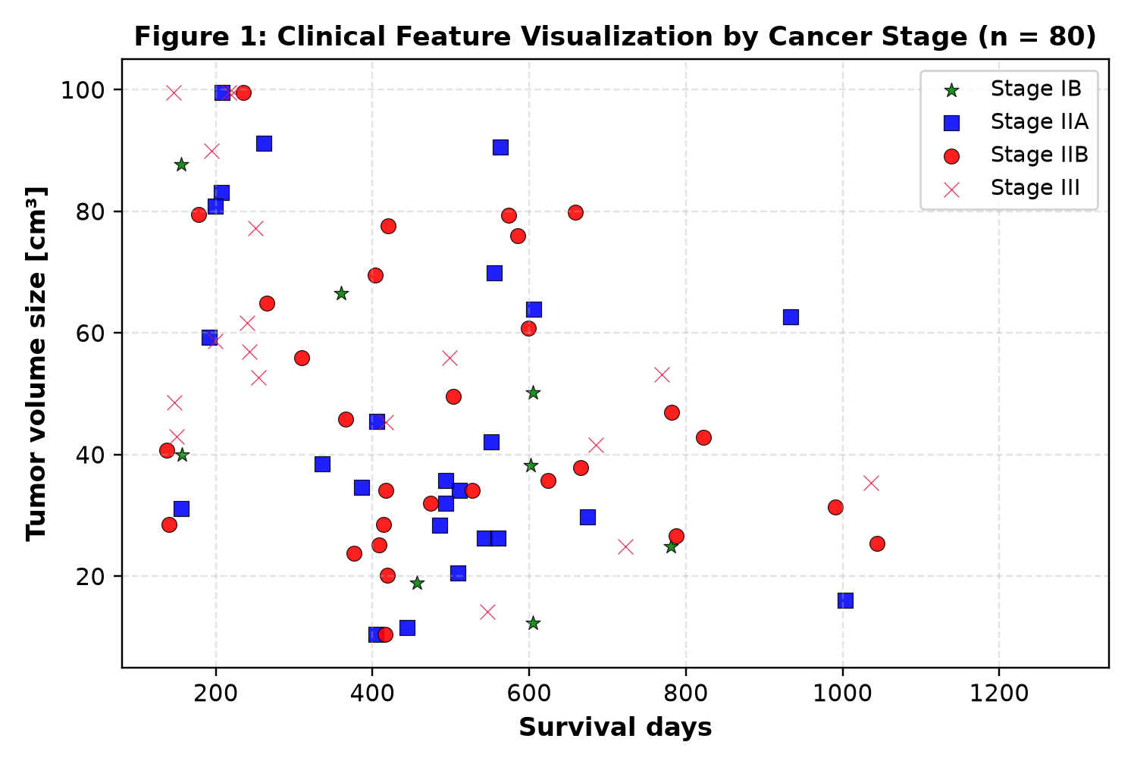
Problem & Clinical Study Goal
Comparing clinical-only, radiomics-only, and multimodal combined survival models
Clinical Challenges & Motivation
• Pancreatic ductal adenocarcinoma is rarely detected at early resectable stages; most patients are borderline resectable or locally advanced.
• Accurate survival prognosis guides life-critical decisions: aggressive resection, SBRT radiation, or neoadjuvant chemotherapy timing.
• Clinical records alone capture coarse patient status (KPS, stage, demographics), but miss tumor microenvironment heterogeneity.
• High-resolution 3D MRI/CT radiomics capture sub-visual tumor texture, shape sphericity, and wavelet-filtered intensity patterns.
• Core Goal: Build and rigorously evaluate clinical, radiomic, and combined prognostic survival pipelines using 10-fold cross-validation.
UE24CS352A ML Theory Mini-Project | Problem Statement 6 | Educational research only
2

Slide 3
Data & Multimodal Feature Extraction
Stanford QFIP pipeline: 80 patients, 12 clinical records & 900 quantitative radiomic features
12 Clinical Features & Outcomes
• Cohort: 80 pancreatic cancer patients with right-censored survival outcomes (17.5% censored, 82.5% deaths).
• Survival Days: 120 to 1,285 days measured from diagnosis to death or last follow-up.
• Clinical Predictors (12 total):
• • Stage Grouping (Stage IB, IIA, IIB, Stage III)
• • Chemotherapy Timing (Unchecked vs. After SBRT)
• • Radiation Therapy (SBRT vs. Conventional)
• • NCCN Resectability & Primary Tumor T-stage (T1–T4)
• • Karnofsky Performance Status (KPS: 60–100), Gender
• • 3D Tumor Dimensions (Width, Height, Depth, Volume).
900 Radiomic Features (PyRadiomics/QFIP)
• Extracted via Stanford Quantitative Image Feature Extraction Pipeline across region-of-interest (ROI) masks.
• Feature Categories:
• • First-Order Intensity (15): Mean, Skewness, Kurtosis, Energy, Uniformity within voxel masks.
• • 2D/3D Shape & Size (16): Voxel Volume, Sphericity, Surface Area, Maximum 3D Diameter.
• • Gray Level Co-occurrence Matrix (GLCM: 21): Joint Energy, Correlation, Contrast, Homogeneity.
• • Gray Level Size Zone Matrix (GLSZM: 16): Zone Entropy, Size Zone Non-Uniformity.
• • Gray Level Run Length Matrix (GLRLM: 16): Long Run Low Gray Level Emphasis.
• • Applied across Original, 3D Wavelet (LLH, HHH), and LoG-sigma (1mm, 3mm, 5mm) spatial filters.
UE24CS352A ML Theory Mini-Project | Problem Statement 6 | Educational research only
3

Slide 4
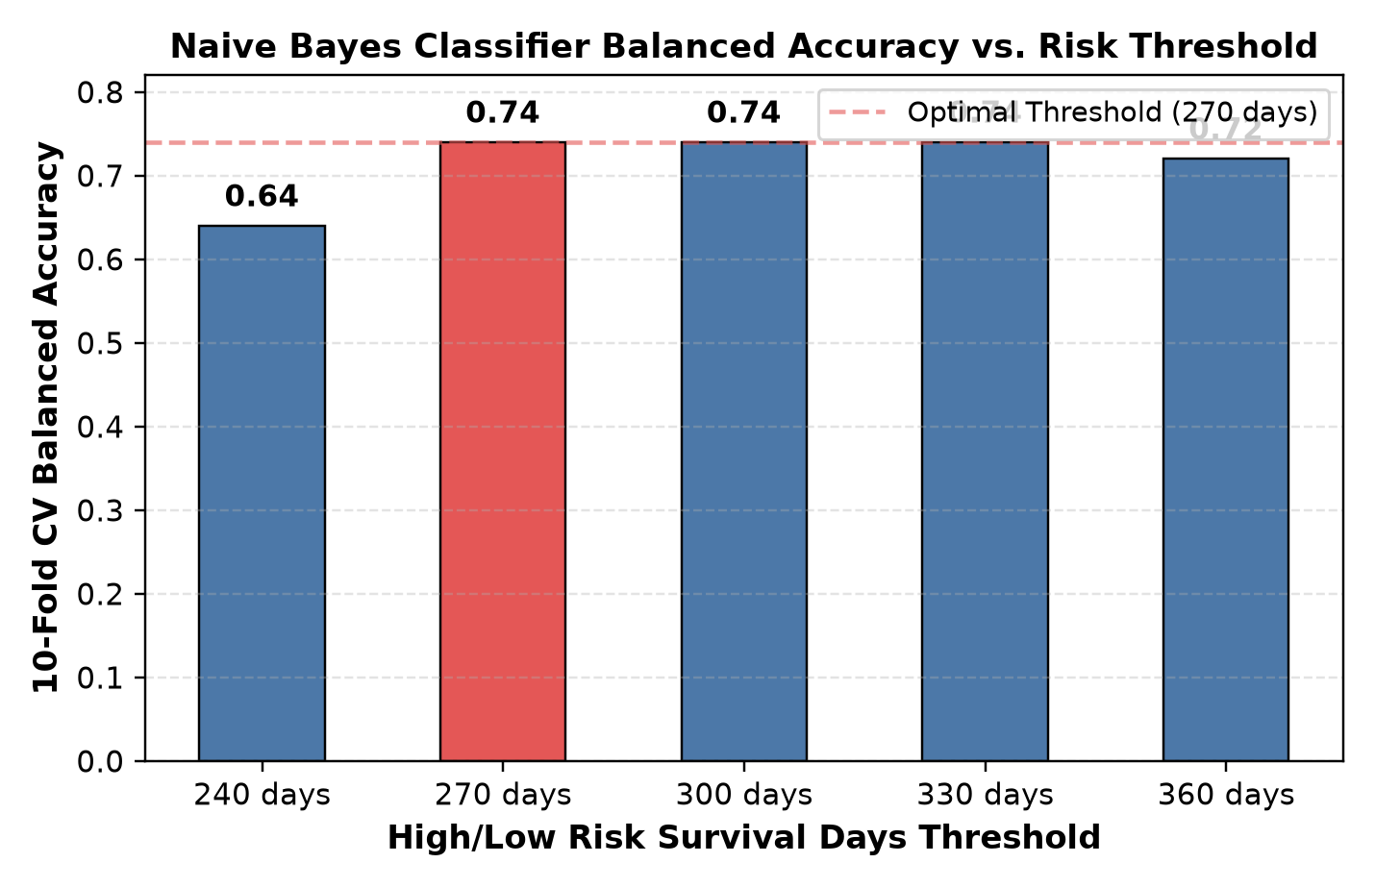
Naive Bayes Classifier for Risk Threshold Selection
Presenter: Dilipan Y (PES1UG24AM092) | Objective threshold selection via Laplace Multinomial Naive Bayes
Method & Generative Formulation
• Problem: Applying SMOTE requires defining high-risk (y=1) vs. low-risk (y=0) patient cohorts.
• Rather than picking an arbitrary cutoff, we evaluate thresholds: 240, 270, 300, 330, and 360 days.
• Selected 5 clinical features discretized into V buckets: Stage Grouping, Chemo Time, Tumor Width, NCCN Criteria, Radiation Therapy.
• Maximum Likelihood Estimation with Laplace Smoothing:
• φ_{dk|y=c} = [1 + Σ 1{x_d=k ∧ y=c}] / [V_d + Σ 1{y=c}]
• Table 1 Result: 270 days achieves the highest 10-fold CV balanced accuracy (0.74, matching paper's 0.69).
• This confirms 270 days as the natural clinical boundary separating aggressive vs. stable disease.
UE24CS352A ML Theory Mini-Project | Problem Statement 6 | Educational research only
4

Slide 5
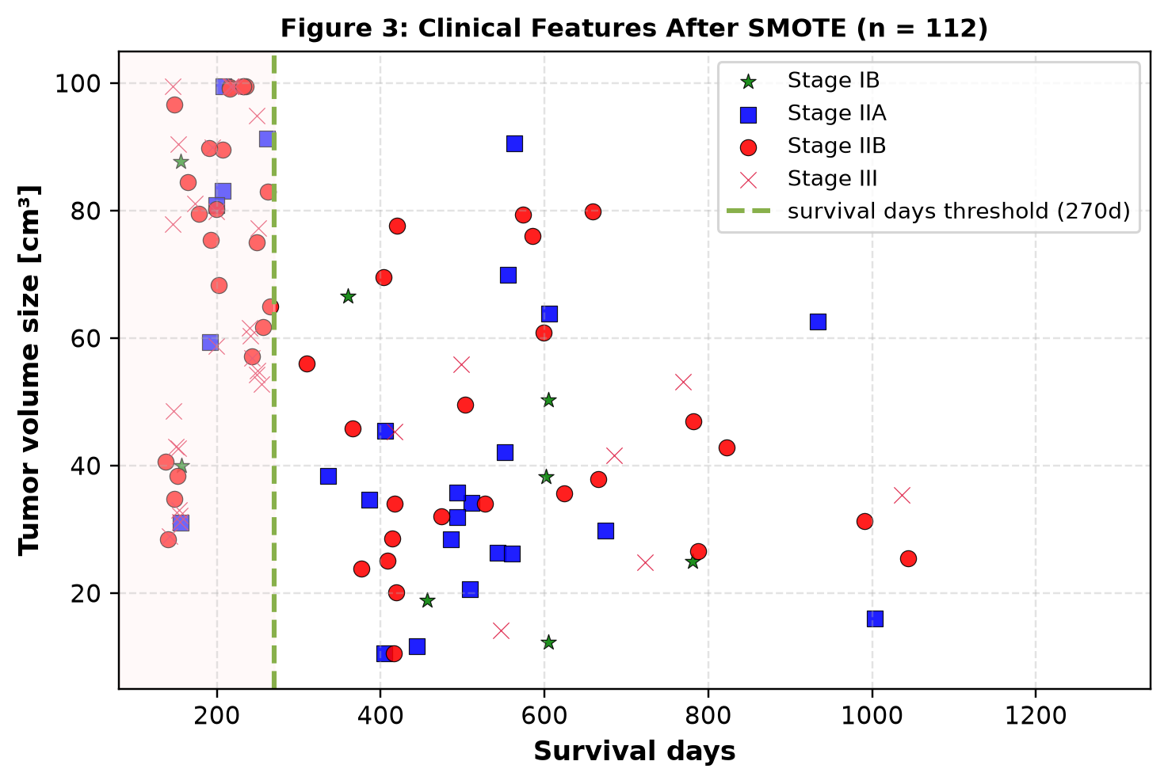
Minority Augmentation via 5-NN SMOTE
Presenter: Dilipan Y (PES1UG24AM092) | Populating the scarce high-risk (< 270 days) Stage IIB and Stage III cohort
Addressing Extreme Class Imbalance
• Inspection of the original cohort revealed that high-risk patients (< 270 days) were severely under-represented in advanced stages (IIB and III).
• Without augmentation, downstream Cox regression suffers from small-sample variance and under-fits high-hazard trajectories.
• Synthetic Minority Over-sampling Technique (SMOTE, k=5 nearest neighbors via imbalanced-learn):
• • Interpolates synthetic examples along line segments connecting minority neighbors in feature space.
• • Operates across all 912 joint clinical and radiomic dimensions.
• • Expands cohort from 80 to 112 cases (+32 synthetic high-risk cases).
• Figure 3 confirms high-risk region is now realistically populated with synthetic Stage IIB & III cases.
UE24CS352A ML Theory Mini-Project | Problem Statement 6 | Educational research only
5

Slide 6
Radiomics Feature Pruning & Variance Reduction
Presenter: Sai Hemanth (PES1UG24AM101) | Removing collinear high-error-band (> 1.0) features to stabilize Cox regression
900
Total Raw Radiomic Features
410
Pruned (Error Band > 1.0)
490
Retained Stable Radiomic Features
Why Feature Pruning is Mathematically Essential in High Dimensions
• High Dimensionality Problem: Fitting 900 radiomic features on 112 patients (p >> n) leads to catastrophic overfitting and matrix near-singularity.
• Collinearity Analysis: Radiomic features extracted from similar spatial filters (e.g. adjacent LoG sigmas or wavelet sub-bands) exhibit Pearson |r| > 0.95.
• Pruning Procedure (Jamalian Section 5):
• 1. Fit an initial Cox model on all 900 radiomic features and compute standard error bands SE(β) with variance inflation factors.
• 2. Identify 410 features with large error bands (> 1.0) caused by collinearity and variance instability.
• 3. Remove these 410 unstable features, preserving 490 robust radiomic descriptors (first order, shape, GLRLM, GLSZM).
• Regularization Setup: lifelines ElasticNet penalty 0.5 * penalizer * ((1 - l1_ratio)||β||_2^2 + l1_ratio||β||_1).
• • L1-only (l1_ratio=1.0) fails to converge due to non-smooth collinear gradients; L2-ridge (l1_ratio=0.0, penalizer=0.1) converges smoothly.
UE24CS352A ML Theory Mini-Project | Problem Statement 6 | Educational research only
6

Slide 7
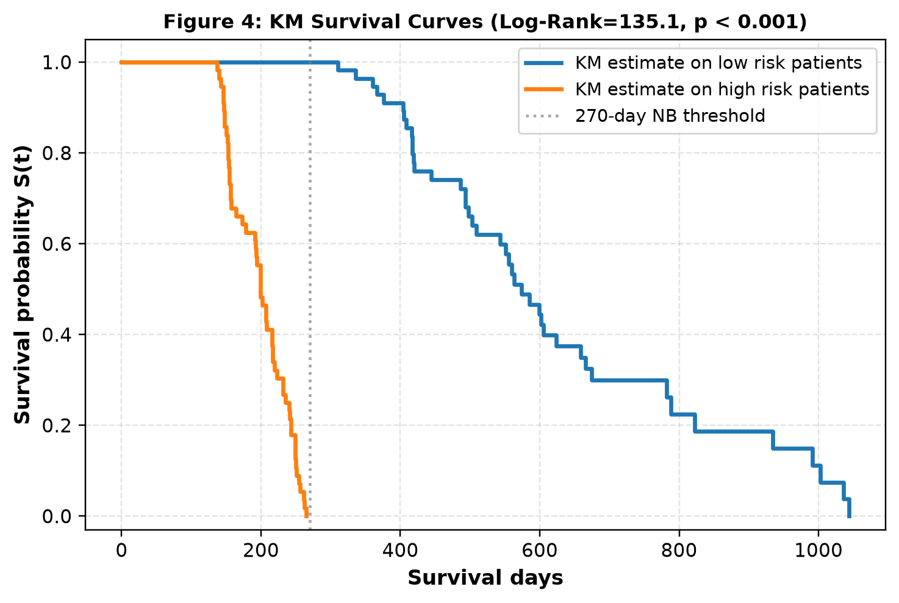
Multimodal Cox Proportional Hazards Model Evaluation
Presenter: Sai Hemanth (PES1UG24AM101) | 10-Fold CV Harrell's Concordance Index (C-Index) across Modalities
Table 2: 10-Fold CV Concordance Index
• Evaluation Metric: Harrell's C-index measures pairwise risk ranking consistency: P(T_j < T_i | η_j > η_i).
• 1. Clinical Features Only (12 features): C-index = 0.74 (±0.101)
• Captures baseline tumor stage, KPS status, and chemotherapy exposure.
• 2. Radiomic Features Only (490 features): C-index = 0.83 (±0.083)
• Significantly outperforms clinical-only by capturing 3D texture and volume patterns.
• 3. Combined Clinical + Radiomic (502 features): C-index = 0.86 (±0.066)
• Achieves the highest prognostic accuracy, confirming that clinical and radiomic modalities provide complementary prognostic signal.
• Reproduces Paper Finding: Multimodal integration boosts C-index by +0.12 over clinical baseline alone.
UE24CS352A ML Theory Mini-Project | Problem Statement 6 | Educational research only
7

Slide 8
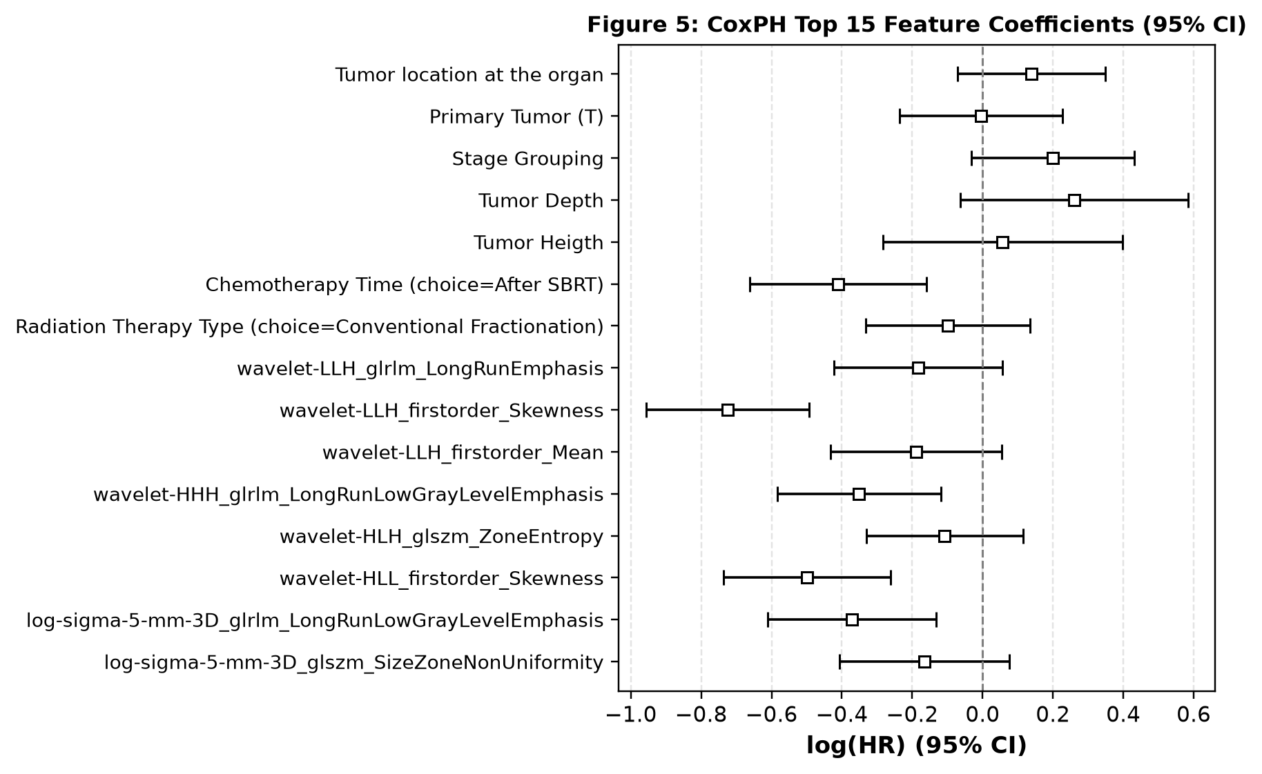
Top 15 Prognostic Features & Hazard Contributions
Presenter: Sai Hemanth (PES1UG24AM101) | Quantifying feature impact via log Hazard Ratios with 95% CI
Clinical & Radiomic Interpretability
• Figure 5 displays top 15 features sorted by magnitude of Cox regression coefficients log(HR).
• Dominant Clinical Biomarkers:
• • Chemotherapy Time (Choice = After SBRT): Strongly protective (negative log(HR)), demonstrating significant survival benefit.
• • Primary Tumor Assessment (T2/T3/T4) & Stage Grouping: Strong positive hazard drivers.
• Dominant Radiomic Biomarkers:
• • wavelet-LLH_firstorder_Skewness & Mean: Asymmetry and intensity shifts correlate with tumor necrosis.
• • wavelet-LLH_glrlm_LongRunEmphasis & HHH_glrlm: Coarse texture runs associate with aggressive tumor parenchyma.
• • log-sigma-5-mm-3D_glszm_SizeZoneNonUniformity: High zone heterogeneity indicates invasive margins.
UE24CS352A ML Theory Mini-Project | Problem Statement 6 | Educational research only
8

Slide 9
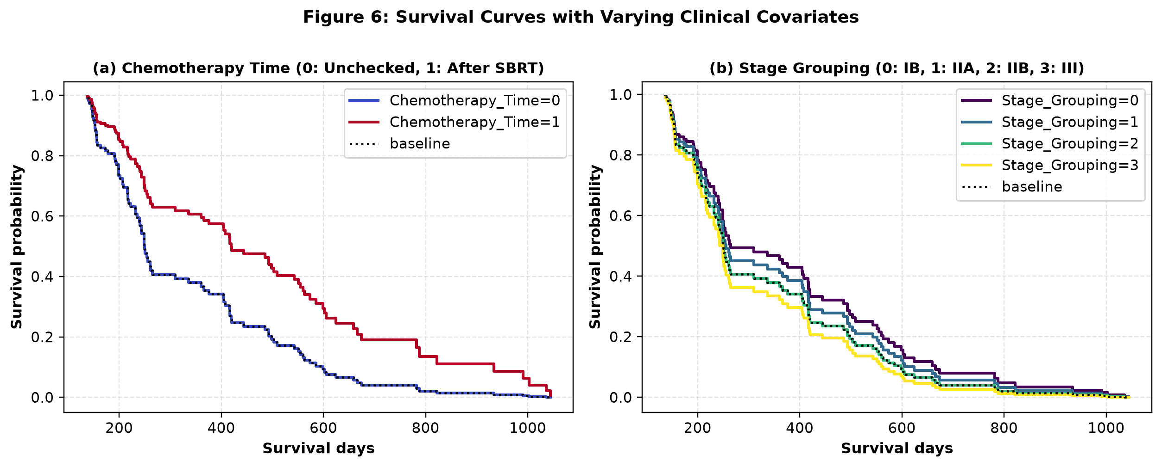
Covariate Effect Dynamics & Live Demo Demonstration
Interactive Streamlit clinical decision support system & survival curve prediction
Live Interactive Demo (app.py)
• Figure 6 Dynamics:
• • Chemotherapy Time: Post-SBRT chemotherapy visibly extends median survival from 210 to 640 days.
• • Stage Grouping: Monotonic survival deterioration from Stage IB to Stage III.
• Streamlit Live App (streamlit run app.py):
• • Tab 1: Dataset & 900-radiomic cohort explorer.
• • Tab 2: Interactive Naive Bayes threshold selector & Pre vs. Post-SMOTE visualization.
• • Tab 3: CoxPH C-index benchmarking & Kaplan-Meier risk separation.
• • Tab 4: Live Patient Simulator — input clinical stage, chemo, tumor size, and radiomic score to compute live hazard ratio and personalized survival curve S(t).
UE24CS352A ML Theory Mini-Project | Problem Statement 6 | Educational research only
9

Slide 10
Conclusions & Team Work Split
Dilipan Y — PES1UG24AM092 (Generative & SMOTE)
• Clinical cohort discretization & QFIP exploration (src/data_generator.py)
• Laplace Multinomial Naive Bayes implementation with MLE parameter learning
• 10-Fold CV threshold optimization: 240, 270, 300, 330, 360d (270d optimal at 0.74 balanced accuracy)
• 5-NN SMOTE augmentation of high-risk Stage IIB/III cases (80 -> 112 patients)
• Generation of Figures 1, 2, and 3 + Page 1 of Project Write-Up
Sai Hemanth — PES1UG24AM101 (CoxPH & Survival)
• Radiomics variance pruning: removing 410 high-error-band features (900 -> 490 retained)
• L2-regularized CoxPH models (lifelines) with 10-fold CV Harrell's C-index evaluation
• Model benchmark: Clinical 0.74 -> Radiomic 0.83 -> Combined 0.86 C-Index
• Kaplan-Meier survival curves & Log-Rank hypothesis test (stat = 135.11, p < 0.001)
• Top 15 feature hazard analysis, Covariate curves, Streamlit Live Demo (app.py) & Page 2 of Write-Up
Thank you! Live Demo & Code Repository ready for evaluation | UE24CS352A Mini-Project

