Slide 1
FINAL YEAR PROJECT DEFENSE
HireHub
A Full-Stack Job Portal
Dilan Shrestha · Department of Computer Science · 2026
Job Seeker
Company
Super Admin
Browse feed · Apply · Save · Follow
Post jobs · Review · Approve / Reject
Manage users · Approve companies · Audit
Next.js 16
MongoDB Atlas
Auth.js v5
Tailwind CSS v4
TypeScript
HireHub — Final Year Project Defense
01 / 23

Slide 2
Introduction
What is HireHub?
JOB SEEKER
A full-stack job portal built as a university final-year project
Three user roles: Job Seeker, Company, and Super Admin
Intelligent weighted match-score algorithm ranks job listings per seeker
JWT-based authentication enforced at the proxy layer via RBAC
Built entirely on Next.js 16 — no separate backend service required
Covers notifications, file uploads, audit logging, and onboarding
Browse personalised feed · Apply · Save · Follow companies
COMPANY
Post jobs · Review ranked applicants · Approve or reject
SUPER ADMIN
Approve companies · Suspend users · Full audit log
HireHub — Final Year Project Defense
02 / 23

Slide 3
Problem Statement
CORE PROBLEM
Job seekers waste hours browsing irrelevant listings with no personalisation. Employers manually review unranked applicants. Platform administrators lack tools to verify companies and moderate users — all within one cohesive system.
Pain Points — Job Seekers
Pain Points — Employers and Admins
No personalised job ranking or recommendation engine
Cannot track application status in real time
Hard to discover companies aligned with career interests
No way to save favourite listings across sessions
No structured onboarding to capture skills and interests
No automated applicant ranking by fit or skill overlap
Manual, time-consuming shortlisting process
No structured approve or reject workflow
Admins cannot verify companies before they post jobs
No audit trail for administrative actions
HireHub — Final Year Project Defense
03 / 23

Slide 4
Objectives
01
Role-Based Authentication
02
Match-Score Algorithm
JWT sessions, Credentials provider, bcryptjs hashing, proxy.ts RBAC
Weighted 6-signal content-based filtering using Jaccard similarity
03
Company Job Management
04
Super Admin Control Panel
Full CRUD for jobs, applicant pipeline, approve and reject workflow
Stats dashboard, user and company management, suspend, soft-delete, audit
05
Personalised Seeker Feed
06
Notifications and File Uploads
Ranked feed, advanced search and filter, apply, save, follow companies
Seven event types, 30-second polling, PDF resume, PNG or JPEG logo
07
Responsive Accessible UI
08
Testing and Seed Script
Tailwind CSS v4, mobile-first, tested from 320 px to 1920 px
Unit tests for algorithm, Zod validation, idempotent seed data script
HireHub — Final Year Project Defense
04 / 23

Slide 5
Scope and Limitations
In Scope
Limitations and Out of Scope
User registration, login, and role-based access control
Job posting, editing, and status lifecycle management
Personalised seeker feed with weighted match-score ranking
Application submission and four-stage status pipeline
Admin panel: statistics, user and company management
In-app notification system with seven event types
File uploads: PDF resumes and PNG or JPEG company logos
Audit log recording every admin action
Responsive layout from 320 px to 1920 px
No email delivery — all notifications are in-app only
File storage uses local filesystem, not cloud storage
No collaborative filtering — content-based approach only
No real-time chat or direct messaging between users
No payment, subscription, or premium tier features
No native mobile application — web responsive only
Job categories are static strings, no admin taxonomy editor
No automated CV parsing — seeker fills profile manually
HireHub — Final Year Project Defense
05 / 23

Slide 6
Development Methodology
AGILE ITERATIVE — 7 PHASES
Each phase delivers working, tested features before the next phase begins. Requirements are tracked using EARS notation acceptance criteria.
01
Schema and DB
05
Seeker Features
Mongoose models, DB connection helper, idempotent seed script
Personalised ranked feed, search and filter, apply, save, follow
02
Auth and RBAC
06
Notifications
JWT Credentials provider, proxy.ts route enforcement, auto-reactivation
Seven event types, 30-second polling handler, notification bell UI
03
Admin Panel
07
Polish and Testing
Statistics dashboard, user and company management, paginated audit log
Responsive layout, empty states, loading skeletons, unit tests
04
Company Features
Job CRUD, applicant pipeline, match-score display, approve or reject
HireHub — Final Year Project Defense
06 / 23

Slide 7
Requirement Analysis
Functional Requirements
Non-Functional
EARS Acceptance Criteria
User registration and authentication (3 roles)
RBAC route-level access enforcement
Job posting, editing, lifecycle management
Personalised feed with match scoring
Application submission and status tracking
Admin: approve, reject, suspend, delete
In-app notifications on key events
File upload for resumes and logos
Audit log for all admin actions
Responsive: 320 px to 1920 px
Secure: bcryptjs rounds 12+, JWT
Performant: compound DB indexes
Maintainable: modular Server Actions
WHEN signup submitted with unique email and 8+ char password, create JOBSEEKER user
WHILE status is PENDING_APPROVAL, block job posting with HTTP 403
WHEN admin approves company, set ACTIVE and notify the company user
WHEN job is posted, notify all followers of the company
WHEN suspendedUntil is before now on login, auto-reactivate the user
IF file exceeds size limit, return HTTP 400 with error message
Validation Rules
All inputs validated via Zod schemas
HTTP 400 with field-level error messages
One application per seeker per job
File type and size enforced server-side
HireHub — Final Year Project Defense
07 / 23

Slide 8
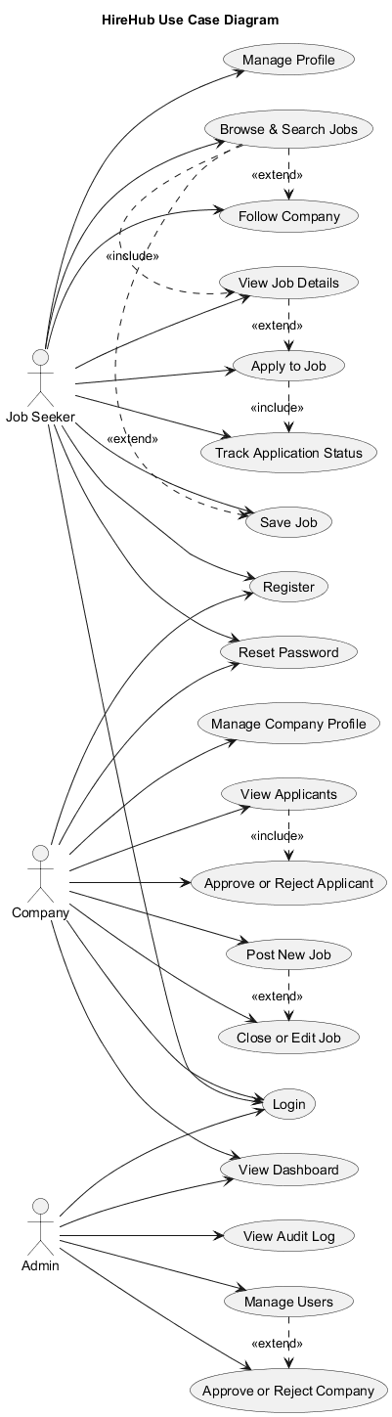
Use Case Diagram
HireHub — Final Year Project Defense
08 / 23

Slide 9
Feasibility Analysis
TECHNICAL FEASIBILITY
Next.js 16 App Router is production-ready with comprehensive documentation
MongoDB Atlas free tier provides sufficient capacity for development and demo
Auth.js v5 delivers stable JWT authentication for the Next.js App Router
Tailwind CSS v4 CSS-first configuration reduces boilerplate significantly
All selected libraries are actively maintained with large developer communities
OPERATIONAL FEASIBILITY
Three-role system maps directly to real-world hiring portal workflows
Admin panel enables content moderation without requiring direct database access
Idempotent seed script enables reproducible demo data for any evaluator
Environment variable configuration supports any cloud deployment target
ECONOMIC FEASIBILITY
Zero-cost stack: MongoDB Atlas free tier and Vercel free hosting tier
No paid APIs or third-party services required at MVP stage
Cloud storage integrates without any call-site code changes
All libraries are open-source with no licensing costs
HireHub — Final Year Project Defense
09 / 23

Slide 10
System Architecture
ARCHITECTURE OVERVIEW
Browser → Next.js 16 App Router → proxy.ts (RBAC) → Server Actions / Route Handlers → Mongoose → MongoDB Atlas
PRESENTATION
AUTH AND PROXY
React Server and Client Components · Tailwind CSS v4 · Framer Motion animations
Auth.js v5 JWT strategy · proxy.ts RBAC enforcement (Node.js runtime, not edge)
BUSINESS LOGIC
DATA ACCESS
Server Actions in src/actions/ · Match Score algorithm · Zod validation schemas
Mongoose ODM · connectDB() cached connection helper · Compound indexes
DATABASE
FILE STORAGE
MongoDB Atlas · Nine collections · Soft deletes on users · Cascade on company
Local public/uploads/ at MVP · Swap-ready interface in src/lib/upload.ts for S3
HireHub — Final Year Project Defense
10 / 23

Slide 11
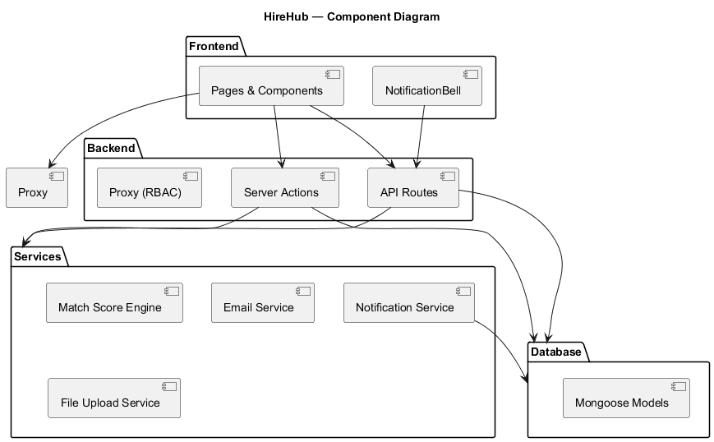
Component Diagram
HireHub — Final Year Project Defense
11 / 23

Slide 12
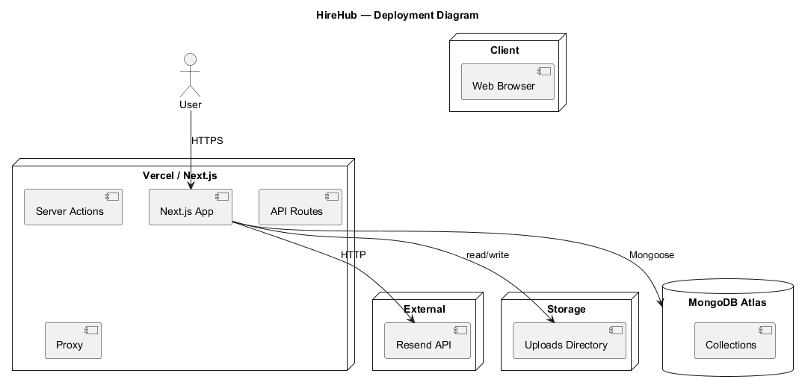
Deployment Diagram
HireHub — Final Year Project Defense
12 / 23

Slide 13
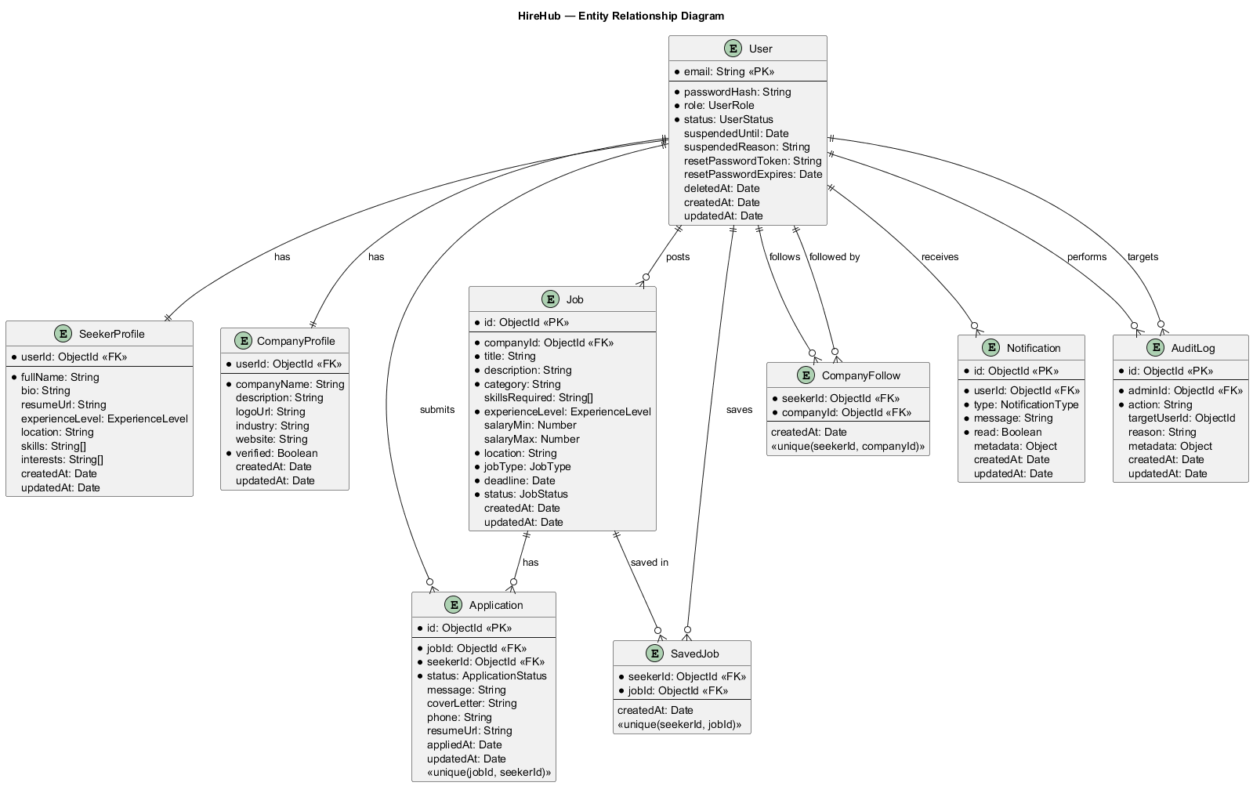
Database Design — ER Diagram
User
email · role · status · passwordHash
SeekerProfile
skills[ ] · interests[ ] · resumeUrl
CompanyProfile
companyName · logoUrl · verified
Job
title · category · skillsRequired[ ] · deadline
Application
jobId · seekerId · status · coverLetter
SavedJob
seekerId · jobId
CompanyFollow
seekerId · companyId
Notification
userId · type · message · read
AuditLog
adminId · action · targetUserId · reason
HireHub — Final Year Project Defense
13 / 23

Slide 14
Algorithms and Core Logic
MATCH SCORE ALGORITHM — src/lib/matchScore.ts
score = 0.35 × categoryMatch + 0.30 × skillOverlap + 0.10 × locationMatch
+ 0.10 × experienceMatch + 0.10 × recencyBoost + 0.05 × followBoost
WEIGHT BREAKDOWN
COMPONENT DEFINITIONS
Category Match
35%
categoryMatch
{0, 1}
1 if job.category is in seeker.interests, else 0
Skill Overlap (Jaccard)
30%
skillOverlap
[0, 1]
Jaccard: |A ∩ B| / |A ∪ B| on lowercased skill sets
Location Match
10%
locationMatch
{0, 0.5, 1}
1 exact match, 0.5 remote job, 0 mismatch
Experience Match
10%
experienceMatch
{0, 0.5, 1}
1 exact level, 0.5 adjacent, 0 for distant levels
Recency Boost
10%
recencyBoost
(0, 1]
1 / (1 + daysSincePosted), decays towards 0 over time
Follow Boost
5%
followBoost
{0, 1}
1 if seeker follows the posting company, else 0
HireHub — Final Year Project Defense
14 / 23

Slide 15
Tools and Technologies
Frontend
Backend and Server
Next.js 16.2 — App Router, Server and Client Components
React 19 — UI rendering layer
Tailwind CSS v4 — CSS-first, no config file required
Framer Motion — page transitions and UI animations
React Hook Form — performant form state management
Next.js Server Actions — form mutations with no boilerplate
Next.js Route Handlers — REST-style API endpoints
Auth.js v5 (NextAuth) — Credentials provider with JWT strategy
bcryptjs — password hashing, rounds 12+, no native bindings
Zod — runtime schema validation for all inputs
Database
Development and Tooling
MongoDB Atlas — NoSQL cloud database, free tier
Mongoose — ODM with typed schemas and indexes
Nine collections with compound indexes for query performance
Soft deletes on users, cascade logic on company deletion
TypeScript — end-to-end type safety across the stack
Turbopack — default bundler for both dev and build
ESLint — linting configured with Next.js ruleset
npm — package management and script runner
Git — version control
HireHub — Final Year Project Defense
15 / 23

Slide 16
System Features
Job Seeker Features
Company Features
Super Admin Features
Personalised job feed ranked by match score
Advanced search and filter by location, category, salary, type
One-click apply with cover letter and resume upload
Application pipeline: Pending, Reviewed, Approved, Rejected
Save and unsave job listings for later review
Follow companies to receive new-job notifications
Notification bell with unread count and read-all action
Onboarding flow to capture skills and interests
Post, edit, and close job listings
View all applicants ranked by match score
Approve or reject applicants with a review message
Company profile management with logo upload
Dashboard with total jobs and applicant count statistics
New-applicant badge for applications in last 24 hours
Receive notification when a seeker applies
Platform statistics dashboard for activity monitoring
Paginated user list with search, role, and status filters
Approve or reject pending company accounts
Suspend users with a reason and optional expiry date
Reactivate suspended users manually
Soft-delete users while preserving audit records
Full paginated audit log of every admin action
HireHub — Final Year Project Defense
16 / 23

Slide 17
Testing and Validation
Unit Testing — Match Score Algorithm
Input Validation — Zod
Test file located at src/lib/matchScore.test.ts
Tests: category hit and miss cases
Tests: Jaccard similarity with empty and overlapping skill sets
Tests: location exact match, remote job boost, and mismatch
Tests: experience adjacency — exact 1.0, adjacent 0.5, far 0.0
Tests: recency decay and followed-company boost
All form inputs validated server-side before any database write
Auth schema: email format, password 8+ chars, role enum
Job schema: required fields, future deadline, salary range
Application schema: cover letter and phone format
HTTP 400 returned with field-level error messages on failure
Manual and Functional Testing
Database Integrity
All three user roles tested end-to-end using seeded demo data
RBAC verified: unauthorized routes redirect to login correctly
Suspension and auto-reactivation logic tested on each login
File size and type restrictions validated at the server
Unique constraint confirmed: one application per seeker per job
Compound unique indexes prevent duplicate applications
SavedJob and CompanyFollow uniqueness enforced at database level
Cascade deletes: removing a company removes jobs and applications
Soft deletes: users excluded from all non-admin queries
Seed script is idempotent — safe to run multiple times
HireHub — Final Year Project Defense
17 / 23

Slide 18
Result Analysis
9
7
6
3
7
20
Collections
Notification Types
Algorithm Signals
User Roles
Dev Phases
Seed Applications
FEATURE COMPLETION STATUS
Feature
Status
Notes
Auth and JWT (3 roles)
Complete
Credentials + JWT, role and status in token
RBAC via proxy.ts
Complete
Admin, Company, Seeker routes enforced
Job Posting and CRUD
Complete
Full lifecycle: Active, Expired, Closed
Match-Score Feed
Complete
Six-signal weighted algorithm, sorted desc
Application Pipeline
Complete
Approve and reject with seeker notifications
Admin Panel
Complete
Stats, users, companies, audit log
Notification System
Complete
Seven event types, 30-second polling
File Uploads
Complete
PDF resume 5 MB, PNG or JPEG logo 2 MB
Responsive UI
Complete
Tested 320 px to 1920 px, Tailwind v4
HireHub — Final Year Project Defense
18 / 23

Slide 19
Risks and Challenges
CHALLENGES ENCOUNTERED AND HOW EACH WAS RESOLVED
1
Next.js 16 Breaking Changes
proxy.ts replaced middleware.ts; cookies, headers, and params are now all async; Turbopack became the default bundler — resolved by following the official migration documentation
2
Auth.js v5 Beta API
JWT callbacks, session shape, and provider config all changed from v4 — resolved by reading the official Auth.js v5 migration guide step by step
3
Edge Runtime Incompatibility
proxy.ts must run on Node.js runtime only — Mongoose is incompatible with the edge runtime; resolved by removing the edge configuration entirely
4
MongoDB Atlas Free-Tier
512 MB storage limit and serverless connection-pool limits — mitigated by caching the Mongoose connection on the Node.js global object
5
File Storage Scalability
Local uploads do not scale past a single server — resolved by designing src/lib/upload.ts as a swap-ready abstraction for S3 or Cloudinary
6
Algorithm Cold Start
Match score requires a populated profile — resolved with an onboarding gate that redirects new seekers before they can access the feed
HireHub — Final Year Project Defense
19 / 23

Slide 20
Conclusion
PROJECT SUMMARY
HireHub successfully delivers a full-stack job portal with three user roles, server-side RBAC, and a weighted match-score algorithm. All planned features across Phases 1 through 7 are implemented and validated. The system is production-ready at MVP level with proper input validation, compound database indexes, and a fully responsive interface.
Key Achievements
Learning Outcomes
Weighted six-signal job ranking algorithm built for this domain
Server-side RBAC enforcement via Next.js 16 proxy.ts
End-to-end type safety: TypeScript, Zod, and Mongoose schemas
Real-time notification system with seven distinct event types
Audit logging for every admin action — compliance-ready design
Idempotent seed script generating a full realistic dataset
Swap-ready file upload abstraction for future cloud migration
Next.js 16 App Router architecture and its breaking changes
JWT session strategy and the Auth.js v5 migration process
MongoDB document modelling and compound index design
Content-based filtering and Jaccard similarity
RBAC, soft deletes, and cascade logic in production code
Agile iterative delivery across seven development phases
Writing EARS-notation requirements and design documents
HireHub — Final Year Project Defense
20 / 23

Slide 21
Future Enhancements
Cloud Storage
Email Notifications
Replace local filesystem with AWS S3 or Cloudinary — only src/lib/upload.ts needs to change, no other files affected
Integrate Resend or SendGrid to deliver job alerts and application status updates directly to user inboxes
Collaborative Filtering
Real-Time WebSockets
Upgrade match score with user-user and item-item similarity once sufficient interaction data has accumulated
Replace 30-second polling with Socket.io or Server-Sent Events for instant notification delivery
Admin Taxonomy Editor
AI Resume Parsing
Allow the Super Admin to create and manage job categories dynamically rather than using a static string array
Use a large language model API to extract skills and experience from uploaded PDFs to auto-populate profiles
Analytics Dashboard
Mobile Application
Track job views, application funnel conversion rates, and seeker engagement over configurable time periods
Build a React Native app sharing the same API layer and authentication system as the web portal
HireHub — Final Year Project Defense
21 / 23

Slide 22
References
1
Next.js 16
7
React Hook Form
App Router, Server Actions, proxy.ts. https://nextjs.org/docs
Performant form state management. https://react-hook-form.com
2
Auth.js v5
8
Jaccard (1912)
Credentials Provider, JWT strategy. https://authjs.dev
Distribution of flora in the alpine zone. New Phytologist, 11(2), 37–50.
3
MongoDB Atlas
9
Pazzani & Billsus
Atlas, Mongoose ODM, Compound Indexes. https://www.mongodb.com/docs
Content-Based Recommendation Systems. The Adaptive Web, LNCS 4321, 2007.
4
Mongoose
10
EARS Notation
Schema design, Model API, Indexing. https://mongoosejs.com/docs
Mavin et al. Easy Approach to Requirements Syntax. IEEE RE, 2009.
5
Tailwind CSS v4
11
Framer Motion
CSS-first configuration. https://tailwindcss.com/docs
Production-ready animation library. https://www.framer.com/motion
6
Zod
12
bcryptjs
TypeScript-first schema validation. https://zod.dev
Node.js bcrypt without native bindings. https://github.com/dcodeIO/bcrypt.js
HireHub — Final Year Project Defense
22 / 23

Slide 23
Thank You
Questions and Discussion Welcome
Dilan Shrestha · Department of Computer Science · 2026
HireHub — A Full-Stack Job Portal
Next.js 16
MongoDB Atlas
Auth.js v5
Tailwind CSS v4
TypeScript
HireHub — Final Year Project Defense
23 / 23

