Slide 1

Trees Get Degrees: Decision Trees of Features for College Enrollment
By Weston Grewe and Angela Morrison

Slide 2


Motivation
Tailored to specific school communities
Better informing schools on how to prepare students to get into college
Interpretable and practical decision tree results

Slide 3

The Data
2017 Public School Data from Massachusetts
Remove schools that do not cater to any high school students
Remove features that are not standard among most schools in the country
Convert data to binary variables for program
Average Percentage of Students that Attended College after high school in Massachusetts
Used in determining if a school is “successful” in that they send a higher percentage of students to college after high school than the state as a whole

Slide 4

Quick Example
Name | Cool | Tall | Strong Bitmoji Game | Eats Pineapple on Pizza
Alyssa | 1 | 0 | 1 | 1
Angela | 0 | 0 | 1 | -1
Collin | 1 | 1 | 0 | 1
Drew | 1 | 1 | 1 | 1
Michael | 1 | 1 | 0 | 1
Sandy | 1 | 1 | 0 | 1
Rebecca | 1 | 1 | 1 | 1
Weston | 1 | 0 | 1 | 1
Steffen | 1 | 1 | 0 | 1
Split on Cool
Angela
The Rest of them

Slide 5


The Model
Maximizing the correct classification given a set tree structure
What features should we branch on
Tree should stay relatively small to keep interpretability

Slide 6

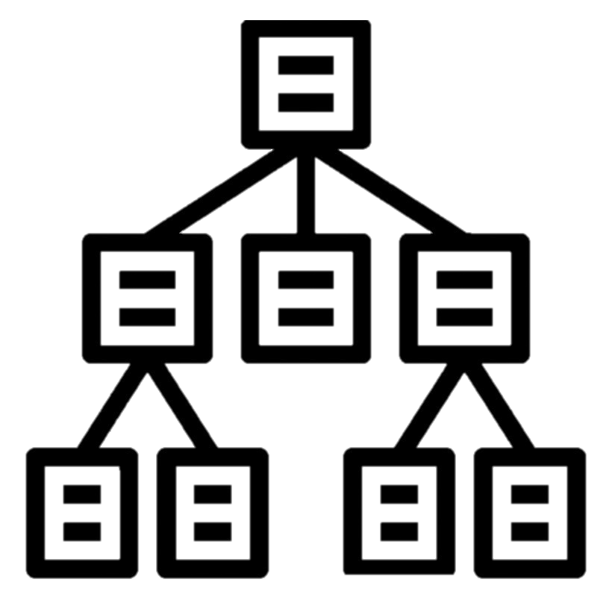
Tree Structures Considered
1
2
3
4
5

Slide 7


Results
First Language Not English 0-33%
1 AP Test Percent 0-33%
1 AP Test Percent 66-100%
1
2 AP Test 33-66%, 2 AP Test 66-100%
2
3
Total Enrollment 500-1000
Total Enrollment 1500-2000
2 AP Test 33-66%, 2 AP Test 66-100%
2 AP Test 33-66%, 2 AP Test 66-100%
Total Enrollment 500-1000
Total Enrollment 500-1000
Total Enrollment 2500-3000
4
5
1 AP Test 33-66%, 1 AP Test 66-100%
Avg Class Size 20-25, Avg Class Size 25-30, Avg Class Size 30-35
1 AP Test Percent 33-66%
1 AP Test Percent 66-100%
Avg Class Size 20-25, Avg Class Size 25-30, Avg Class Size 30-35
2 AP Test 66-100%
2 AP Test 66-100%
2 AP Test 33-66%, 2 AP Test 66-100%

Slide 8


Policy Implementations
Based on features used in data
Examples
Offer more AP classes/tests
Offer SAT Prep classes or more opportunities to take the SAT
Adjust class sizes or number of courses offered

Slide 9


Questions, comments, concerns?

