Slide 1

Trees Get Degrees: Decision Trees of Features for College Enrollment
By Weston Grewe and Angela Morrison

Slide 2


Motivation
Tailored to specific school communities
Better informing schools on how to prepare students to get into college
Interpretable and practical decision tree results

Slide 3

The Data
2017 Public School Data from Massachusetts
Remove schools that do not cater to any high school students
Remove features that are not standard among most schools in the country
Convert data to binary variables for program
Average Percentage of Students that Attended College after high school in Massachusetts
Used in determining if a school is “successful” in that they send a higher percentage of students to college after high school than the state as a whole

Slide 4


The Model
Maximizing the correct classification given a set tree structure
What features should we branch on
Tree should stay relatively small to keep interpretability

Slide 5

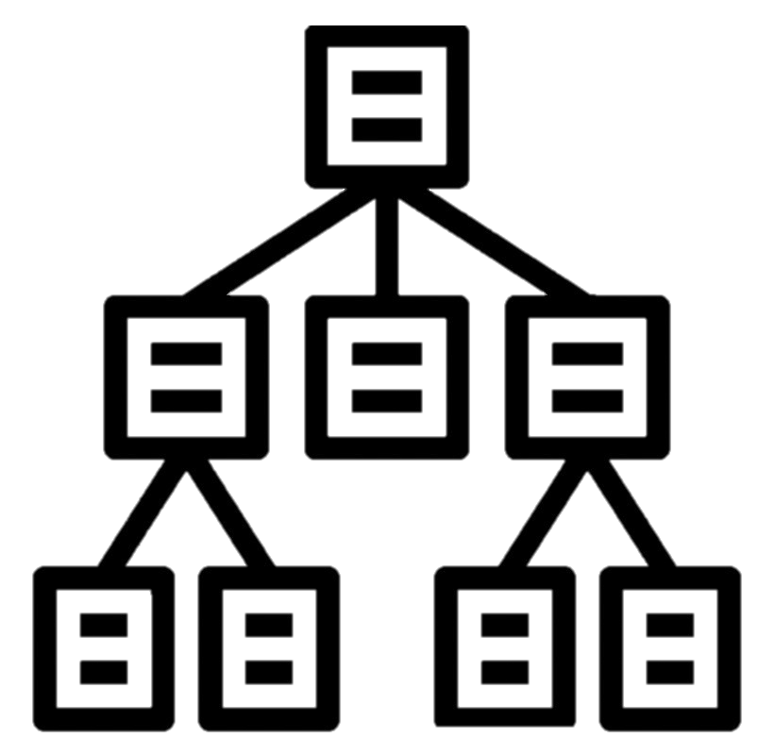
Tree Structures Considered
Fill in later

Slide 6


Results
Fill in later

Slide 7

Model Set Up
Separate samples into “positive” and “negative” outcomes
Define tree structure
Determine ratio between total number of “positive” and “negative” outcomes to include factor in objective function

Slide 8


Policy Implementations
Fill In Later

Slide 9


Questions, comments, concerns?

