Slide 1
Biodiversity in National Parks
An Analysis of Conservation Status and Species Risk
Dillan — Data Science Portfolio Project

Slide 2
Biodiversity in National Parks
An Analysis of Conservation Status and Species Risk
Data Science Portfolio Project
Notes:
This presentation explores biodiversity patterns within U.S. National Parks. The goal was to understand conservation risk, identify vulnerable species categories, and highlight parks requiring conservation attention using data analysis techniques.

Slide 3
Project Objective
• Analyze conservation status across species
• Identify biodiversity risk patterns
• Compare protected species across parks
• Provide data-driven conservation insights
Notes:
The objective was to transform raw ecological datasets into meaningful insights. The analysis focuses on risk concentration, species protection levels, and park-level biodiversity pressure.

Slide 4
Data Overview
Datasets Used:
• Species Information
• Park Observations
Key Fields:
Category, Scientific Name, Conservation Status, Observations
Notes:
Two datasets were cleaned and merged using Python. Species data provided taxonomy and conservation labels, while observations recorded how frequently species were seen across parks.

Slide 5
Data Preparation
• Standardized column names
• Handled missing conservation statuses
• Removed duplicates
• Created protection indicator
• Merged datasets for analysis
Notes:
Data cleaning ensured consistency and reliability. Missing conservation values were interpreted as 'No Intervention', and an 'is_protected' feature was engineered to enable analytical comparisons.

Slide 6
Key Question 1
Which species categories are most at risk?
Notes:
We evaluated protection rates across categories to determine whether certain taxonomic groups experience higher conservation pressure than others.

Slide 7
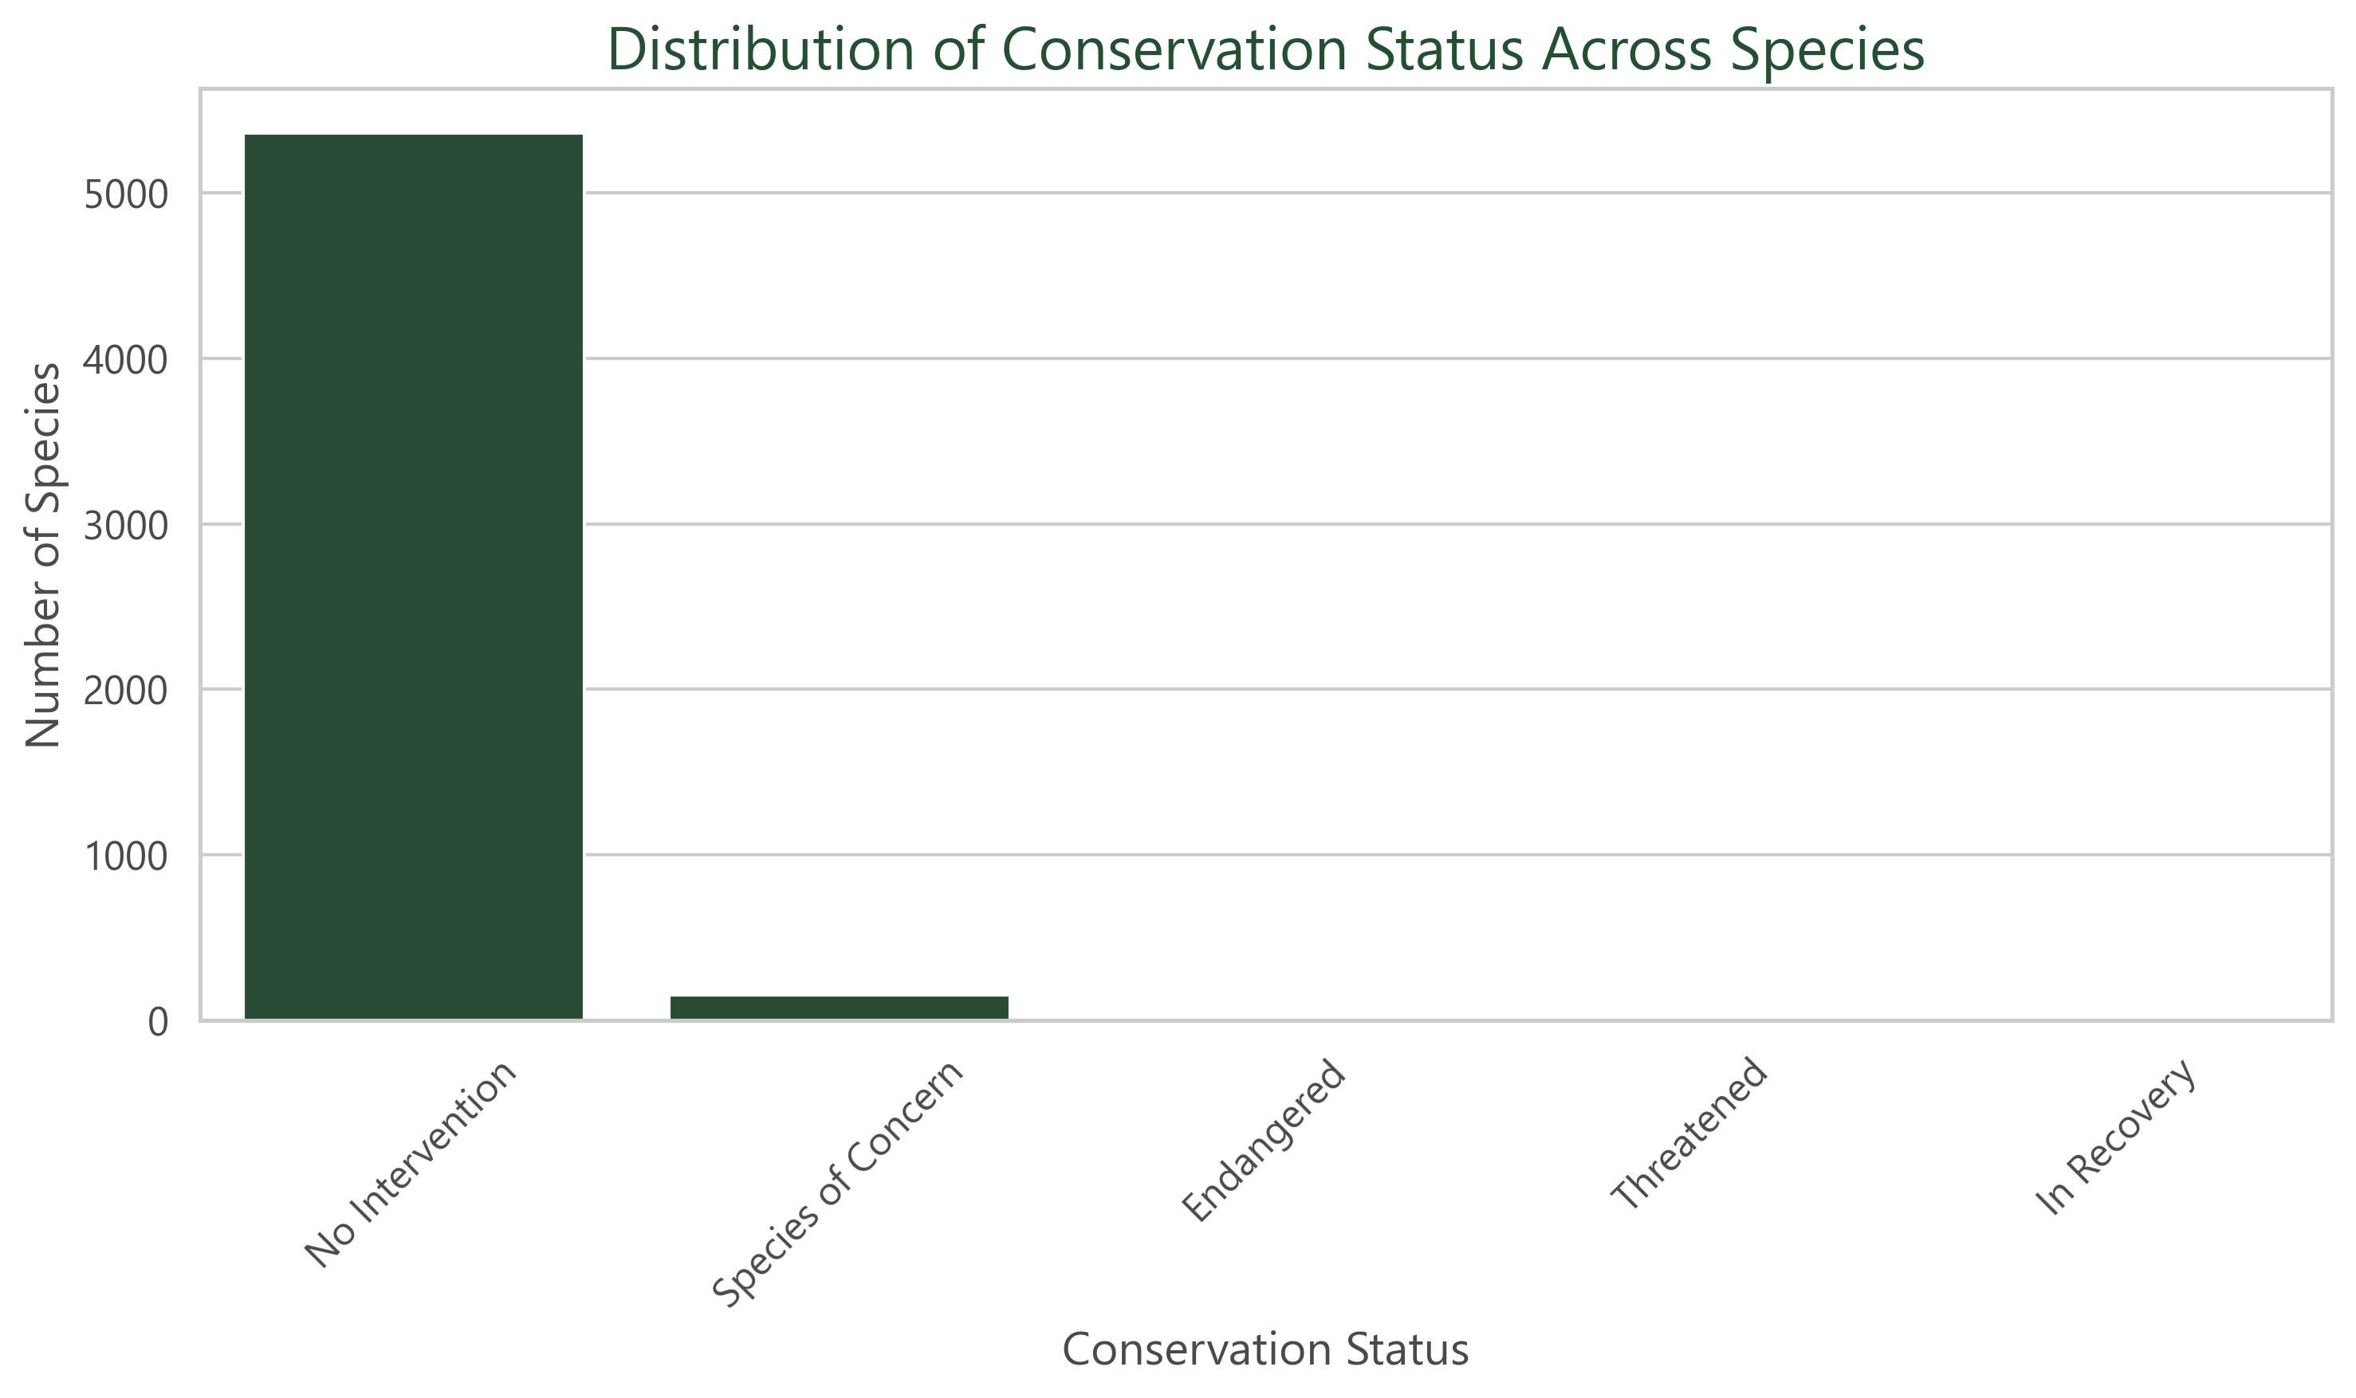
Notes:
“Most species require no intervention, but a meaningful minority fall into Species of Concern, Threatened, or Endangered categories.”

Slide 8
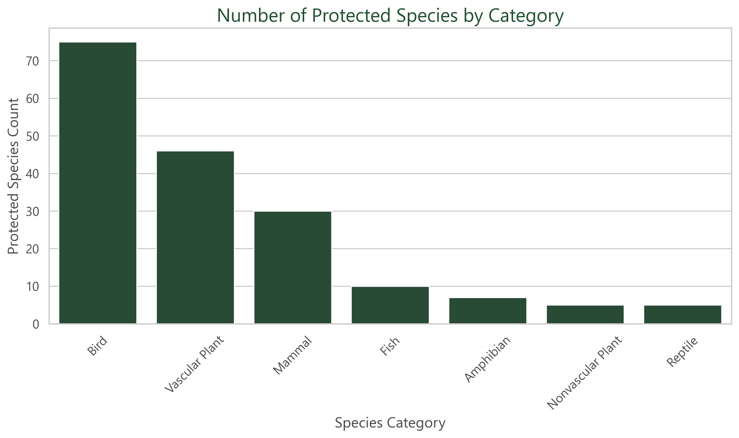
Notes:
Birds and mammals dominate the protected species counts, but mammals have the highest proportion under protection.

Slide 9
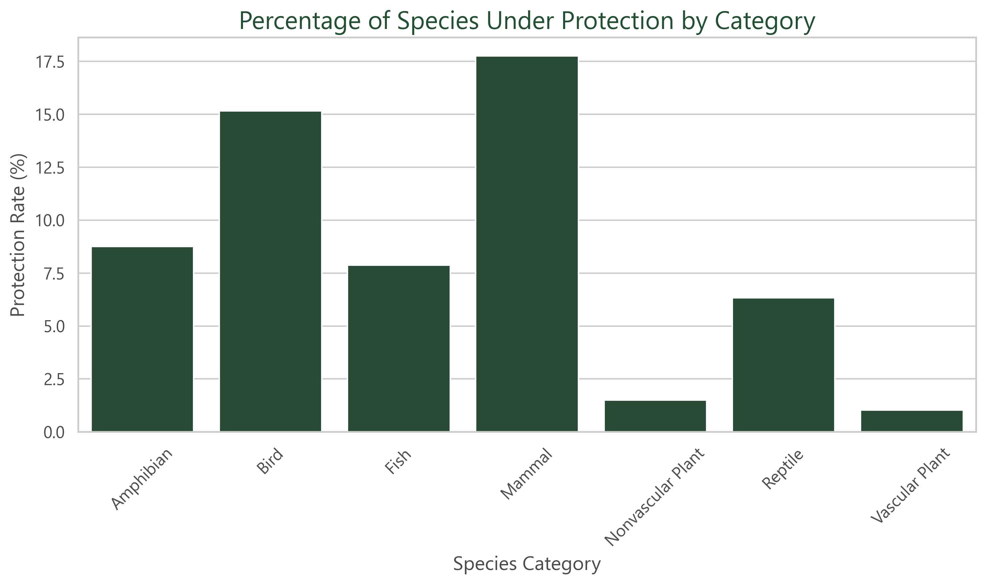
Notes:
Plants show very low protection rates, suggesting under‑representation or lower assessed risk.

Slide 10
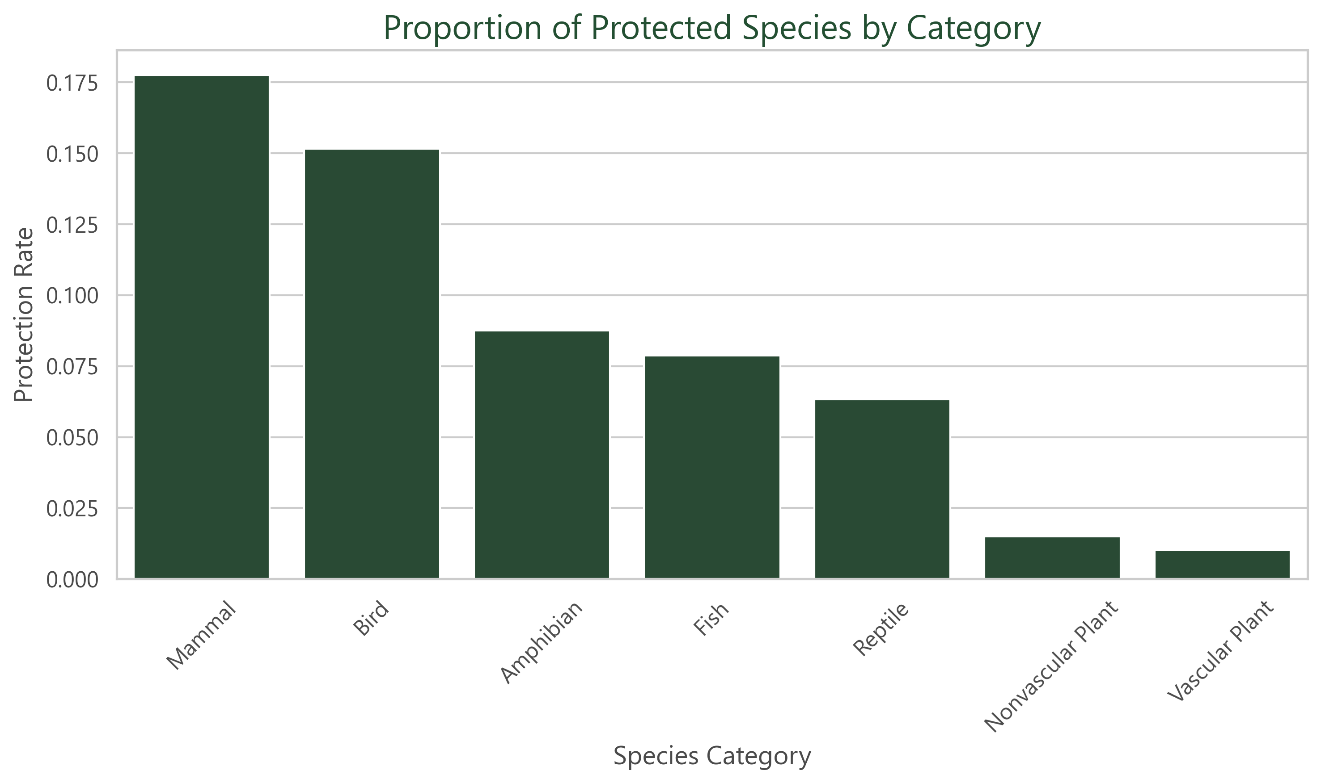
Notes:
Risk is uneven across categories, indicating ecological and taxonomic vulnerability patterns.

Slide 11
Key Question 2
Which parks show the highest protected species activity?
Notes:
By aggregating protected observations, we identified biodiversity hotspots where conservation efforts may need prioritization.

Slide 12
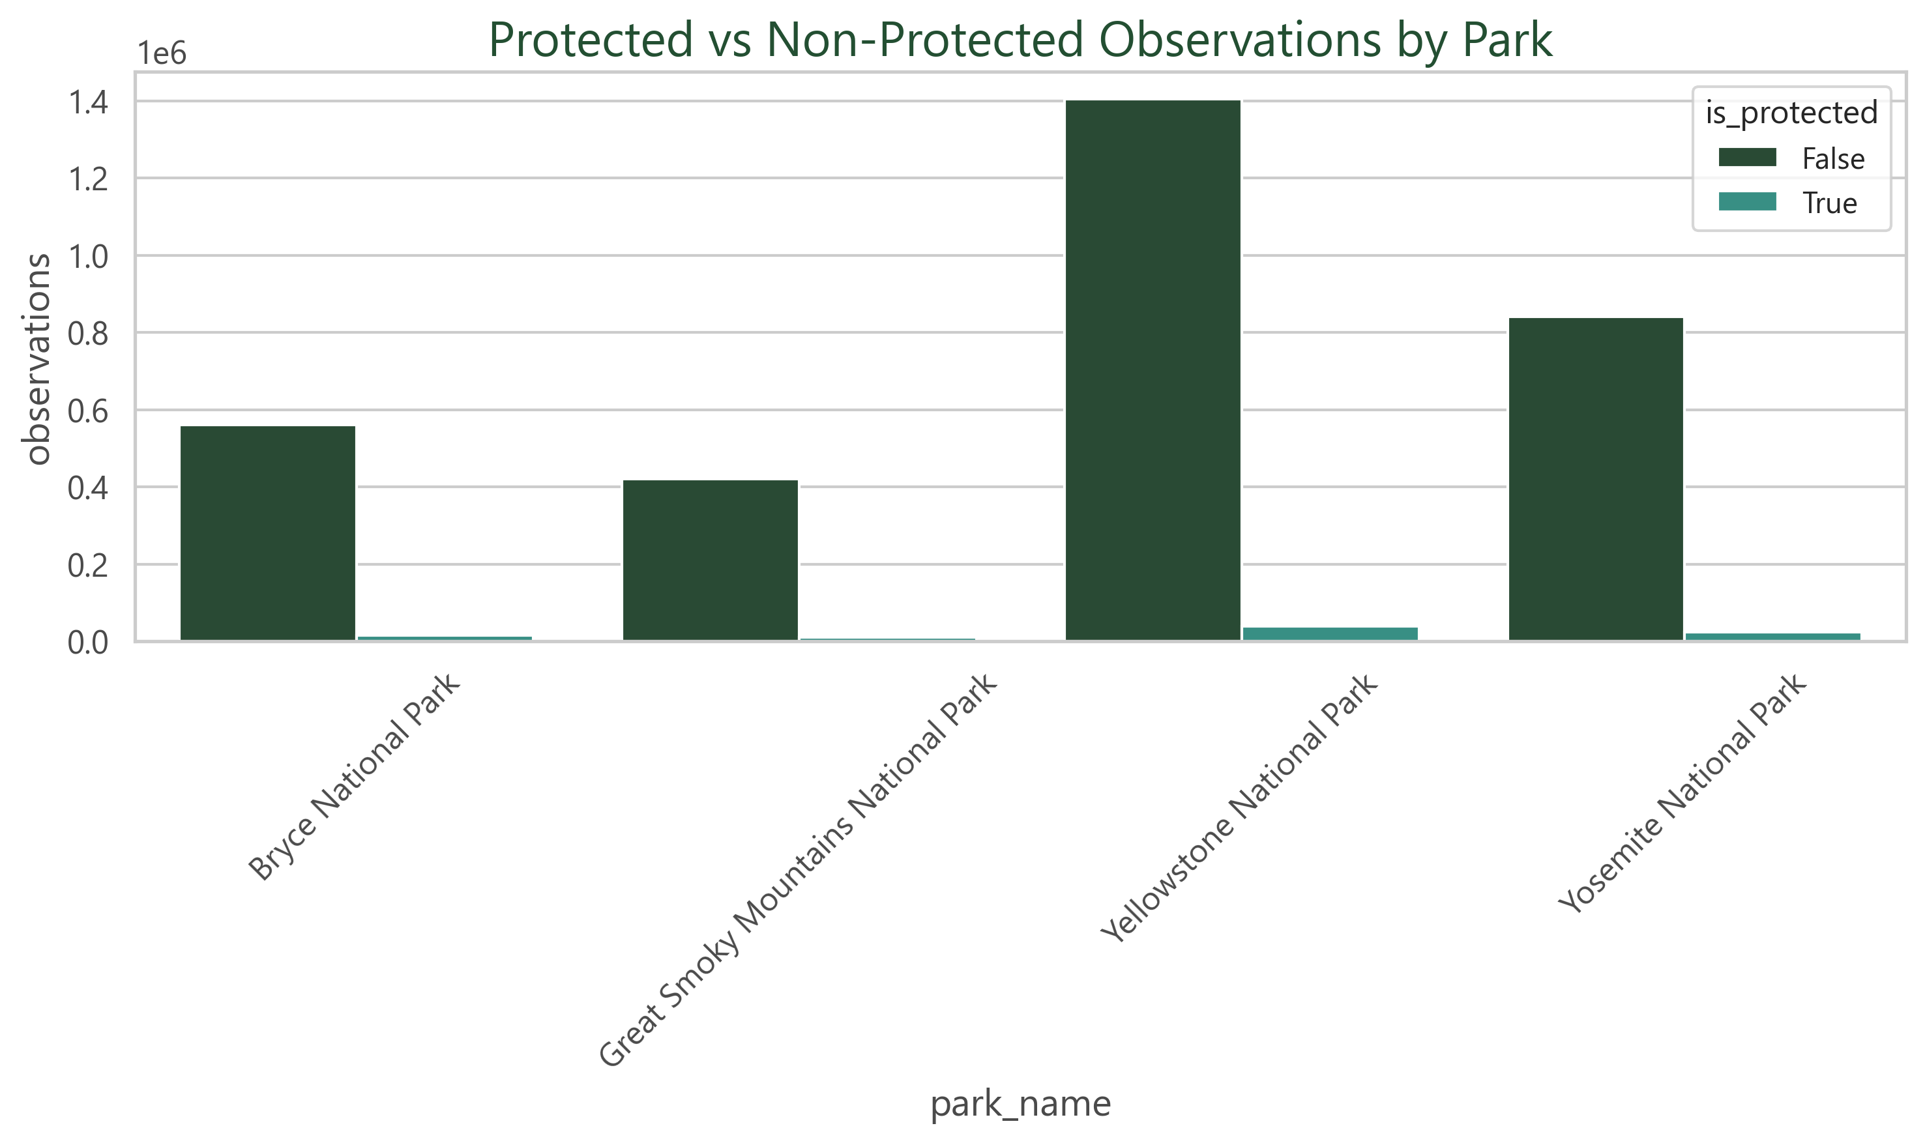
Notes:
Yellowstone and Yosemite show the highest total observations, including protected species. Protected species activity clusters strongly in Yellowstone, suggesting either richer biodiversity or more monitoring effort.

Slide 13
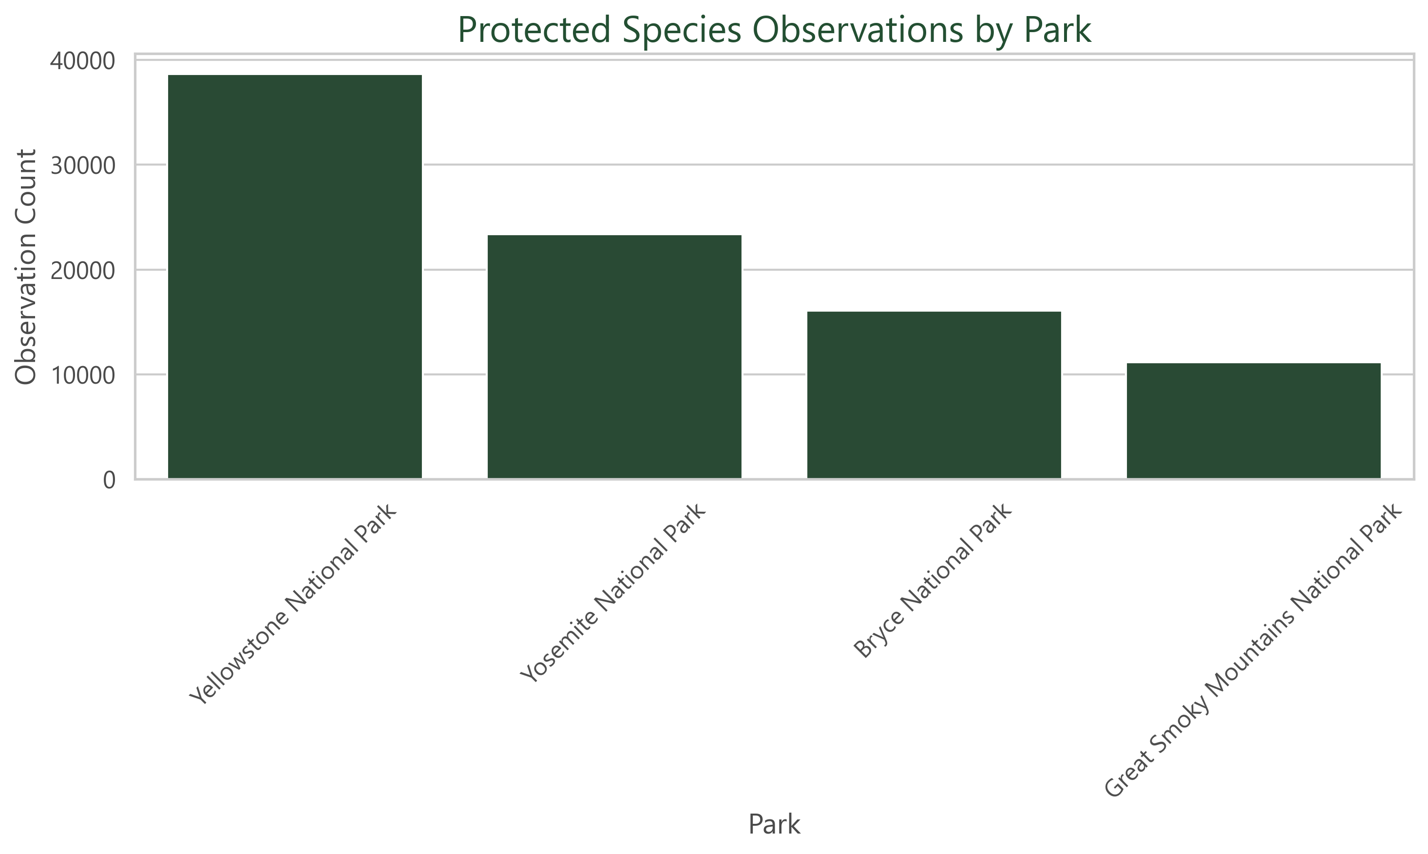
Notes:
Great Smoky Mountains has the lowest protected species observations despite high biodiversity overall. Observation counts do not equal population size but do reflect monitoring intensity and species presence.

Slide 14
Key Question 3
Are certain taxonomic groups disproportionately endangered?
Notes:
Protection percentages were compared against total species counts to reveal uneven ecological risk distribution.

Slide 15
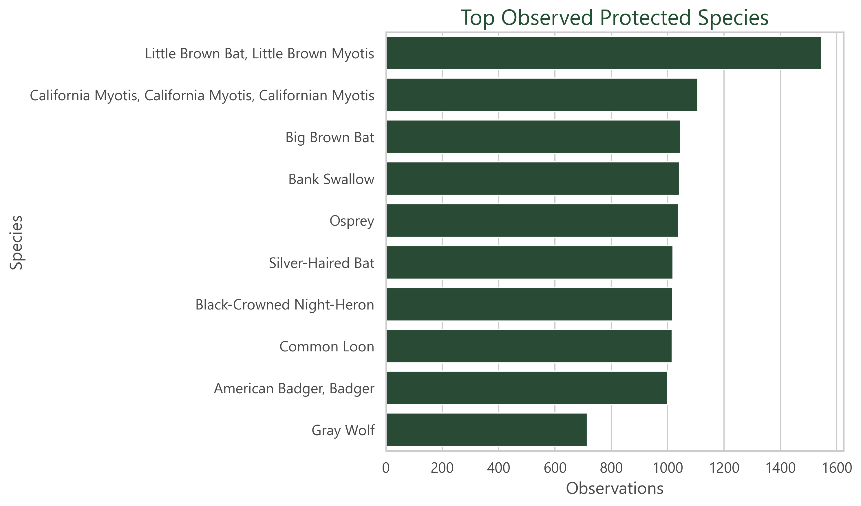
Notes:
Bats dominate the top observed protected species, highlighting their ecological sensitivity and monitoring priority. The Little Brown Bat alone accounts for a large share of protected observations.
Birds and mammals appear frequently in protected lists, but bats are disproportionately represented. This suggests disease (e.g., white‑nose syndrome) and habitat pressures are major drivers.”

Slide 16
Key Findings
• Risk is uneven across categories
• Protected species cluster in specific parks
• Few species dominate protected observations
Notes:
Analysis revealed concentrated conservation pressure rather than evenly distributed risk. Certain categories and parks carry disproportionate ecological importance.

Slide 17
Notes:
Risk is not evenly distributed — mammals and birds show the highest protection rates. Protected species are concentrated in a few parks, especially Yellowstone. A small number of species dominate protected observations, indicating monitoring focus or ecological vulnerability.

Slide 18
Limitations
• Observations ≠ population size
• Limited time-series data
• Assumed missing status = No Intervention
Notes:
The dataset reflects observation counts rather than true population measurements. Future studies should include longitudinal tracking and ecological context.

Slide 19
Conclusion
Data-driven conservation can help prioritize
species categories and parks requiring attention.
Notes:
The analysis demonstrates how data science can support environmental decision-making. Targeted conservation strategies informed by analytics may improve resource allocation and monitoring.

Slide 20
Tools & Skills
Tools Used – Python, Pandas, Seaborn, Matplotlib
Skills Demonstrated – Data Cleaning, EDA, Feature Engineering, Visualization

