Slide 1
DILLI RAJ S
Final Project
3/21/2024 Annual Review

Slide 2
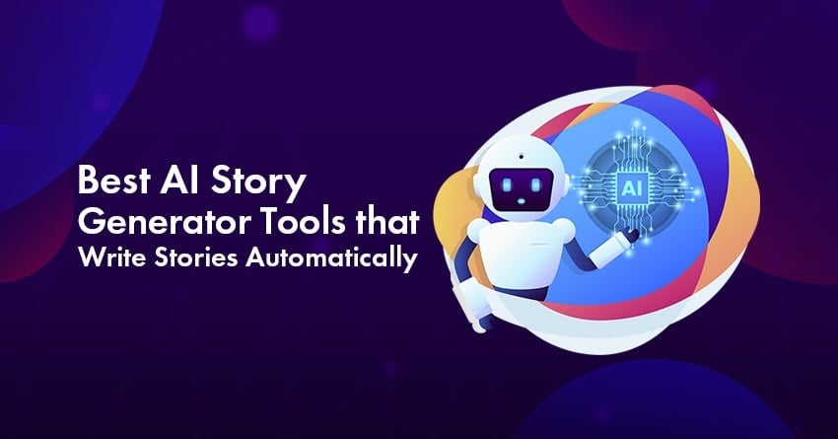
PROJECT TITLE
RNN-based Dialogue Generation with Conditional Text-to-Image Synthesis
3/21/2024 Annual Review

Slide 3


AGENDA
Our project aims to explore the intersection of natural language processing (NLP) and computer vision (CV) by developing a novel system for generating coherent dialogues in conjunction with relevant visual representations. By leveraging recurrent neural networks (RNNs) for dialogue generation and conditional text-to-image synthesis techniques, we aim to create a seamless and immersive conversational experience enriched with visual context.
3/21/2024 Annual Review

Slide 4

PROBLEM STATEMENT
Traditional dialogue generation systems often lack the ability to incorporate visual information, resulting in conversations that may lack depth or relevance. Additionally, generating high-quality images from textual descriptions remains a challenging task. Our project addresses these limitations by proposing a solution that seamlessly integrates text and image modalities to enhance the dialogue generation process.
3/21/2024 Annual Review

Slide 5

PROJECT OVERVIEW
Our project involves developing a system that generates dialogues between virtual agents while incorporating relevant visual context. We employ recurrent neural networks (RNNs) for dialogue generation, allowing our system to capture contextual dependencies and produce coherent responses. Furthermore, we integrate conditional text-to-image synthesis techniques, enabling the generation of visual representations corresponding to the ongoing conversation. This fusion of NLP and CV technologies aims to create engaging and contextually rich dialogues.
3/21/2024 Annual Review

Slide 6

WHO ARE THE END USERS?
The end users of our system encompass various domains, including:
Chatbot developers seeking to enhance the conversational capabilities of their applications.
Virtual assistant platforms aiming to provide more immersive and context-aware interactions.
Educational institutions interested in developing interactive learning environments.
Entertainment industries looking to create compelling narrative experiences in virtual environments.
3/21/2024 Annual Review

Slide 7

YOUR SOLUTION AND ITS VALUE PROPOSITION
Our solution offers several key advantages:
Enhanced Dialogue Quality: By incorporating visual context, our system produces more relevant and engaging dialogues.
Contextual Understanding: The integration of RNNs enables our system to capture contextual dependencies, leading to more coherent responses.
Immersive Experience: The generation of visual representations enriches the conversational experience, making it more immersive and engaging.
Versatility: Our system can be easily integrated into various applications and platforms, catering to diverse user needs across different domains.
3/21/2024 Annual Review

Slide 8

THE WOW IN YOUR SOLUTION
The standout feature of our solution lies in its ability to seamlessly integrate text and image modalities, offering a holistic approach to dialogue generation. By combining advanced NLP techniques with state-of-the-art conditional text-to-image synthesis, we deliver a unique and immersive conversational experience that surpasses traditional dialogue generation systems.
3/21/2024 Annual Review
8

Slide 9
MODELLING
Our system comprises two main components:
Recurrent Neural Network (RNN) for Dialogue Generation: We employ an RNN-based architecture to model the conversational flow and generate coherent responses based on the input dialogue history.
Conditional Text-to-Image Synthesis: We utilize conditional generative adversarial networks (GANs) to generate visual representations corresponding to the ongoing conversation. The generated images are conditioned on both textual dialogue inputs and contextual information.
3/21/2024 Annual Review
9

Slide 10
RESULTS
Upon completion, our project aims to demonstrate:
Improved Dialogue Quality: Evaluation metrics indicating the coherence and relevance of generated dialogues compared to baseline approaches.
Visual Fidelity: Assessment of the quality and relevance of generated images in relation to the corresponding textual descriptions.
User Experience Evaluation: Feedback from end users regarding the immersive and engaging nature of the generated conversations.
Versatility and Integration: Demonstrations showcasing the ease of integration into various applications and platforms catering to different user needs and domains.
https://colab.research.google.com/drive/13OxnNTF0b-_Sl0uQqsQ8Di-6vmiL-vyI#scrollTo=Wf5KrEb6vrkR
10

