Slide 1
Machine Learning LGboost Regression

Slide 2
What is LGBoost Regressor?
LightGBM or 'Light Gradient Boosting Machine', is an open source, high-performance gradient boosting framework designed for efficient and scalable machine learning tasks. It is specially tailored for speed and accuracy, making it a popular choice for both structured and unstructured data in diverse domains.
Key characteristics of LightGBM include its ability to handle large datasets with millions of rows and columns, support for parallel and distributed computing, and optimized gradient-boosting algorithms. LightGBM is known for its excellent speed and low memory consumption, thanks to histogram-based techniques and leaf-wise tree growth.

Slide 3
lightgbm.LGBMRegressor
classlightgbm.LGBMRegressor(*, boosting_type='gbdt', num_leaves=31, max_depth=-1, learning_rate=0.1, n_estimators=100, subsample_for_bin=200000, objective=None, class_weight=None, min_split_gain=0.0, min_child_weight=0.001, min_child_samples=20, subsample=1.0, subsample_freq=0, colsample_bytree=1.0, reg_alpha=0.0, reg_lambda=0.0, random_state=None, n_jobs=None, importance_type='split', **kwargs)

Slide 4
Attributes
best_iteration_ | The best iteration of fitted model if early_stopping() callback has been specified.
best_score_ | The best score of fitted model.
booster_ | The underlying Booster of this model.
evals_result_ | The evaluation results if validation sets have been specified.
feature_importances_ | The feature importances (the higher, the more important).
feature_name_ | The names of features.
feature_names_in_ | scikit-learn compatible version of .feature_name_.
n_estimators_ | True number of boosting iterations performed.
n_features_ | The number of features of fitted model.
n_features_in_ | The number of features of fitted model.
n_iter_ | True number of boosting iterations performed.
objective_ | The concrete objective used while fitting this model.

Slide 5
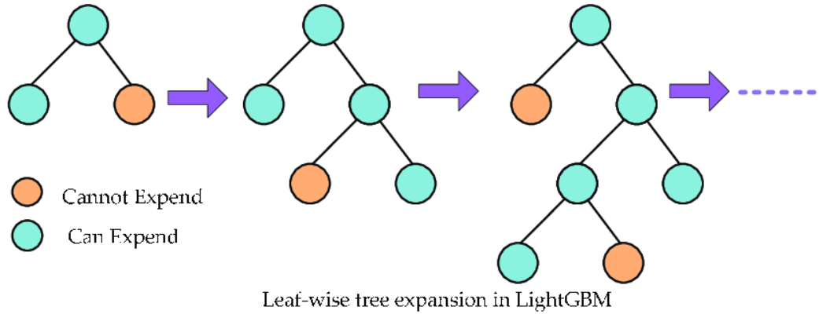

Slide 6
Advantages of the LightGBM
LightGBM offers several key benefits:
Faster speed and higher accuracy: It outperforms other gradient boosting algorithms on large datasets.
Low memory usage: Optimized for memory efficiency and handling large datasets with minimal overhead.
Parallel and GPU learning support: Takes advantage of multiple cores or GPUs for faster training.
Effective on large datasets: Its optimized techniques such as leaf-wise growth and histogram-based learning make it suitable for big data applications.

Slide 7
Disadvantages of the LightGBM
It may under-perform on small datasets because of the complexity reduction methods used.
It may over-fit on noisy data because of the large number of trees used.
It may not be suitable for very deep trees, as the leaf-wise tree growth method used by LightGBM can cause over-fitting.

Slide 8
Thank you

