Slide 1
Machine Learning Adaboost Regression

Slide 2
What is a AdaBoost regressor?
AdaBoost regressor is a meta-estimator.
It begins by fitting a regressor on the original dataset.
It fits additional copies of the regressor on the same dataset.

Slide 3
sklearn.ensemble.AdaBoostRegressor
class sklearn.ensemble.AdaBoostRegressor(estimator=None, *, n_estimators=50, learning_rate=1.0, loss='linear', random_state=None)
This class implements the algorithm known as AdaBoost.
Parameters:
estimator: object, default=None
n_estimatorsint: default=50
learning_rate: float: default=1.0
loss{‘linear’, ‘square’, ‘exponential’}, default=’linear’
random_state: int, RandomState instance or None, default=None

Slide 4
Attributes
estimator_estimator
estimators_list of regressors
estimator_weights_ndarray of floats
estimator_errors_ndarray of floats
n_features_in_int

Slide 5
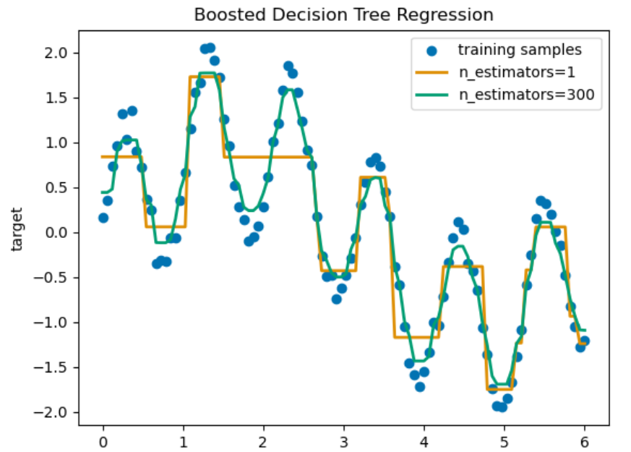

Slide 6
Thank you!

