Slide 1
Machine Learning Adaboost Regression

Slide 2
What is a AdaBoost regressor?
AdaBoost regressor is a meta-estimator.
It begins by fitting a regressor on the original dataset.
It fits additional copies of the regressor on the same dataset.

Slide 3
sklearn.ensemble.AdaBoostRegressor
class sklearn.ensemble.AdaBoostRegressor(estimator=None, *, n_estimators=50, learning_rate=1.0, loss='linear', random_state=None)
This class implements the algorithm known as AdaBoost.
Parameters:
estimator: object, default=None
n_estimatorsint: default=50
learning_rate: float: default=1.0
loss{‘linear’, ‘square’, ‘exponential’}, default=’linear’
random_state: int, RandomState instance or None, default=None

Slide 4
Attributes
estimator_estimator
estimators_list of regressors
estimator_weights_ndarray of floats
estimator_errors_ndarray of floats
n_features_in_int

Slide 5
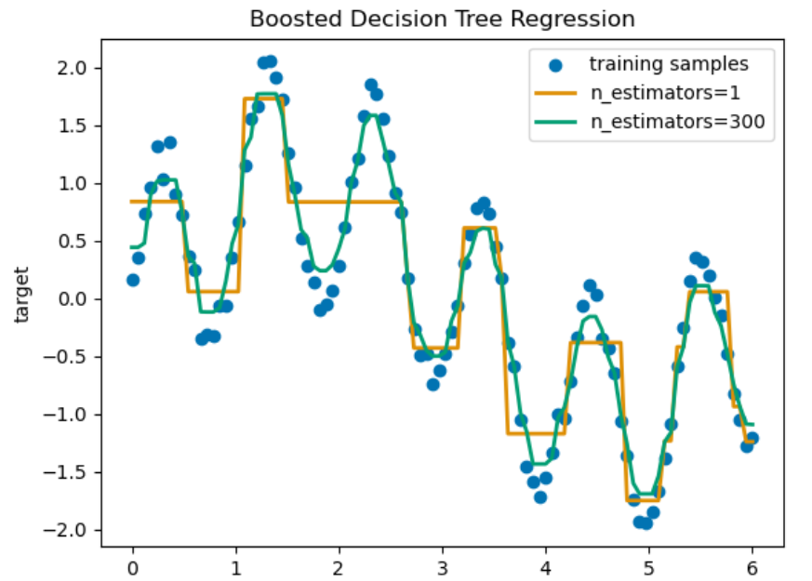

Slide 6
Advantages of Adaboost Algorithm
Can handle binary and multi-class classification problems.
Can handle noisy data and outliers.
Has a high degree of interpretability, since it relies on simple weak classifiers that can be easily understood.
Often results in high accuracy and outperforms other algorithms in many scenarios.
Disadvantages of Adaboost Algorithm
Sensitive to noisy data and outliers that are not properly preprocessed.
Can be computationally expensive, especially with large datasets.
Can lead to overfitting if the weak classifiers are too complex or if the number of boosting iterations is too high.
Requires careful parameter tuning to achieve optimal performance.

Slide 7
Thank you!

