Slide 1
Hierarchical Side-channel Leakage Assessment for Post-Quantum Cryptographic Accelerators
Patrick Schaumont 9/30/25
Notes:
This PowerPoint Template includes a series of slide masters with predefined layouts and color schemes for formatting slides
Slide Masters are displayed when you right click on a slide and select Layout from menu

Slide 2




Why Hierarchical PSLA for RoT (ML‑DSA‑87)?
Secure algorithm ≠ secure implementation
Find leakage early in the design cycle.
Trace root causes across Arch → µArch → Gate
Fixes are cheaper and less risky pre‑tape‑out.
Secure Design (SW + RTL)
Arch PSLA
FIX
Arch Root Cause
Arch Leakage
FIX
μArch Root Cause
μArch PSLA
Emergent uArch Leakage
Logic
Synthesis
Hierarchical PSLA
Parasitics
FIX
Gate Root Cause
Gate PSLA
Emergent Logic Leakage
Backend
Post-silicon SLA
Prototype
Measurement
Notes:
Secure algorithm ≠ secure implementation
RoT anchors boot, attestation, identity
leakage breaks trust
Why Pre-silicon Leakage Assessment(PSLA)?
Detects weaknesses before tape-out
Fixes are cheapest at this stage
Why Hierarchical PSLA?
Large, long-running accelerators
Leakage can be progressive, disappear, or emerge
Requires cross layer analysis

Slide 3

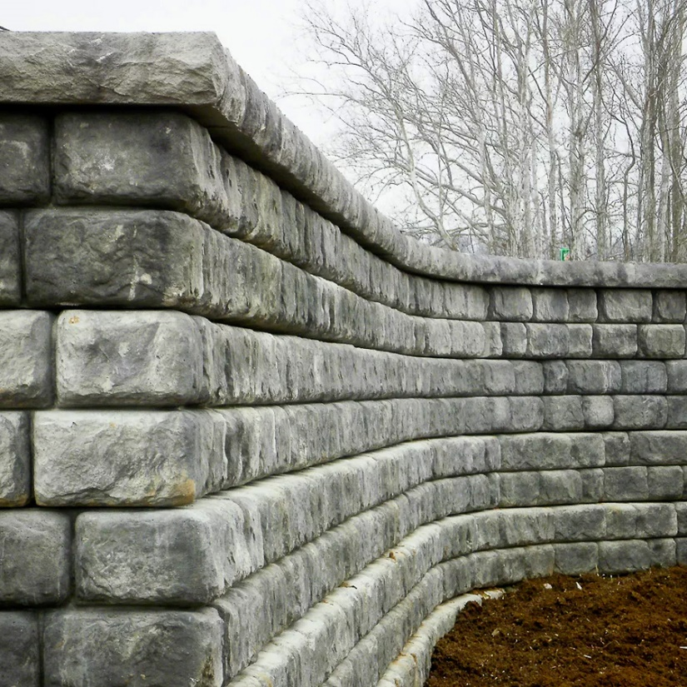


Black‑box vs White‑box testing
Simulator‑driven PSLA scenario
Classic measurement scenario
Operation Selection
Cryptographic
Algorithm
Properties
Simulator
Studied by
Considered
by
ISA with Extensions
Predicts
leakage
Designer
Tester
Implements
Micro-architecture Design
Tester
measures
Black
Box
Gate-level Design
Early
Feedback
White‑box PSLA delivers early feedback
by estimating leakage

Slide 4
Toggle-based Pre-silicon Simulator
Testbench
Replay
Toggle
monitor
Gate level
wrapper
mldsa wrapper
D
memory
Adams Bridge RTL
Signature
Signature same?
Dynamic power ≈ α·C·V²·f; Dynamic power ∝ switching activity (α)
Capture cycle‑accurate toggles (VCD/SAIF) from RTL and gate‑level simulation
Treat toggle counts as the power/EM proxy for leakage testing
Notes:
- Cycle‑accurate toggles preserve the same functional dependence on data as post‑silicon power/EM (up to noise and constant operations overheads).
- Use per‑register toggle features as attack traces; center/align per experiment; run CPA/2oCPA/template.

Slide 5
RTL vs Gate Level Summary
RTL
2 minutes for an mldsa sign operation
Gate Level
RAM modules are synthesized as black-box​
Gate-level model on IHP13, TSMC180​
 | IHP13 | TSMC180
RAM | 10 | 10
Flip Flop | 273,701 | 273,363
Comb + Flip Flop | 1,153,569 | 824,942
Cell Area (sqmu) | 26,338,600.335 | 20,146,217.239
Simulation(Time) | 7 hours | 15 hours
Challenge: scaling correlation, TVLA to full design

Slide 6
ML-DSA-87: Point of Interest
Signing :
To sign a message M ∈ {0,1}*,
Alice does:
Compute c = H(M || w).
Compute z = y + cs₁.
Output σ = (c, z).
w is commitment
c is challenge
z is response
c.s₁ is critical security parameter
s₁ is secret
The coefficients have 23 bits
Number-Theoretic Transform(NTT)
Z = NTT(c) * NTT(s₁) * is point-wise multiplication(PWM)
This step is vulnerable to side‑channel attacks.
Notes:
Alice’s verification key is (A, t),
where A ∈R and t = As₁ + s₂
where s₁ ∈R and s₂ ∈R
Alice’s signing key is (s₁, s₂).

Slide 7
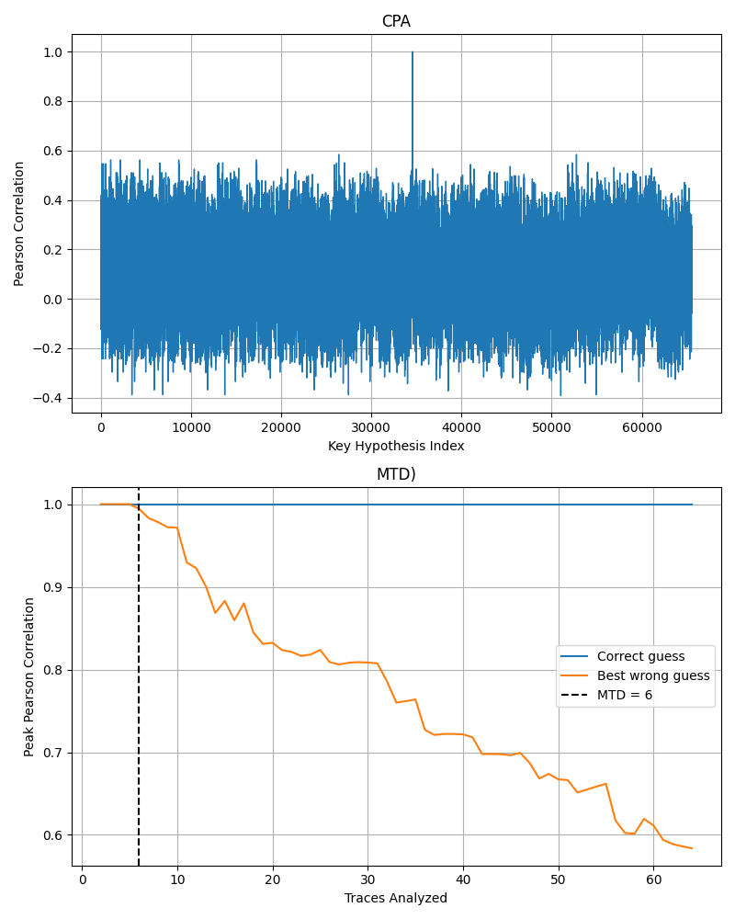
PSLA : Unprotected point-wise multiplication
Z = c.s₁
We collect toggle counts of the register holding Z = c⋅s₁ as a power proxy
Correlate with a hypothetical power model

Slide 8



PSLA: Masked two-share PWM (2s-PWM)
Masked 2-share product Z = C⋅S1 (mod q)
q is 8380417; S1 is secret; C is known;
mask variables : m1, m2; refresh : r
S1 - m1​
m1​
r
C - m2​
m2​
Second order leakage models
HD_{t1} = HD(C0) + HD(D0) + HD(C1) + HD(D1)
HD_{t2} = HD(Z0) + HD(Z1) HD = Hamming Distance
L _{product} = HD_{t1} * HD_{t2} L _{abs diff} = abs (HD_{t1} - HD_{t2} )
L _{sum of sq} = (HD_{t1} * HD_{t2} + HD_{t1} * HD_{t2} )
C0​
D0​
D1​
C1​
t1
Z0
Z1​
t2
Expose coupling in masked data paths

Slide 9
Results: Key Rank and Traces
MTD by distinguisher
Key rank vs traces​
Distinguishers | Traces (MTD)
CPA (PWM) | 6
SOCPA (2S PWM) | 10250
Template (2S PWM) | 55
Traces | Key rank (23bit)
 | L _{product} | L _{abs diff} | L _{sum of sq}
6 | 1 | 1 | 1
10250 | 163 | 147 | 1
55 | 5 | 1 | 1
Our analysis identified successful second‑order attacks on masked PWM

Slide 10
Parallel 2S‑PWMs: Randomness Reuse Weakness
C0
D0
D1
C1
C0
D0
D1
C1
C0
D0
D1
C1
C0
D0
D1
C1
Z0
Z1
Z0
Z1
Z0
Z1
Z0
Z1
Masks m1,m2 identical across instances (→ same C1 ).
Randomness reused in two instances (white)
Result: partial key recovery for those instances.

Slide 11
Plan for Next Phase
Gate‑level PSLA
build efficient simulator
define gate‑level distinguishers
account for multiple leakage sources of CSPs.
Cross-layer Analysis
Hierarchical PLSA with outcome matching across levels
Identify a module for tape out

Slide 12
Selected References
Cross-layer Analysis
Z. Liu, A. Malnicof, A. Roy, P. Schaumont: Telescope: Top-Down Hierarchical Pre-silicon Side-channel Leakage Assessment in System-on-Chip Design. 20th ACM ASIA Conference on Computer and Communications Security (AsiaCCS 2025), August 2025, Hanoi, Vietnam.
* M.-J. O. Saarinen, “WiP: Applicability of ISO Standard Side‑Channel Leakage Tests to NIST Post‑Quantum Cryptography,” Cryptology ePrint Archive, Report 2022/229, 2022. [Online]. Available: https://eprint.iacr.org/2022/229.pdf
Caliptra : Adams bridges https://github.com/chipsalliance/adams-bridge

Slide 13
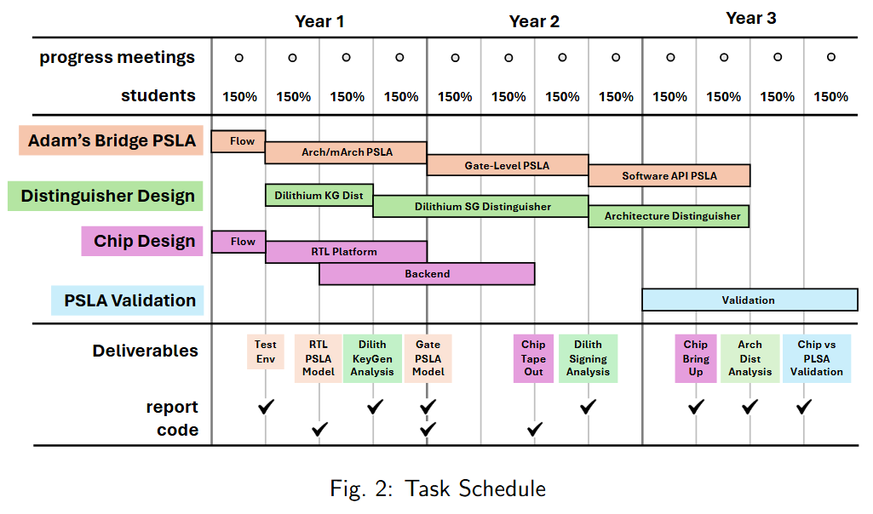
Project Schedule
Annual Review
Current Focus
Arna Roy
Dillibabu Shanmugam
Pending

Slide 14
Thank you

Slide 15
Cross-layer Analysis

Slide 16
Cross Layer Analysis
Secure Design (SW + RTL)
Arch PSLA
FIX
Arch Root Cause
Arch Leakage
FIX
μArch Root Cause
μArch PSLA
Emergent uArch Leakage
Logic
Synthesis
Hierarchical PSLA
Parasitics
FIX
Gate Root Cause
Gate PSLA
Emergent Logic Leakage
Backend
Post-silicon SLA
Prototype
Measurement

Slide 17

Matching the PSLA outcomes
False Negative
False Positive
Leaky
Undecided
High-Level Model (e.g. instruction- accurate)
Leakage Test
N
N
Y
Y
Design Refinement
Low-Level Model (e.g. cycle- accurate)
Leakage Test
N
Y
N
Y
Progressive Leakage

Slide 18
Matching the PSLA outcomes
False Negative
False Positive
Leaky
Undecided
High-Level Model (e.g. instruction- accurate)
Leakage Test
N
N
Y
Y
Design Refinement
Low-Level Model (e.g. cycle- accurate)
Leakage Test
N
Y
N
Y
Emerging Leakage
Progressive Leakage

Slide 19
Matching the PSLA outcomes
False Negative
False Positive
Leaky
Undecided
High-Level Model (e.g. instruction- accurate)
Leakage Test
N
N
Y
Y
Design Refinement
Low-Level Model (e.g. cycle- accurate)
Leakage Test
N
Y
N
Y
Emerging Leakage
Disappearing Leakage
Progressive Leakage

Slide 20
Hierarchical Root causing
To demonstrate progressive side-channel leakage, we must establish a causal relationship between the SLA results at different abstraction levels
However, this cannot be achieved by looking at data alone (aka the plausible deniability problem of root-causing ..)
high
level
t-value
???
low
level
t-value

Slide 21
Hierachical Root Causing through Dependencies
Architecture
Time (Cycles)
a
Micro-architecture
Time (Cycles)
causes
Gate-level
Time (Cycles)
Intracycle Dependency Analysis
a

Slide 22
Hierachical Root Causing through Dependencies
Architecture
c
Time (Cycles)
Micro-architecture
b
Time (Cycles)
Gate-level
Time (Cycles)
Intercycle Dependency Analysis
b
c

Slide 23
Defining the dependency
a dependency implies a timing path through digital logic
1 cycle
reg2
dependency examples:
reg1 to reg2
gate2 to reg2
reg1 to gate3
reg1
gate1
gate3
gate2
start point
register output
primary input
path elements
logic gates
wiring
end point
register input
primary output

Slide 24
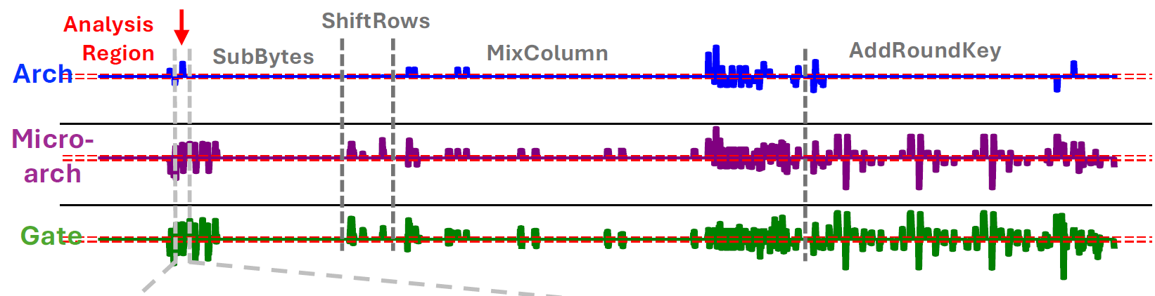
Example: Tracking Progressive Leakage
AES128_Encrypt:
...
lbu a4, 0(a4); load sbox[index]
sb a4, -1(a5); store in state
fix-vs-random test on a plaintext byte

Slide 25
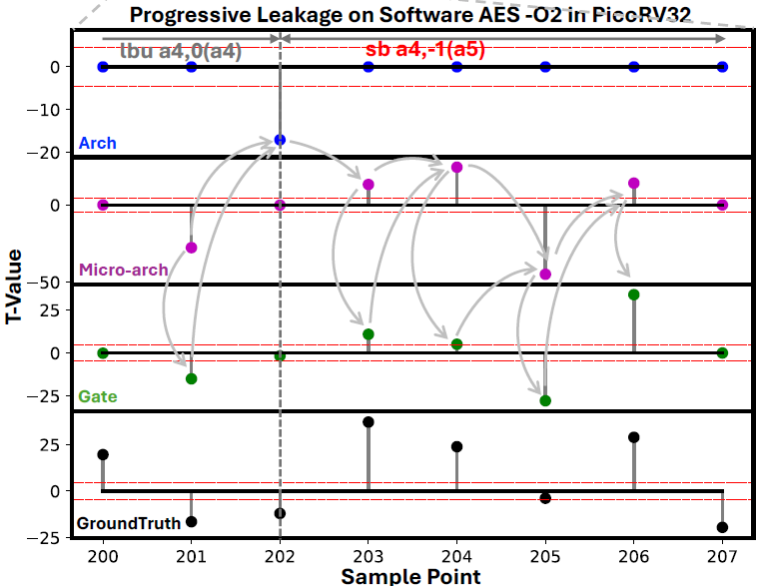
Example: Tracking Progressive Leakage

Slide 26
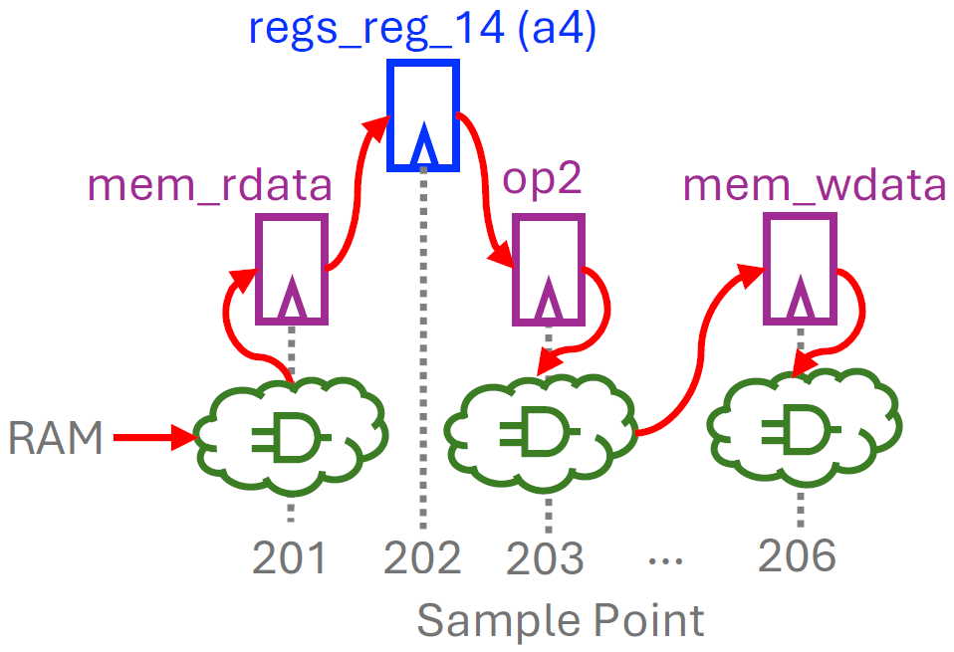
Example: Tracking Progressive Leakage

Slide 27
Example: Tracking Progressive Leakage
Gate Power Post Syn

Slide 28
Adams Bridge PSLA

Slide 29
Distinguishing features of the PQC PSLA
Analysis on very large implementation
No architecture-level
Micro-architecture level: 508,413 flip-flops in ML-DSA (+ 408,608 SRAM bits)
Gate-leve: TBD

Slide 30
Distinguishing features of the PQC PSLA
Analysis on very large implementation
No architecture-level
Micro-architecture level: 508,413 flip-flops in ML-DSA (+ 408,608 SRAM bits)
Gate-leve: TBD
Multiple sources of leakage of CSPs*
Dilithium
Sign/Verify API
Message distinguisher
Public/Secret Key distinguisher
Kyber
Encrypt/Decrypt API
Secret Key/ Public Key distinguisher
Encapsulate/Decapsulate API
Plaintext Checking
* M.-J. O. Saarinen, “WiP: Applicability of ISO Standard Side‑Channel Leakage Tests to NIST Post‑Quantum Cryptography,” Cryptology ePrint Archive, Report 2022/229, 2022. [Online]. Available: https://eprint.iacr.org/2022/229.pdf

Slide 31
Distinguishing features of the PQC PSLA
Analysis on very large implementation
No architecture-level
Micro-architecture level: 508,413 flip-flops in ML-DSA (+ 408,608 SRAM bits)
Gate-leve: TBD
Multiple sources of leakage of CSPs*
Very large activity footprint
MLDSA signing takes 42,666 cycles creating a 24G VCD file
Dilithium
Sign/Verify API
Message distinguisher
Public/Secret Key distinguisher
Kyber
Encrypt/Decrypt API
Secret Key/ Public Key distinguisher
Encapsulate/Decapsulate API
Plaintext Checking
Main Analysis Challenge is on scaling up traditional testing techniques (Correlation, TVLA, ..) to apply to a very large design. Hierarchical top/down analysis will be essential.
* M.-J. O. Saarinen, “WiP: Applicability of ISO Standard Side‑Channel Leakage Tests to NIST Post‑Quantum Cryptography,” Cryptology ePrint Archive, Report 2022/229, 2022. [Online]. Available: https://eprint.iacr.org/2022/229.pdf

Slide 32
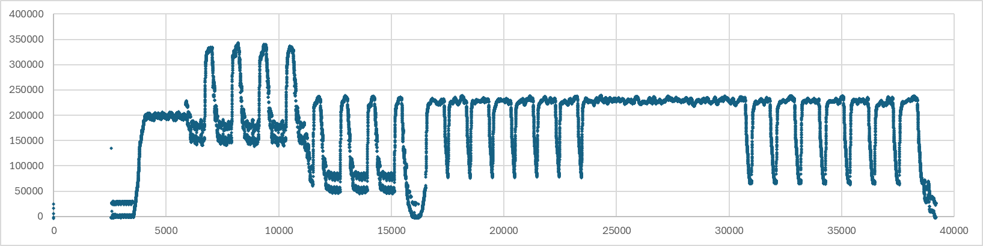
Starting Point
Pre-silicon Side-channel Leakage Assessment Model for ML-DSA
Performs VCD toggle counting on RTL model
https://github.com/ml-dsa/abr-sim
https://github.com/chipsalliance/adams-bridge

Slide 33
Planned Activities (next 3 months)
Planned Activities
Rework testbench to do micro-arch level PSLA
Build distinguishers for ML-DSA leakage testing
Key generation
Signature Generation
Synthesize a gate-level model for gate-level PSLA
Currently aiming at IHP SG13G2 (130nm) Open Source PDK with SRAM cells
Extend testbench to do gate level PSLA

Slide 34
Project Schedule
Annual Review
Current Focus
Arna Roy
Dillibabu Shanmugam
Pending

Slide 35
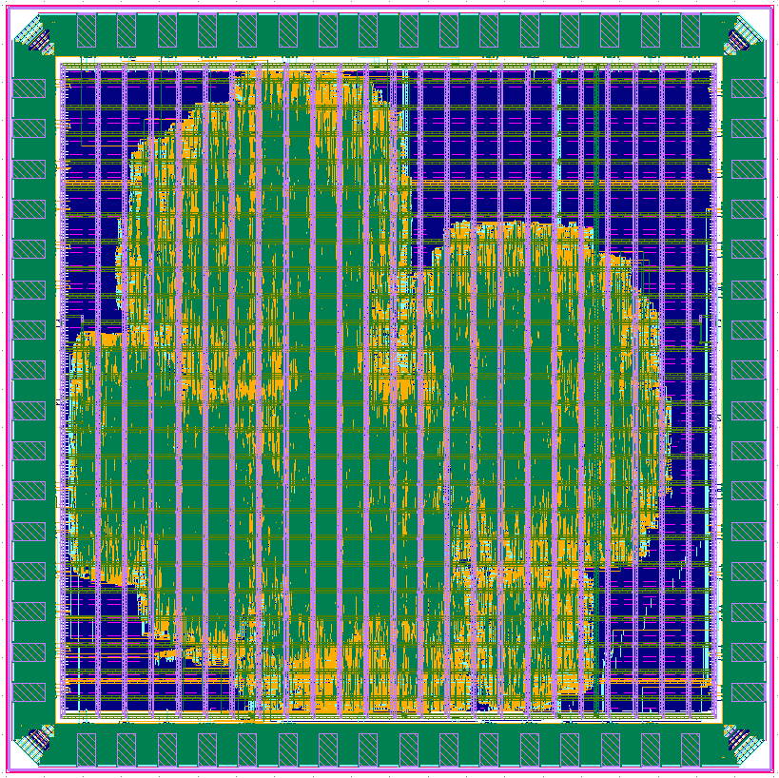
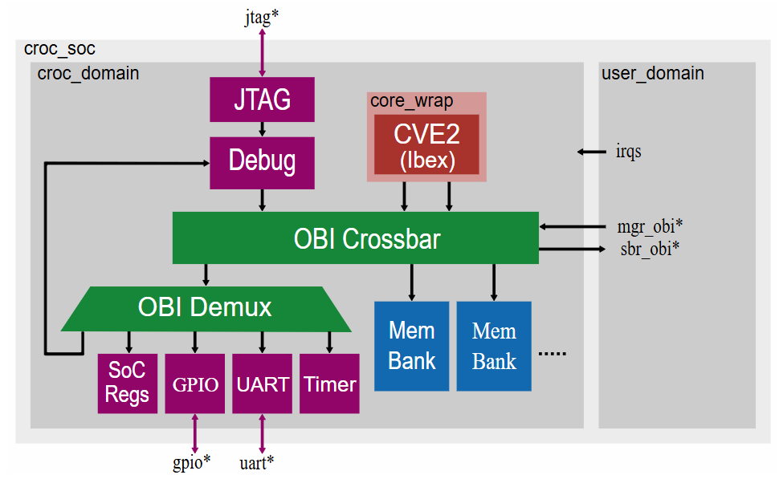
Jun 11, 2025 Tapeout
180 MS RF G

Slide 36
Discussion

Slide 37
How much power detail do we need?
6
IR Drop
R
i
Vdd
Static leakage
A
3
1
Transitions
B
2
Early propagation & glitches
Y
C
X
4
Capacitive coupling
Vss
Substrate noise coupling
5

Slide 38
How much power detail do we need?
6
IR Drop
R
i
Vdd
Signal/Power Integrity
Gate Power Post Syn
Static leakage
A
3
Toggle
1
Transitions
B
2
Early propagation & glitches
Y
C
X
4
Capacitive coupling
Gate Power Post Layout
Vss
Substrate noise coupling
5

