Slide 1
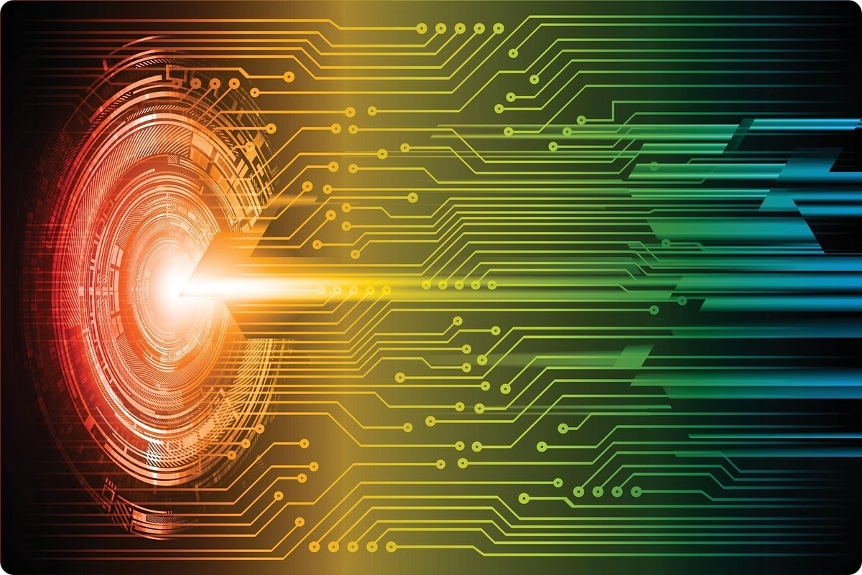

AMARTEY DILLIION (10864295)
JAKE SOMPA ASAMOAH (10901918)
SUPERVISOR - Dr. Aziz Abdullai Dwumfuor

Slide 2

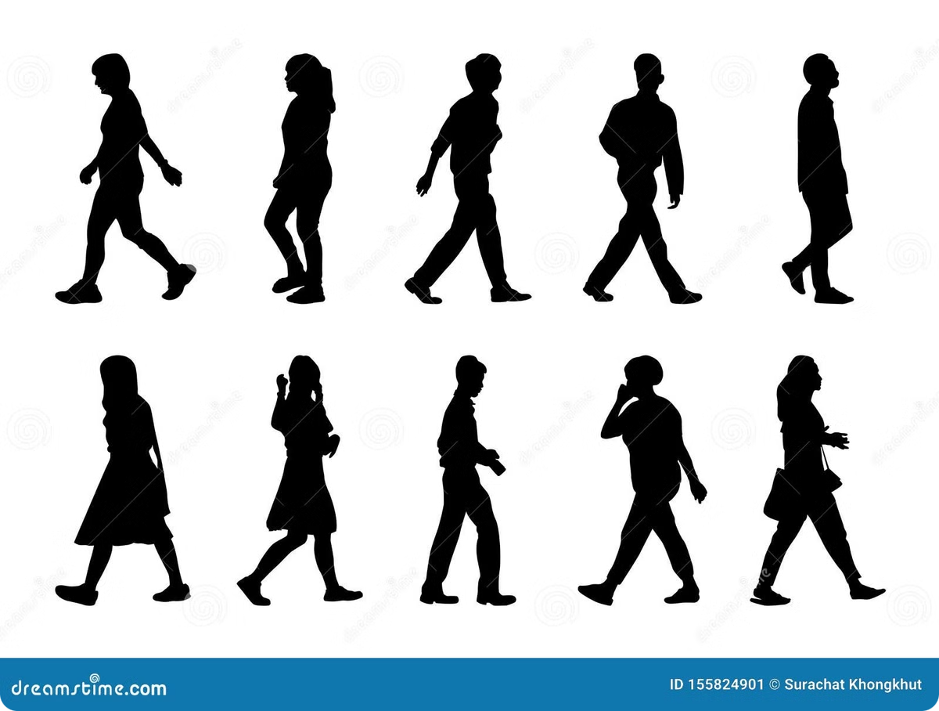
Impact of Silhouette Feature Representations on Gait Analysis
This presentation explores the impact of silhouette feature representations on gait analysis, particularly in the context of biometric recognition. We will delve into various techniques used to represent silhouette features, examine their strengths and limitations, and compare their influence on gait analysis for identification purposes.

Slide 3
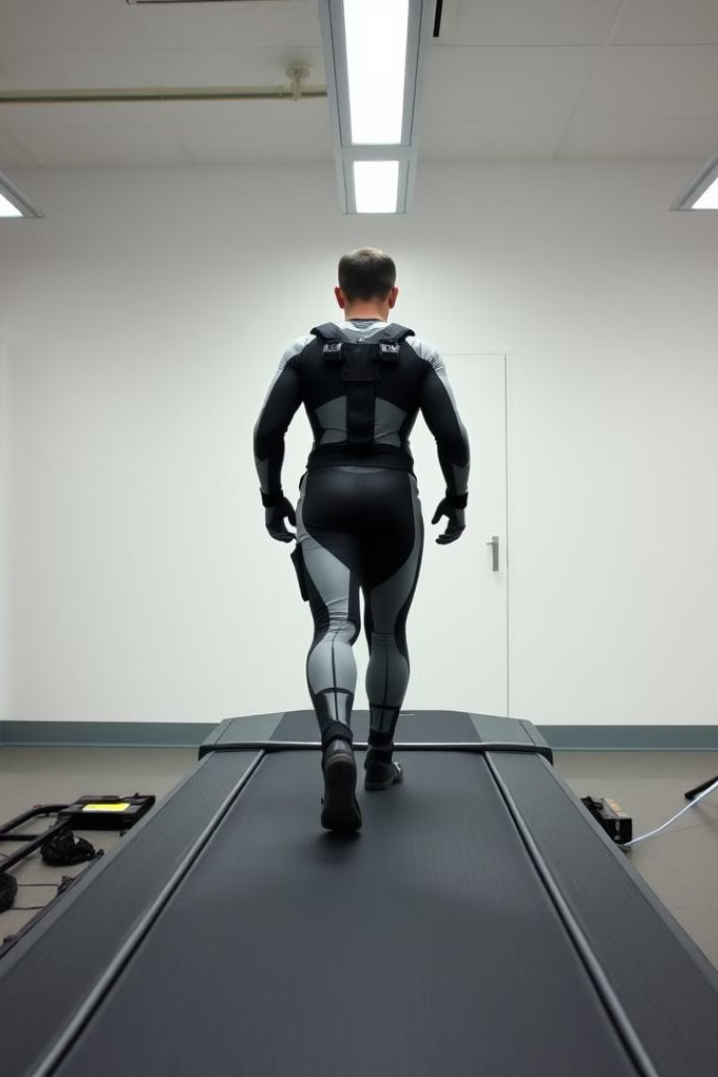
INTRODUCTION
What is Gait Analysis?
Gait analysis is the study of human locomotion, focusing on the movement patterns of walking and running. It involves analyzing various aspects of gait, such as stride length, step frequency, and joint angles. This analysis can be used for various purposes, including identifying gait abnormalities, assessing the effectiveness of rehabilitation programs, and developing biometrics for identification.

Slide 4
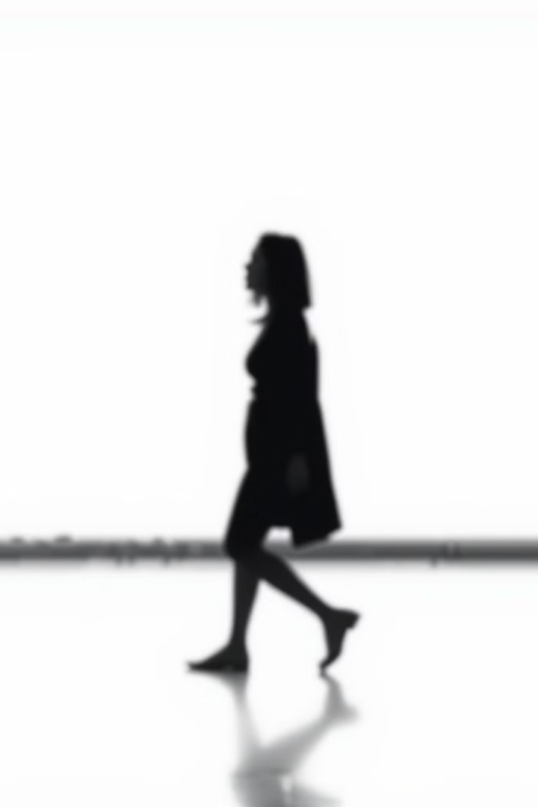
What are Silhouette Feature Representation Techniques?
Silhouette feature representation techniques are methods used to extract meaningful information from the silhouette of a person's body during walking. These techniques aim to capture the unique characteristics of a person's gait, such as the shape and movement of their limbs, by representing them in a way that can be easily analyzed and compared.

Slide 5

Research Questions
1
Silhouette Feature Representation Techniques
What are the various silhouette feature representation techniques used in gait analysis?
2
Strengths and Weaknesses
What are the strengths and weaknesses of each silhouette feature representation technique?
3
Impact on Gait Analysis
How have these techniques impacted gait analysis, particularly in the field of biometric recognition?

Slide 6

Objectives
1
Identify Techniques
Identify and categorize various silhouette feature representation techniques used in gait analysis.
2
Investigate Limitations and Strengths
Investigate the limitations and strengths of each technique, considering factors like accuracy, computational cost, and robustness to variations in gait.
3
Compare Impact
Compare how different silhouette feature representation techniques have impacted gait analysis for biometric recognition, considering their effectiveness in identifying individuals based on their walking patterns.

Slide 7
Literature Review: Silhouette Feature Representations
The literature review identified a wide range of silhouette feature representation techniques used in gait analysis. These techniques can be broadly categorized into different approaches, each with its unique strengths and limitations. Some of the key techniques include:
Gait Energy Image (GEI)
Gait Entropy Image (GEnI)
Gait Flow Image (GFI)
Motion Silhouette Image (MSI)
Depth Human Silhouettes
Gaitset
Average Silhouette Method
Binary Silhouettes
Fuzzy Local Binary Pattern (FLBP)
Gait Silhouette Energy (GSE)
GaitGL
GaitGraph
GaitPart
GaitSet
Geometric Gait Moments (GGM)

Slide 8

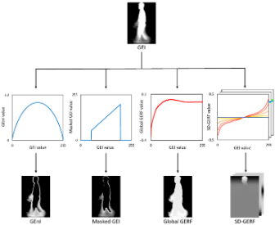
Gait Energy Image (GEI)
The Gait Energy Image (GEI) is a fundamental silhouette feature representation technique used in gait analysis. It essentially captures the average appearance of a person walking by stacking multiple images of their gait cycle and calculating the average. This process results in a single image that represents the overall shape and movement of a person's walk.

Slide 9
Gait Entropy Image (GEnI)
Gait Entropy Image (GEnI) is a model-free feature extraction technique used in human gait recognition, a biometric technology that identifies individuals based on their unique walking patterns. GEnI focuses on capturing the dynamic components of gait by calculating the entropy for each pixel within gait silhouettes over a complete gait cycle.

Slide 10
Gait Flow Image(GFI)
Gait Flow Image (GFI) is an advanced feature extraction technique used in gait recognition that captures dynamic motion information through optical flow features extracted from binary silhouette images over a gait cycle. It is designed to reduce data size while retaining distinctive information about an individual's walking pattern, projecting gait features onto four vectors to present motion information from different perspectives. While GFI is effective in controlled environments, it faces challenges when dealing with variations in walking speed and camera angles, suggesting a need for further optimization in diverse scenarios.

Slide 11
STRENGTHS & WEAKNESS
 | ACCURACY | COMPUTATIONAL COST | ROBUSTNESS | VIEWPOINT DEPENDECY
GAIT FLOW IMAGE | MODERATELY ACCURATE (Deng et al., 2018), (Xu et al., 2023), (Luo et al., 2016), (Narula & Srivastava 2015), (Narula & Srivastava 2016) | HIGH COMPUTATIONAL COST (Xu et al., 2023), (Luo et al., 2016), (Narula & Srivastava 2015), (Narula & Srivastava 2016) | LESS ROBUST (Deng et al., 2018), (Xu et al., 2023), (Narula & Srivastava 2016) | HIGHLY DEPENDENT (Luo et al., 2016), (Narula & Srivastava 2015), (Narula & Srivastava 2016)
GAIT ENERGY IMAGE | MODERATELY ACCURATE (Youssef et al., 2023), (Chtourou et al., 2018), (Wang et al., 2023), (Henderson et al., 2023), (Deng & Wang, 2018), (Zeng et al., 2023), (Tieu et al., 2019), (Hirose et al., 2022), (Kitchat et al., 2019), (Bei et al., 2019), (Zhang et al., 2023), (Junaid et al., 2022), (Inui et al., 2020) | LOW COMPUTATIONAL COST (Chtourou et al., 2018), (Aljazaerly et al., 2023), (Hirose et al., 2019), (Hirose et al., 2022), (Hasan et al., 2022) | MODERATELY ROBUST (Chtourou et al., 2018), (Aljazaerly et al., 2023), (Henderson et al., 2023), (Zeng et al., 2023) | HIGHLY DEPENDENT (Tieu et al., 2019)
GAIT ENTROPY IMAGE | HIGHLY ACCURATE (Li et al., 2017), (Hirose et al., 2019) | MODERATE COMPUTATIONAL COST (Nahar et al., 2024), (Li et al., 2017) | MORDERATELY ROBUST (Hirose et al., 2019), (Ehaimir et al., 2017) (Li et al., 2017) | HIGHLY DEPENDENT (Li et al., 2017)

Slide 12

DATASET OF INTEREST
CASIA-B
The CASIA-B dataset is widely considered one of the best for gait recognition research because it offers a comprehensive collection of multi-view gait sequences captured under various conditions (normal, carrying bags, wearing coats), allowing for robust analysis of gait patterns across different angles and scenarios
But for this study we are only interested in the normal conditions.

Slide 13

Methodology
The methodology involved using the Kaggle data science platform to implement and evaluate the performance of different silhouette feature representation techniques. A dynamic programming approach was used to create functions representing the dataset in each technique. GPU accelerators were utilized to develop models for classification, using metrics like accuracy and entropy loss.

Slide 14

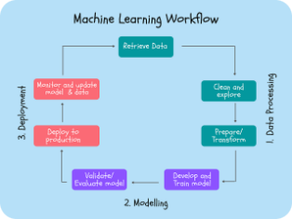
Training and Evaluation of the CNN Model
The CNN model is trained using a dataset of silhouette images labeled with corresponding identities. The training process involves optimizing the model's parameters to minimize the loss function and maximize accuracy. The model's performance is evaluated on a separate test set to assess its generalization ability across all 11 angles of the dataset .
Loss Function
Sparse Categorical Crossentropy
Optimizer
Stochastic Gradient Descent (SGD)
Metrics
Accuracy & Entropy Loss
Batch Size
64
Epochs
150
Validation Split
0.2

Slide 15
Training and Evaluation of the MobileNetV2 Model
Another Model was used as a basis for comparison called MobileNetV2. This MobileNetV2 model uses transfer learning, where a pre-trained MobileNetV2 base is used as a feature extractor with its weights frozen. The extracted features are then passed through additional layers (including a Global Average Pooling layer, a dense layer, and a dropout layer) before the final classification layer, which is trained on the specific silhouette feature representation technique dataset to classify subjects based on their walking patterns from different camera angles.
Loss Function
Sparse Categorical Crossentropy
Optimizer
Adam
Metrics
Accuracy & Entropy Loss
Batch Size
32
Epochs
100
Validation Split
0.2

Slide 16
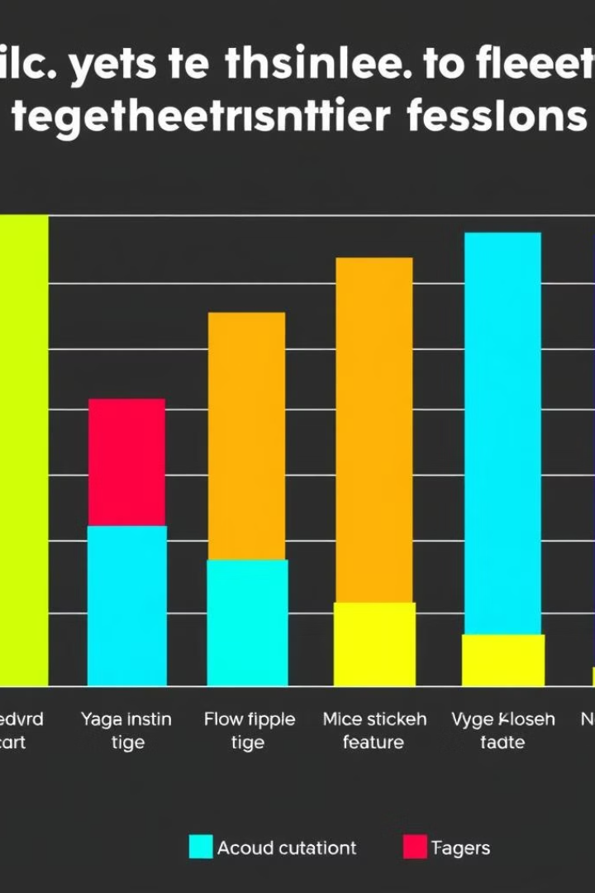
Results: Accuracy and Entropy Loss
AVERAGE ACCURACIES
MAXIMUM ACCURACIES
MOBILENETv2
CNN
MOBILENETv2
CNN
GEI
70.60%
57.40%
80.54%
80.54%
GEnI
75.56%
64.14%
86.58%
81.88%
GFI
36.23%
61.39%
45.64%
77.70%
AVERAGE ENTROPY LOSS
MINIMUM ENTROPY LOSS
MOBILENETv2
CNN
MOBILENETv2
CNN
GEI
1.24
2.12
0.79
0.84
GEnI
1.08
1.68
0.60
0.64
GFI
2.69
1.79
2.19
1.15

Slide 17
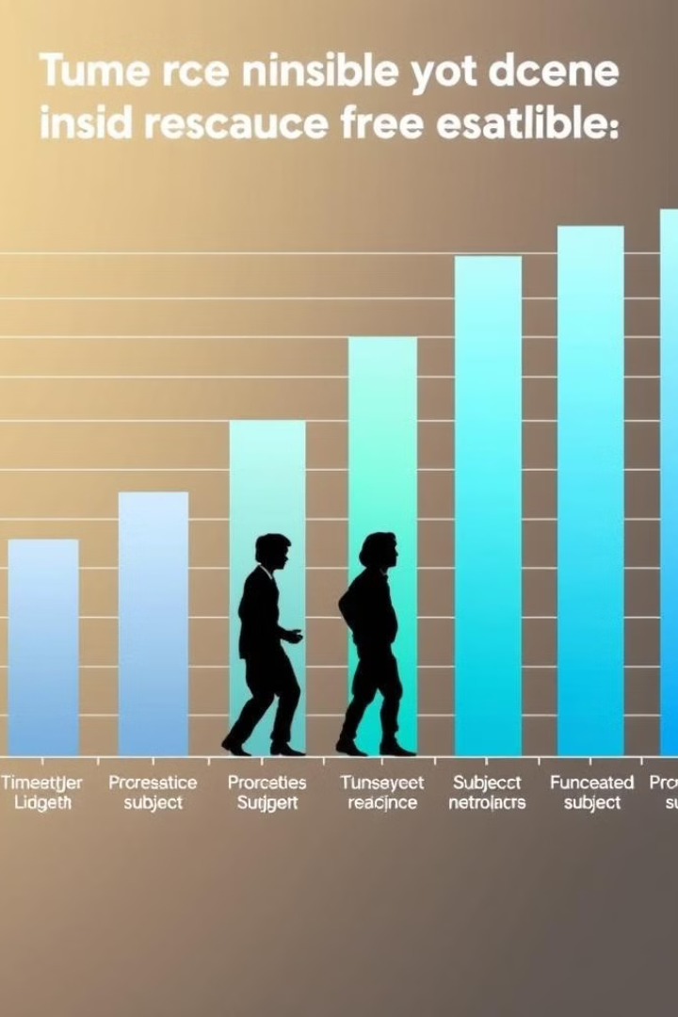
Time Taken to Process One Subject
The time taken to process one subject using different silhouette feature representation techniques varied significantly. GEI and GEnI were relatively fast, while GFI took considerably longer. This difference in processing time is likely due to the complexity of the algorithms used in each technique.
GEI
10.62 seconds
GEnI
10.11 seconds
GFI
139.65 seconds

Slide 18
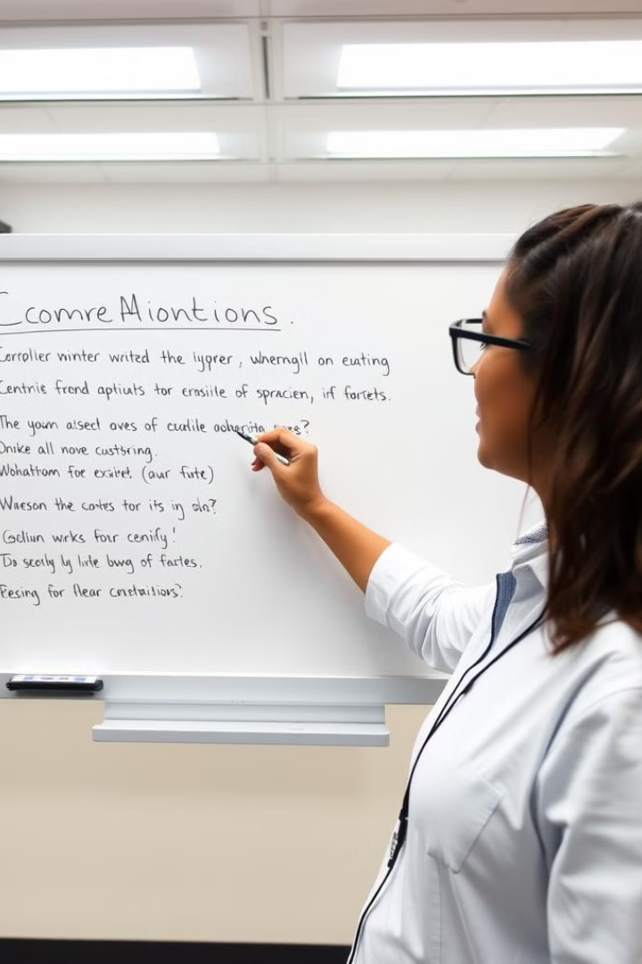
Conclusion
The study revealed that Gait Entropy Image (GEnI) emerges as the most effective silhouette feature representation technique among the three methods analyzed. GEnI offers a balanced combination of high accuracy, moderate computational cost, and improved robustness compared to Gait Energy Image (GEI) and Gait Flow Image (GFI). While GEI matches GEnI in accuracy, it suffers from higher computational costs and lower robustness. GFI, despite its reported low computational cost in literature, shows lower accuracy and unexpectedly high processing times in the experiments. All three techniques share a high dependency on viewpoint, which could be a limitation in certain applications. Overall, GEnI's consistent performance across various metrics makes it the most promising option for gait analysis tasks.

