Slide 1
EduTrack
Student Performance Analysis System
A web application to organize student records, marks, results and academic performance insights.
Project presentation | B.Tech CSE
EduTrack | Student Performance Analysis System
1

Slide 2
Problem Statement
•
Student information and marks may be stored across separate sheets or records.
•
Manual checking makes it harder to review subject-wise performance and identify students who may need support.
•
EduTrack brings student details, marks, results and analytics into one web interface.
EduTrack | Student Performance Analysis System
2

Slide 3
Project Objectives
•
Maintain student details such as roll number, name and section.
•
Record and manage assessment marks for configured subjects.
•
Present results and pass/fail outcomes from entered marks.
•
Summarize subject performance and flag students who may need teacher assistance.
EduTrack | Student Performance Analysis System
3

Slide 4
Technology Stack
•
Frontend: HTML, CSS and JavaScript for pages and user interactions.
•
Backend: Python with Flask routes and server-side logic.
•
Database: MySQL hosted on Aiven for online data storage.
•
Deployment: Render hosts the Flask web application; GitHub stores project source code.
EduTrack | Student Performance Analysis System
4

Slide 5
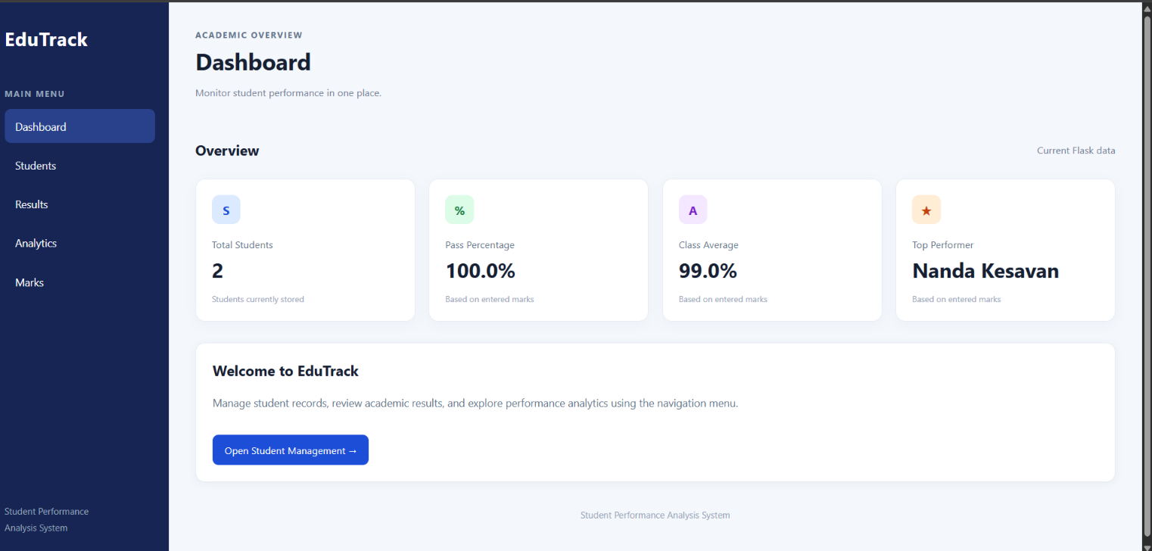
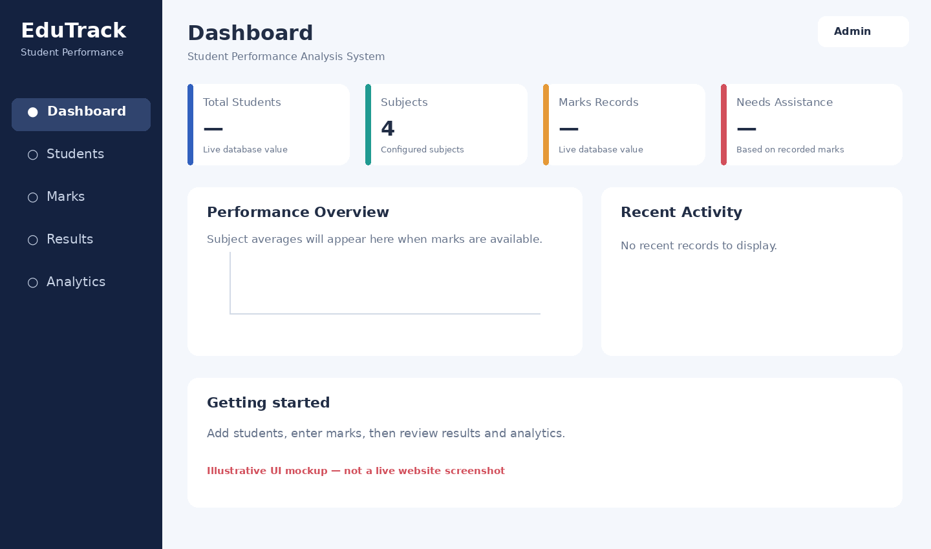
Dashboard
Summary view for key student and academic indicators.
EduTrack | Student Performance Analysis System
5

Slide 6
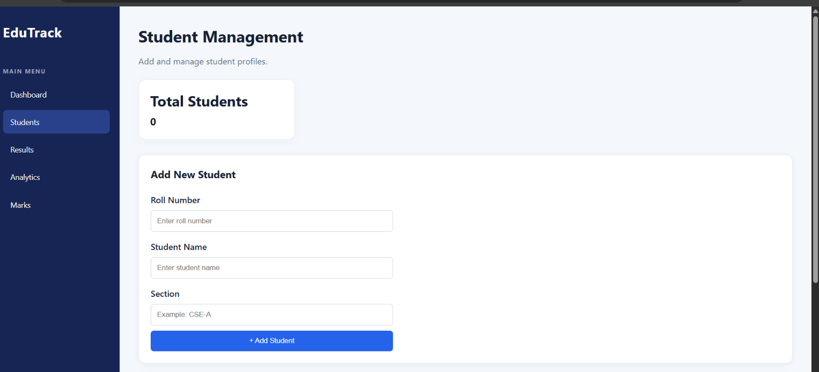
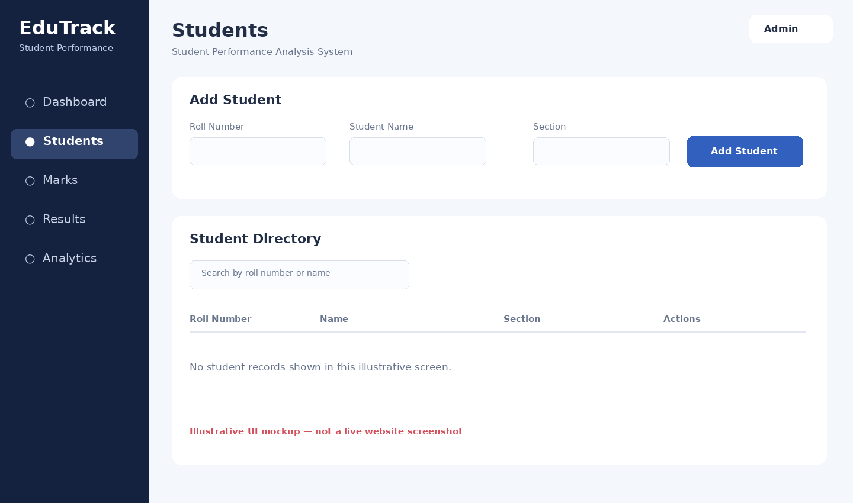
Student Management
Add and search student records; edit/delete actions depend on the implemented page.
EduTrack | Student Performance Analysis System
6

Slide 7
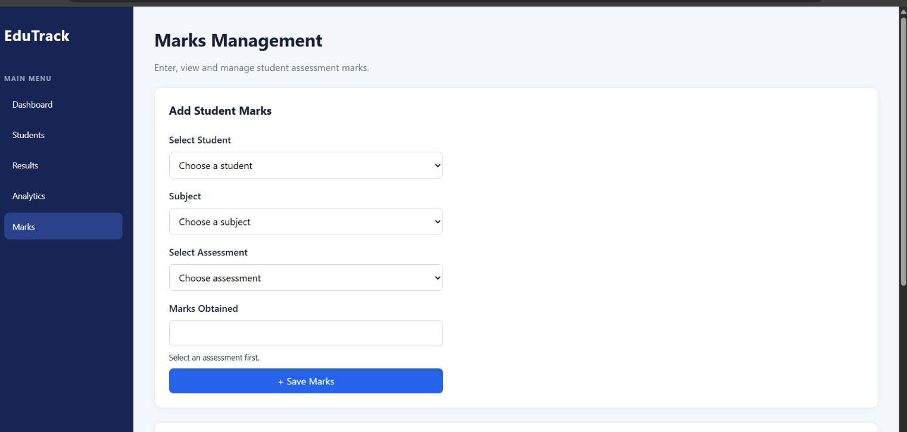
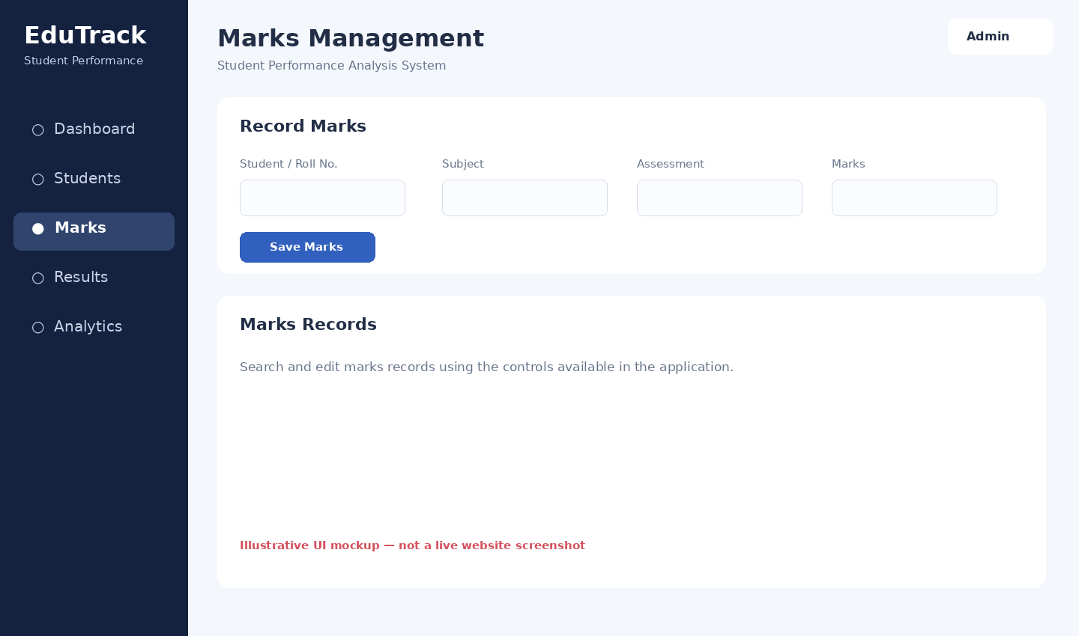
Marks Management
Enter and manage assessment marks for students and subjects.
EduTrack | Student Performance Analysis System
7

Slide 8
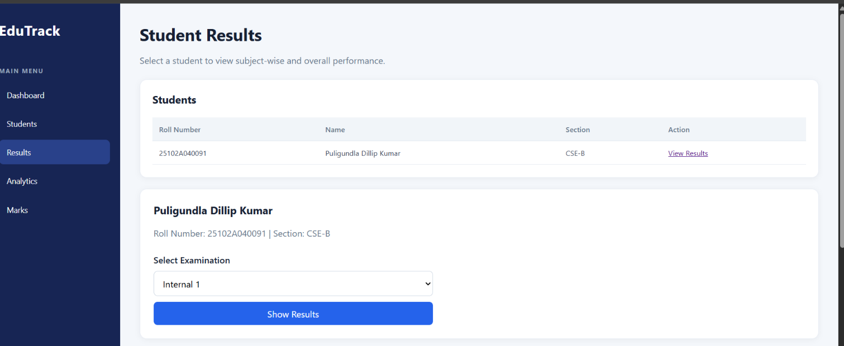
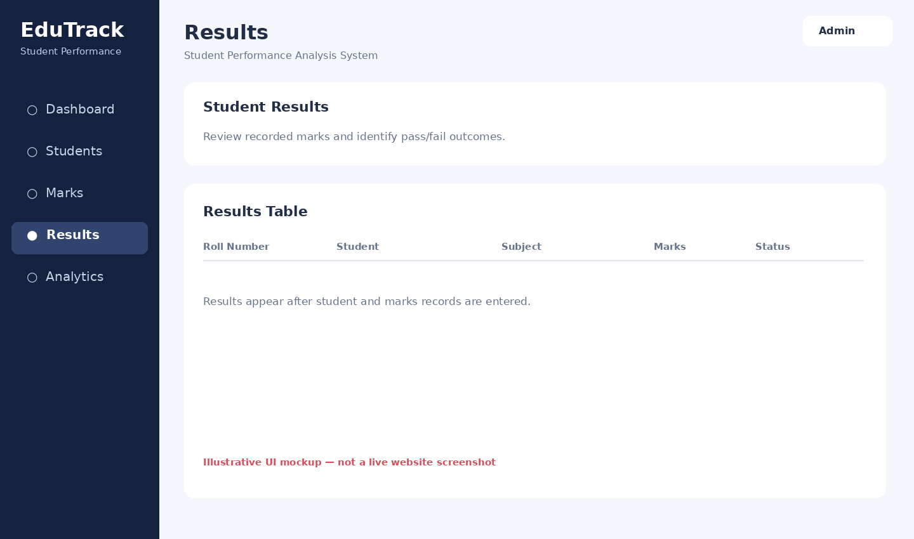
Results
Review stored marks and their outcomes.
EduTrack | Student Performance Analysis System
8

Slide 9
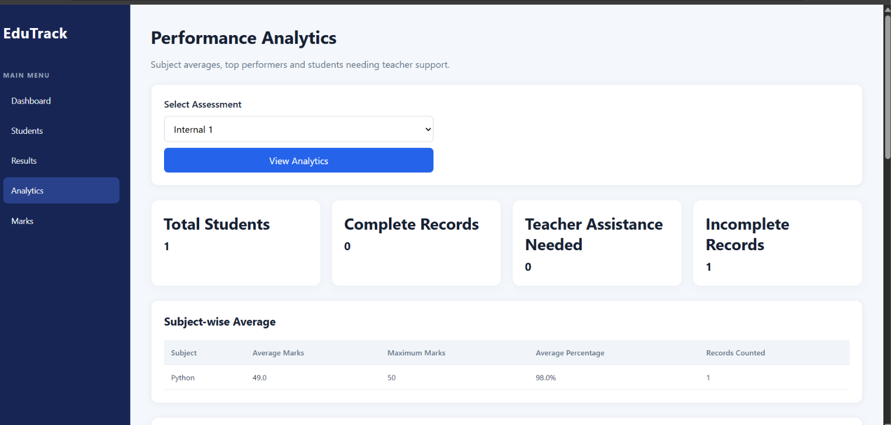
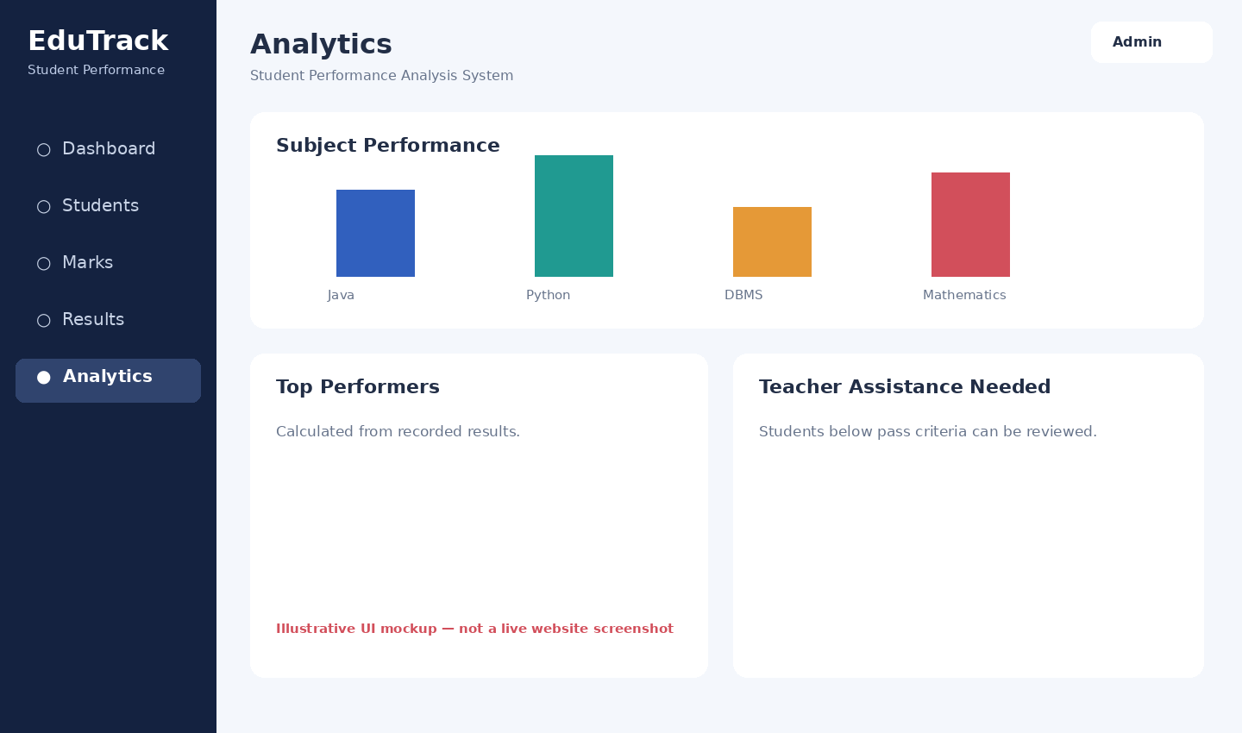
Analytics
View subject averages, top performers and students needing assistance when data is available.
EduTrack | Student Performance Analysis System
9

Slide 10
Database Design
•
students: student identity and section details.
•
subjects: subject names and assessment/pass criteria.
•
marks: marks linked to students and subjects.
•
Relationships connect marks to the relevant student and subject; actual schema constraints should be confirmed against database.sql.
EduTrack | Student Performance Analysis System
11

Slide 11
Typical User Workflow
•
Open the dashboard and navigate to Students.
•
Add a student using the roll number, name and section.
•
Open Marks and record the student's subject marks.
•
Review Results and Analytics after records are available.
•
Use the results to support academic review; the system does not replace teacher judgment.
EduTrack | Student Performance Analysis System
12

Slide 12
Testing and Deployment
•
Local Flask app was tested during development.
•
MySQL connectivity was verified through MySQL Workbench for the hosted Aiven database.
•
Render deployment has previously shown intermittent database connection delays; recheck response times and logs before a formal demo.
•
Keep database credentials in Render environment variables and never commit secrets to GitHub.
EduTrack | Student Performance Analysis System
13

Slide 13
Limitations and Future Enhancements
•
Analytics depend on complete and accurate student/marks records.
•
Authentication and role-based access should be added before using real student data.
•
Improve connection monitoring and loading/error messages for database delays.
•
Possible extensions: CSV import/export, printable reports and more detailed semester-wise analytics.
EduTrack | Student Performance Analysis System
14

Slide 14
Thank You
EduTrack — supporting clearer academic record management
Demo URL: edutrack-student-performance.onrender.com
EduTrack | Student Performance Analysis System
15

