Slide 1

Silver River Career Consultants
Soft Skills Training for the 21st Century Workforce
Notes:
This file created specifically for DILLON GREEK

Slide 2
Hard Skills vs. Soft Skills
Hard Skills
Technical
What you know
Soft Skills
Interpersonal
How you act
Notes:
Ask audience for examples, write on flip chart.

Slide 3

Hard Skills Get You Hired Soft Skills Keep You There

Slide 4
Communication
Increases Productivity

Slide 5
Why It Matters
46% Newly hired employees fail within 18 months
19% Succeed
89% Lack soft skills
26% Cannot accept feedback
23% Unable to manage emotions
Notes:
Update to 2020 statistics

Slide 6
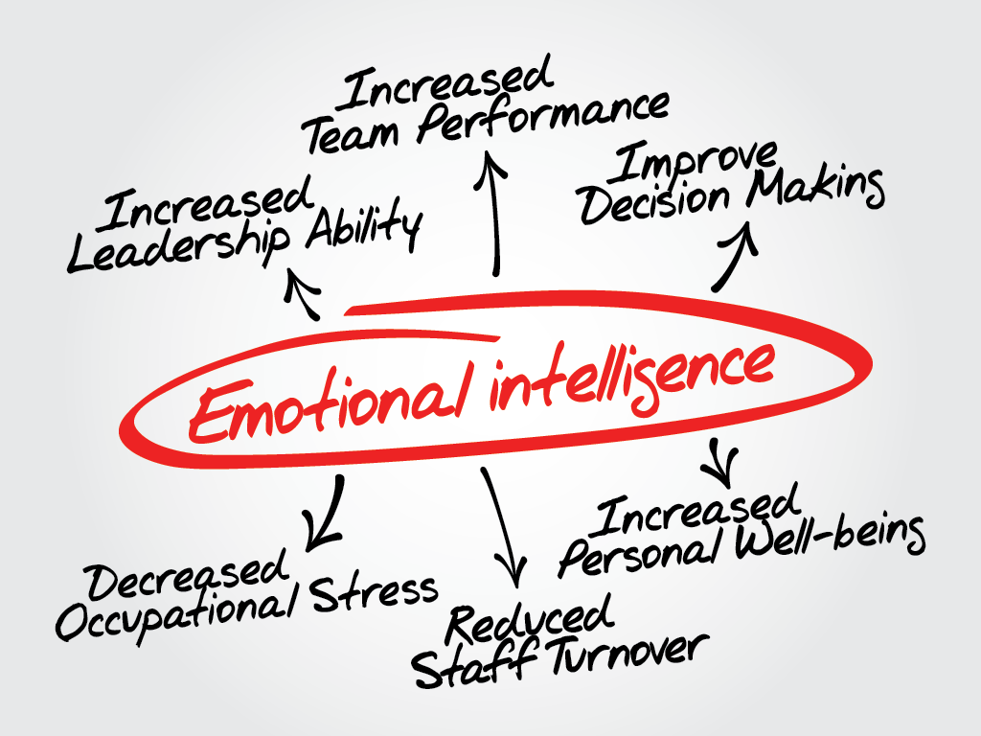
What Is Emotional Intelligence?
The ability to recognize and manage emotions in yourself and others.

Slide 7
Ask Employers
77% Consider soft skills just as important as hard skills
20% Believe soft skills are more important than hard skills
Vital to culture fit
Notes:
Mention over 8,000 surveyed

Slide 8

Forecast: Success
Leadership
Problem solving
Interpersonal skills
Professionalism
Adaptability

