Slide 1

Focux Safeguards Training
Security Baked in
Notes:
This file created specifically for DILLON GREEK

Slide 2
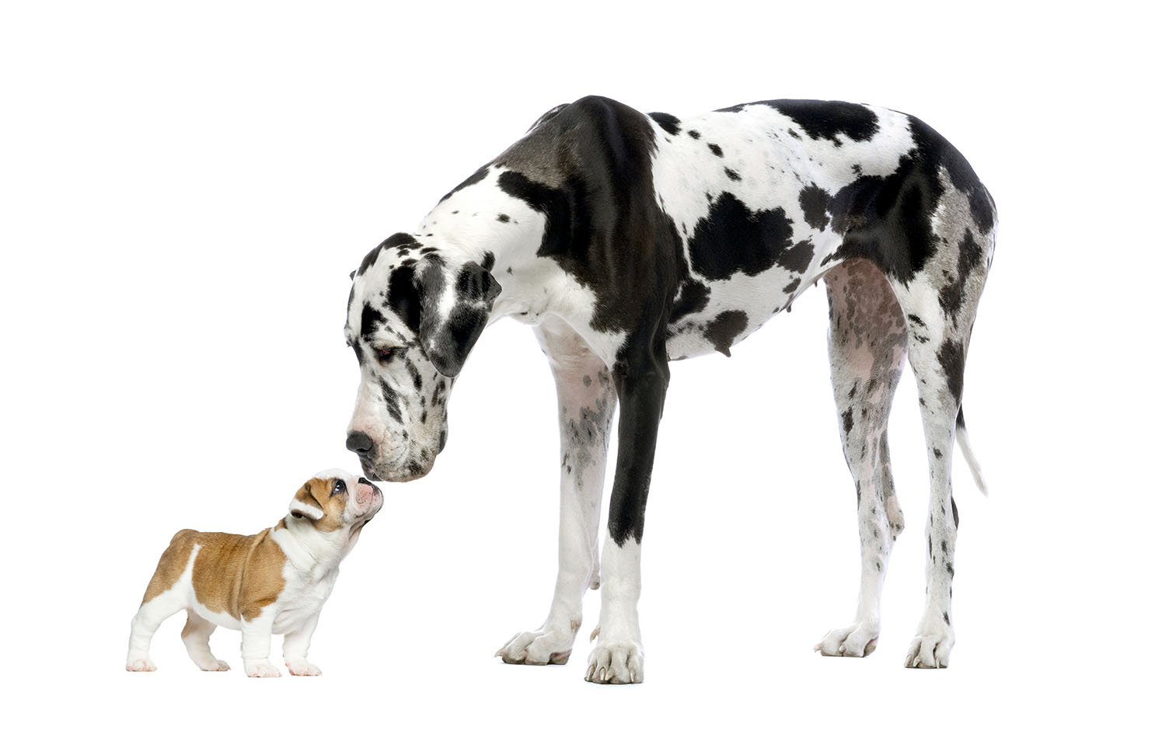
Small Things Add Up
Awareness
Motivation
Compliance

Slide 3
Refresher Briefing
PROTECT YOUR ID BADGE
Cyber Threat Awareness
Constant updates
Telecommuting Smarts
Handling Business-sensitive Information
Employee Reporting
What are your obligations and requirements

Slide 4
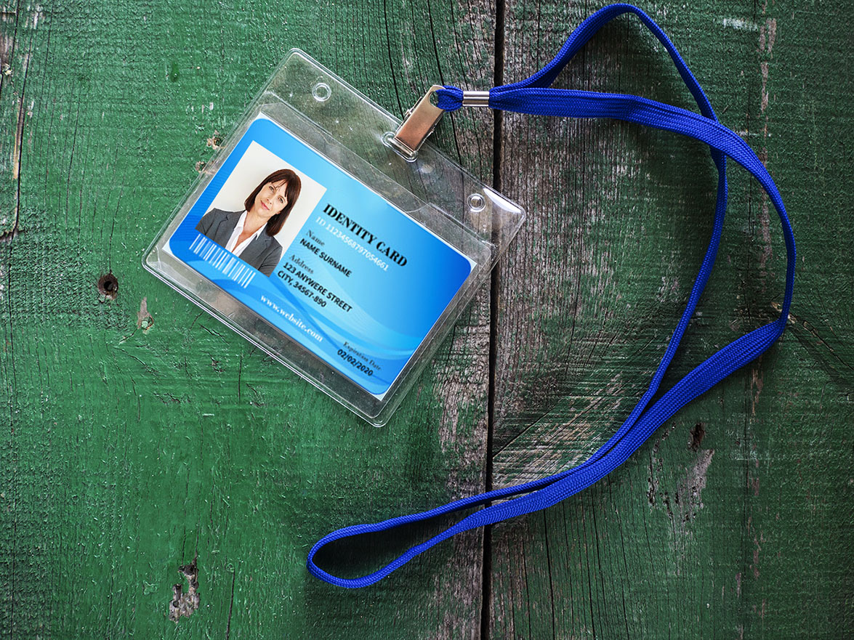
Credentials Essentials
Quality Is Key

Slide 5

An ID Badge Is Not
Ice scraper
Dust pan
Can opener
Fly swatter
Coaster
Rear view mirror ornament

Slide 6
Normal Wear & Tear
Sunlight
Moisture
Temperature extremes
Laundry
Oils
Scrapes

