Slide 1
Team 5 project Proposal
Dillon Williams, Ryan Reed, Austin Sigg, Nidhay Patel, Michel turpeau

Slide 2
Project Overview
nidhay

Slide 3
Nidhay – mainly background and the objective

Slide 4
Specifications and standards
dillon

Slide 5
dillon

Slide 6
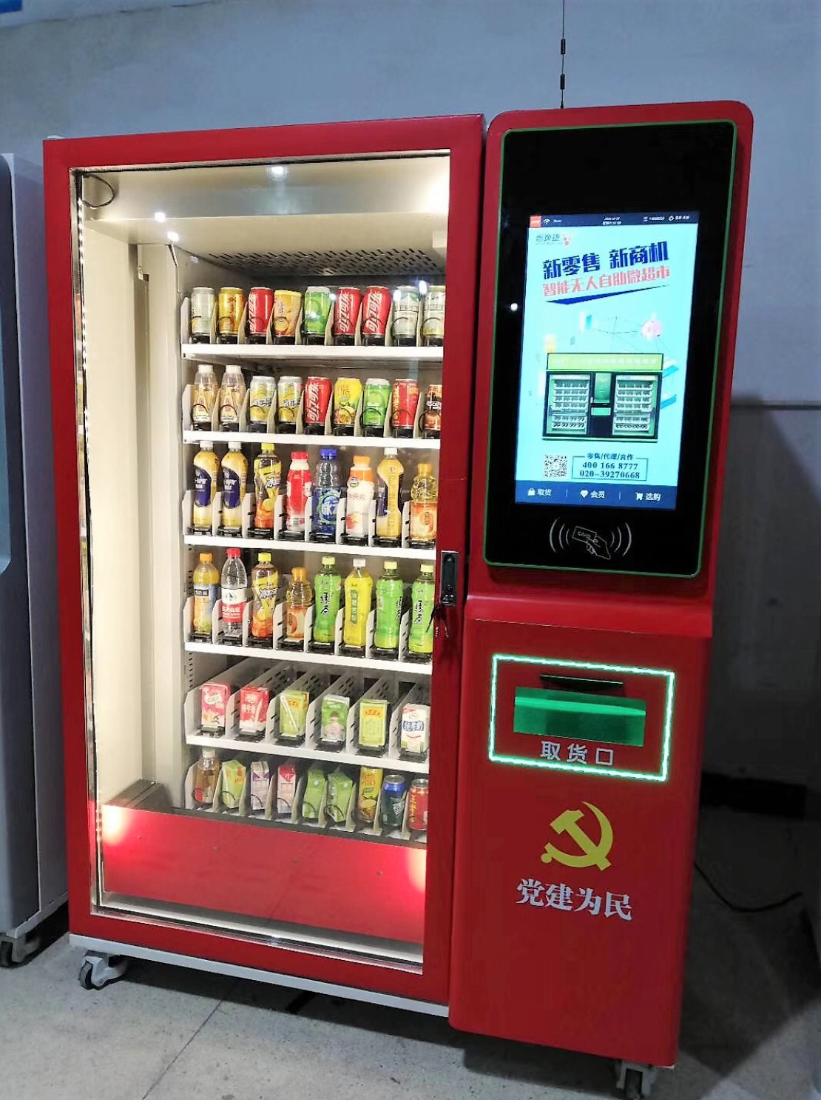
Existing Solutions
Elevator Vending Machine
PROS:
Safety of Devices
Decent Inventory
CONS:
Shelf Customization Decreases Inventory
Machine Size (6’4”H x 4’7”L x 3’3”W)
PRICE:
Unknown, but generally > $3500

Slide 7
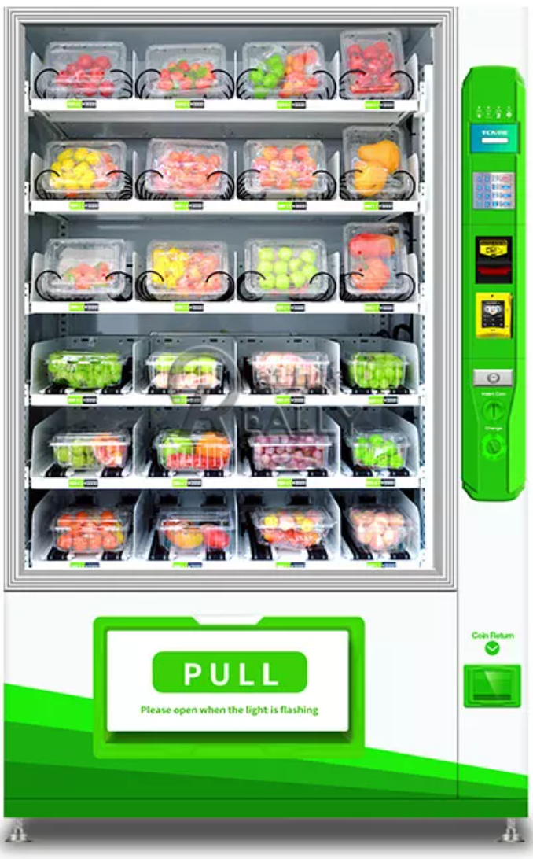
Existing Solutions
Smart Vending Machine
PROS:
Convenience is its Priority
No Buttons = Less Jams
CONS:
Low Safety for Higher Shelves
Maintenance and Repairs
Size as well (6’3”H x 3’10”L x 2’10”)
PRICE:
$2000 - $2350, some can reach $7000

Slide 8
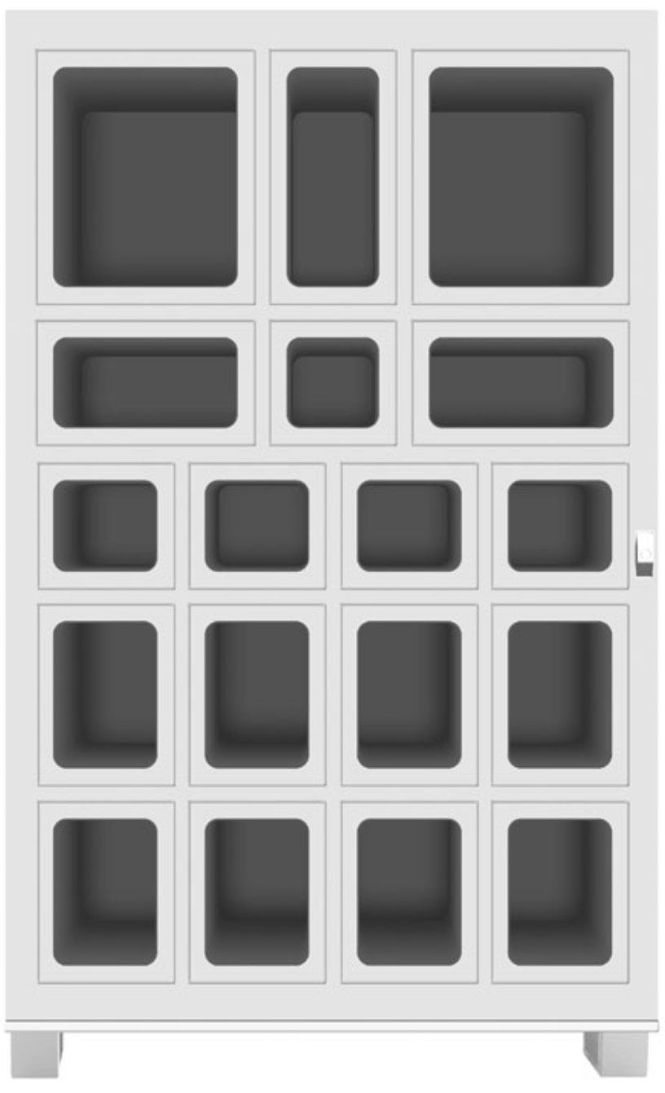
Existing Solutions
Lockerbox Array
PROS:
Various Sized Boxes
Locks for each device
CONS:
Storage / Refilling
Locks must have Strong Resistance
Price:
Unknown, generally

Slide 9
Proposed Solution
Ryan – systems (basic talk of what we want), unknowns, ways of testing systems, mention mechanical and what they think would work (Like Fastenal 3D array lockbox)

Slide 10
Measures of Success
austin

Slide 11
Austin – also impacts of the project

Slide 12
Resources
Michel - budget, timeline, conclusion area

Slide 13
Timeline and Conclusion
michel

Slide 14
Questions?

