Slide 1
Basics of Web Design
Chapter 5 Graphics & Text Styling Basics Key Concepts

Slide 2
Learning Outcomes
Describe types of graphics used on the Web
Apply the image element to add graphics to web pages
Configure images as backgrounds on web pages
Configure images as hyperlinks
Configure multiple background images with CSS3
Configure text typeface, size, weight, and style with CSS
Align and indent text with CSS
Configure list markers with CSS
Configure an image map

Slide 3
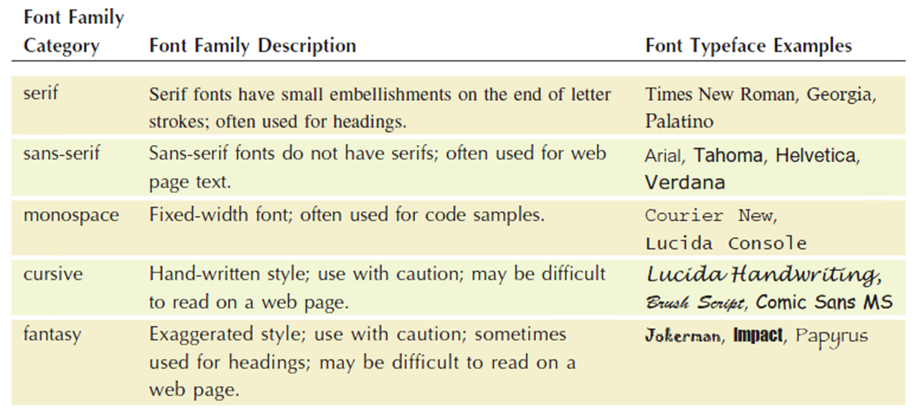
Configure Typeface with CSS
font-family property
Configures the font typeface of the text
Include a generic family name
p { font-family: Verdana, Arial, sans-serif; }

Slide 4
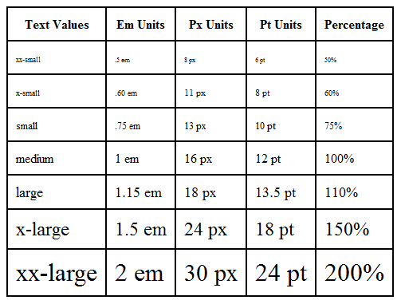
The font-size Property
Configures the size of text
p { font-size: 90%; }
Accessibility Recommendation:
Use em or percentage font sizes – these can be easily enlarged in all browsers by users

Slide 5
Align and Indent Text with CSS
text-align property
Configures the alignment of text
text-indent property
Configures the indentation of the first line of text in an element
h1 { text-align: center; }
p { text-indent: 5em; }

Slide 6
More CSS Text Properties
font-weight property
Configures the boldness of text
font-style property
Configures the style of the text
line-height property
Modifies the height of a line of text
text-decoration property
Modifies the display of text Typically used to remove the default underline from hyperlinks
text-transform property
Configures the capitalization of text
letter-spacing property
Configures the space between text characters
li {font-weight: bold; }
#special { font-style: italic; }
p { line-height: 120%; }
a { text-decoration: none; }
h3{ text-transform: uppercase; }
h1 { letter-spacing: 3px; }

Slide 7
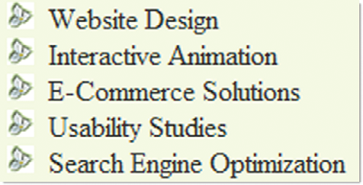
Configure List Markers with CSS
CSS Properties
list-style-type
list-style-image
list-style position
Example:
ul {list-style-image: url(trillium.gif); }

Slide 8
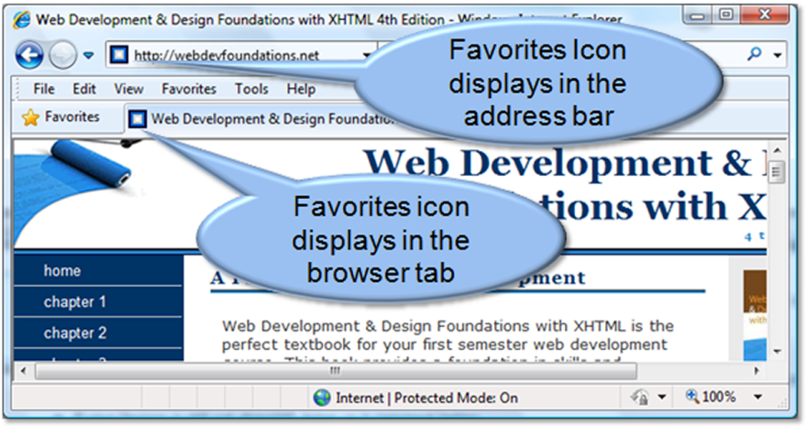
Favorites Icon
Small icon that displays in the address bar or tab bar of some browsers
Also called a favicon
<link rel="icon" href="favicon.ico" type="image/x-icon">

Slide 9
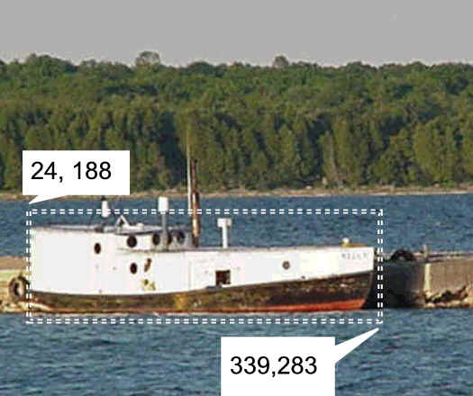
Image Map
map element
Defines the map
area element
Defines a specific area on a map
Can be set to a rectangle, circle, or polygon
href Attibute
shape Attribute
coords Attribute
<map name="boat" id="boat">
<area href="http://www.doorcountyvacations.com" shape="rect" coords="24, 188, 339, 283" alt="Door County Fishing">
</map>
<img src="fishingboat.jpg" usemap="#boat" alt="Door County“ width="416" height="350">

