Slide 1
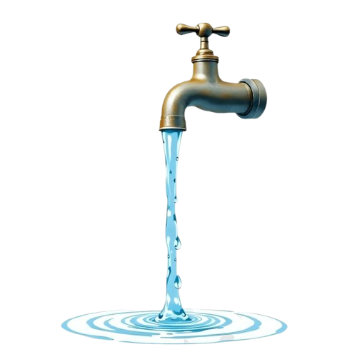

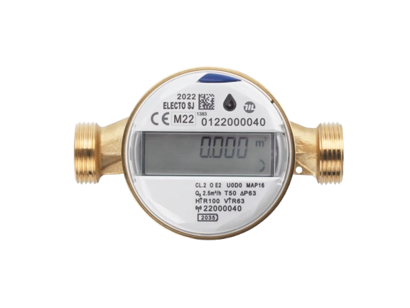

Date:23/Oct/2025
Smart Water Meter
Smart water meter
From a drop to a flood, your Smart meter is the first line of defense.
Project

Slide 2

Project Developers
Circuit Coder
Bringing code to life, one circuit at a time.
Circuit Coder
Bringing code to life, one circuit at a time.

Slide 3

Project Discription Smart Water Meter Project is a comprehensive IoT solution designed and developed by a dedicated team of two.This project manage system designed to provide real-time monitoring and analysis of water consumption. This system moves beyond traditional analog meters to empower consumers and utility providers to detect leaks, monitor usage, optimize billing and promote efficient water use. We built a project that combines hardware with a smart online platform. This helps you get personalized information and manage resources in a smarter way for the future.

Slide 4
Problems Faced
1.Inefficient and Costly
Manual Meter Reading
Utilities relying on old mechanical meters must deploy personnel to physically visit every meter location, often monthly or quarterly. This process is time-consuming, expensive, prone to human error, and sometimes requires estimating usage when meters are inaccessible or difficult to read, leading to inaccurate billing and customer disputes.

Slide 5
Solutions
Automated Remote Meter Reading
Smart meters utilize Automatic Meter Reading (AMR) or Advanced Metering Infrastructure (AMI) technology (like cellular, radio, or LoRa networks) to wirelessly transmit usage data directly to the utility's central system. This eliminates the need for field personnel to visit each site
S

Slide 6
Problems Faced
2. Customer Inability to Control Consumption
With traditional billing, customers receive a water bill weeks after the usage period has ended. This "lag" means consumers have no opportunity to adjust their behavior, budget, or identify a high-consumption event until it's too late and they are faced with a high bill. This lack of feedback contributes to general water wastage.

Slide 7
Solutions
Empowering Consumers with Data
Because smart meters collect data in real-time, customers can access their usage information instantly through a dedicated mobile app or website dashboard. This immediate feedback helps customers:
Set Goals: They can monitor daily or weekly usage against a budget.
Identify Wasteful Activities: They can pinpoint exactly when high-volume usage occurs (e.g., a lawn sprinkler running too long).
Avoid Bill Shock: They can predict their next bill and make consumption adjustments before the end of the billing cycle.
S

Slide 8
Problems Faced
3. Water Theft and Meter Tampering
In many regions, water theft (bypassing the meter) or tampering (mechanically slowing or stopping the meter) is a serious concern that impacts network integrity and fairness. Detecting tampering with old meters often requires a physical inspection, which is usually only triggered by prolonged low usage, allowing the theft to continue for a long time.

Slide 9
Solutions
Tamper and Reverse Flow Alerts
Smart meters are equipped with built-in sensors and software algorithms designed to detect unauthorized activity. These can include:
Magnetic Tamper Detection: Alerts if a strong magnet is placed near the meter attempting to stop the internal turbine.
Reverse Flow Detection: Alerts if water is flowing backward, which can indicate an attempted bypass.
Enclosure Removal: Alerts if the meter housing or seal is broken.
S

Slide 10
Key Features
Automated Leak Detection
Real-Time Controll
This is a technology that uses a variety of sensors, software, and systems to continuously monitor for and identify leaks in pipelines without the need for manual inspection.
Smart water meters, equipped with automated leak detection, continuously monitor water flow.
Smart water meter refers to the advanced capability to remotely and instantly open or close a valve on the meter using a digital command. a smart meter with this feature allows for immediate, on-demand management of the water supply through a mobile app or a computer dashboard.
Real-Time Monitoring
Mult_Communication
Provides a live view of consumption water via a mobile app and computer, This allows for the immediate visualization of water daily usage, enabling customers to understand their consumption patterns and make informed decisions.
To effectively manage water usage in a multi-unit building, smart water meters rely on a layered communication architecture, which allows many devices to send data to a single central application like smart phone and computer. Instead of each meter having its own connection to the internet, they form a local network within the building. This method is more scalable, cost-effective, and efficient.
Conservation View
Delivers personalized tips and historical data to help users understand their water footprint and reduce waste.The system keeps a record of your past consumption. This allows you to view your water usage on different timescales—hourly, daily, weekly, monthly, or even yearly.

Slide 11
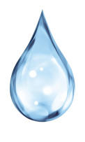

Key Features
Optimal Water Quality
The smart water meter system goes beyond simply measuring consumption. It transforms into a real-time monitoring station, providing measures of water's cloudiness, and measures the acidity or alkalinity of the water for ensuring public health, and optimizing treatment and delivery systems.

Slide 12
Benefits of smart water meter
01
02
A smart water meter is a modern device that measures how much water you use and sends the information wirelessly to your dashboard or water company. This replaces the old way of having someone read your meter once a month or once every few months.
03
04
05

Slide 13
Benefits of smart water meter for consumers
01
02
Empower Customers to Save Water
Goal-Based Savings: Our dashboard allows users to set daily, weekly, or monthly usage goals (e.g., "Use 10% less water this month"). The system tracks their progress and provides visual feedback (like a digital gauge or chart).
03
04
05
Identify Wasteful Appliances: Users can analyze their water usage down to the hour, easily identifying if a particular appliance (like an old washing machine or shower) is responsible for unexpectedly high consumption.

Slide 14
Benefits of smart water meter for consumers
01
Real-Time Health and Safety Monitoring
02
Instant Water Quality Alerts: We monitor key parameters like Total Dissolved Solids (TDS) and Turbidity (cloudiness) in real-time. If levels spike suddenly—indicating a pipe failure or contamination—you get an immediate health alert.
03
04
05
Temperature Control: Continuous tracking of water temperature helps maintain system efficiency and prevents scalding or equipment damage due to excessive heat.

Slide 15
Benefits of smart water meter for consumers
01
Total Convenience and Control (The Modernization Pitch)
02
Remote Digital Access: All data—usage history, quality metrics, and goal status—is accessible 24/7 via a simple mobile app or web interface. No more searching for a meter buried in a basement or yard.
03
04
05
Data for Better Planning: Utilities gain granular, aggregated data to improve water infrastructure planning, predict demand spikes, and manage resources more effectively for the entire community.

Slide 16
Benefits of smart water meter for consumers
01
Accurate billing and Environmental contribution
02
Reading Errors: Human error during reading or transcription can lead to incorrect numbers being entered into the billing system, immediately creating an unfair bill. Get bills based on actual water usage instead of estimates.
03
04
05
The ability to measure water use with precision and frequency allows utilities to create targeted and effective water conservation policies, especially during extreme weather events.

Slide 17
Smart water meter in your home
01
02
In conclusion, smart water meters are a valuable tool for any household looking to control and monitor their water consumption. From cost savings to accurate measurement, real-time monitoring, easy maintenance, early leak detection, and environmental contribution, telemetric water meters offer a variety of significant benefits. If you’re looking for ways to save money, reduce your environmental impact, or simply have greater control over your water consumption, considering installing a smart water meter in your home may be an excellent option.
03
04
05

Slide 18
Benefits of smart water meter for utility companies
01
Improved efficiency:
Remote meter reading reduces the need for manual meter readers, lowering operational costs and carbon emissions.
Accurate data and revenue:
Pinpoint accuracy throughout the meter's lifetime leads to correct billing and increased revenue.
Water loss reduction:
Real-time data allows for quicker identification of leaks in the water network, minimizing water loss.
02
03
04
05

Slide 19
Benefits of smart water meter for utility companies
01
02
Enhanced resource management:
Data-driven insights help utilities better manage water supply and demand, and improve long-term planning.
Increased customer satisfaction:
Accurate billing and early leak detection improve the relationship with customers.
03
04
05

Slide 20
System Architecture

Slide 21
Hardware Components
This is the physical hardware that used to carry out this project inorder to become smart water meter
ESP32
Water Flow Sensor
Lora Module
Turbidity Sensor

Slide 22
Hardware Components
This is the physical hardware that used to carry out this project inorder to become smart water meter
TDS sensor
Lcd display
Solenoid Valve
Leds

Slide 23

Web Platform
Desktop Platform
Real time data analyzis
Water Quality analyzis
A goal Setter and analysiz
Bills calculating for liters used
Daily,week and monthly chart analysiz
Full management of smart meter

Slide 24
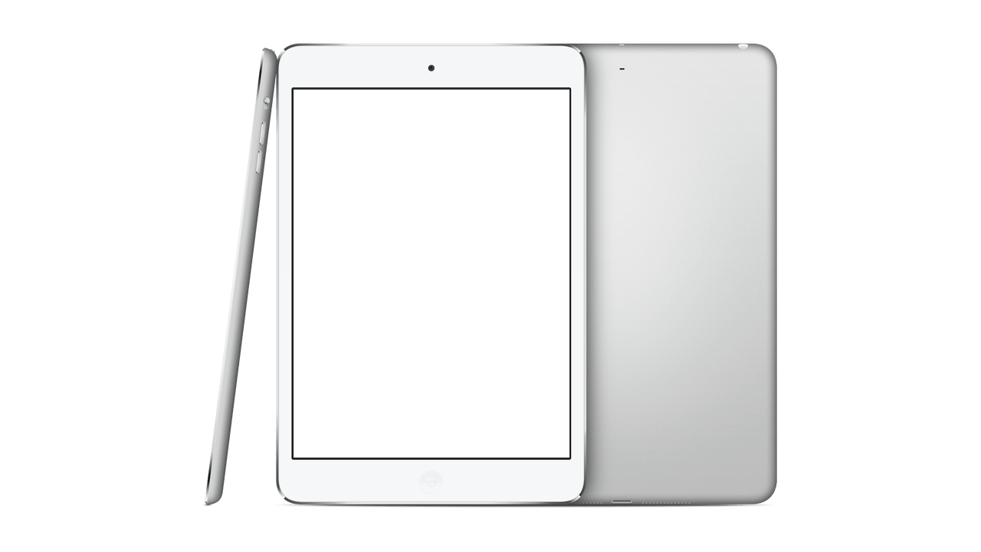
System
Mobile dashboard
The mobile dashboard of smart water meter serves as the central hub for data visualization and interaction. Its core purpose is to translate raw, time-series data into actionable insights (for consumers) and operational intelligence (for utilities).
GET APPLICATION

Slide 25
Operational problems
Water shortages:
Some areas, particularly in Kigali, experience frequent water cuts and receive water only a few days a week. This is partly due to a gap between demand and supply capacity, which is exacerbated during dry seasons.
High non-revenue water (NRW):
A high percentage of water (41.8% in 2022/23) is lost before reaching the consumer, mainly due to old and leaky pipes.
Inefficient supply:
The distribution system is challenged by outdated infrastructure, and some of the water produced doesn't reach the population as intended.
High energy costs:
Water distribution is costly, with electricity consuming a significant portion of the company's income (about 40%40 %
40%
of its revenue).
:
:
:
:

Slide 26
Final Option
We are currently managing our most precious asset blindly.
This system delivers perfect intelligence to every pipeline, transforming unknown water loss into instant, actionable savings. It's the only way to build a truly resilient and profitable water utility.
System Step 1
Kigali leads Africa in urban efficiency. Our water utility must reflect this standard.
Smart meters provide the digital backbone to stop water loss instantly, ending guesswork and guaranteeing fair, transparent billing for every resident.
This is the essential step for securing Kigali's future water resilience.

Slide 27
Final Option
Smart meters are not an expense; they are instant cost control.
We eliminate estimated bills, find major leaks in hours (not months), and give customers the power to save water.
Invest today to transform water loss into guaranteed profit and reliable service.
System Step 2
GET smart Water meter with Empower your Development

