Slide 1
Reel-ize Movie Finder
Mid Project Review Presentation
Maxwell Klema, Ivie Xue, Myles Edwards, Dillon Coker

Slide 2
Outline
Overview Recap
Face Model
Age Model
Overall + Future Work

Slide 3

Overview Recap
1
2
3
4
Face Model
Predict the actor’s name based on the image.
Input
Search TMDB
Display Results
User inputs an image or a short video.
Find the movie based on the results of the models
Display on the UI what the distributions are and what the movie predictions are.
2
Age Model
Predict the actor’s age based on the image

Slide 4
Face Model

Slide 5
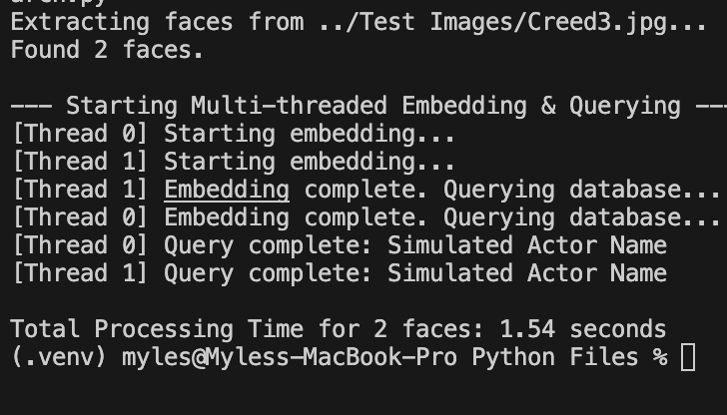
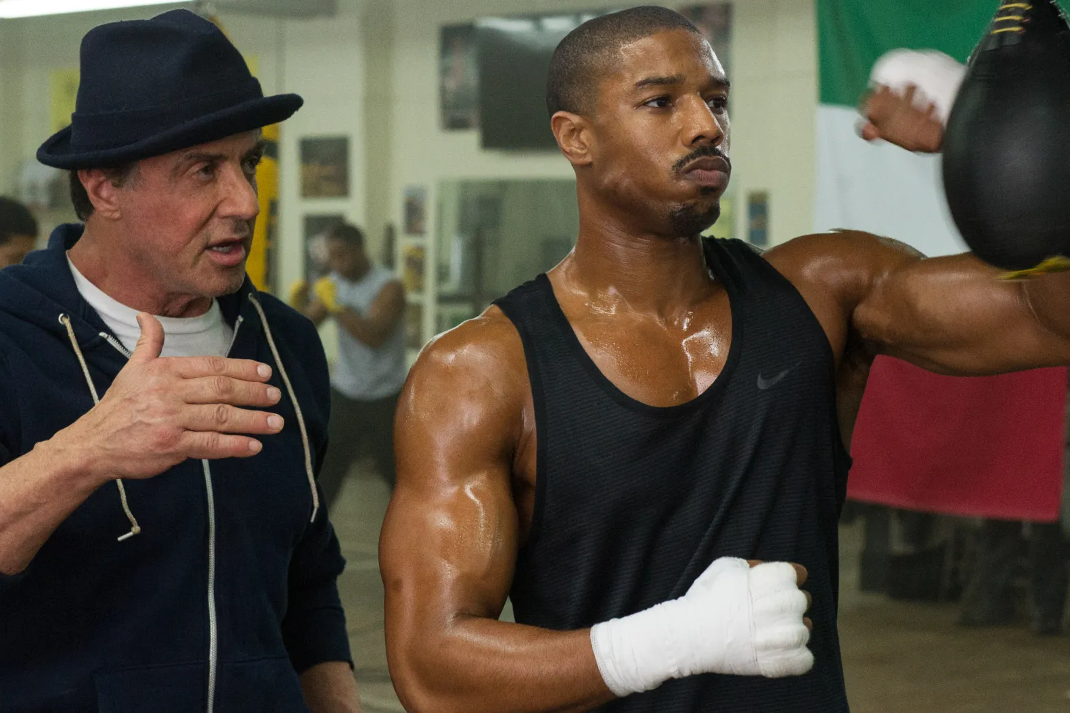
Reviews (what went right/wrong)
Inserted a picture from the movie Creed
DeepFace utilizes the RetinaFace detector to locate and extract the 2 faces
ArcFace begins to embed the faces into vectors for each face
We then use the vectors to search the database for matching vectors to give us back the actor names

Slide 6
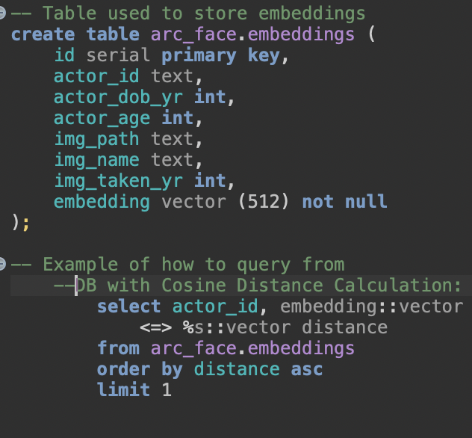
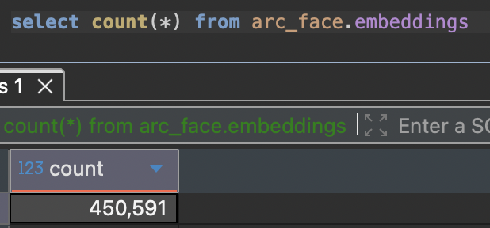
Database of Embeddings
We use the DeepFace Package for it’s efficiency and easy of use for:
Use RetinaFace to do facial detection and pre-processing
Using ArcFace model to embed all 460,000 photographs

Slide 7
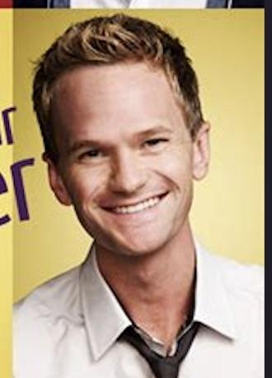
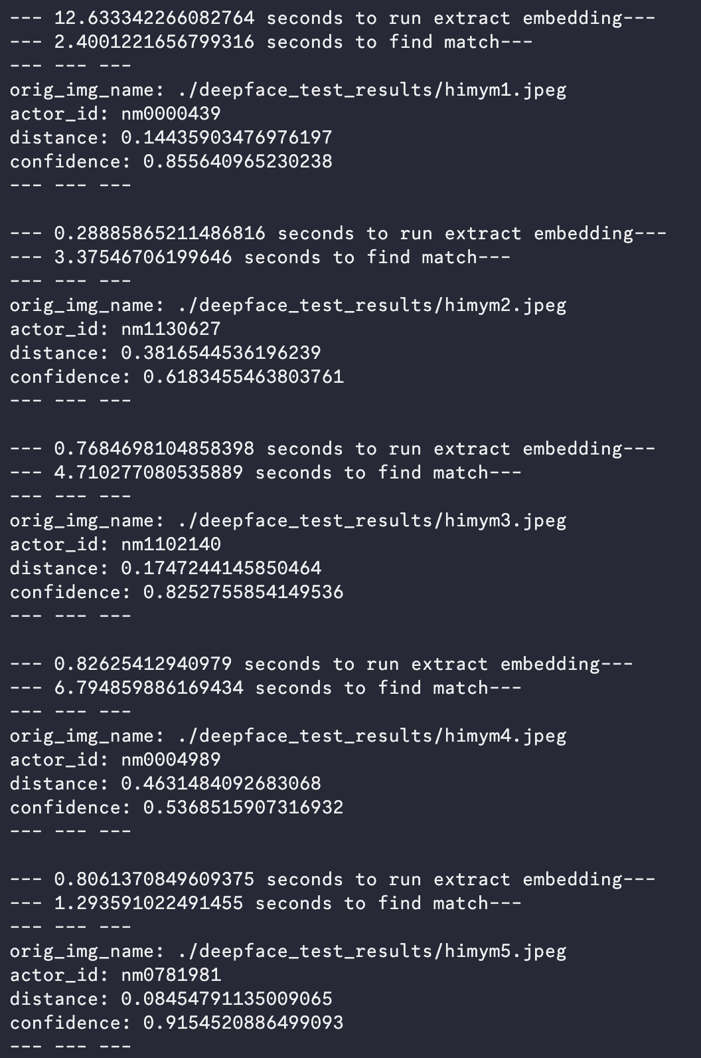
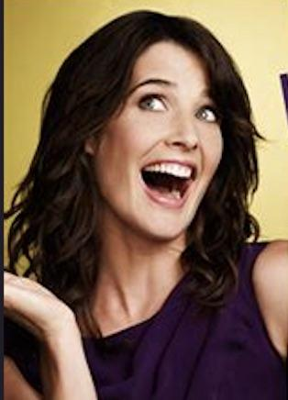
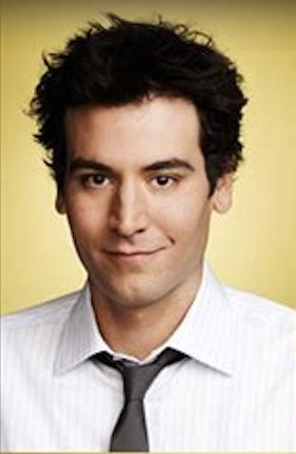
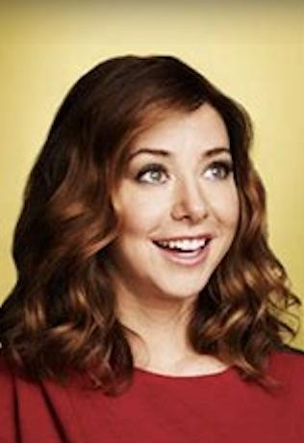
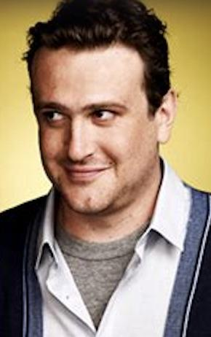
Face Model Demo
Actor_id: nm0000439
Neil Patrick Harris
Actor_id: nm1130627
Cobie Smulders
Actor_id: nm1102140
Josh Radnor
Actor_id: nm0004989
Alyson Hannigan
Actor_id: nm0781981
Jason Segel

Slide 8
Age Model

Slide 9
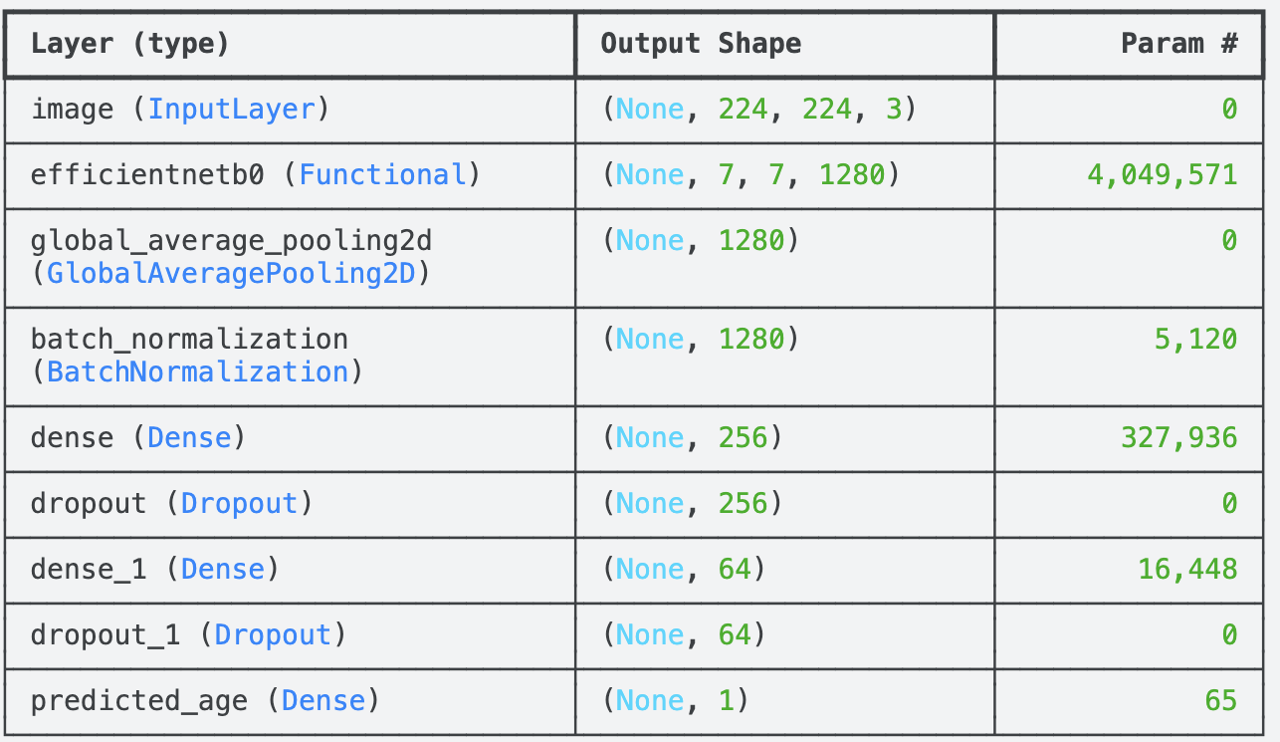
Age Model Overview
Standard Convolution Neural Network (CNN)
Scalar Regression
Supervised Learning
Data Preprocessing Needed:
Resize + Upscaling (LANCZOS)
Padding
Size: 224 x 224 pixels
Model: custom CNN w/ Efficient Net B0 backbone + pretrained imagenet weights
Loss function: Huber
Optimizer: Adam
Layers: 9
Epoch: ~22-25
Batch size: 32
Current Dataset size: 25,000 (UTKface)
Potentially adding more data
Total Params: 4,399,140 (16.78 MB)

Slide 10
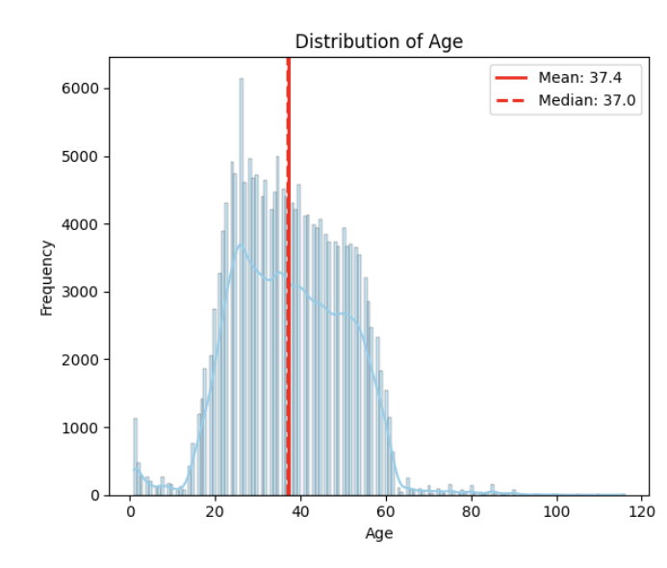
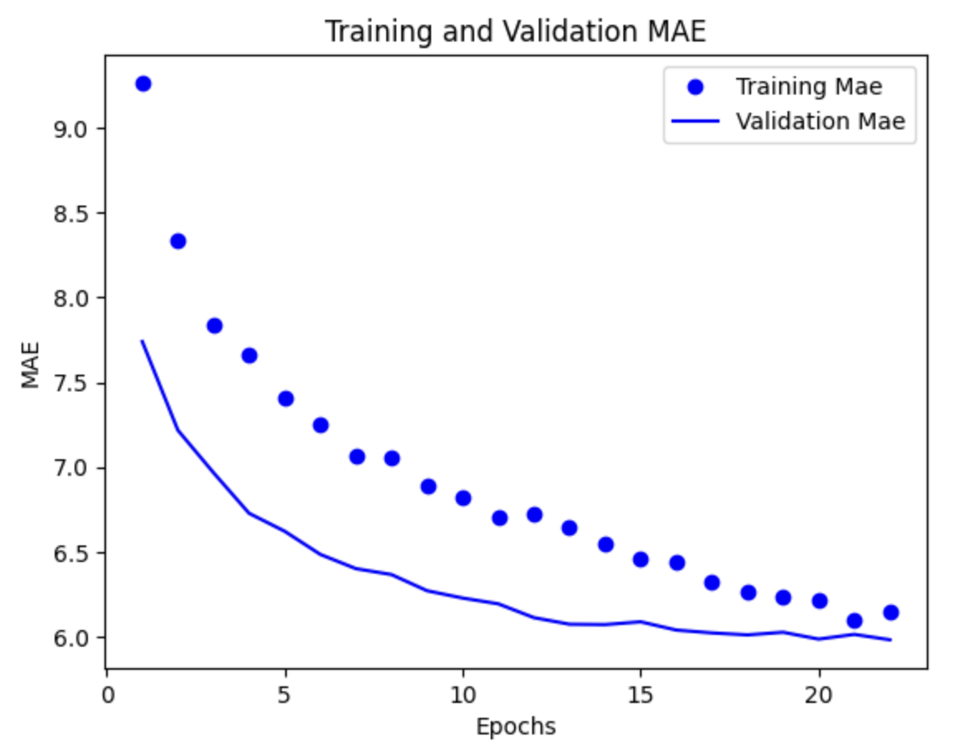
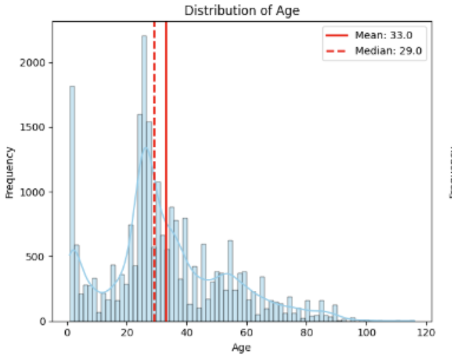
Age Model Statistics
MAE: ~ 6.3
~150,000 images
MAE: ~ 5.98
~17,000 images
MAE: 5.98, Loss: 17.8713
Within 10 years: 82.25%
Within 5 years: 52.84%
Within 2 years: 28.09%

Slide 11
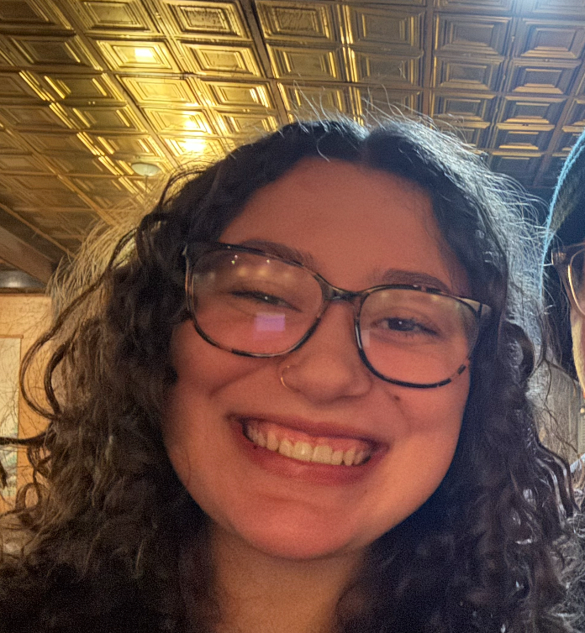
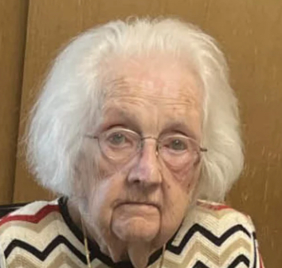
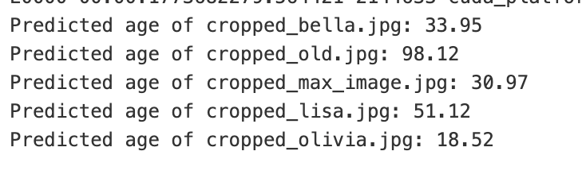
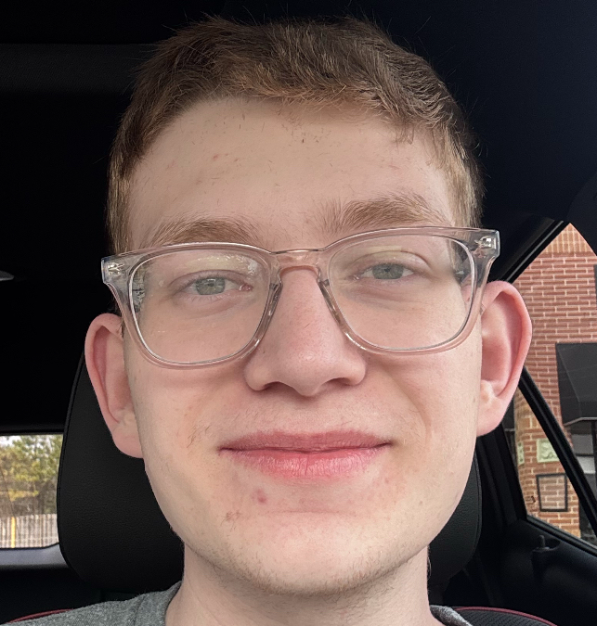
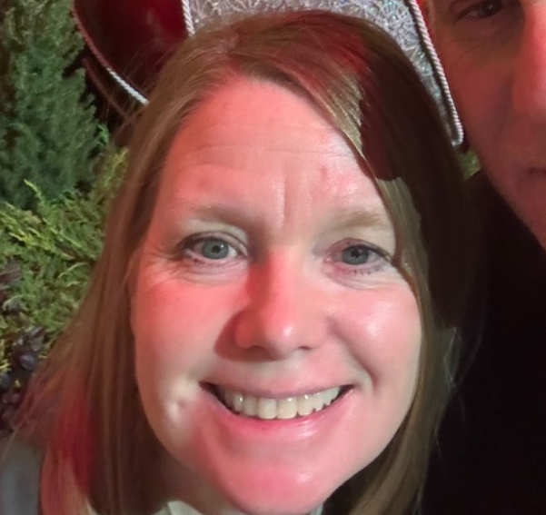
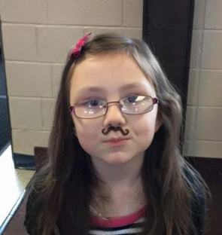
Age Model Demonstration
Predicted: 33.95
Actual: 20 (~14)
Predicted: 98.12
Actual: 95 (~3)
Predicted: 30.97
Actual: 21 (~10)
Predicted: 51.12
Actual: 56 (~5)
Predicted: 18.52
Actual: 8 (~11)

Slide 12
Reviews (what went right/wrong)
Rights
Found decent datasets
CNN Model architecture and hyperparameters are well established
Semi-decent MAE
Wrongs
Bad age distributions in datasets
Initially, bad model design of training all feature maps from scratch instead of using pre trained ImageNet weights
Noisy datasets (e.g., IMDB wiki)
Wrong labels

Slide 13
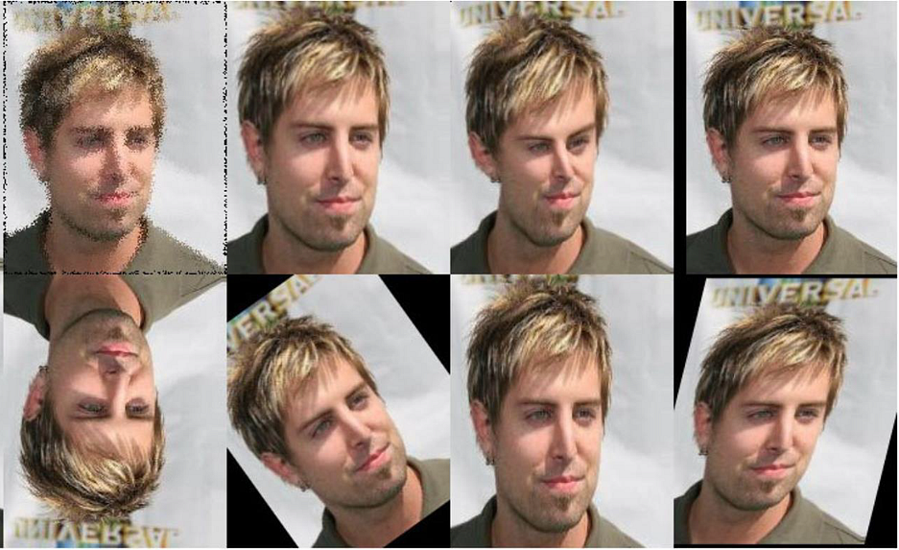
Next Steps (improvements)
What we should keep doing
Keep hyperparameters (e.g. batch size, input size, current model setup, etc.)
What we should improve
Find a way to even the distribution of ages in dataset
Data Augmentation with ages that are less common
Find new datasets to add
Collect more correctly labelled image data for training
https://miro.medium.com/v2/resize:fit:1400/1*zcKMFwf_kiPZgY_Ulr2t1g.png

Slide 14
Overall and Future Work

Slide 15
Summary
Overall
Future Works
We have decided on models and they work
Face Model isn’t tested extensively but it’s been correct so far (overfitting?)
Age Model’s MAE is ~5.9 years
Improving the current models or find ways to fine tune our models
Find a library that will grab unique faces from videos
In case user uploads a short clip instead of an image into our website
Query into TMDB for the movie given model results for age and IMDB IDs
Create UI for input and display

Slide 16
Timeline
Stage 1
Stage 2
Today
Stage 4
Stage 5
FINAL
Research into how resources required for models
Divide workload for the two models
Mid Review Presentation
Fine tuning or improve our models
Create our UI and the database query
Final presentation and Demo

Slide 17
Thank you for listening!

