Slide 1
Reelize
Movie Finder
Requirements Presentation
Maxwell Klema, Ivie Xue, Myles Edwards, Dillon Coker

Slide 2
Outline
Project Overview
Must Have Requirements
Nice to Have Requirements
Datasets
Model Overview
Timeline

Slide 3
Project Overview

Slide 4
Project Overview
Reelize: Movie Finder
Given a still image or short video from a movie or TV show, predict all the actors in the scene
Use those predictions to then predict the movie/TV show
What differentiates our project?
Identifies both actors and the media
Returns a distribution of outputs with confidence scores
Not just a single prediction

Slide 5
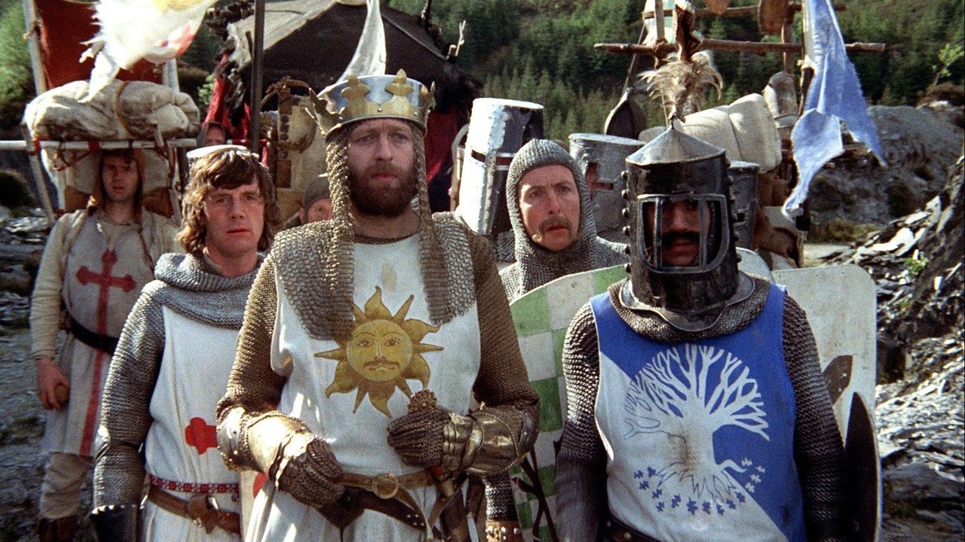
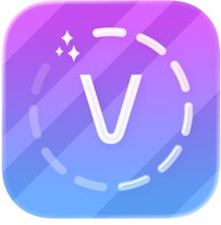



Similar Projects
Our Project
Actors Only
Still/video
[model]
Voola
Confidence
distributions
[model]
Movie/TV Show Only
Actors
[model]
ClipFix
[api]
Movie/TV Show

Slide 6
Must Have Requirements

Slide 7
Video and picture Inputs (F)
Model should be able to handle pictures and videos that are at most 10 seconds long
Handle multiple faces (F)
We should have 3rd party face detection and cropping for both images and videos
Actor Identifications (F)
Model should recognize actors from the cropped faces

Slide 8
Movie matches through TMDB (F)
Program should search TMDB for movies that these actors were together in and display them
UI Displays predictions and distributions (F)
Our UI should display the confidence and distributions of what the top predictions of each actor is
UI should be easy to use (NF)
UI should be easy to use and self explanatory

Slide 9
Nice to Have Requirements

Slide 10
High accuracy (NF)
We want to have >80% accuracy
Low latency (NF)
<20 seconds per face
Can handle longer videos (NF)
Can handle videos <30 seconds long
UI improvements (NF)
Allow users to hover over faces to see confidence distribution per face

Slide 11
Parse video from links (F)
Can input timestamps and a link to splice a video to input. I.e. using youtube videos with time stamps
Actor age identification (F)
Model accounts for actor ages to make movie prediction more accurate
Predict movies based on high confidence results (F)
Only use actors predicted for the movie search if the confidence is high enough (80%)
UI shows distribution chart of top 5-10 predictions (F)
UI output shows the distributions of confidence per face for the top 5-10 predicted actors

Slide 12
Datasets

Slide 13
Model Datasets
IMDB-Wiki
Adience
A large IMDB image dataset with over 500,000+ images.
Contains age labels of actors and photo date, too.
[Data Set Link]
A dataset with ~38,000 facial images
Contains age and gender labels
[Data Set Link]
facescrub
CelebFaces Attributes (CelebA)
A dataset of ~265 A-list celebrities with ~80-100 images of each.
Covers more popular actors
[Data Set Link]
A dataset of ~200,000 images of ~10,000 unique actors
Facial attribute labels
[Data Set Link]

Slide 14
Model Overview

Slide 15
Models We’re Considering
Multi-output Classification
Train a multi-output model ourselves to output both actors and age to use to query possible movies/TV shows.
DeepFace for Age Recognition
Build multi-class model for actor identification only and use existing Deepface model for age recognition.
DeepFace for Age & Comparison
Use the existing DeepFace models, and train to compare faces against the database we currently have

Slide 16
Timeline

Slide 17
Stage 3
Stage 4
Stage 2
Research
Requirements
Trade offs
Libraries
ML Model
Assign workload and branch off
Evaluating and merging given workload
Finalizing our Demo
Polishing Model
Stage 1
Stage 5
Timeline

Slide 18
Thank you for listening!

