Slide 1
Application frameworks
Docker

Slide 2
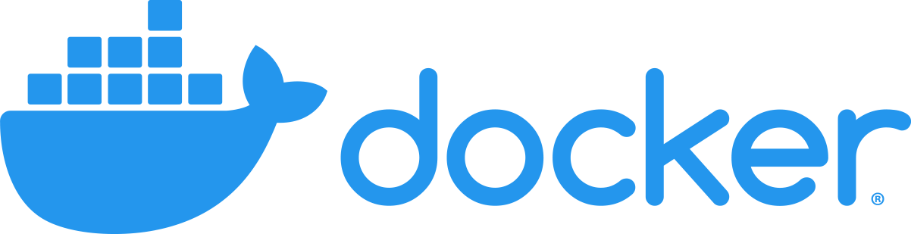
Overview
Virtual Machines
Containerization
Docker

Slide 3
Virtual machines
Machines that run on top of the same physical servers.
Deploying applications to physical server is not convenient.
Downtimes.
Scalability.
Resource abundance.
Though VMs resolved lot of issues, it also has some limitations.
OS overhead.
Lack of flexibility in deployments (blue/green deployments).
Resource utilization can still be optimized.
Lack of portability.

Slide 4
Virtual machine types
System virtual machines.
Running on top of a software called hypervisor. Hypervisor directly interact with the infrastructure. Host OS is not involved.
Windows Hyper-V, Oracle Virtual Box.
Process virtual machines
A process that runs within an OS.
Objective is to provide platform independent programming/runtime environment.
Java VM, .NET CLR.
Operating system level virtualization
Runs at the OS level.
Same OS kernel used for the guest environments.
OS supports multiple isolated servers.
Docker, Solaris Containers, FreeBSD.

Slide 5
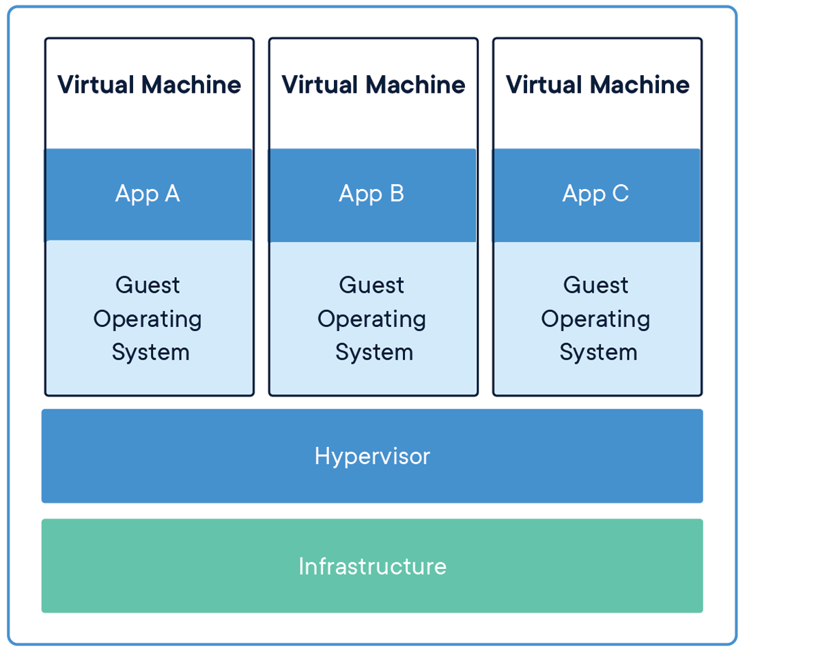
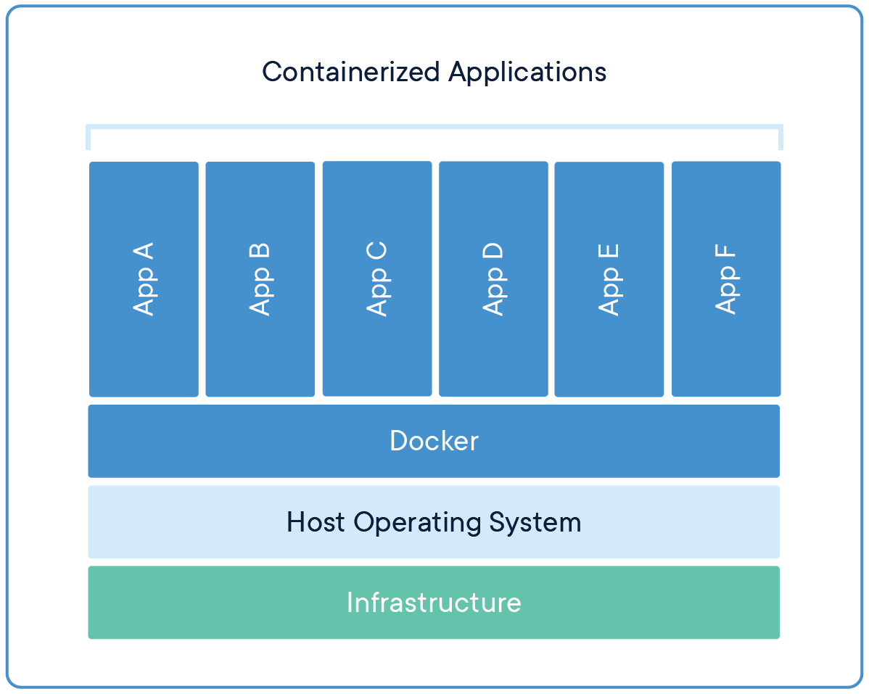
Virtual machine vs containerization

Slide 6
Containerization
Package software into units that are easily manageable, deployable and shippable.
Package is consisting of all the dependencies that are required to run the application.
Libraries.
Runtime.
System tools and libraries.
Settings and configurations.

Slide 7
Docker
Industry standard for containerized applications.
Lightweight, no kernel or OS overhead.
Supports wide variety of OS.
Leverage existing containerization concepts.
Specifically in the Linux world named cgroups and namespaces.
Cgroups – Linux kernel feature that limits and isolates resource usage for process.
Namespaces – More strict isolation Linux kernel feature. One resource in one namespace simply cannot see any resources in other groups.
Inbuild orchestration framework called docker swarms.
Written in GO.
Docker initiate the standardization of container eco system (containerd – Industry standard container runtime and the core container runtime of Docker engine).

Slide 8
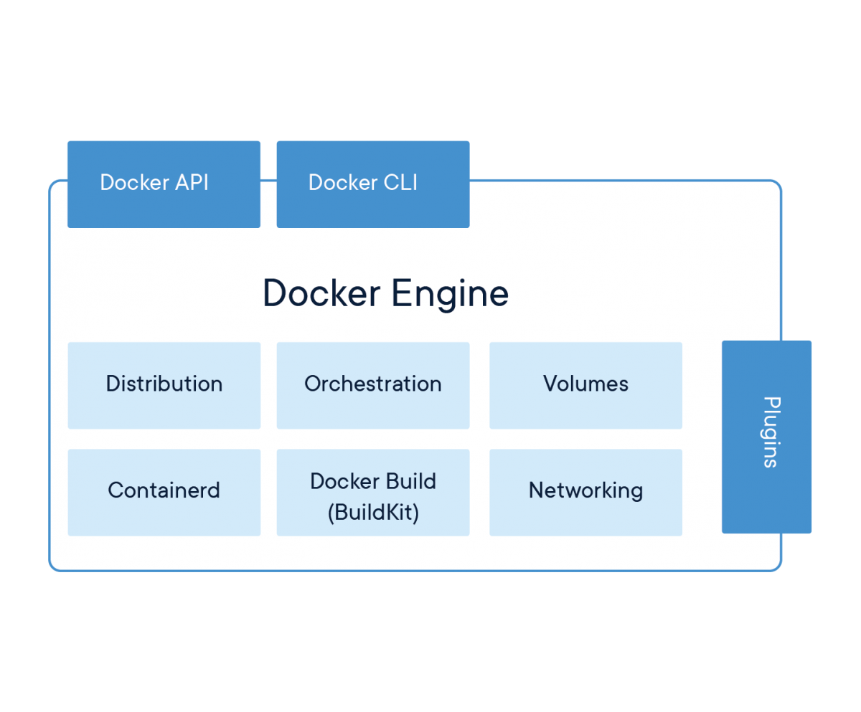
Docker

Slide 9
Docker advantages
Multiple OS support (Debian, Fedora, Windows, RHEL).
Run applications anywhere without any concern on the tooling and dependencies.
Security (build with security regulations).
Support for CI/CD and ideal platform for microservices development.
Support in multiple cloud providers (ECS).
Support in multiple container orchestration.

Slide 10
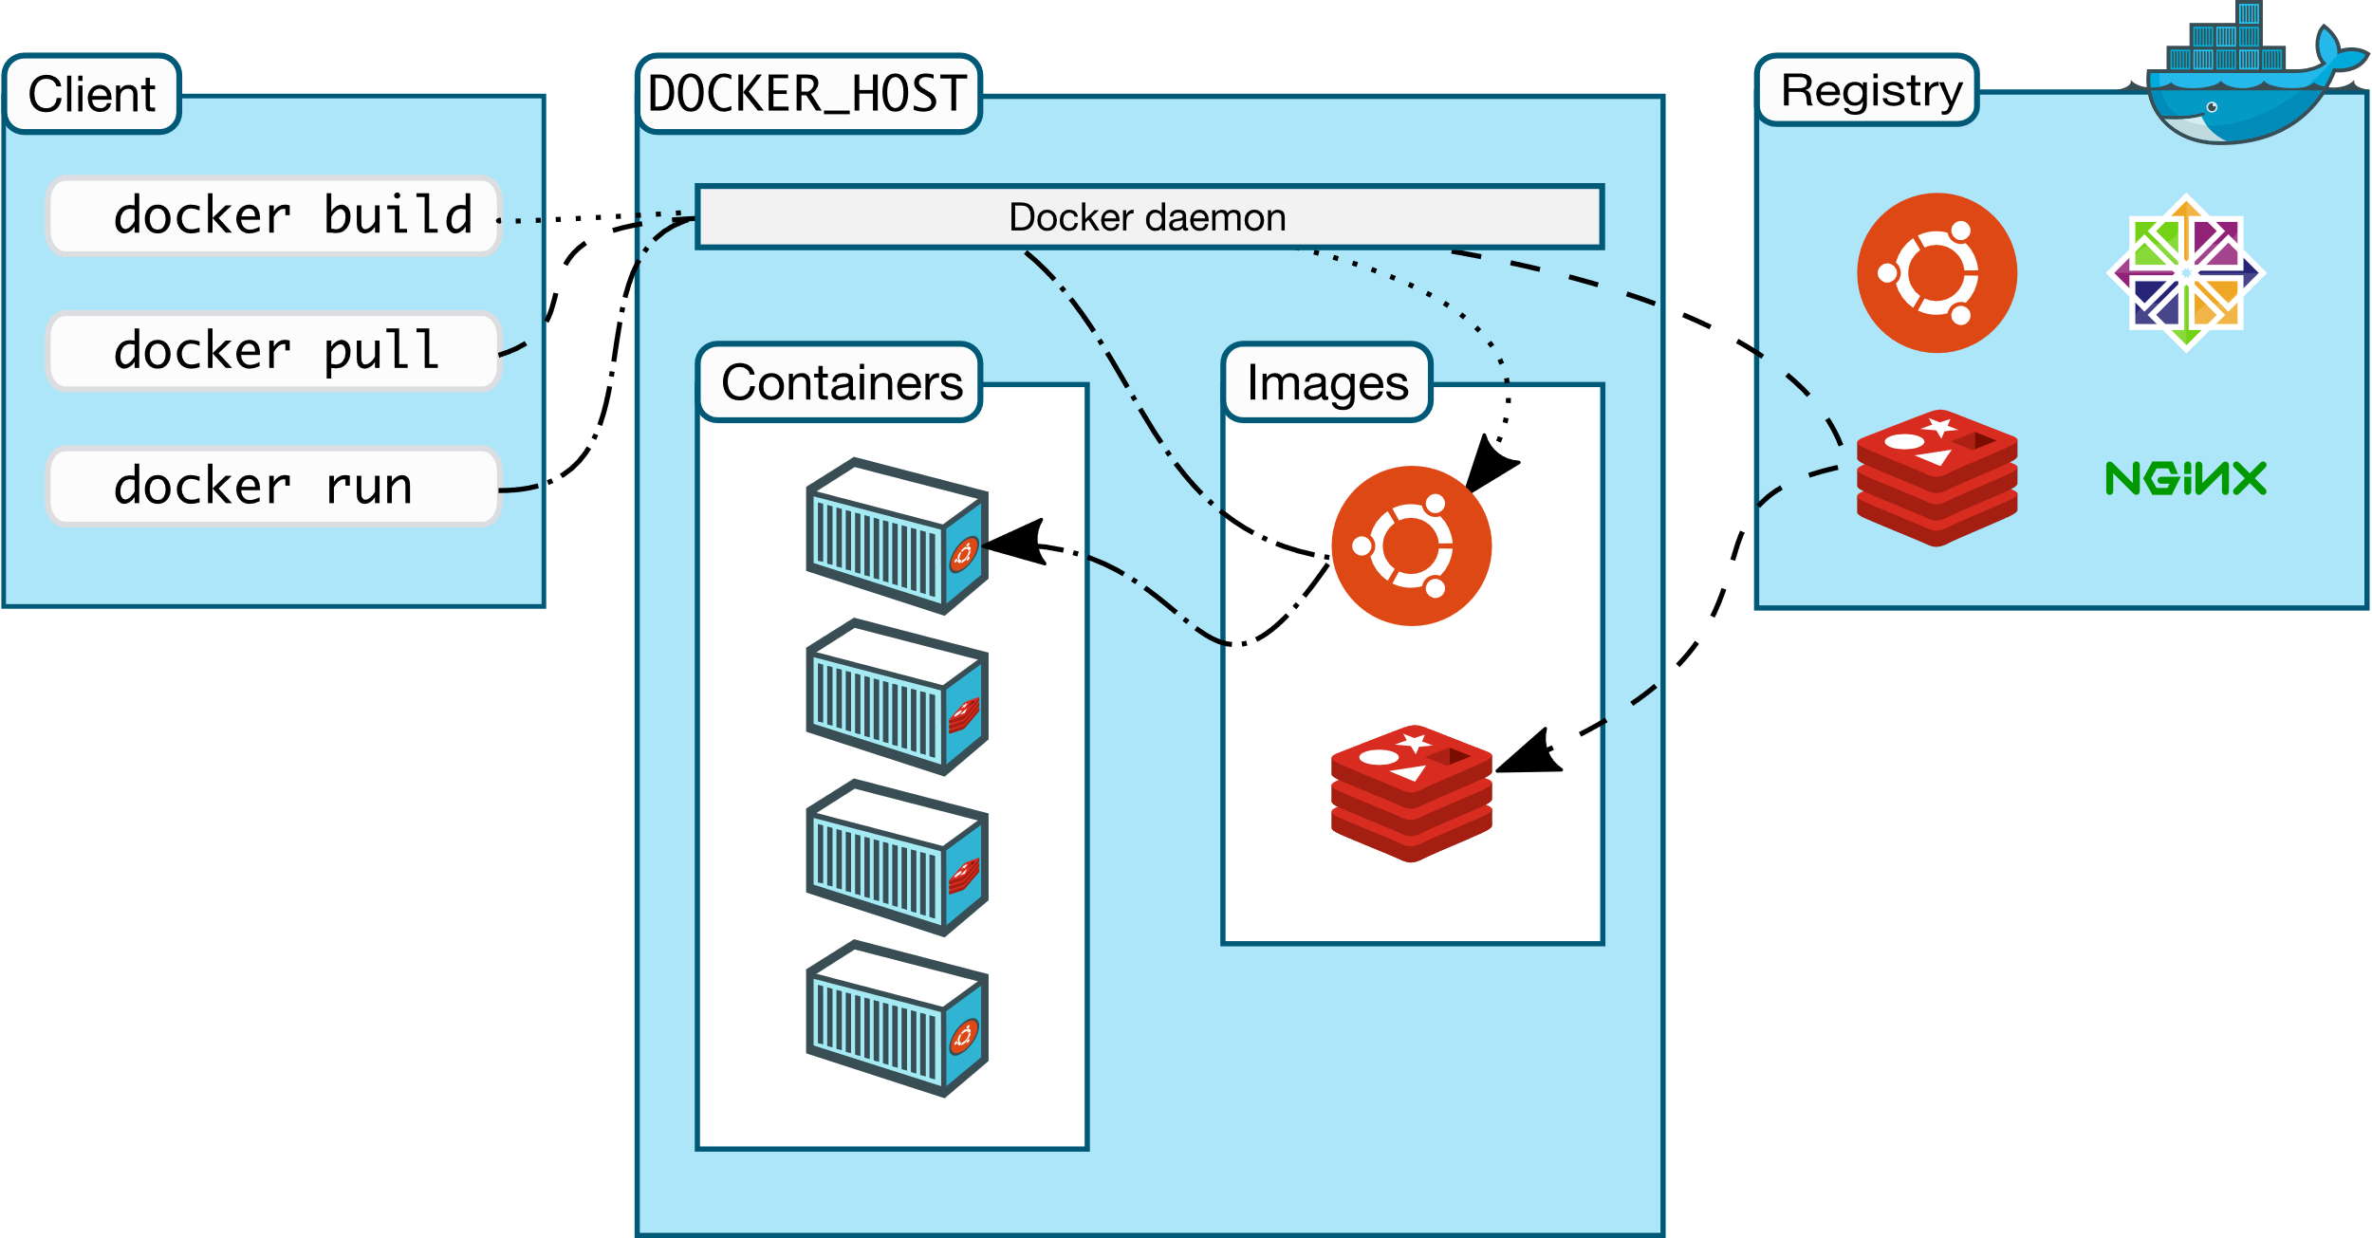
Docker architecture

Slide 11
Docker architecture
Client-server and use REST API to communicate.
Server – Docker Daemon
Client – Docker Client, Docker Swarm.
Client and Server can exist on the same host or different hosts.
Docker Daemon
Mange Docker objects such as images, containers, networks, and volumes.
Can communicate with other daemons.
Registries
Store of Docker images.
Docker Hub

Slide 12
Docker objects
Images
Read-only template with instructions to create the container.
Often images are based on another image.
Dockerfile is used to create images. It contains based image and steps to build the image such as other tool installations, downloads, configurations.
Containers
Running instance of an image.
Isolated from other containers and host machine.
Can control the network, resources and storage of a container.

Slide 13
Docker running an image
Download base images (if not already downloaded).
Creates a new container.
Allocated a read-write file system to the container. Container can create modify files in it’s local system.
Docker creates a network interface and assigned to container with an IP address. Containers can connect to external network using host machine network. (default setup).
Docker starts the container and execute /bin/bash

Slide 14
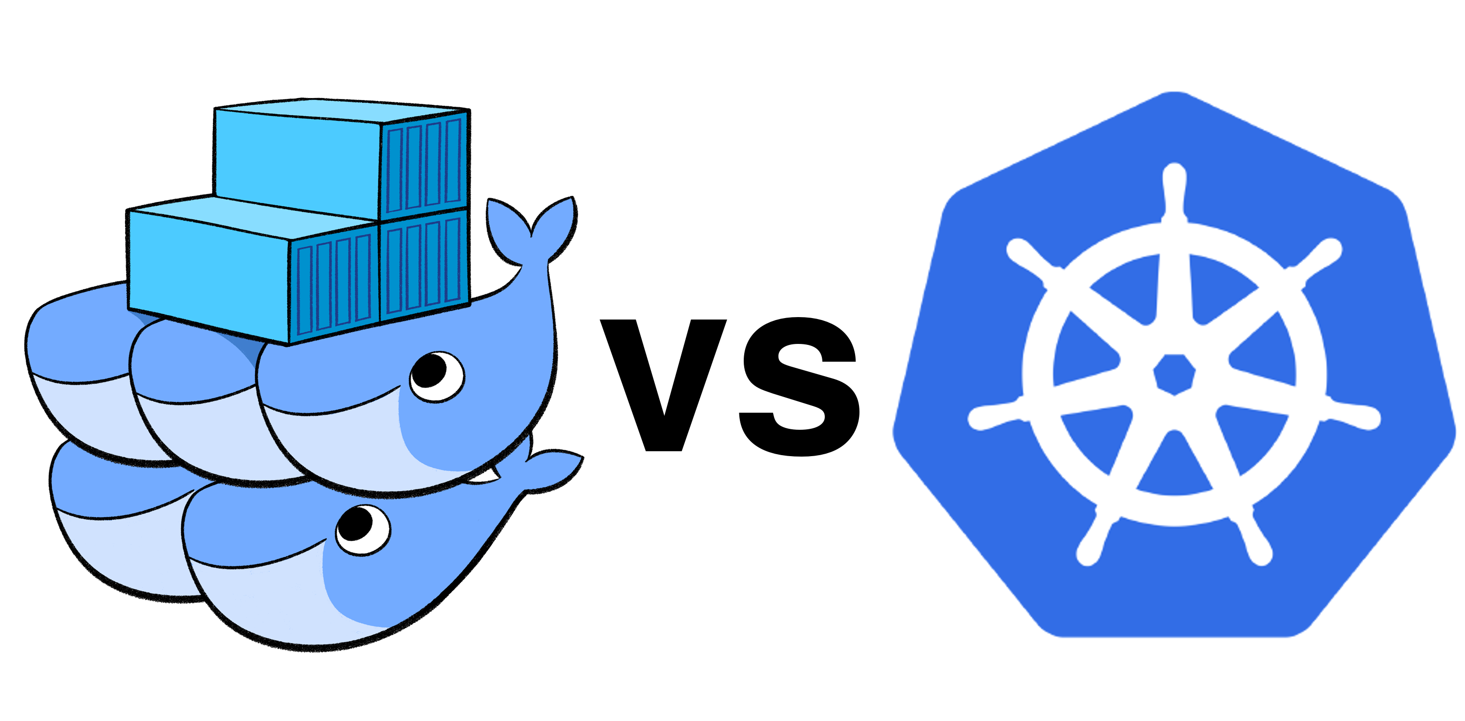
Orchestration
Managing deployment of containers. Including auto recovery, load balancing, network, autoscaling, managing configurations.
Docker Swarm, Kubernetes.

Slide 15


