Slide 1

Hospital appointment system
Hospital
appointment
management
Four agent roles support
one patient booking request.
1
Notes:
0:00–0:20. Introduce the project as a proposed booking assistant. The aim is to translate a patient’s request into a reservation that the hospital can confirm. Four agents share the work. Each color in the presentation follows one agent through the same booking example. Visual direction uses white and cool mist surfaces, dark teal typography and four consistent agent colors. All workflow nodes and connectors are native editable PowerPoint objects. Cover illustration generated with the built-in ImageGen tool. This is an illustrative scene, not a photograph of a real hospital.

Slide 2



Booking in a changing hospital
Services change. Patients need guidance.
Patient
AI assistant
Hospital staff
May be unsure which
service to choose.
Clarifies the request using
the current service directory.
Resolves requests that
need human judgment.
Fixed menus can fall behind hospital reorganizations.
2
Notes:
0:20–0:55. The proposed assistant would consult the current hospital directory as departments reorganize. For example, a patient may know the name of a follow-up visit but not which clinic now handles it. The LLM asks for the details needed to find that service. Next week and in the morning are preferences, while cardiology identifies the specialty. The patient can change preferences or stop. The AI asks for missing information and finds options. The patient chooses the appointment. Hospital staff handle a request when the automated process cannot resolve it. Icons: Lucide, ISC licence, https://lucide.dev/license.0, https://github.com/twitter/twemoji. Visual direction uses white and cool mist surfaces, dark teal typography and four consistent agent colors. All workflow nodes and connectors are native editable PowerPoint objects.

Slide 3


Four agents, one booking request
0 Coordinator
Follows the case through to an outcome.
A Chat Agent
B Classifier
C Booker
Understands the request
and asks for details.
Checks fields against
hospital requirements.
Finds slots and attempts
the reservation.
3
Notes:
0:55–1:25. Introduce the four roles in Workflow.pdf. Agent zero follows the whole case. Agent A owns the conversation, B checks the request, and C works with the booking system. These colors identify responsibility throughout the workflow. The taxonomy on the next slides is a proposed mapping between these responsibilities and the patterns in Cimino’s Agentic Engineering lectures. Visual direction uses white and cool mist surfaces, dark teal typography and four consistent agent colors. All workflow nodes and connectors are native editable PowerPoint objects.

Slide 4

0 Coordinator
Proposed agent taxonomy
Patient selects a slot
Goal setting
& monitoring
Booker attempts reservation
Tracks the booking goal
and delegates tasks.
Hospital confirms the booking
The case stays open until confirmation.
Multi-agent collaboration and human-in-the-loop
4
Notes:
1:25–1:55. Imagine the patient has chosen a slot but the service has not reserved it yet. The Coordinator keeps the case open until it observes the booking result. It tracks the goal across the work of the three specialists. If the case requires human judgment, it hands it to hospital staff. Course reference: Cimino, slides 57, 46 and 63. Visual direction uses white and cool mist surfaces, dark teal typography and four consistent agent colors. All workflow nodes and connectors are native editable PowerPoint objects.

Slide 5



A Chat Agent
Proposed agent taxonomy
Memory
management
“Tuesday morning
works.”
The conversation keeps the earlier context.
Retains the patient’s context
across turns.
Specialty
Day
Time
Cardiology
Tuesday
Morning
System role in prompt chaining
5
Notes:
1:55–2:25. Suppose the patient adds that Tuesday would work. The Chat Agent combines Tuesday with cardiology and the morning preference already given. It asks only for the missing details. Memory Management fits because the agent retains relevant context across turns within this booking conversation. Course reference: Cimino, slide 50. Visual direction uses white and cool mist surfaces, dark teal typography and four consistent agent colors. All workflow nodes and connectors are native editable PowerPoint objects.

Slide 6
B Classifier
Proposed agent taxonomy
Guardrails
and safety
Check hospital requirements
Required referral present?
Checks the request against
hospital rules.
Yes
Missing / unclear
Continue to booking
Refer to hospital staff
Router workflow for the validation outcome
6
Notes:
2:25–2:55. A complete request may still fail a hospital rule. For example, a required referral might be missing. The Classifier matches fields against the booking schema and checks requirements. A valid request proceeds to search. Unclear eligibility goes to staff through the Coordinator. Course reference: Cimino, slides 75 and 30. Visual direction uses white and cool mist surfaces, dark teal typography and four consistent agent colors. All workflow nodes and connectors are native editable PowerPoint objects.

Slide 7
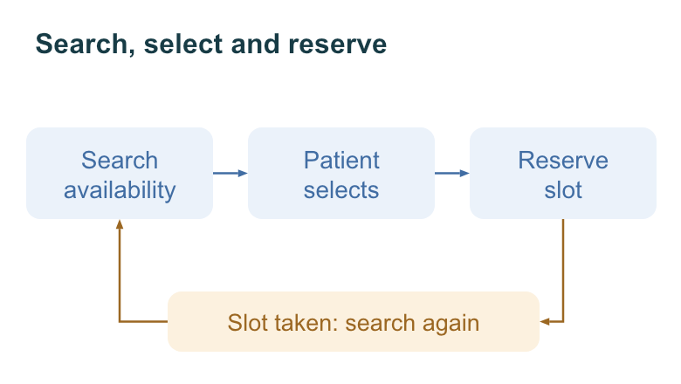
C Booker
Proposed agent taxonomy
Click the diagram to play the recovery sequence
Search, select and reserve
Tool use
Search
availability
Patient
selects
Reserve
slot
Queries availability
and reserves a selected slot.
Slot taken: search again
Exception handling and recovery
7
Notes:
2:55–3:25. The Booker queries the hospital schedule for compatible doctors and times. It presents the options and waits for the patient to choose. It then rechecks the slot and attempts the reservation. If another patient takes it first, the Booker searches again. Tool Use describes its interaction with the scheduling service. Course reference: Cimino, slides 40 and 60. Visual direction uses white and cool mist surfaces, dark teal typography and four consistent agent colors. All workflow nodes and connectors are native editable PowerPoint objects. Optional 15-second silent illustrative animation embedded in this slide. Click the diagram to play. It explains the search-selection-reservation conflict-retry sequence, not a recorded live system run. Skip it to retain the five-minute script.

Slide 8
Complete booking workflow
AGENT RESPONSIBILITY
0 Coordinator
A Chat Agent
B Classifier
C Booker
Patient requests an appointment
Collect patient details and preferences
NO
Ask patient for missing information
Information complete?
YES
Validate request and hospital requirements
Request valid?
NO / UNCLEAR
NEW PREFERENCES
YES
Escalate to hospital staff
Search doctors and available slots
NO
Slots available?
Suggest alternative dates or doctors
YES
Present appointment options
Patient selects an appointment
PATIENT STOPS
Recheck availability and reserve the slot
NO · SEARCH AGAIN
Booking successful?
YES
Request closed or referred to staff
Send confirmation to the patient
Appointment confirmed
NO SUITABLE OPTION
Notes:
3:25–4:10. Follow the main column downwards. The Chat Agent gathers details, the Classifier checks the request and the Booker searches availability. The patient selects the slot before reservation. Missing details return to the conversation. Unclear eligibility goes to staff. No matching slot leads to alternatives. A lost slot returns to search. The Coordinator follows the request until confirmation, referral or closure. Source: UC-01 and supplied workflow. Complete reconstruction of Desktop/PMI/Untitled.jpg. Includes all original activities and branches: missing information loop, validation and staff escalation, search, availability, alternatives with new preferences or no suitable option, selection, reservation failure returning to search, confirmation and both outcomes. Patient stops is explicit from UC-01. Color assignments match the agent taxonomy. The Coordinator owns referral/closure and overall completion, Chat Agent owns information collection, Classifier owns validation and Booker owns scheduling and confirmation. Patient actions use neutral grey.

Slide 9




Three possible outcomes
Confirmed
Referred
Closed
Date, doctor and location
reach the patient.
Hospital staff take over
the unresolved request.
The patient ends
the booking process.
Process mining can reveal repeated searches and waiting times.
9
Notes:
4:10–4:35. The workflow ends with a confirmed booking, referral to staff or closure by the patient. Confirmation contains the date, doctor and location. Event logs could later reveal repeated searches and delays, supporting the proposed process-mining extension. The next slide connects the project proposal to its executable demonstration. Visual direction uses white and cool mist surfaces, dark teal typography and four consistent agent colors. All workflow nodes and connectors are native editable PowerPoint objects.

Slide 10


bpmn8n
BPMN workflows on n8n
BPMN model
Typed Python tasks
n8n execution
Hospital demo
Local models
Typed tasks, patient review
and booking recovery
Ollama with domain research
through SearXNG
github.com/Dilox02/bpmn8n
10
Notes:
4:35–5:00. bpmn8n provides BPMN nodes on n8n, typed Python activities and a people inbox. The hospital demonstration adds reviewed request fields, synthetic appointment slots and conflict recovery. Ollama and multi-round SearXNG domain research already exist. Two pull requests add the use case and improve setup documentation and tests. Hospital connections remain future adapters. Sources: https://github.com/Dilox02/bpmn8n, https://github.com/Dilox02/bpmn8n/pull/1, https://github.com/Dilox02/bpmn8n/pull/2. The hospital example is proposed in an open PR. Automated tests passed with mocked model/web calls. Live n8n, Ollama and SearXNG integration was not exercised. Visual direction uses white and cool mist surfaces, dark teal typography and four consistent agent colors. All workflow nodes and connectors are native editable PowerPoint objects.

