Slide 1
Sequential Group Recommendation Part 2
Dilrukshi Keerthirathna
Kalpana Randeniya

Slide 2
Drawbacks of Static Aggregation Methods
Average Method
Treats all group members equally and easily ignores the minority preference, leading to high disagreement
Least Misery Method
Often recommends bland items with low preference scores for everyone (low utility)
Motivation for Sequential Methods
Static methods only produce a single list and cannot adapt over time
Need a method that considers sequential group preference

Slide 3
Proposed Method : Markov Decision Process (MDP)
MDP Components:
State: Current movie recommended to the group
Action: Next movie to recommend, balancing individual interests
Transition Probability: Likelihood of moving from one movie to another, based on historical group preferences (e.g., highly rated movies are prioritized)
Reward: Aggregated group satisfaction (e.g., average rating), guiding future recommendations
Why MDP Works:
Learns the best sequence instead of a single list
Balances group members’ preferences across multiple rounds

Slide 4

Pipeline Overview
Generates a ranked list of new, group-unseen movies that the user is most likely to enjoy, using collaborative-filtering predictions
Calculate how satisfied a user is with the group’s recommended list by comparing the total predicted ratings of the group’s movies to the total predicted ratings of the user’s own top-k ideal movies
Disagreement calculation

Slide 5

Pipeline Overview cont…
Calculate weighted blend of Average and Least Misery predicted ratings across users, using disagreement
Calculate Predicted Average Satisfaction

Slide 6
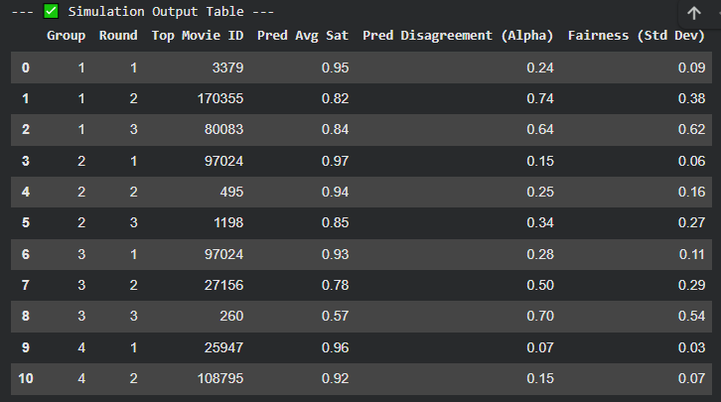
Simulation Findings
High average satisfaction across most groups (> 0.8)
Significant disagreement (α) for some groups — split preferences on top picks
Substantial variation in fairness: some rounds show high satisfaction disparity (std dev up to ~0.6)

Slide 7
Thank You

