Slide 1


Micro-Services Session I
Monolith
Micro-services
Modern Topics in IT(MTIT)
4th Year – Semester 1
By Isuru Jayakantha

Slide 2

Evolution from Monoliths to Microservices
Monolith means composed all in one piece.
A monolithic architecture is one in which a software application is designed to work as a single, self-contained unit.
The components within a monolithic architecture are interconnected and interdependent, resulting in tightly coupled code.
Presentation, Business logic, Data access, Application integration layers are compacted in a single artifact.

Slide 3
Monolithic Web Application Example
UI – Front End
Account Service
Web Browser
Database
Order Service
Booking Service
Shipping Service
WAR as a single artifact
Web Server / Container

Slide 4
Benefits of Monolithic Architecture
Simple to develop – Easier to develop at the beginning of the project.
Simple to test – End to end testing is much more easier.
Simple to deploy – Only required to copy single artifact to the server.
Simple to scale – scale horizontally by running multiple copies behind a load balancer.

Slide 5
Drawbacks(අඩුපාඩු) of Monolithic Architecture
Maintenance - If Application is too large and complex to understand entirely, it is challenging to make changes fast and correctly.
Deployment - The size of the application can slow down the start-up time.
Monolithic applications can also be challenging to scale when different modules have conflicting resource requirements (i.e. when a certain module is required to scale).
Redeployment is required for the entire application on each update.
Difficulty to adopting new and advance technologies.
Notes:
Discussion Points : When to use Monolithic ?

Slide 6
Core principles of Microservices
Microservices, aka Microservice Architecture, is an architectural style that structures an application as a collection of small autonomous services, modeled around a business domain.
Account DB
Account Service
Order Service
WAR as a single artifact
Order DB
Web Browser
UI – Front End
WAR as a single artifact
WAR as a single artifact
Shipping Service
Shipping DB
Booking Service
WAR as a single artifact
WAR as a single artifact
Inventory DB

Slide 7
Core principles of Microservices
Modelled Around Business Domain
Hide Implementation Details
Culture Of Automation
Highly Observable
Decentralize All The Things
Isolate Failure
Consumer First
Deploy Independently

Slide 8
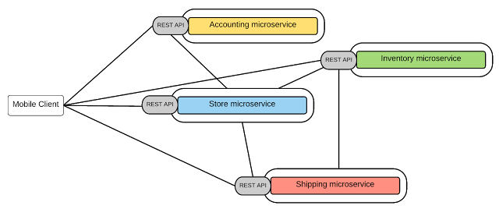
Modelled Around Business Domain
Discussion Points : List down Domain Driven Modules for a Taxi and Cab Booking Platform & Online Food Ordering Platform.

Slide 9
Culture Of Automation
1 Month
3 Month
6 Month
12 Month

Slide 10
Culture Of Automation
Infrastructure Automation
Automation Testing
Continuous Delivery

Slide 11


Hide Implementation Details
Database
Database

Slide 12
Decentralize All The Things

Slide 13
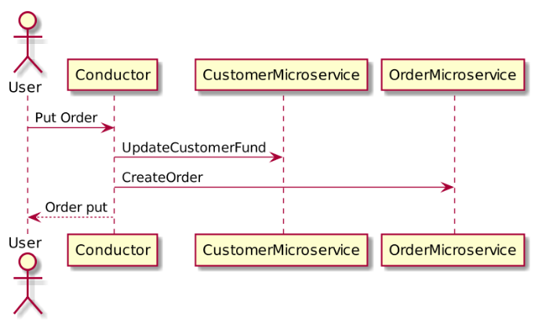
Decentralize All The Things
Ensuring data consistency across services

Slide 14
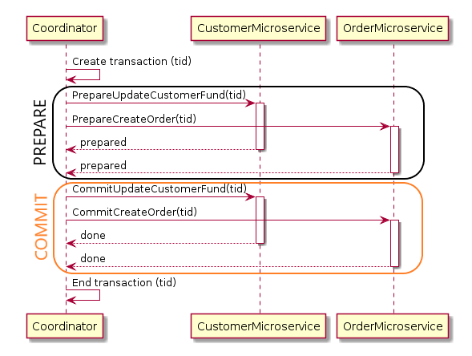
Two-Phase Commit
2PC consists of two stages, one is “PREPARE” and “COMMIT”.

Slide 15
SAGA
SAGA commits multiple compensatory transactions at different stages
ensuring to rollback when required.
Coordinator
Customer Microservice
Order Microservice
Create Transaction
Update Customer Fund
success
Create Order
failed
failed
Reverse Transaction
Cancel Update Customer Fund
success
Cancel Order

Slide 16
Deploy Independently
HOST
HOST
Service
Service
Service
Service
Service
Service
Service
Service instance per host
Multiple service instances per host

Slide 17
Consumer First
Identify Consumers
Method of Communication
Documentation
Standards and Best Practices
Service Discovery

Slide 18
Service Discovery : The Problem Context
Dynamically Assigned
Order
Service
Instance
Dynamically Created
10.4.3.1:8080
?
Stock
Service
Instance
Customer Service
Client
How to load balance
20.4.12.20:8080
Account
Service
Instance
172.4.3.32:8083
Shipping
Service
Instance
92.168.0.11:7023

Slide 19
Service Discovery Patterns
The Client‑Side Discovery Pattern
Order
Service
Instance
Registry aware client
10.4.3.1:8080
Stock
Service
Instance
Customer
Service
Client
20.4.12.20:8080
Account
Service
Instance
Service
Registry
172.4.3.32:8083
Shipping
Service
Instance
92.168.0.11:7023

Slide 20
Service Discovery Patterns
The Server‑Side Discovery Pattern
Order
Service
Instance
10.4.3.1:8080
Customer
Service
Client
Load Balancer
Stock
Service
Instance
Query Instance Details
20.4.12.20:8080
Account
Service
Instance
Service
Registry
172.4.3.32:8083
Shipping
Service
Instance
92.168.0.11:7023

Slide 21
Isolate Failure
One of the best advantages of a microservices architecture is that you can isolate failures and achieve graceful service degradation as components fail separately.
Booking Service
Invoice Service
Shipping Service
Account Service
Discussion Points : When one service synchronously invokes another there is always the possibility that the other service is unavailable or is exhibiting such high latency it is essentially unusable. This might lead to resource exhaustion, which would make the calling service unable to handle other requests. How to prevent a network or service failure from cascading to other services?

Slide 22
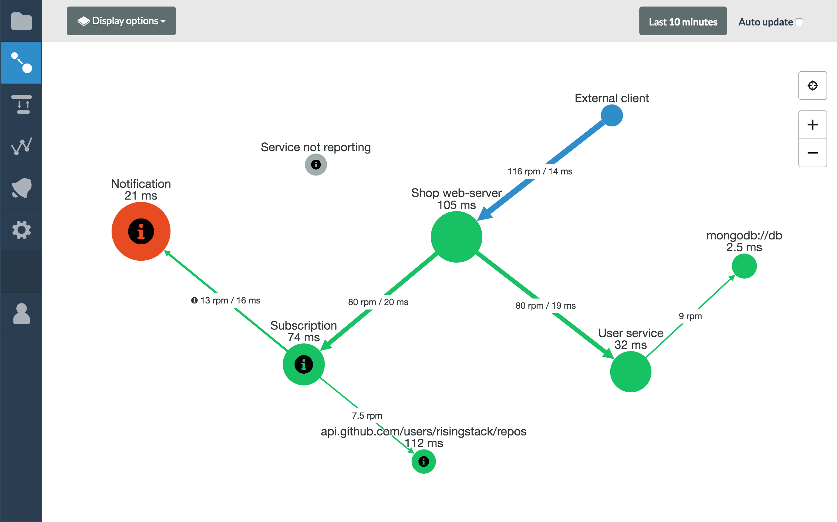
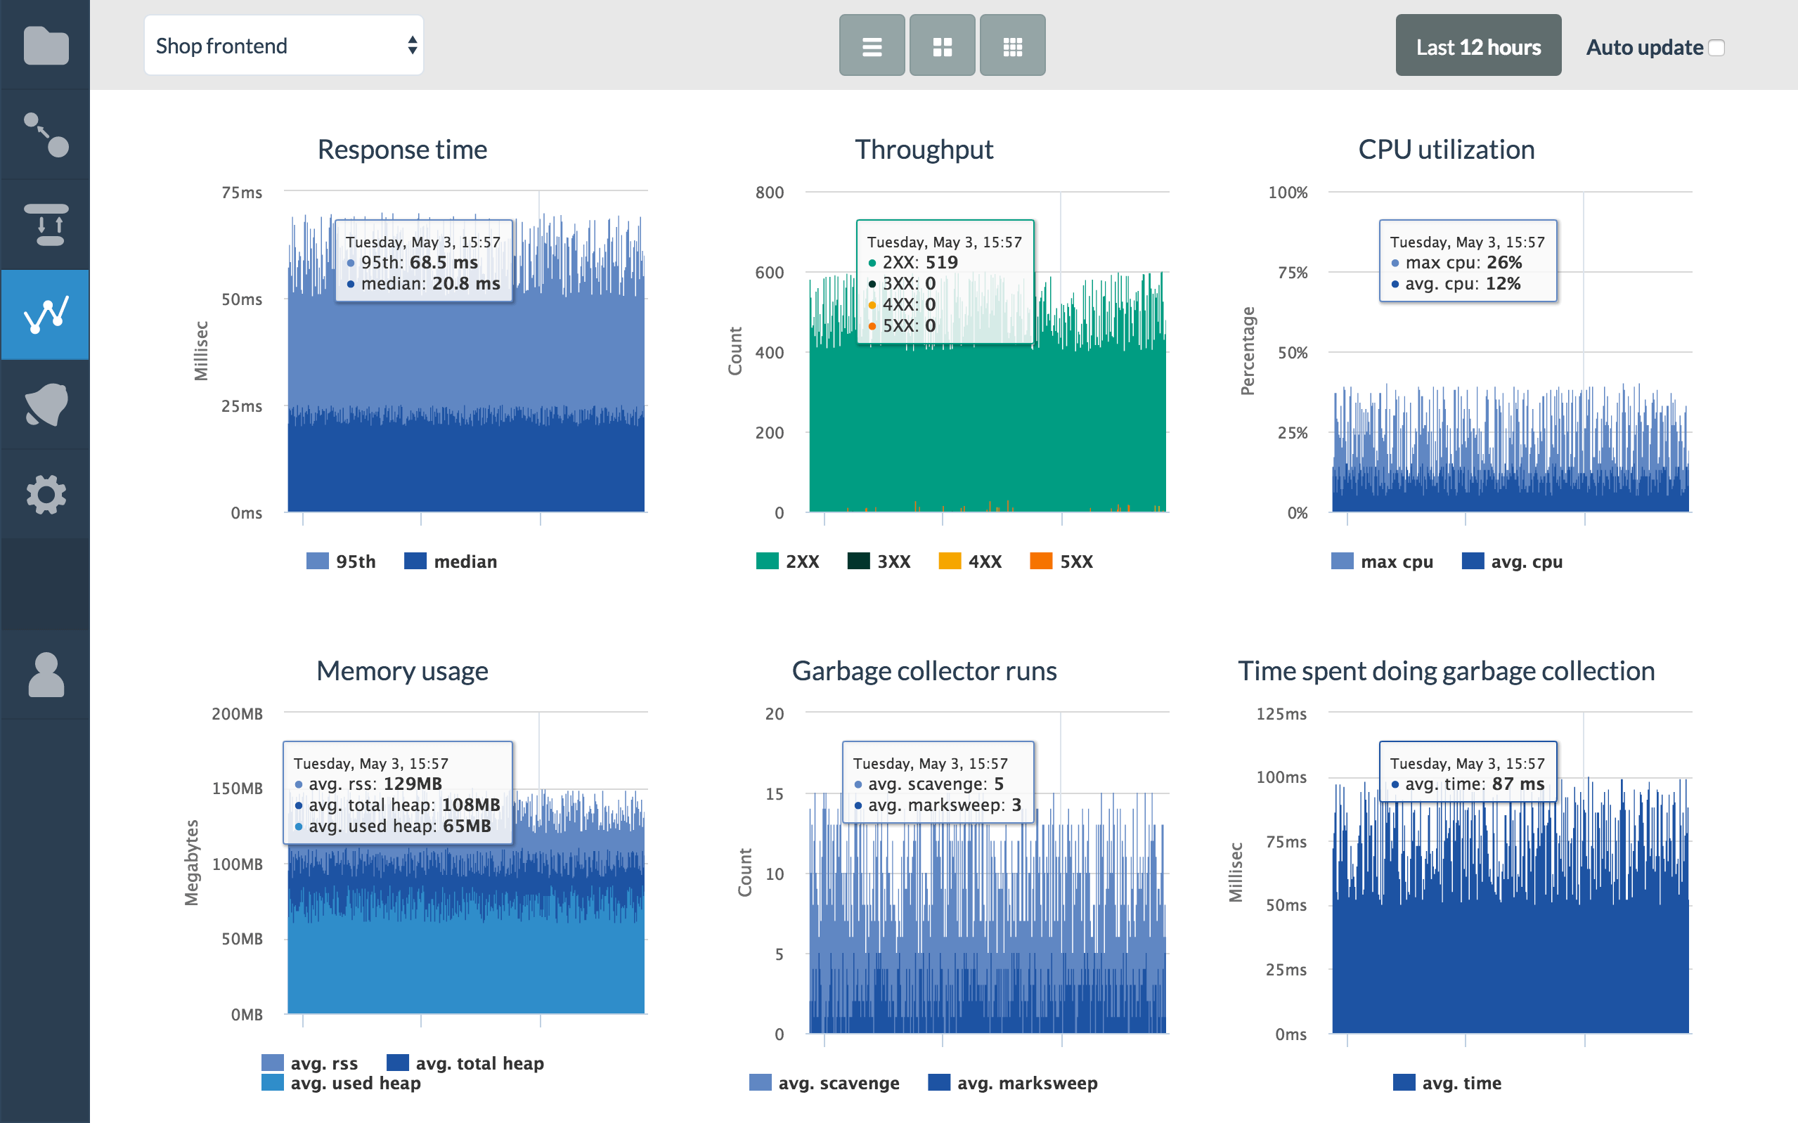
Highly Observable
Discussion Points : How to uniquely identify each 'customer order', or the equivalent
in your system when request travels through multiple microservices ?

Slide 23
Lab Session - I

Slide 24
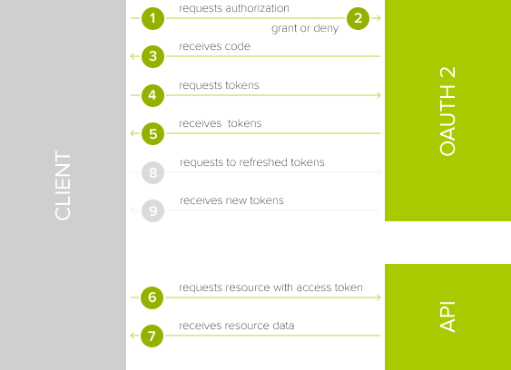
OAUTH 2

Slide 25
Securing Microservices
Use TLS-protocols for all APIs
Profile All APIs
Use OpenID or OAuth 2.0, etc.
Encrypt Sensitive Data
Protect APIs From Denial-Of-Service-Attacks
Rate Limiting (Throttling)
The token expiry times should be as short as possible

Slide 26
Securing Microservices
Obtain / validates token
Identity Server
Access resource with a token
Client
Microservices

Slide 27
Lab Session - II

Slide 28
Principles of Microservice Scalability and Performance
Portability
Ability to deploy quickly.
Elasticity
Ability to locate both a single and multiple microservices on a single host.
Availability
Ability to be replicated and spread across data-centers and geographical distances.
Robustness
Implement some fault-tolerant mechanisms that can detect possible failures in microservices they depend on in order to prevent cascading failures.

Slide 29
Best Practices for Designing a Microservices Architecture
Create a Separate Data Store for Each Microservice
Teams can work independently.
Keep Code at a Similar Level of Maturity
Maintain versioning for changes.
Deploy in Containers
One tool to deploy everything.
Document API’s
Asynchronous Messaging
Applying domain-driven design principles
Use Service registry
Registration, Heartbeats, Service discovery, De-registration.
Integration Testing is a must

Slide 30
References
Software Architect's Handbook by Joseph Ingeno
Production-Ready Microservices by Susan J. Fowler
Hands-On Microservices - Monitoring and Testing By Dinesh Rajput
Microservices Best Practices for Java By Michael Hofmann, Erin Schnabel and Katherine Stanley

