Slide 1
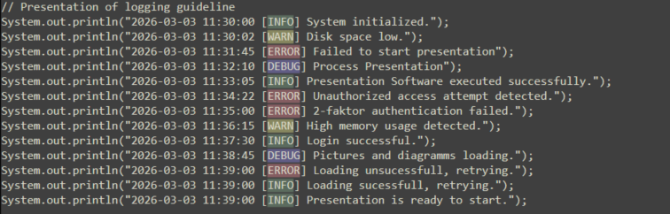
MINING AND STRUCTURING LOGGING GUIDELINES FOR IMPROVING LOG ANALYSIS
Supervisor: Thorsten Berger
Advisor: Mukelabai Mukelabai
Dilsan Mahadeva, 14.10.26

Slide 2
Table of content
    Motivation & Research Problem
    Research Questions, Design
    Methodology
    Results
    Discussions & Contribution
    Conclusion

Slide 3
Motivation
Modern systems growing log data
Debugging, monitoring, fault localisation
Log quality & consistency

Slide 4
Research Problem
Varying logging practices by developers, team, projects
Inconsistent, incomplete log information
No structured, traceable guideline catalogue

Slide 5
    Research Question
RQ1: What logging practices and challenges do software developers encounter in software development and maintenance?
RQ2: What logging guidelines are documented in academic literature?
RQ3: What logging guidelines are documented in open-source repositories?
RQ4: What themes can be identified within the logging guideline catalogue?

Slide 6
    Research Design
Developer Study
RQ 1
Academic Literature
Collection
RQ 2
Open-Source
Collection
RQ 3
Logging Guideline Catalogue
Thematic Analysis
RQ 4

Slide 7
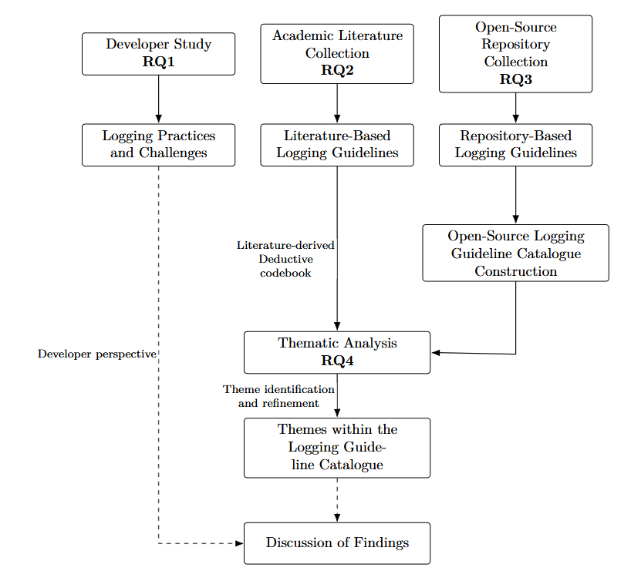
    Research Design

Slide 8
    Methodology: Developer Study (RQ1)
  Industry survey (aviation)
  Voluntary participants
  Three fields:
    Logging Implementation
    Log Analysis
    Fault Localisation
  Structured & free-text questions
  Quantitative frequencies & qualitative response analysis

Slide 9
    Methodology: Academic Literature Collection (RQ2)
  Google Scholar literature search
  Search Terms:
    Logging Guideline
    Logging Practice
    What to Log
    Where to Log
    How to Log
  Publication period: 2020-2026
  Backwards snowballing
  Extraction of guideline
  Literature-derived deductive codebook

Slide 10
    Methodology: Open-Source Collection & Extraction(RQ3)
  Repository Collection:
    GitHub search queries
    Metadata collection
    Duplication, similarity check
  Guideline Extraction:
    AI-assisted identification by XML tagging
    Python structured content extraction
    Contextual content tags
    Guideline formulation & normalisation
    Manual review & source traceability

Slide 11
    Methodology: Thematic Classification (RQ4)
  Deductive-Inductive Classification:
    Literature-derived initial codebook
    Inductive themes from guideline content
    Theme refinement
  Semantic Consolidation:
    Equivalent recommendations grouped
    Unique conditions & recommendations
    Source to canonical mappings

Slide 12
    Methodology: Validation
XML & Extraction:
  XML structure, tag consistency
  Manual review
  Untagged files
Guideline Normalisation:
  Random sample 10% (234)
  Original Content & Content Tag
  Meaning, condition & unsupported information
  NO_GUIDELINE tags
Thematic Classification:
  Theme assignments with final codebook
  Themes re-examined
  Misclassification & recurring pattern corrected
Semantic Consolidation & Traceability:
  Semantic equivalence & unique condition
  Incorrect merged guideline separated
  Source-level guideline in canonical guideline
  Retain original source content

Slide 13
    Research Results
RQ1: Developer Practices & Challenges
RQ2: Academic Logging Practices and Guidelines
RQ3: Open-Source Logging Guideline
RQ4: Themes within the Guideline Catalogue

Slide 14
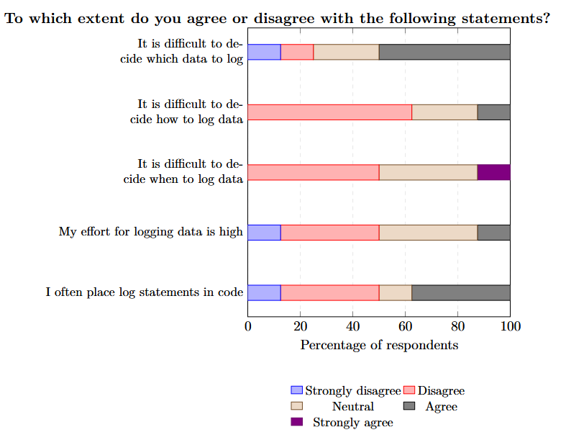
    Logging Implementation
Strongly disagree | disagree | Neutral | Agree | Strongly agree
12.5% | 12.5% | 25% | 50% | 0%
0% | 62.5% | 25% | 12.5% | 0%
0% | 50% | 37.5% | 0% | 12.5%
12.5% | 37.5% | 37.5% | 12.5% | 0%
12.5% | 37.5% | 12.5% | 37.5% | 0%

Slide 15
    Logging Implementation
Practices:
  Event reporting, state dumps & execution tracing
  Structured, readable & consistent log messages
  Framework usage & component-level logging
  Relevant context, input & output information
Challenges:
  Log content selection
  Excessive vs insufficient logging
  Logging performance costs

Slide 16
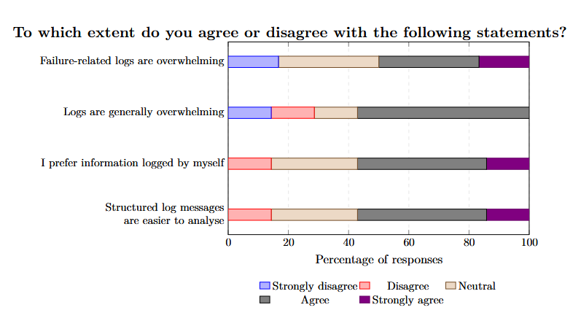
    Log Analysis
Strongly disagree | disagree | Neutral | Agree | Strongly agree
16.6% | 0% | 33.3% | 33.3% | 16.6%
14.29% | 14.29% | 14.29% | 57.1% | 0%
0% | 14.29% | 28.6% | 42.9% | 14%
0% | 14.29% | 28.6% | 42.9% | 14%

Slide 17
    Log Analysis
Practices:
  Debugging, failure identification & fault localisation
  Searching error messages, timestamps & keywords
  Relating logs to source code & execution flow
  Analysing system states, inputs & outputs
  Using documentation, developer knowledge & collaboration
Challenges:
  Overwhelming log information
  Interpreting unfamiliar logs
  Missing or inconsistent contextual information
  Understanding logs across different components

Slide 18
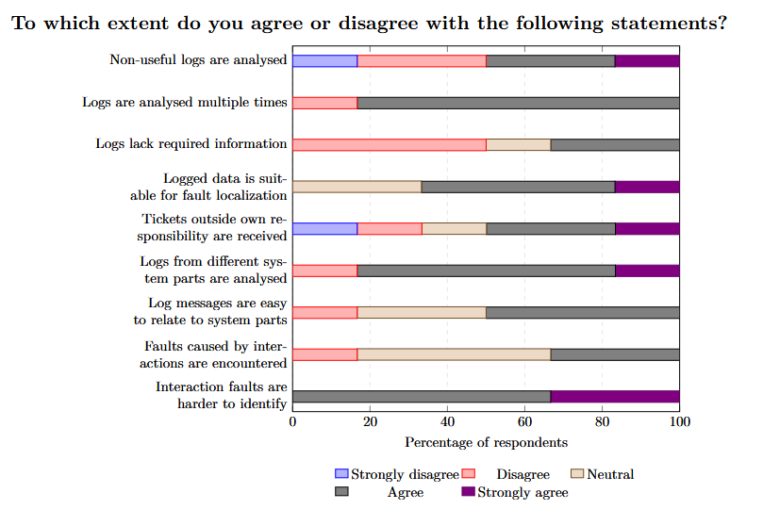
    Fault Localisation
Strongly disagree | disagree | Neutral | Agree | Strongly agree
16.7% | 33.3% | 0% | 33.3% | 17%
0% | 16.7% | 0% | 83.3% | 0%
0% | 50% | 16.7% | 33.3% | 0%
0% | 0% | 28.6% | 42.9% | 17%
16.7% | 16.7% | 16.7% | 33.3% | 17%
0% | 16.7% | 0% | 66.7% | 17%
0% | 16.7% | 33.3% | 50% | 0%
0% | 16.7% | 50% | 33.3% | 0%
0% | 0% | 0% | 66.7% | 33%

Slide 19
    Fault Localisation
Practices:
  Tracing failures back to underlying causes
  Identifying affected components through logs & source code
  Combining logs with additional technical information
  Cross-component analysis & developer collaboration
Challenges:
  Complex cross-component interaction
  Repeated analysis of log information
  Dependency on architecture & project knowledge
  Insufficient or irrelevant log information

Slide 20
    Results: Developer Practices & Challenges (RQ1)
Logging Implementation:
  Practices: Event reporting, state dumps & execution tracing
  Challenges: Log content selection, logging performance overhead
Log Analysis:
  Practices: Debugging, error searches & execution tracing
  Challenges: Information overload, unfamiliar log interpretation
Fault Localisation:
  Practices: Tracing failures, source-code inspection & collaboration
  Challenges: Cross-component interactions, missing contextual information

Slide 21
    Results: Logging Guidelines in Academic Literature (RQ2)
Literature Collection:
  Google Scholar search & backward snowballing
  31 relevant academic publications
  7 supporting logging tools
Main Findings:
  Actionable recommendations across four logging dimensions
  Literature-derived classification with 17 deductive themes

Slide 22
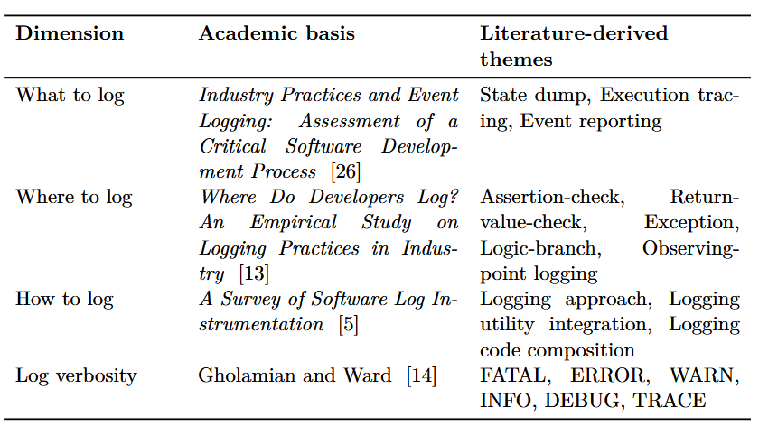
    Literature-Derived Classification (RQ2)

Slide 23
    GitHub Search Strategy (RQ3)
10 Search Queries:
General logging guideline
Log content & severity levels
Engineering standards & conventions
Structured logging
Security & sensitive information
Log level
Programming language-related
Markdown-based documentation
Observability, telemetry, diagnostics
Logging anti-patterns

Slide 24
    Open-Source Repository Collection (RQ3)
Collection:
  10 GitHub search queries (966 total)
  895 Unique repositories identified
  229 Source files retained
Preparation:
  Repository metadata collection
  Duplicate detection & source relevance review
  File-level similarity checks & source cleaning

Slide 25
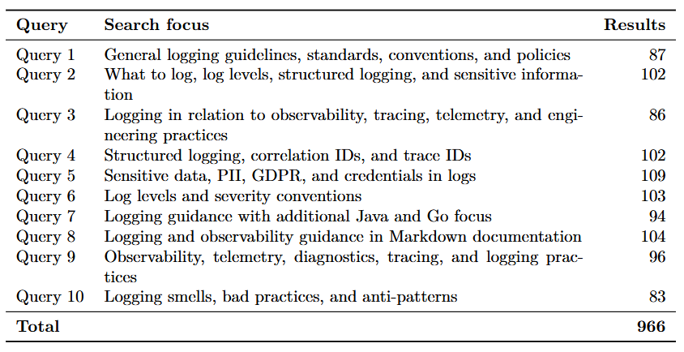
Repository Collection (RQ3)

Slide 26
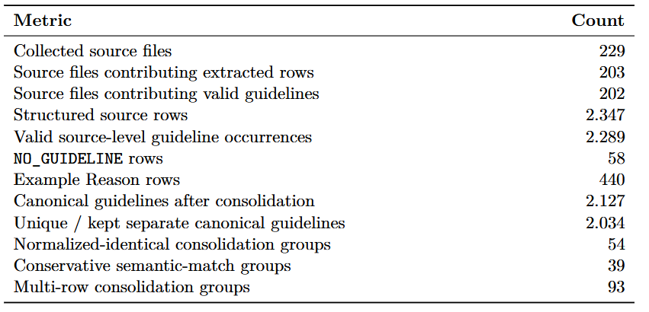
Guideline Extraction & Normalisation (RQ3)

Slide 27
Deductive-Inductive Thematic Classification (RQ4)
Deductive Codebook:
  17 literature-derived themes in 4 dimensions
Open-Source Catalogue :
  Normalised guideline content and source context
AI-Assisted mapping:
  Deductive codebook
  Inductive codebook
Final Theme codebook
  28 themes: 17 deductive · 11 inductive

Slide 28
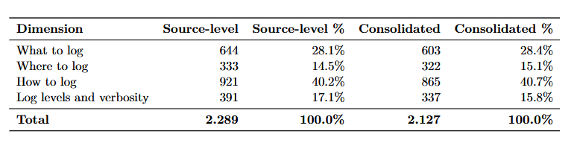
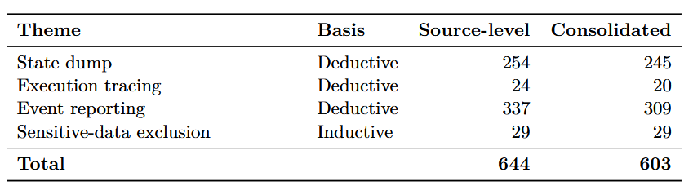
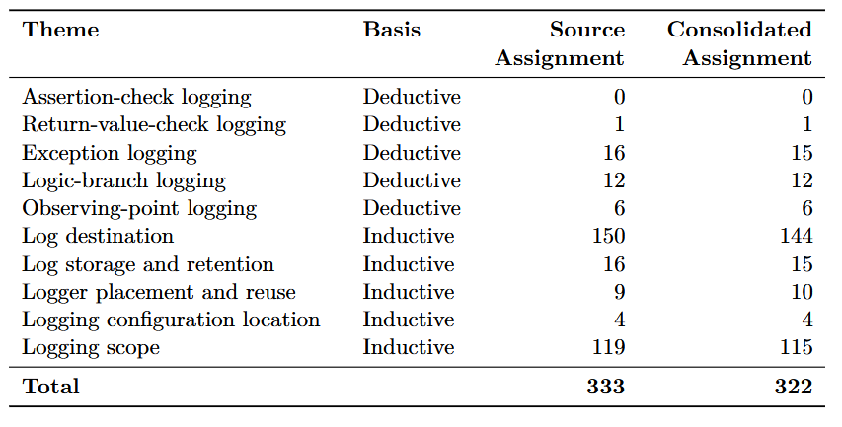
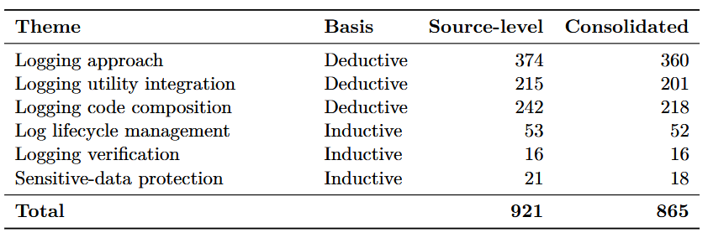
Thematic Catalogue Dimension Distribution (RQ4)

Slide 29
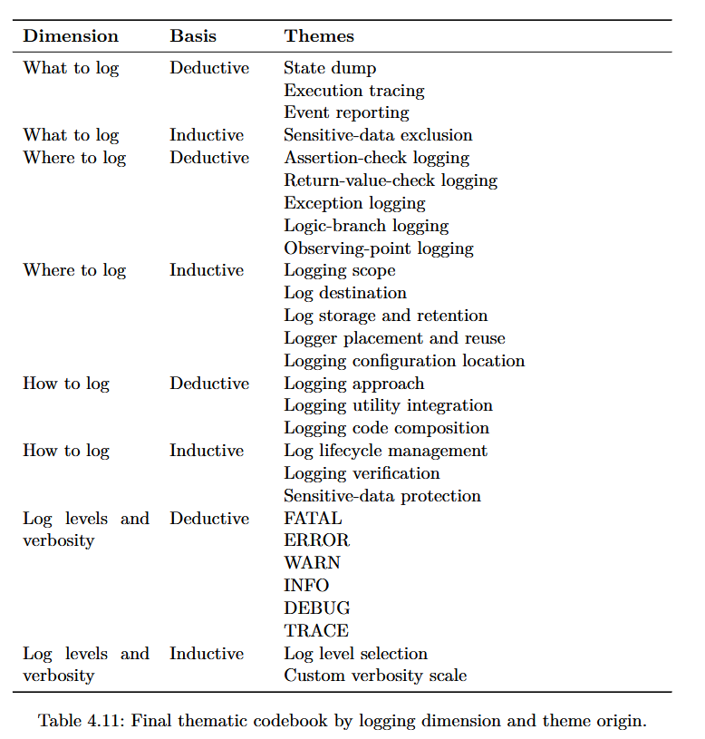
Thematic Catalogue Dimension Distribution (RQ4)

Slide 30
Final Thematic Findings (RQ4)
28 themes: 17 deductive & 11 inductive
27 themes observed, Assertion-check logging not identified
Logging approach: 794 -> 374 (source level)
Logging approach: 360 canonical guidelines
2127 canonical guidelines

Slide 31
    Research Question
RQ1: What logging practices and challenges do software developers encounter in software development and maintenance?
  Context-dependent logging decision
  Log information selection & cross-component challenges
RQ2: What logging guidelines are documented in academic literature?
  31 academic publications
  4 dimensions & 17 literature-derived themes
RQ3: What logging guidelines are documented in open-source repositories?
  2127 canonical guidelines after consolidation
RQ4: What themes can be identified within the logging guideline catalogue?
  28 themes: 17 deductive & 11 inductive

Slide 32
Example
Search Query:
  Query 1 (General guidelines)
  Repo: sveneisenschmidt/n8n-openai-bridge
  “This document describes the logging standards and practices for the n8n OpenAI Bridge application.”
Metadata:
  Stars: 124
  Commits: 87
  Developers: 3
  Latest updated: 27/03/26
  Created: 10/10/25

Slide 33
Example
XML Tag:
  <how_to_log>3. **Never log sensitive data directly**:
  ```javascript
  // Bad
  console.log('Token:', bearerToken);
  // Good
  console.log('Headers:', maskSensitiveHeaders(headers));
  ```</how_to_log>
Content Tag:
  access tokens · sensitive data · console output
Normalised Guideline:
  Never log sensitive data directly.

Slide 34
Example
Dimensions and Themes:
  How to log, Sensitive-data protection (Inductive)
Final Consolidated Guideline (CG-1779):
  Never log sensitive data directly.
    Example ER-0207

Slide 35
Discussion: Interpretation of Findings
Developer logging decisions & challenges
Academic recommendations in collected guidance
Initial deductive codebook not complete
Frequency indicates occurrence not guideline quality
Specific guideline meaning preserved beyond themes

Slide 36
Contributions & Implications
Empirical observations of developer logging practices
Academic logging recommendations
Traceable open-source guideline catalogue & consolidation mapping
Proposed deductive-inductive codebook (28 themes)
Preserved source references & 440 rows with examples
Basis for practical exploration and future semantic retrieval

Slide 37
    Threats of Validity
Construct Validity:
  Implicit logging guidance not covered
  Theme definition & classification boundaries
  Practices interpretation bias
Conclusion Validity
  Partial survey responses
  Theme frequencies
  Limited observed dataset
Internal Validity:
  AI-assisted processing error
  Classification & consolidation risks
  Manual review & source traceability
External Validity:
  Developer study of one company
  Bounded GitHub search
  Limited literature collection

Slide 38
Conclusion & Outlook
Main Contribution:
  Collection & structuring of logging guidance
  2127 traceable canonical guidelines
  28 themes across 4 dimensions
  Structured catalogue for guideline exploration
Future work:
  Broader industrial & academical evaluation
  Further thematic refinement
  Evaluation of practical catalogue usefulness

Slide 39
Sources
All tables and figures are from the thesis
  https://github.com/Dilsan-M/Mining-and-Structuring-Logging-Guidelines-for-Improving-Log-Analysis
Value table in RQ1 are created in PowerPoint
Titlepage picture self-created example

Slide 40
Endfolie
Thank you
for your
attention

Slide 41
Endfolie
Demonstration

Slide 42
Endfolie
Q & A

Slide 43

Endfolie

