Slide 1

TITLE: CONCEPT HIERARCHIES
Presented by:
Amarah Rasheed (210301)
Dilshada Farooq (210324)
8th Semester – CSE
GOVERNMENT COLLEGE OF ENGINEERING AND TECHNOLOGY SAFAPORA,GANDERBAL,KASHMIR

Slide 2
INTRODUCTION
Concept hierarchies define mappings of low-level data to higher-level concepts.
In data mining, the concept of a concept hierarchy refers to the organization of data into a tree-like structure, where each level of the hierarchy represents a concept that is more general than the level below it.
Example: City → State → Country → Continent.

Slide 3
IMPORTANCE OF CONCEPT HIERARCHIES
Help in data abstraction and summarization.
Enable roll-up and drill-down operations in OLAP and data cubes.
Useful for pattern discovery and knowledge extraction.

Slide 4
TYPES OF CONCEPT HIERARCHIES
1. Schema-based hierarchies
2. Set-grouping hierarchies
3. Attribute-oriented induction hierarchies
4. Rule-based hierarchies

Slide 5
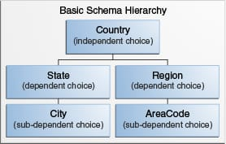
SCHEMA-BASED HIERARCHIES
Schema Hierarchy is a type of concept hierarchy that is used to organize the schema of a database in a logical and meaningful way
Often implemented using foreign key relationships.

Slide 6
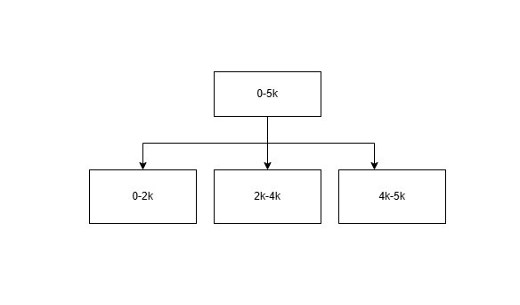
SET-GROUPING HIERARCHIES
Set-Grouping Hierarchy is a type of concept hierarchy that is formed by grouping a set of objects or attribute values.
Useful for categorical data grouping.
Example: Price Range

Slide 7
OPERATION-DERIVED HIERARCHY:
An Operation-Derived Hierarchy is a type of concept hierarchy that is used to organize data by applying a series of operations or transformations to the data.
The operations are applied in a top-down fashion, with each level of the hierarchy representing a more general or abstract view of the data than the level below it.

Slide 8
RULE-BASED HIERARCHIES
Rule-based Hierarchy is a type of concept hierarchy that is used to organize data by applying a set of rules or conditions to the data.
Example: IF income < 50,000 THEN ‘Low Income’; IF income ≥ 50,000 THEN ‘High Income’.

Slide 9
EXAMPLE OF CONCEPT HIERARCHY
Geographical Hierarchy: Street → City → State → Country → Continent.
Temporal Hierarchy: Second → Minute → Hour → Day → Month → Year.
Product Hierarchy: Item → Category → Department → Division.

Slide 10
APPLICATIONS IN DATA MINING
Data summarization and generalization.
OLAP operations (roll-up, drill-down).
Knowledge discovery and pattern recognition.
Efficient query processing and data analysis.

Slide 11
CONCLUSION
Concept hierarchies play a vital role in simplifying and summarizing large datasets.
They support effective data analysis and knowledge discovery.
A well-defined hierarchy improves the performance of data mining results.

Slide 12
Thank You

