Slide 1
DATA ANALYTICS | WEEK 2 ACTIVITY 2 | YOOBEE COLLEGES
Beijing Multi-Site
Air Quality Analysis
Statistical Analysis — Tasks 1 to 6
UCI ML Repository | 420,768 rows | 12 stations
March 2013 – February 2017 • Hourly Measurements

Slide 2
TASK 1 — Load & Inspect the Dataset
420,768
18
12
4 Years
Total Rows
Columns
Stations
Hourly Data
2013–2017
Columns
(station added during loading)
No, year, month, day, hour
PM2.5 — fine particulate matter
PM10 — coarse particulate matter
SO2 — sulfur dioxide
NO2 — nitrogen dioxide
CO — carbon monoxide
O3 — ozone
TEMP — temperature (°C)
PRES — atmospheric pressure
DEWP — dew point
RAIN — precipitation
wd / WSPM — wind direction / speed
Source: UCI Machine Learning Repository — Beijing Multi-Site Air Quality Data

Slide 3
TASK 2 — Data Cleaning
Missing values identified:
Numeric columns (11 cols)
Column | Missing | % Missing
CO | 20,701 | 4.92%
O3 | 13,277 | 3.16%
NO2 | 12,116 | 2.88%
SO2 | 9,021 | 2.14%
PM2.5 | 8,739 | 2.08%
PM10 | 6,449 | 1.53%
wd | 1,822 | 0.43%
Filled with per-station median
Preserves local pollution levels
Wind direction (wd)
1,822 rows dropped
Categorical — cannot be imputed
Result after cleaning
418,946 rows | 0 missing values
Why per-station median? Pollution varies significantly between urban and suburban areas. Using a global median would distort local patterns.

Slide 4
TASK 3 — Basic Statistical Analysis
79.18
55.00
80.03
999
µg/m³
µg/m³
µg/m³
µg/m³
Mean
Median
Std Dev
Max
Key insight: Mean (79) >> Median (55) — the data is heavily right-skewed. Extreme pollution spikes pull the average up. Std Dev ≈ Mean confirms very high variability in Beijing's air quality.
Summary across all pollutant & weather columns:
Column | Mean | Median | Min | Max | Std Dev
PM2.5 | 79.18 | 55.00 | 2.00 | 999.00 | 80.03
PM10 | 104.17 | 82.00 | 2.00 | 999.00 | 91.10
SO2 | 15.66 | 7.00 | 0.29 | 500.00 | 21.48
NO2 | 50.34 | 43.00 | 1.03 | 290.00 | 34.70
TEMP | 12.45 | 13.00 | -19.0 | 42.00 | 12.18

Slide 5
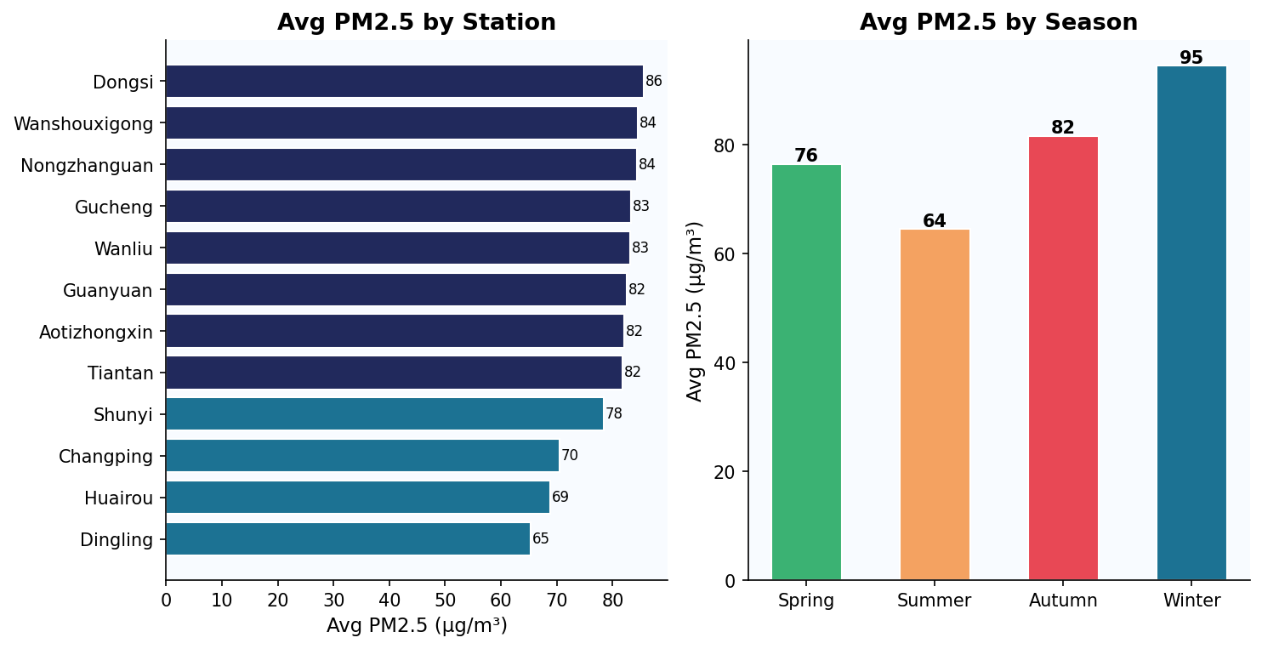
TASK 4 — Data Filtering
Wanshouxigong & Nongzhanguan: highest avg PM2.5 (>84 µg/m³) — dense urban areas
Dingling & Huairou: lowest PM2.5 (<70 µg/m³) — suburban / northern Beijing
Winter PM2.5 is nearly double Summer — coal heating + atmospheric inversion
15.4% of all readings (64,452 rows) exceed the hazardous threshold of 150 µg/m³

Slide 6
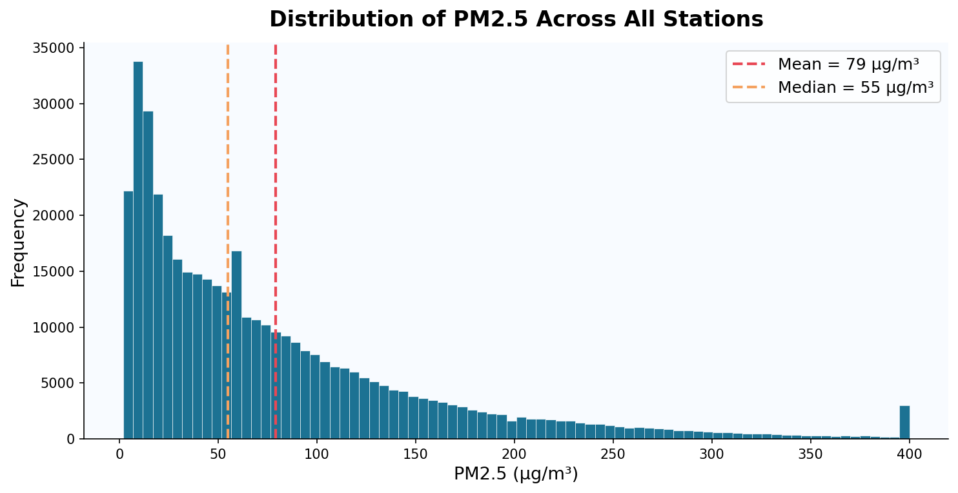
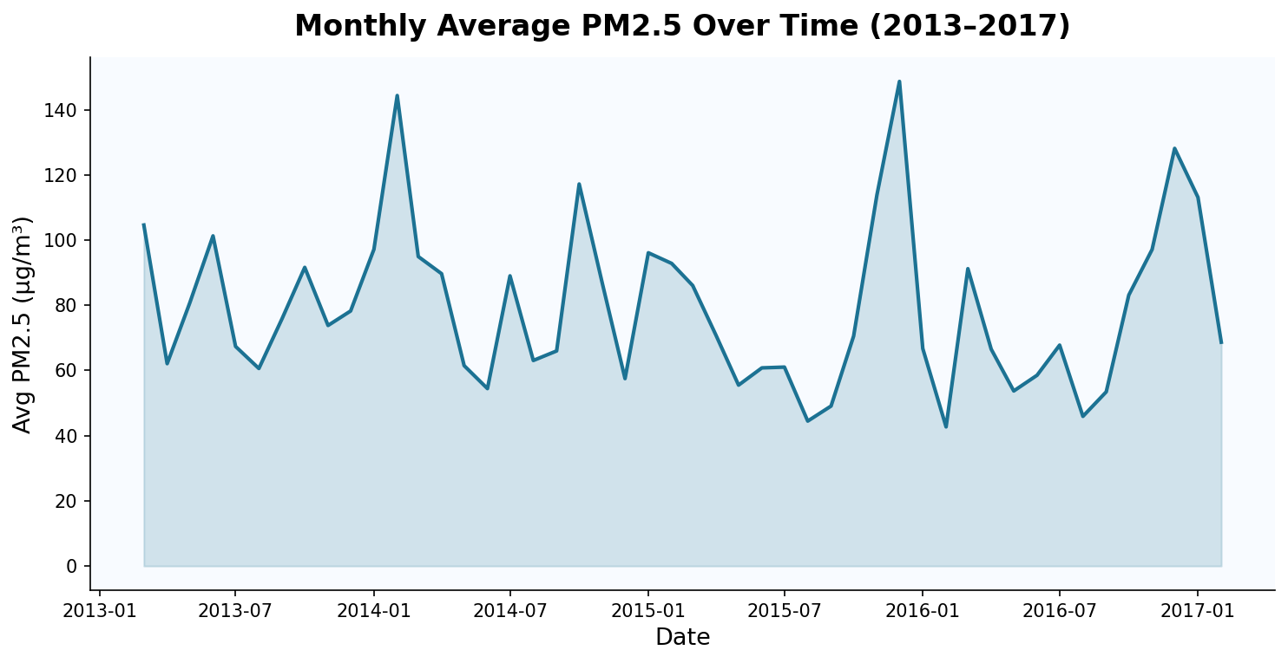
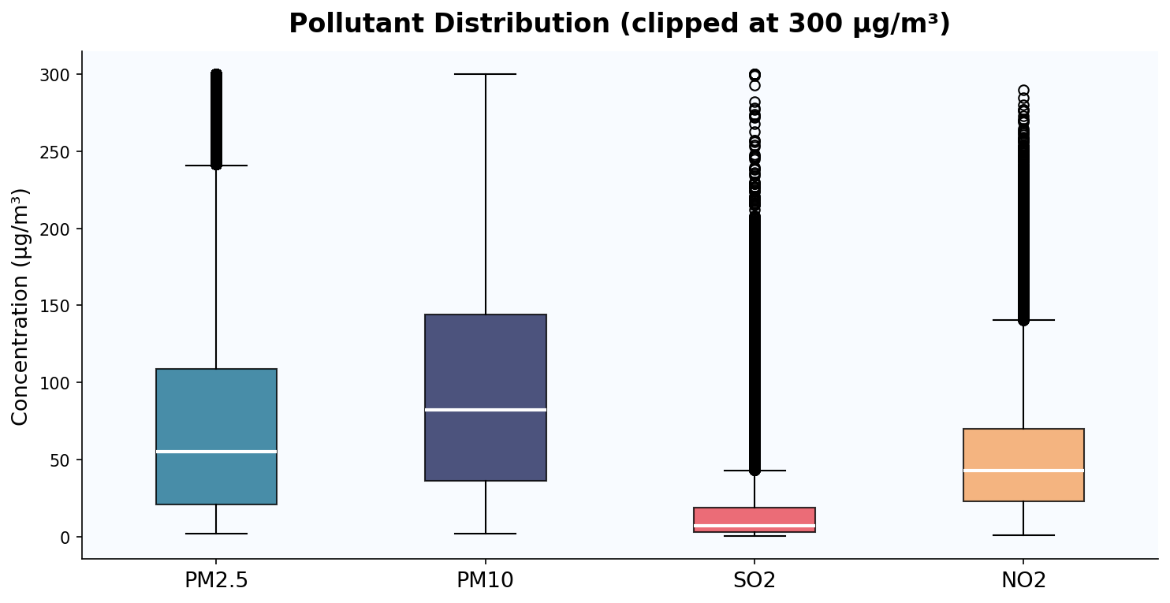
TASK 5 — Data Visualisation (1 of 2)
Histogram of PM2.5
Monthly PM2.5 Over Time
Boxplot of Pollutants

Slide 7
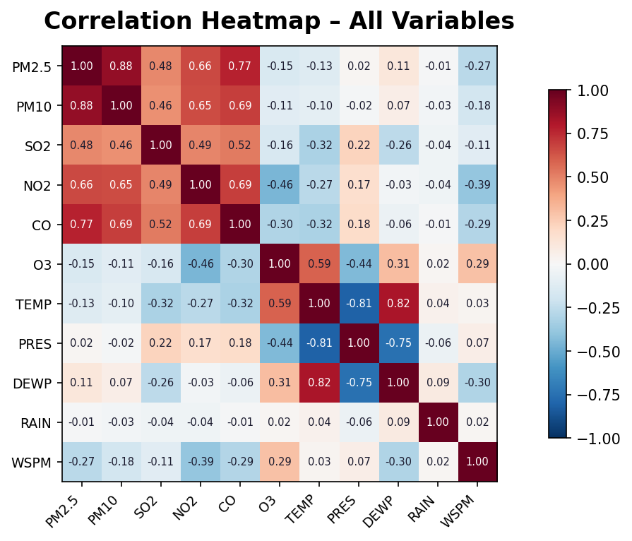
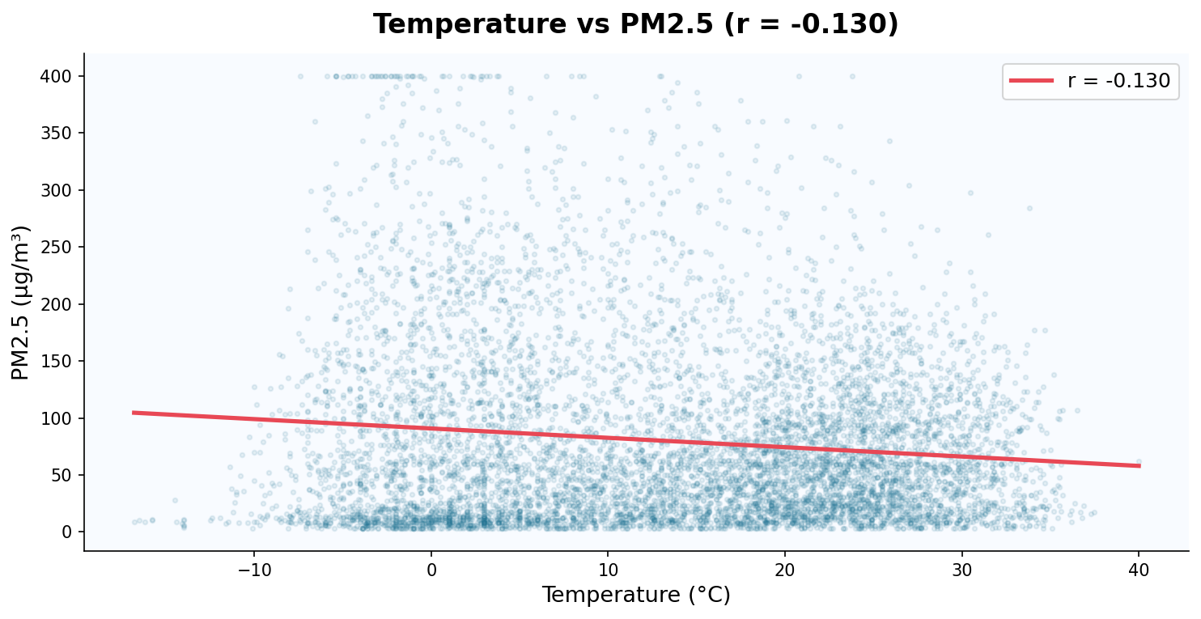
TASK 6 — Correlation Analysis
Q1: Most correlated with PM2.5?
Q2: Does temperature affect PM2.5?
PM10 (r = 0.879)
PM10 and PM2.5 share identical pollution sources — vehicles, coal, and industry emit both together.
Yes — r = −0.130 (negative)
Cold winters drive coal heating + atmospheric inversion traps pollution close to the ground.

Slide 8
Key Insights & Conclusion
01
Severe pollution
04
Shared sources
Beijing's PM2.5 mean of 79 µg/m³ is 15× the WHO annual guideline of 5 µg/m³
PM10 is the strongest predictor of PM2.5 (r = 0.879) — same emission sources
02
Seasonal pattern
05
Wind is protective
Winter pollution is nearly double Summer — coal heating is the primary driver
Higher wind speed reduces PM2.5 (r = −0.269) — dispersal is the key mechanism
03
Urban vs suburban
06
Right-skewed data
Urban stations show 20–25% higher PM2.5 than suburban Dingling and Huairou
Median (55) far below mean (79) — a minority of extreme events drive averages up
Course: Data Analytics | Yoobee Colleges | 2511-YCCIA-MSE

