Slide 1

FLOOR PLAN

Slide 2


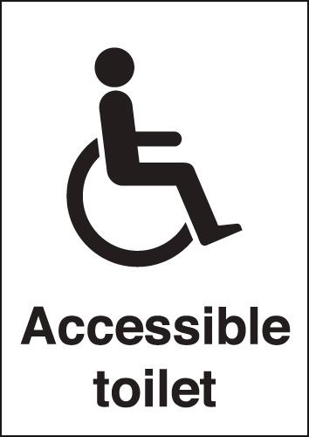
FLOOR PLAN - 1st Floor
To 3rd Floor
To 2nd Floor
Lift
Dean’s Office
Lab 01
Department of Information Technology
MAIN ENTRANCE
Level 2 & 4 Projects
AC
Historical Instrument

Slide 3
FLOOR PLAN - 2nd Floor
To 3rd Floor
To 1st Floor
To 3rd Floor
Lift
Lab 05
Lab 02
AC
Department of Computational Mathematics
Level 2 & 4 Projects
Level 2 & 4 Projects(AI)

Slide 4
FLOOR PLAN - 3rd Floor
To 4th Floor
To 2nd Floor
To 4th Floor
Lift
FYP Lab
Lab 03
Lab 08
Department of Interdisciplinary Studies
Game Zone

Slide 5
FLOOR PLAN - 4th Floor
Behavioral Systems Lab
Electronic & Embedded Systems Lab
Server Room
PG Research Lab
To 3rd Floor
Audio Visual Unit
Embedded Systems Lab
To 3rd Floor
Lift
AI Lab
Lab 06
Auditorium
Lunch Area
Hardware Lab
IFS Network and Security Lab
AC
Level 1 Project
Company Stall

