Slide 1
Basics of Technical Writing – 2
Shapes and Objects
Focus: Adjectives
S.J.K.R.K.Kumarihami
Department of Multidisciplinary Studies
University of RUhuna

Slide 2
Learning Objectives
By the end of this lesson, students will be able to:
Identify different types of adjectives.
Use adjectives to describe shapes (2D, 3D) and objects.
Apply adjectives to express function, components, characteristics, and position.
Write short descriptions using appropriate adjectives.

Slide 3
Introduction to Adjectives
Adjectives = words that describe nouns.
They answer: What kind? How many? Which one?
Important in technical writing → give clarity, precision, accuracy.

Slide 4
Types of Adjectives
Qualitative → size, color, shape, material (round, smooth, metallic)
Quantitative → amount, degree (some, many, few, several)
Numerical → exact numbers (one, two, first, second)
Possessive → ownership (its, their, our)
Interrogative → used in questions (which, what, whose)

Slide 5
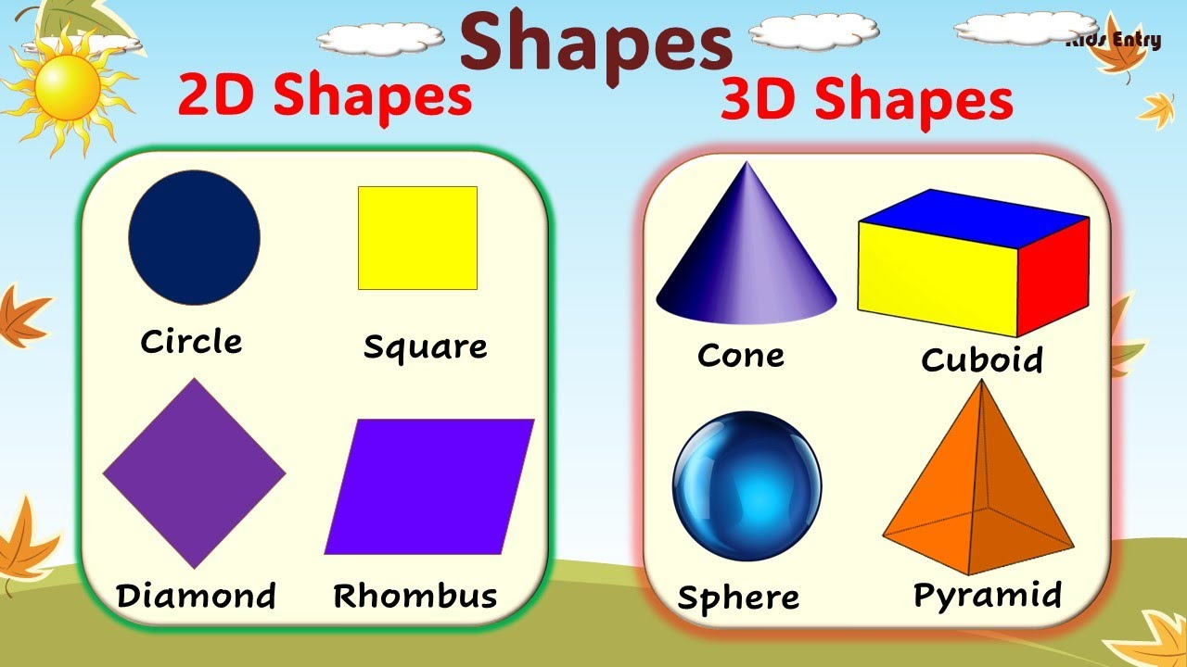
Shapes in Technical Writing
2D Shapes → circle, square, rectangle, triangle, hexagon
3D Shapes → sphere, cube, cylinder, cone, pyramid

Slide 6
Using Adjectives with Shapes
Examples:
A large round circle
A small triangular sign
A smooth metallic cylinder
A rectangular box with sharp edges

Slide 7
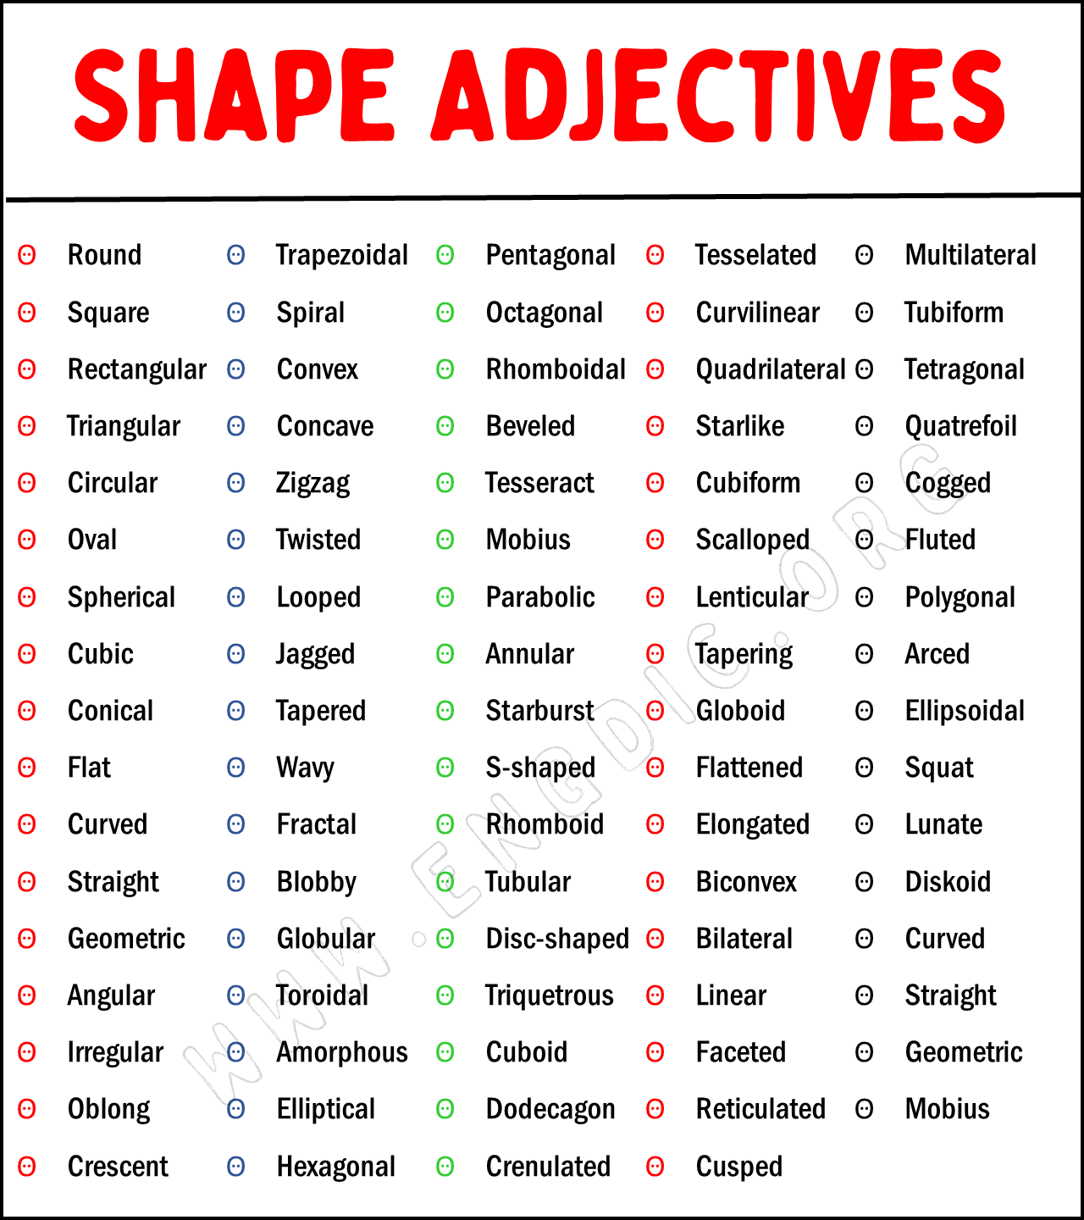
Shape Adjectives

Slide 8

Describing Objects (Function + Components + Characteristics
Example: A modern digital clock
Function: shows time
Components: plastic case, LED screen
Characteristics: rectangular, portable, lightweight

Slide 9
Adjectives for Position
Left, right, top, bottom, inside, outside, front, back
Examples:
The button is on the left side.
The logo is at the top right corner.

Slide 10
Positional / Locational Adjectives
Top / Bottom → the bottom drawer, the top shelf
Upper / Lower → the upper part of the engine, the lower section of the bridge
Left / Right → the left panel, the right side button
Front / Back → the front cover, the back door
Inner / Outer → the inner layer, the outer wall
Central / Middle → the central unit, the middle section
Adjacent / Opposite → the adjacent building, the opposite wall
Nearby / Distant → a nearby object, a distant star

Slide 11
Examples
The upper panel of the machine contains the control buttons.
The front wheel is slightly larger than the back one.
The logo is placed at the top-right corner of the page.
The sensor is located on the inner surface of the device.
The central unit connects all other components.

Slide 12
Positional / Locational Adjectives
Top / Bottom → the bottom drawer, the top shelf
Upper / Lower → the upper part of the engine, the lower section of the bridge
Left / Right → the left panel, the right side button
Front / Back → the front cover, the back door
Inner / Outer → the inner layer, the outer wall
Central / Middle → the central unit, the middle section
Adjacent / Opposite → the adjacent building, the opposite wall
Nearby / Distant → a nearby object, a distant star

Slide 13
Activity
Task: Write 5 sentences describing shapes/objects using adjectives.
Example prompts:
A smartphone A knife
A water bottle A cup
A chair An apple
A clock A bag
A table lamp A laptop
A pen A house

Slide 14
THANK YOU

