Slide 1
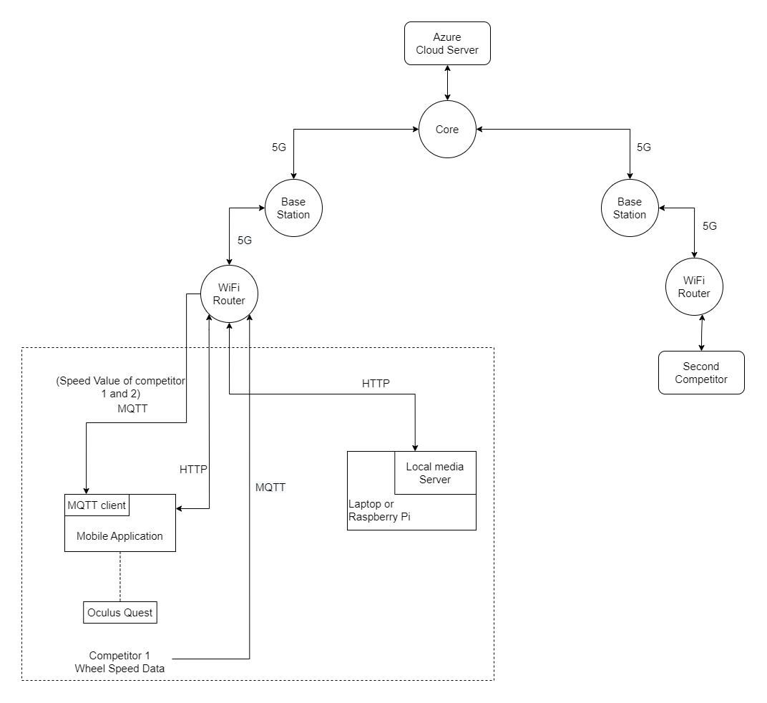
Architecture 1
Using Local media server

Slide 2
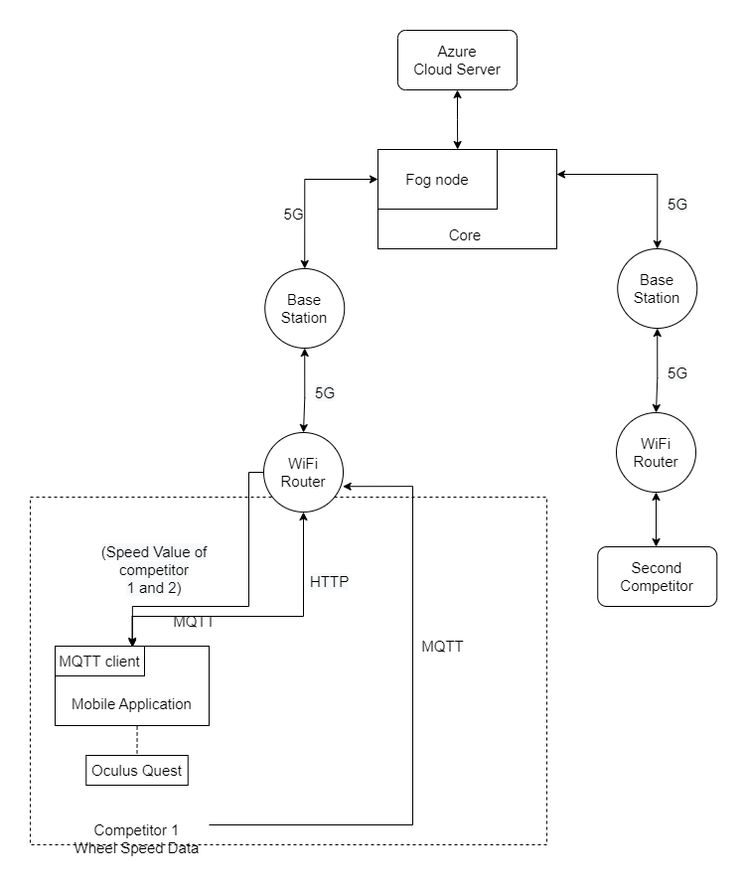
Architecture 2
Fog node implemented in network core

Slide 3
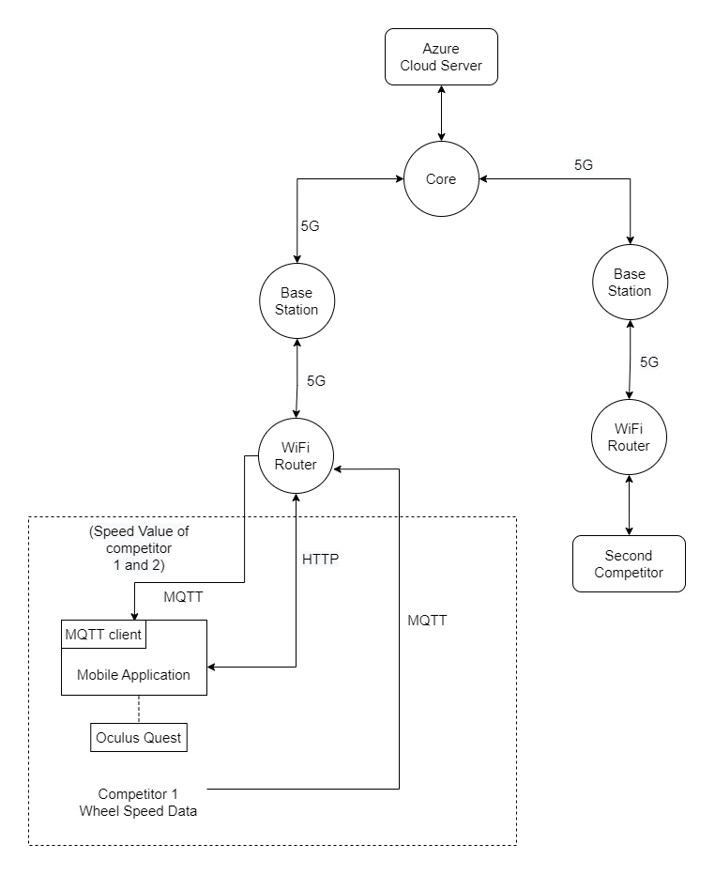
Architecture 3
Using Cloud server

Slide 4
Architecture Comparison
 | Local media server | Fog node implemented in core | Cloud server
Description | The user has to select and download a video from the cloud storage to the local media server according to their preference. Then the video will be streamed to the oculus. Processing and rendering happen in the oculus. | The user has to select and download a video from the cloud storage to the fog node according to their preference. Then the video will be streamed to the oculus. Processing and rendering happen in the oculus. | Videos are stored in the cloud server. Both video processing and rendering happen there. Then the video will be streamed to the oculus.

Slide 5
 | Local media server | Fog node implemented in core | Cloud server
Latency | Low | Medium | High
Sharing the media server | Can be shared between users in the same LAN | Since videos are stored inside the core, users that are connected to the same network core. | Any user regardless of the connected network
Required processing power of the edge device | High | High | Low
Cost | Medium | Low | High

Slide 6
Proposed timeline
 | Task |  |  |  | 2022 Sep | 2022 Oct | 2022 Nov | 2022 Dec | 2023 Jan | 2023 Feb | 2023 March | 2023 Apr | 2023 May
 | Feasibility Study
 | PCB Designing
 | Implementing 5G Network Setup and Fog Node
 | Unity App Development
 | Platform for Single User
 | Object Positioning
 | User Dashboard
 | Platform for Two User
 | Optimization
Milestones
Proposed time period

Slide 7
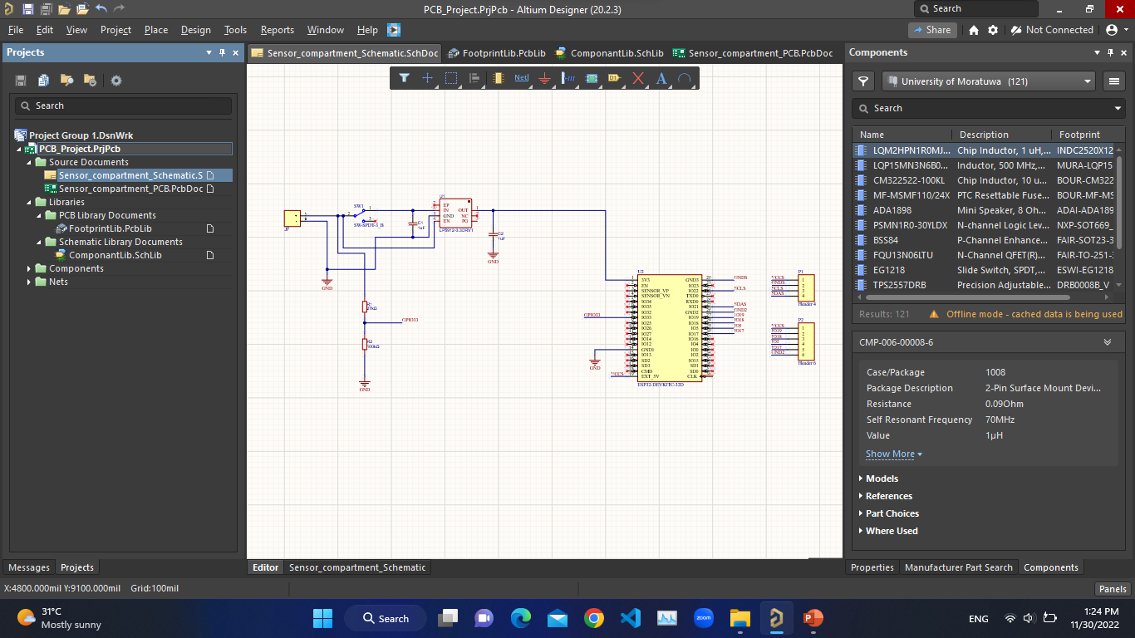

Slide 8
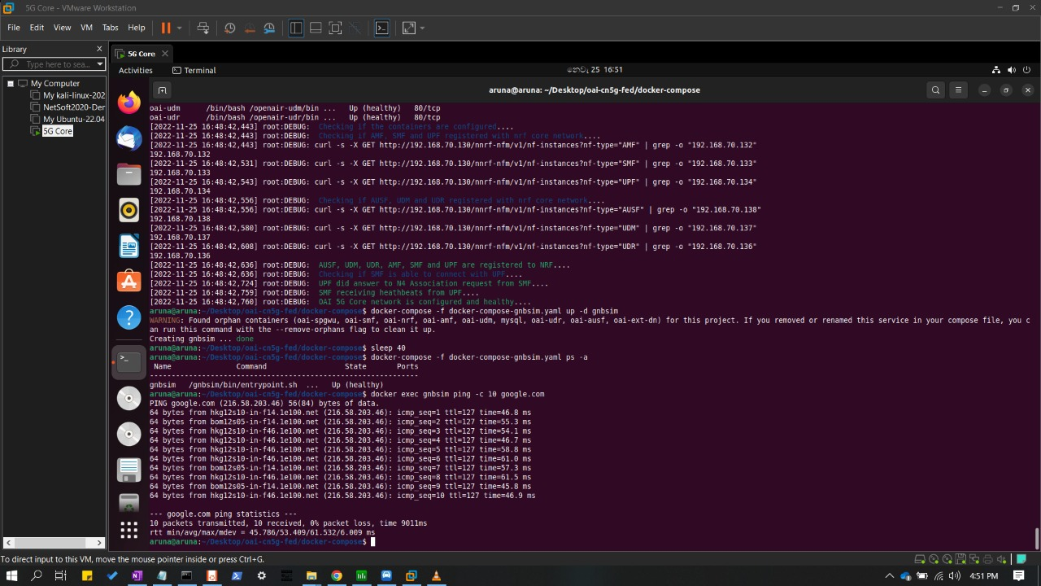

Slide 9
