Slide 1
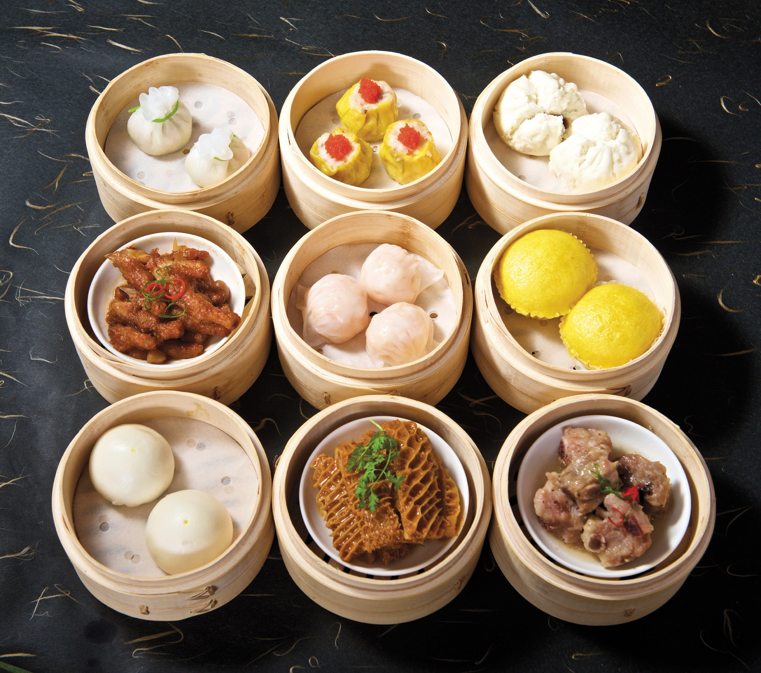
Dim Sum Devs
Michael Ritchie & Fuli Lan

Slide 2
Solar orbiter
Description:
A system of animated spheres that orbit each other as specified by the user.

Slide 3
Requirements and Features
The user can select any object by left clicking on it.
Selected object's size and position can be modified via direct manipulation.
The UI will support adding new objects that will orbit the currently selected object.
The orbiting object will be a child SceneNode of the orbited object, there will be no hard limit to the number of generations of SceneNodes
There will be a hero camera that is centered on the currently selected object.

Slide 4
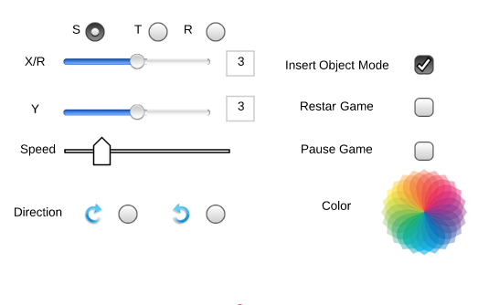
User interface

Slide 5
Things we won’t have.
There will be no object collision between orbiting objects.
There will be no physics or gravity.
Only circular orbits.
No changing the object hierarchy (probably).

Slide 6
Questions?

