Slide 1

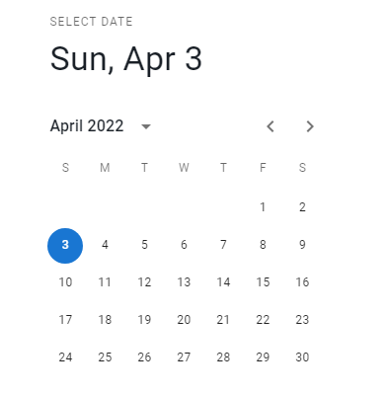




Promotion name
Start Date
End Date
Choose categories
Choose products
discount
Amount

