Slide 1

NHS Data Analysis by Dzmitry Brykach
NHS Data Analysis
The analysis examines NHS medical appointment data and Locations to uncover patterns and inform strategies for improvement.
Key Findings and Trends
Insights and trends from NHS data are identified to answer the following questions
Has there been adequate staff and capacity in the networks?
What was the actual utilization of resources?
Recommendations
The analysis provides recommendations to help improve decisions healthcare delivery.
Notes:
Image source: Microsoft 365 content library This presentation, prepared by Dzmitry Brykach, explores comprehensive data analysis within the NHS. It highlights key findings, trends, and insights derived from NHS data. The analysis aims to support informed decision-making and enhance the effectiveness of healthcare delivery.

Slide 2
Overview
Provided Datasets cover information about
42 Integrated Care Boards
106 Locations
> 290 000 000 appointment grouped by National Categories, Service and Context Types

Slide 3
Has there been adequate staff and capacity in the networks?
Let’s start with exploring the monthly distribution of appointments

Slide 4
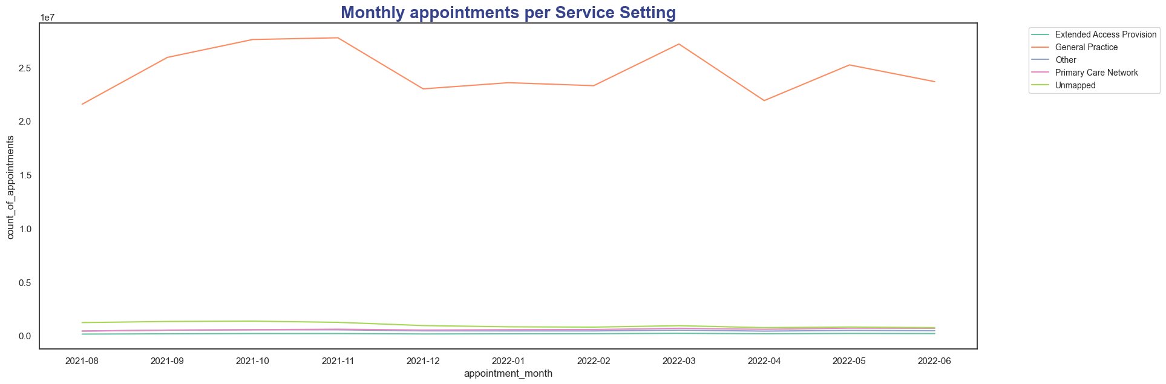
Monthly appointments per Service Setting
General Practice is an undisputed leader

Slide 5
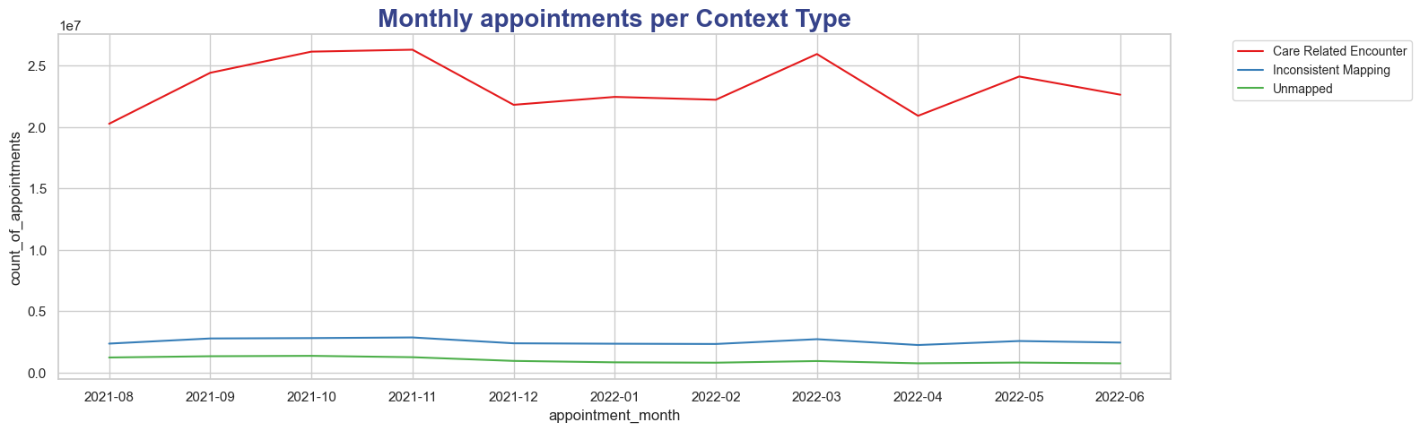
Monthly appointments per Context Type

Slide 6
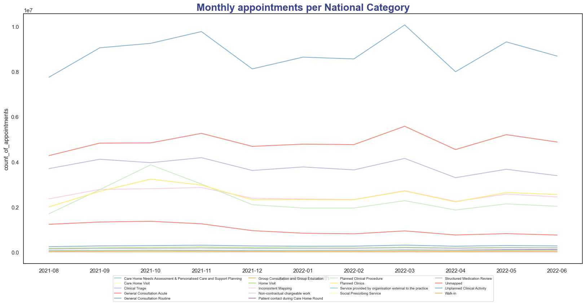
Monthly appointments per National Category
TOP 3 Categories
General Consultation Routine
General Consultation Acute
Clinical Triage

Slide 7
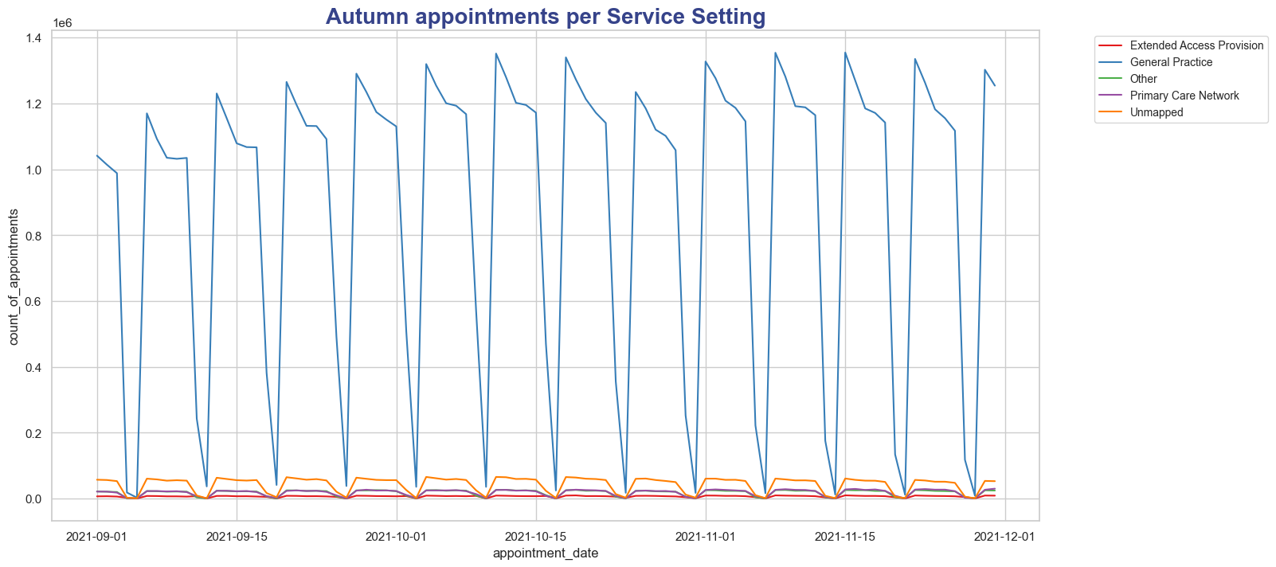
As mentioned earlier, we can see the increase in number of GP appointments starting from September and lasting till mid- October

Slide 8
Key Highlights on National Category
Number of appointments start rising in the beginning of Autumn
General consultation services and General Practices are always in high demand
Winter typically has even pattern
The next increase in appointments begins in March and May

Slide 9

NHS Appointment Capacity Projection
The NHS aims for 1,200,000 appointments daily to address rising healthcare demands and improve service capacity.
Notes:
Image source: Microsoft 365 content library The NHS projects a capacity of 1,200,000 appointments per day, aiming to meet increasing healthcare demands. This ambitious target supports faster patient access and reduced waiting times. Achieving this goal will require enhanced resource allocation, workforce optimization, and technological advancements in healthcare delivery.

Slide 10
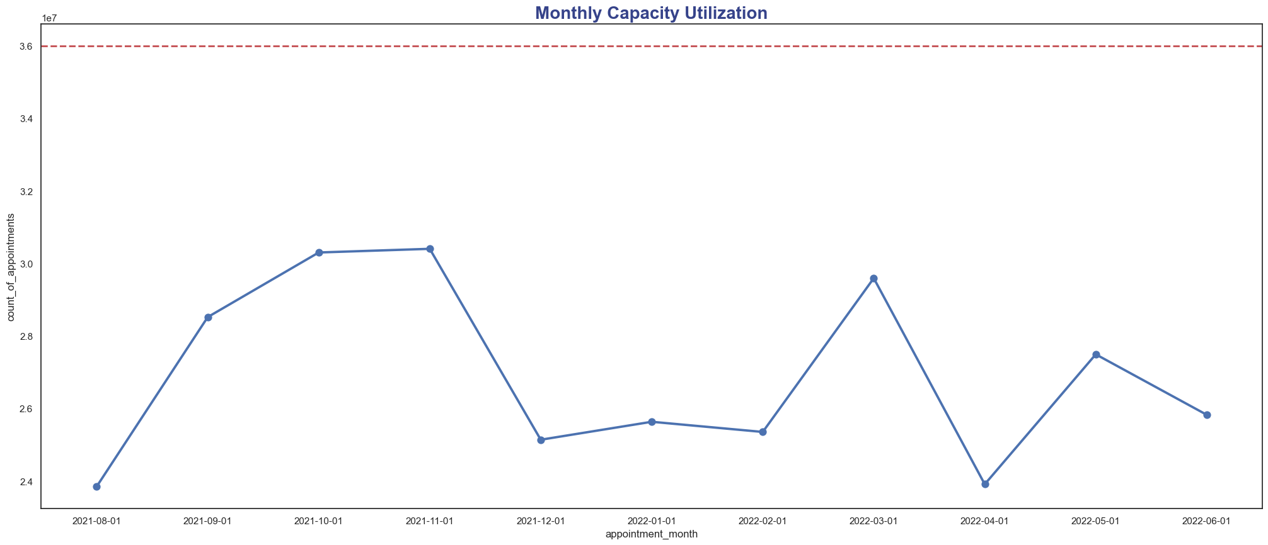
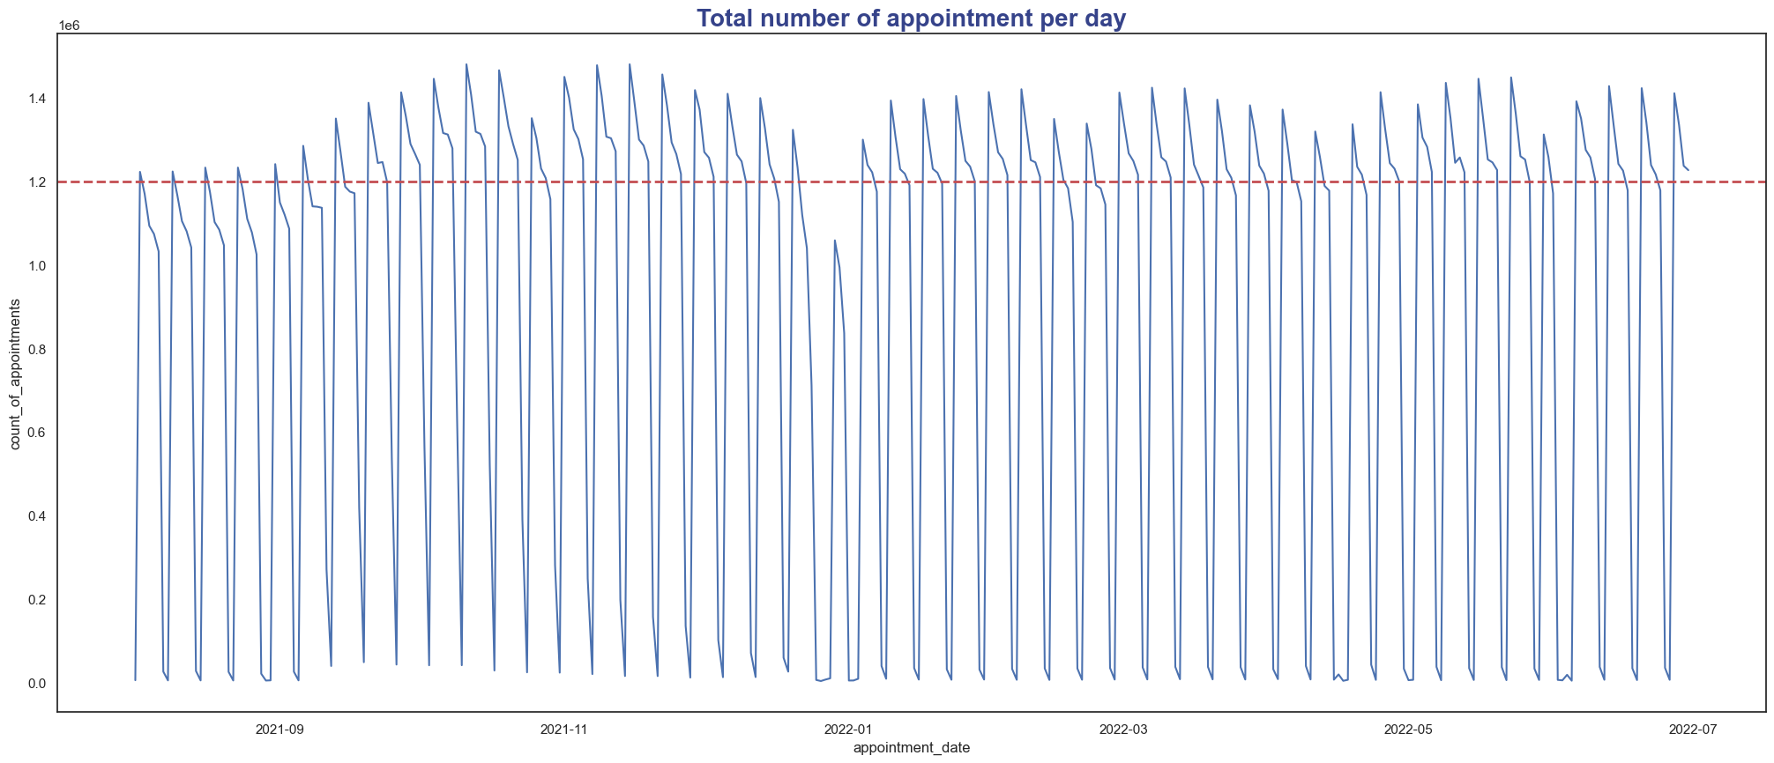
Capacity Utilization (monthly vs. daily)
Monthly capacity looks good at first glance. The workload far below the expected level.
Daily level shows that there are many cases of overloaded days.
Precisely, 175 overloaded days, about 48% of the year.

Slide 11
Key Highlights on capacity
The overall (monthly capacity) looks like there’s space for more patients to be admitted.
The daily capacity shows that 45% of the year doctors are overloaded with patients.
Again, autumn and spring are the busiest periods, as we discovered earlier.

Slide 12
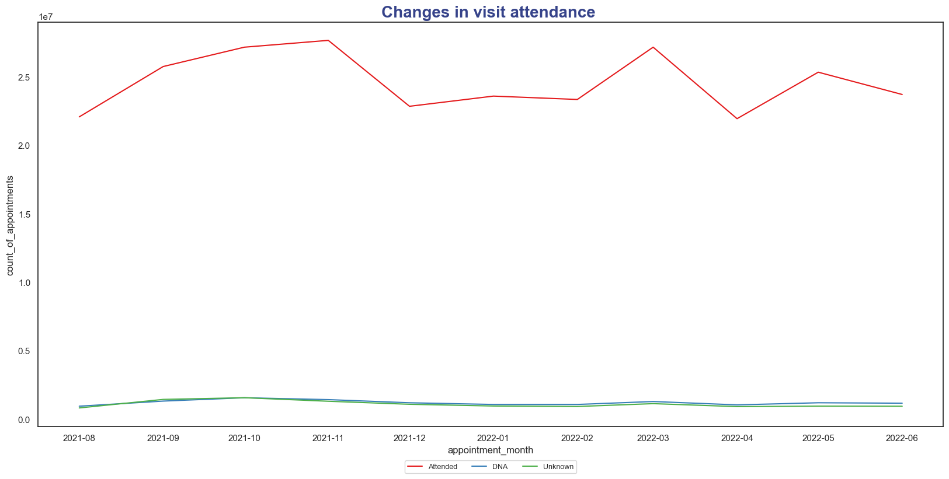
Most of the appointments are attended. Missed and unknown appointments have a very small share.

Slide 13
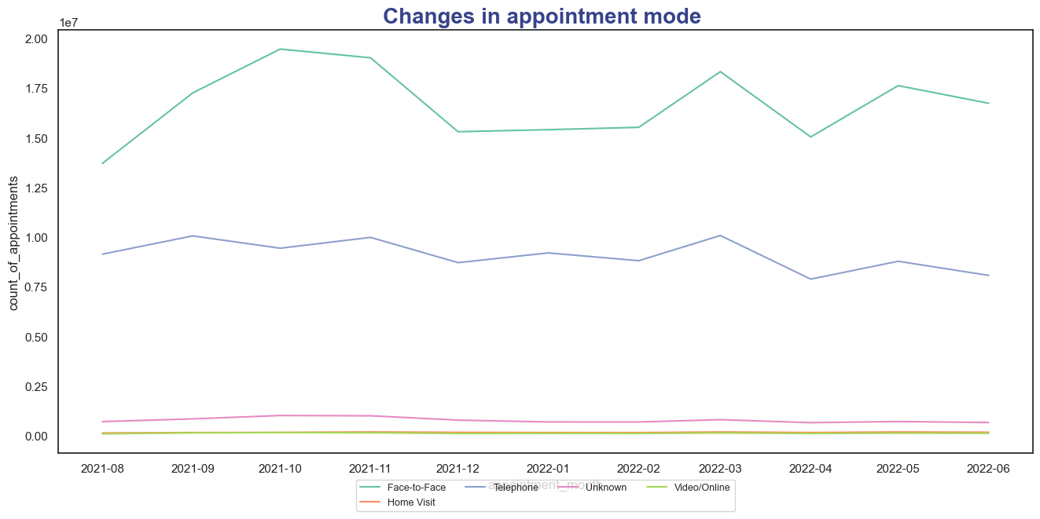
Most of the appointments are conducted in face -2 –face mode, with “Phone appointments on the 2nd place.
Video / Online and Home Visits are the most unpopular modes

Slide 14
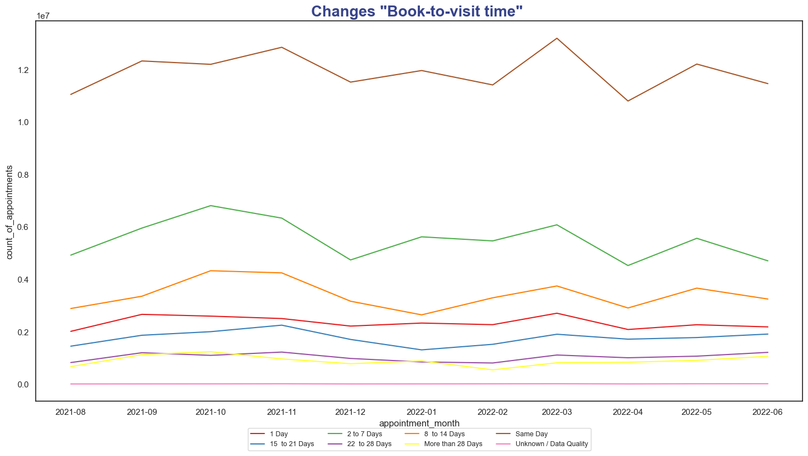
‘Same day’ appointments prevail significantly. Then come 2-7 days and 8-14 days respectively

Slide 15
Key Highlights on Appointment Attendance
Face-2-face, same day appointments are the most popular .
The overall trend with total amount of appointments remains.
Online & Phone call appointments are the least popular.

Slide 16
Missed (‘DNA’) Appointments Overview
Total number of unattended appointments : 13,318,384
Total number of appointments share: 4.50%

Slide 17
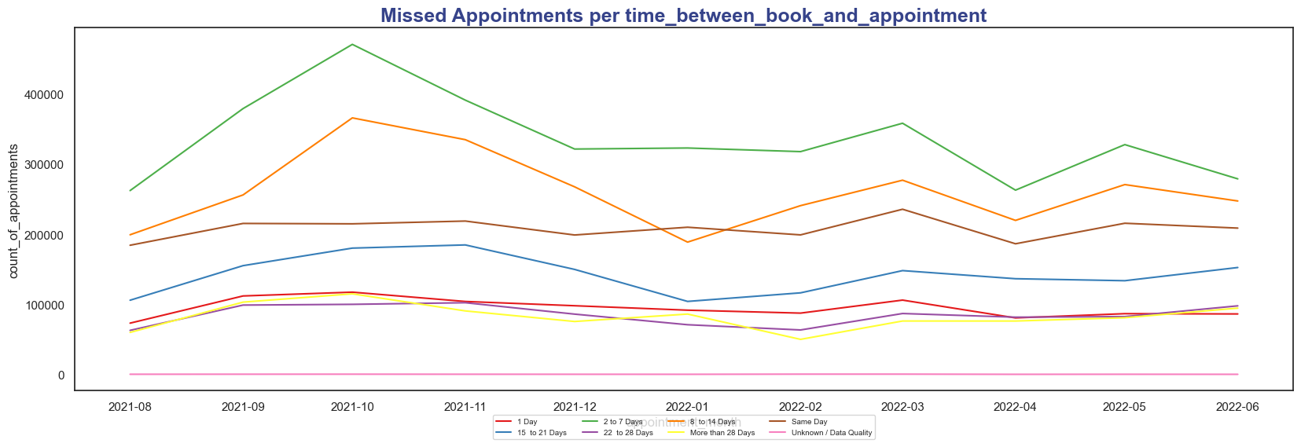
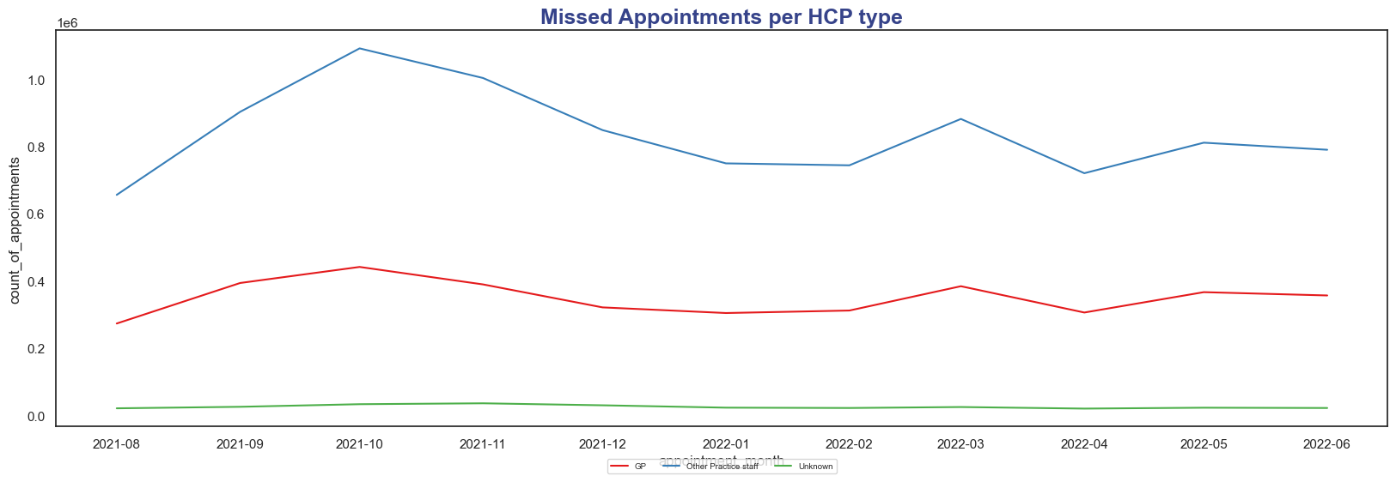
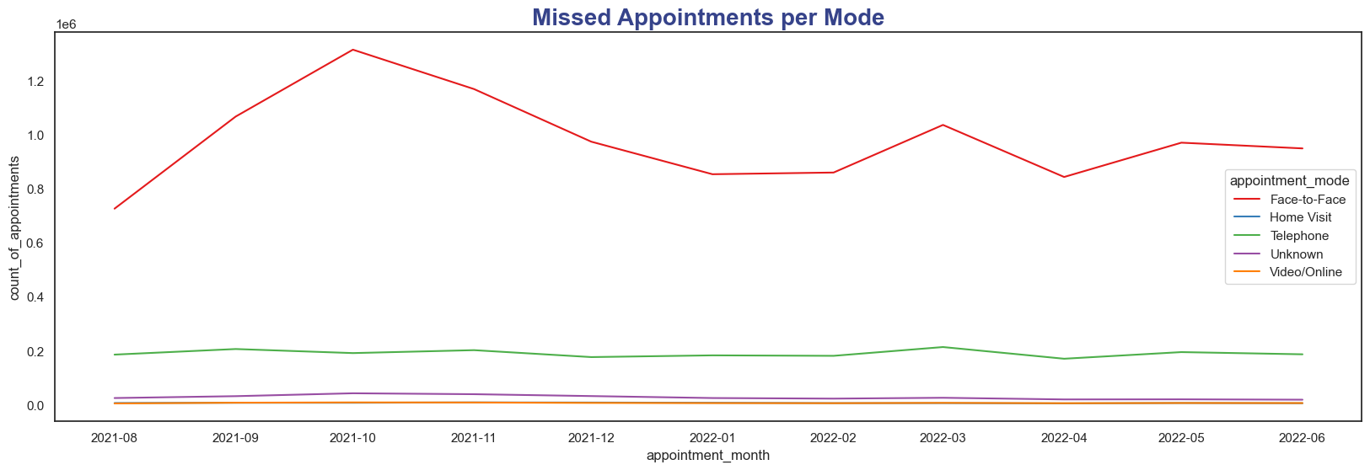

Slide 18
Quick Cost Overview
HCP Type | Count of Appointments
GP | 3845356
Other Practice staff | 9197617
Unknown | 275411
Let's assume that NHS loses ~ £35 per missed GP appointment and around £165 per hospital
outpatient appointment. Since we don't have clear data on whether some of the missed
appointments are related to the hospital outpatient ones, I will use the average number
provided by NHS
Total loss is around : 399,551,520 £ from Aug 2021 to Jul 2022

Slide 19
Key Highlights on capacity
People are tend to skip ‘Other Practice Staff’ appointments. Missed GP appointments rate is ~ 2.5 times lower
The most “popular” mode is face-2face, followed by phone appointment mode. People are less tend to skip video calls and home visits.
The most ‘distant’ appointments (22-28 days, >28 days) have the lowest DNA rate and this rate remains more or less even during the observation period

Slide 20
Recommendations
There is no need to hire additional staff as current amount of personnel seems adequate to fulfill the needs
Review the standards of collecting the data from GP practices. Currently there are many unmapped data in provided datasets. The cleaner the data, the better will be planning outcomes.
Utilize phone and video appointments more extensively as people seem to skip them less.
Balance the workload among GP Practices, if possible, to avoid overloading during the peak seasons.
Compare the expected and actual appointment duration, because this may affect workload planning.
Review the process of missed appointment handling. Probably, it could be enhanced so that these slots will be available for other people in the queue.

