Slide 1
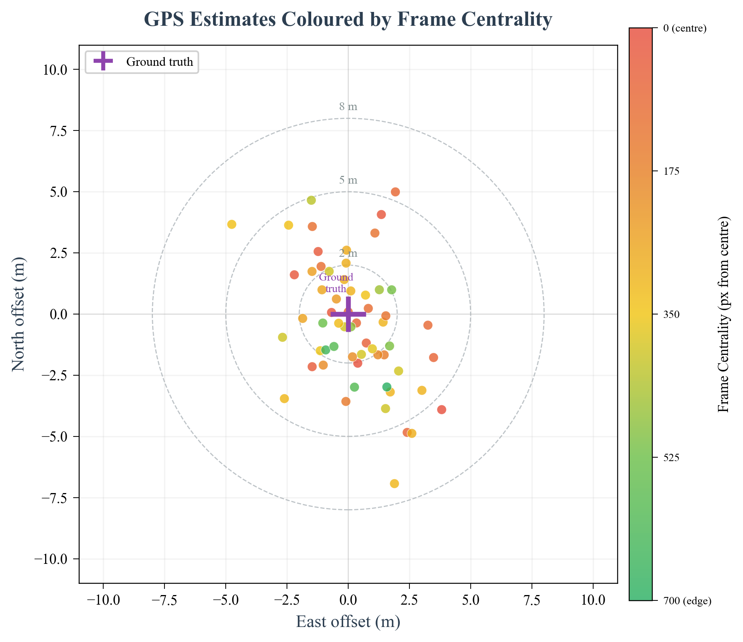
CV to Target Estimate Pipeline
Camera
1456 x 1088 px
Global shutter
YOLOv8n
NCNN, 73 ms
640x640 tensor
Pixel -> GPS
FOV + altitude
Ground projection
Attitude Fix
Pitch + roll
Ray-trace from FC
Target GPS
~9 FPS effective
CEP50 = 2.2 m
Backend (Pi 5)
Pixel -> Distance
Camera & Calibration
Eff. FPS
IMX296 Global Shutter
12
10.9
1456 x 1088 px native resolution, 30 fps capture
Global shutter - no rolling-shutter distortion at any speed
Sub-pixel motion blur (<0.5 px at 8 m/s) - no gimbal needed
9
54°
6
4.8
Pixel -> Real-World Distance
3
h = 35m
FOV calibrated - focal length 5.46mm (22% off datasheet!)
GSD = 0.022 m/px at 35m altitude
Ground footprint = 32 x 24 m at 35m alt
Pixel offset × GSD -> metre offset -> add to drone GPS
0
TFLite
NCNN
2.3x faster
d = px × GSD
target
Lens Distortion Correction
32m ground width
Checkerboard calibration - 14x9 board, RMS = 0.4 px
Precomputed undistortion maps applied every frame
Cost: +1.5ms per frame (negligible on 206ms inference)
GSD = 0.022 m/px at 35m

Slide 2
Simulation and Sim2Real Ladder
Sim2Real Ladder
(never fly something you haven't proven at every level below it)
★
Real Mission
GOAL
Full autonomous SAR - demo day
▲
FLIGHT MISSIONS
M4
Auto detect + hover
M3
Waypoint flight
Simulation Recording
✓
M2
Passive flight
✓
M1
Bench integration
takeoff -> search -> detect -> centre -> verify -> land
▲
GROUND VERIFICATION
✓
G2
Outdoor calibration
✓
G1
Unit tests + dry-run
STACKABLE SIMULATION FLAGS
▲
--sim-tilt
Camera perspective (pitch/roll)
--shake N
Pixel-level vibration jitter
SIMULATION FOUNDATION
--blur F
Motion blur proportional to speed
All 12 mission requirements verified end-to-end in SITL
--noise L
GPS + attitude Gaussian noise
Spiral search pattern
AI detection + centering
Geofence + SSSI no-fly zone
PLB beacon redirect
Attitude-compensated GPS
Payload deploy sequence
RTL failsafes
Offset landing
Simulated Realism
--spiral
Spiral search (vs lawnmower)
Same 1456×1088 as real camera
Camera tilt (pitch/roll)
Motion blur at flight speed
GPS drift noise (±3m)
Altitude-correct target scaling
--lock-yaw
Maintain heading during sweep
--smart-detect
Require consecutive confirms
--center-verify
Hover GPS average at target

